Slide 1

(BIMS) Blast Impact Monitoring System
Andrew Barraford, EE
Fabio Dallorto, EE
Joshua Ryan, EE
Aysha Mehjabeen, CSE
Advisor: Marinos Vouvakis

Slide 2


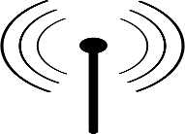
(IMS)
Network of 4 modular sensors
Data storage hub

Slide 3
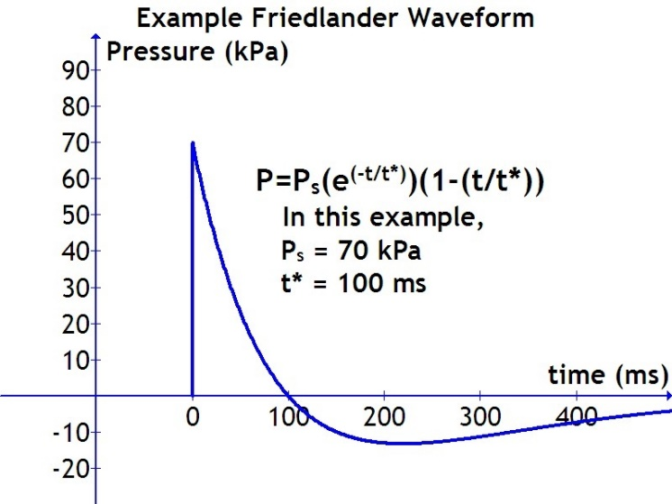
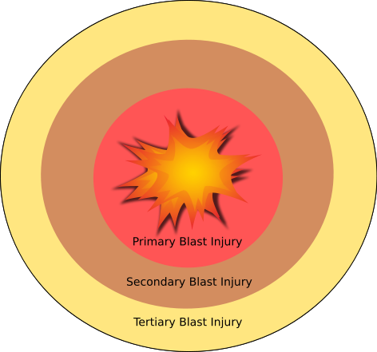

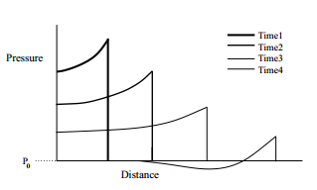
Blast Characteristics

Slide 4
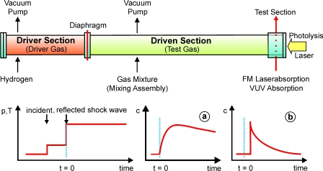
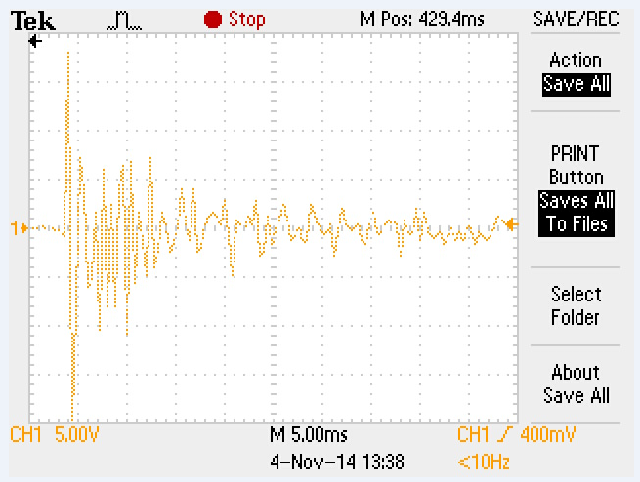
Made Contact with the following experts with Shock Tube Labs
Dr. Jerry Shan, Rutgers University. Available Dec/Jan
Dr. Michael Courtney, BTG Research. Available Anytime
Dr. Chandra, New Jersey Institute of Technology. TBD
Tested Piezoelectric Film
Voltage Response over varied lengths wired of 5ft and 0 feet (attached to probe)- Results in minimal attenuation.
Collected voltage response from direct impact due to weight.
Next Step: Collect sensor response in shock tube, under varied situations.

Slide 5
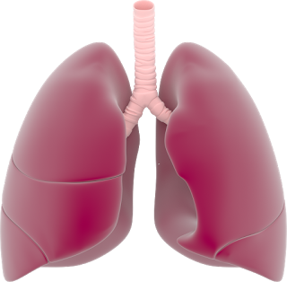
Problem Statement
Impact of blast waves on the body are a cause of Traumatic Brain Injury (TBI)
Traumatic Brain Injury (TBI) is more treatable the earlier it is detected.
Rapid pressure change, driving kinetic energy through the blood veins cause TBI.^{[1]}
Research suggests impacts to the body result in TBI caused by bleeding in the lungs (Blast Lung) that leads to hypoxia.^{[1]}
Current focus of monitoring devices is on the head.
More portable data collection instruments are needed.^{[2]}
Currently there is no device for field data acquisition to aid in correlating levels of forces seen at the body with TBI.
^{[1]} Cernak and Noble-Haeusslein. "Traumatic Brain Injury: An Overview of Pathobiology with Emphasis on Military Populations."National Center for Biotechnology Information. U.S. National Library of Medicine, 07 Oct. 2009.
^{[2]} The CDC, NIH, DoD, and VA Leadership Panel. “Report to Congress on Traumatic Brain Injury in the United States: Understanding the Public Health Problem among Current and Former Military Personnel.” Centers for Disease Control and Prevention (CDC), the National Institutes of Health (NIH), the Department of Defense (DoD), and the Department of Veterans Affairs (VA). 2013.
Notes:
Blast injuries are characterized by anatomical and
physiological changes from the direct or reflective over-pressurization force impacting the
body’s surface. From http://www.cdc.gov/masstrauma/preparedness/primer.pdf

Slide 6
Effect on the Individual
Mild Symptoms of TBI: ^{[3]}
Headache
Confusion
Lightheadedness
Dizziness
Blurred Vision
Ringing in Ears
Tiredness
Mood Changes
Trouble with Memory, Concentration, or thinking
Sensitivity to light and Sound
Nausea or Vomiting
“Some moderate to severe TBI symptoms last for a longer period of time or may be permanent.” www.Maketheconnection.com
^{[3]} "Mild TBI Symptoms." Editorial. TraumaticBrainInjury.com. N.p., n.d. Web. 16 Oct. 2014.

Slide 7

Societal Impact
2.5 Million people have served in Iraq and Afghanistan.^{[4]}
19.5% Of soldiers may suffer from brain injury.^{[5]}
Since 2000 - 307,283 cases of TBI.^{[6]}
Many people who get a TBI develop PTSD.^{[7]}
Economic burden of $60 Billion (2000).^{[2]}
Affects families
Effected often struggle with jobs and relationships
The effects of TBI are felt beyond the individual, emotionally for the family and economically for the rest of the society.
[4] "Invisible Wounds Mental Health and Cognitive Care Needs of America’s Returning Veterans." RAND Corporation. RAND Center for Military Health Policy Research, 2008.
[5] Adams, Chris. "Millions Went to War in Iraq, Afghanistan, Leaving Many with Lifelong Scars." McClatchy Newspapers, 14 Mar. 2013.
[6] "DoD Worldwide Numbers for TBI." Defense and Veterans Brain Injury Center. N.p., 2014.
[7]”Traumatic Brain Injury: A Guide for Patients” (n.d.): n. pag. CogSMART Program of the VA San Diego Healthcare System.

Slide 8


Our Solution
A wearable data acquisition device to track and log the forces seen by soldiers in the field to later be used to correlate any resulting TBI.
This data may lead to future early detection enabling earlier intervention.
“Early detection with better diagnostic tools also can lead to better outcomes when paired with timely interventions. “ 2013 Congressional Report
Notes:
Under, Methods to Identify TBI the congressional report makes a direct statement in the need to produce portable data collection instruments.

Slide 9

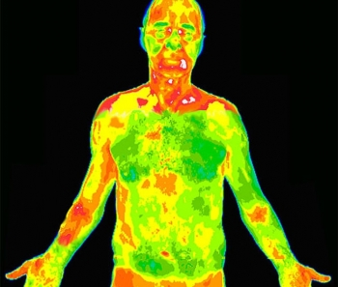
Design Requirements/Specs
Device Requirements
Inputs and Outputs Requirements
Must be lightweight and ultra portable
Must be able to fit into existing clothing
Transmit Data wirelessly to hub
Collect pressure(impact) data.
Display impact data on multiple platforms.
Third party modification must be in mind when developing software.
Inputs:
Pressure (psi)
Outputs
Data from impacts
Voltage output of sensors over time
Multi-Platform Visual Representation
Either voltage alone or also its corresponding pressure

Slide 10
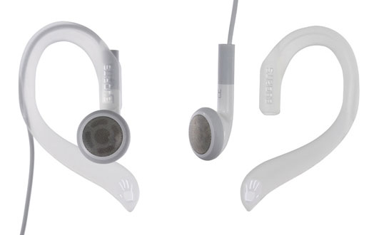
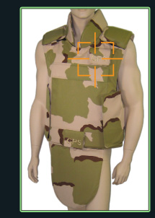
Current Market Solutions
Intelligent Tactical Vest – WPI SDP 2011, This vest monitors for ballistic impacts and calls for help. Identical functionality to S911 model below
S-911 Vest, Laipac Technologies
Detects Ballistic Impacts
Sends GPS coordinates
Army Research has developed ear buds to track head impacts (Not official, nor is there any data available).
Current solutions do not monitor the forces seen at the body due to explosions.

Slide 11
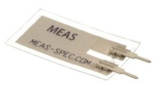
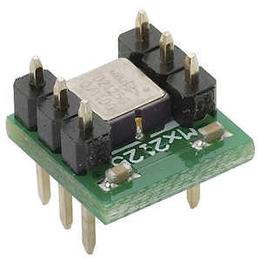
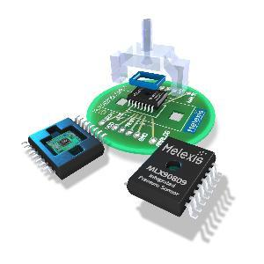
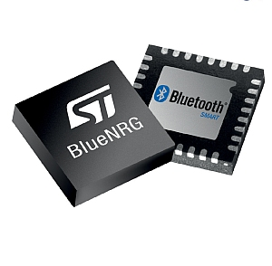
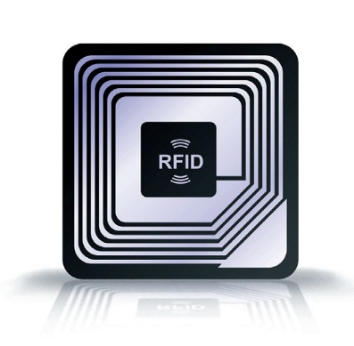
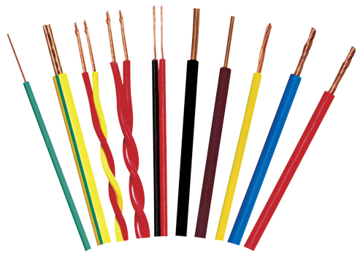
Design/Solution Alternatives: Hardware
Input Sensing:
Piezoelectric Film
Accelerometers
Discrete Pressure Sensors
Data Transmission:
Bluetooth
RFID
Wired
Monitoring:
External Pressure
Monitor Blood Pressure
Monitor Blood Oxygen Levels
We are planning to use Piezo film as sensors to monitor pressure applied to the body externally. An effective calibration strategy has to be implemented.

Slide 12

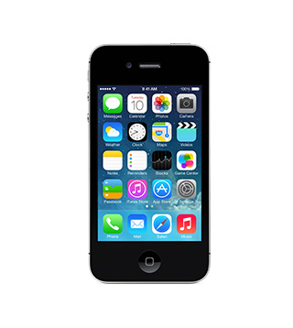


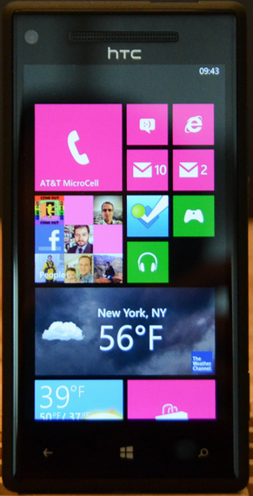
Design/Solution Alternatives: Software
Application Options
Windows Based (Non Cloud Based)
Windows Based (Cloud Based)
Android
iOS
Windows Phone
JAVA
ASP.NET
PostgreSQL
SQL Server (MS)
MySQL
We are planning to implement a cloud based backend/end point, using JAVA, for a Windows application and an Android mobile app.

Slide 13




Our Solution: Block Diagram
Sensing, Signal Processing, and Power
Transmission/Storage
Input
Piezo Film Sensor
Amplification/Filtering
Input Data
Store Data
Josh
Power
A to D Processing
Transmit Data to apps
Fabio
Android Application
Windows Application
Aysha
Graphical Data View
UI
Graphical Data View
UI
Outputs
Application Endpoint
Backend Server
Device Settings
Andy

Slide 14
Block 1: Overview/Work Plan
Calibrate Piezo Input vs Output
Measure voltage response to known input pressure/force
Shock Tube generates a focused settable pressure wave
Determine Ideal Patch Size
Determine input threshold over which to save data
Review current research on harmful pressure wave levels
Design and build power supply and amplification circuitry
Integrate A to D converter
Calibration
Amplification
Analog to Digital Conversion
Output Storage

Slide 15
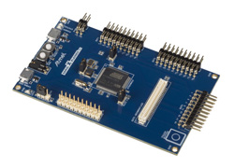
Block 2: Overview/Work Plan
Signal from each sensor is collected by the microcontroller
The main logic receives the data and stores it in chronological form
The stored data is polled to external device for visualization
Design possibilities:
Ideal implementation would have individual wireless sensors conneted to a single hub--this could impact reliability as orientation of the antennas and body attenuation could impair transfer
Wired connection between the A/D and the storage device--Reduces design complexity, but has some physical design shortcomings.
Input From A to D
Storage
Output to Application Server

Slide 16
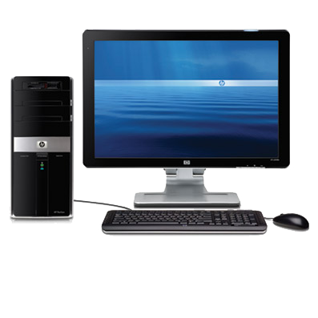
Block 3: Overview/Work Plan
Web Application
Tier 1 Priorities
MySQL Database for long term data storage
Backend server: Java web application
User interface: web-browser driven
Login required for data view
Graphically represent data from USB
Display device history with graphical representation
Tier 2 Priorities
User preferences / device settings
User Login Credentials
Data Representation
Database Storage
Graphical Interface

Slide 17
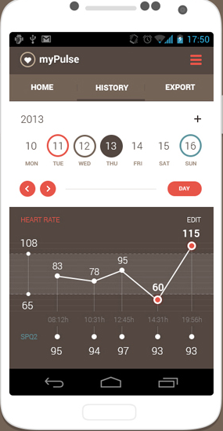
Block 4: Overview/Work Plan
Android Application
Data Analysis
Calculates impact received at any point in time and on any region
Collects impact received over a period of time
Discovers and categorizes meaningful patterns in data
Graphical User Interface
Shows detailed data on a selected region of body
Presents a trend graph of accumulated data over a selected duration
Visualizes comparison of impact received over time and on each region of body
Allows user to share and export data
Pushes alert messages when impact threshold is crossed to dangerous levels
Data from Web Server
Data Statistics & History
Graphical User Interface

Slide 18
MDR Deliverables Presented At PDR
Block 1
Prototype of working piezoelectric module.
Functioning Signal Amplification.
Analog To Digital Conversion.
Specifications for clothing integration.
Block 2
Prototype of working components:
Sensor to main logic connection
Prototype of main logic implementation
Storage Device
Computer Connection scheme
Block 4
Functioning Android Application
User Interface
Data Analysis
Data Display
Endpoint Server
Block 3
Functioning Windows Web Application
Established Database Schema
User Logins
Pre-Design for Data Display
Backend Server
Data Analysis voltage-force/pressure

Slide 19
Actual MDR Deliverables
Block 1
Prototype of working piezoelectric sensor.
Shock Tube for preliminary characterizations of sensors.
Block 4
Data Processing
Data Display
Graphs/Charts
Multi-layer View for different sensors
Data I/O Scheme
Block 3
Functioning Windows Web Application
Established Database Schema
User Logins
Backend Server

Slide 20
Q&A

Slide 21
ADDENDUM

Slide 22
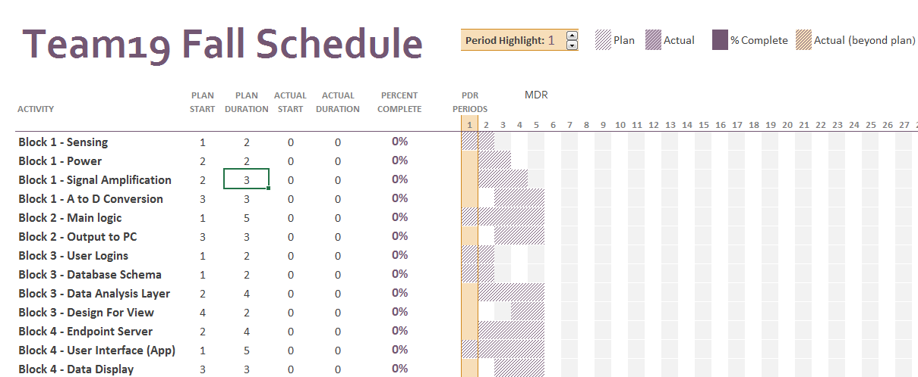
Timeline

Slide 23
Projected Costs
Project Projected Cost
Item | Qty | Amount (USD) Each | Total
Analog to Digital Converter | 10 | $2.28 | $22.80
Analog Amplifier | 10 | $3.57 | $35.70
Cell Phone Battery | 2 | $3.95 | $7.90
Wireless Transmitter | 10 | $1.44 | $14.40
Wireless Reciever | 10 | $1.00 | $10.00
PiezoFilm | 10 | $13.80 | $138.00
PCB | 4 | $24.50 | $98.00
Misc Costs | 1 | $100.00 | $100.00
Total |  |  | $426.80
We have partnered with the UMASS Polymer Science Division
They have offered to:
Fully fund our project
Provide Piezoelectric film to specifications we require
Provide ongoing support of the technology

Slide 24
Questions We Have
Will we be able to calibrate sensors for our application?
Can we get access to a shock tube to simulate blasts?
Will useful data come from device prior to destruction?
What data transmission platform will we ultimately use?
Or does make sense to store data on soldier for download later?

Slide 25
Possible approaches for data transfer
Active RFID (i.e. ST M24LR04E-R, or UHF RFID)
IEEE 802.15.4 (multipoint connection, 2.4 GHz means small antennas)
Bluetooth (pairing process could be problematic)
Wired connection (more reliable, but increase in manufacturing complexity and loss of flexibility)

Slide 26
Possible choices for microcontroller
ATMega SAM4
ARM based, integrated USB controller, USART
Low cost (~40USD for basic development board)

