Slide 1
Team E-μ
Preliminary Design Review – October 2014
Advised by Professor Baird Soules
Notes:
30 seconds

Slide 2
Team members
Shehzeen Hussain
EE
Professor Baird Soules
Advisor
Jeffrey Maloney
EE
Christopher Allum
CSE and EE
Notes:
30 seconds

Slide 3
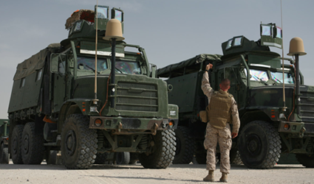
The Problem
Jeff
People guiding vehicles through tight or crowded spaces are unable
to reliably communicate with the driver.
Visual cues are not always enough because:
The driver may become distracted
Low light levels impair vision
Noisy environments
The spotter on ground isn’t visible
Land profiles that obstruct vision
Fig 1: A guide is often deployed on the ground to assist vehicle operators [1]
Notes:
1 minute no evidence of the process we went through to get to the problem.

Slide 4
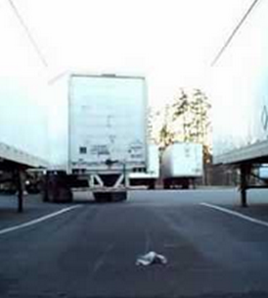
The Problem
Jeff
Failure to safely maneuver vehicles can result in
Damage to vehicles and other equipment
Injuries to trained personnel
In extreme cases - death
Fig 2: Vehicles in motor pools and shipping warehouses often squeeze into very tight spots. [2]
Notes:
1 minute
Damage to equipment and damage to people

Slide 5
Effects on Individuals
Effect on Groups
The Problem
Jeff
Injuries can mean
Incurred medical expenses
Impaired mobility
Loss of job
Loss of life
Unsafe work environments can lead to lower levels of morale
Retention rates are lower for dangerous jobs
Expensive for the workplace
Notes:
1 minute
remo

Slide 6
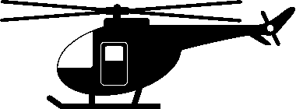
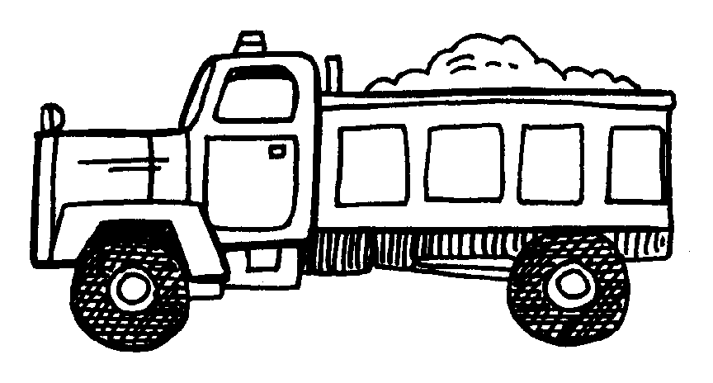
Requirements
Christopher
Such a system should:
Be portable and weigh under 5 pounds
Wireless communication within at least 10 meters
Work in low light levels
Work in high noise areas
Implement existing hand signals
Be intuitive and easy to use
Loud Noises
Night Time
Large Vehicle
Loud Noises
Obstacle
Guide
10 meters
Fig 3: Worst case scenario depicting loud noises and low light (figure not to scale)
Notes:
2 min

Slide 7
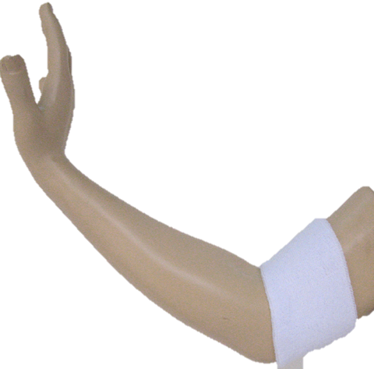
Our Solution
Shehzeen
A wearable device to detect hand signals and relay information to a vehicle operator via recognizable pre-recorded voice commands
No need to change existing hand gestures
Easy for both vehicle operator and guide to use
Fig 4: Wearable Armband [3]
Notes:
2 min

Slide 8
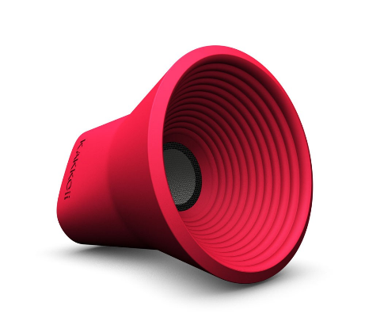
Input and Output
Shehzeen
Input
Existing hand signals can be
detected using a combination of
EMG and IMU sensors
Output
An audio signal delivered by
wireless speakers inside the cab and to the guide on the ground.
Fig 4: Armband [3]
Fig 5: Wireless Speaker [4]
EMG – Electromyography
IMU – Inertial Measurement Unit
Notes:
1 min

Slide 9
Design Alternatives
Shehzeen
Sensing Alternative:
External vehicle-mounted sensor: Proximity sensors
Output Alternatives:
Visual output interface with device like Google Glass
Car radio interface
Phone application
System Alternatives:
Hand-held radio
Rearview camera
Notes:
1 min add specs

Slide 10
System Level Block Diagram
Jeff
Power
Data Signal
Bluetooth
Control
Hardware Block
Software Block
Armband
10V Rechargeable Battery
3.3V Regulator
MCU
Bluetooth TX/RX
Output Devices
EMG Sensor
IMU Sensor
IMU Digital Processing
Bluetooth TX/RX
SD Card Module
Pattern Recognition
Speaker
Signal Conditioning Circuitry
Controller
Standby Mode Flip Switch
Notes:
>4 minutes differentiate btwn software and hardware verbally (if not in block diagram)
Need a d/a to give to speaker ex. Mp3 decoder or high speed pwm for audio. Look up teensy dac
Possibly have black arrow from mcu instead of controller

Slide 11
First Subsystem: EMG Sensor & Conditioning
Shehzeen
Power
Data Signal
Bluetooth
Control
Hardware Block
Software Block
Armband
10V Rechargeable Battery
3.3V Regulator
MCU
Bluetooth TX/RX
Output Devices
EMG Sensor
IMU Sensor
IMU Digital Processing
Bluetooth TX/RX
SD Card Module
Pattern Recognition
Speaker
Signal Conditioning Circuitry
Controller
Standby Mode Flip Switch

Slide 12
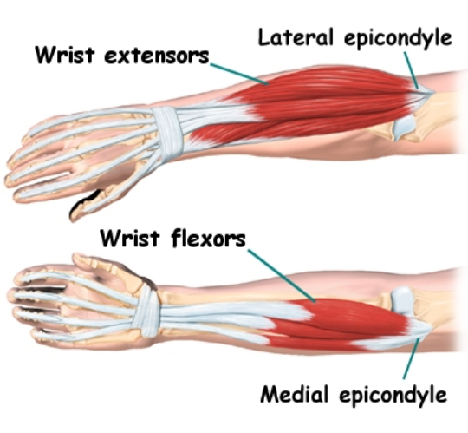
First Subsystem: EMG Sensor & Conditioning
Shehzeen
Summary: Electromyography (EMG) measures electrical activity produced by skeletal muscles.
Requirements:
Must sense muscle activity reliably.
Ability to setup within two minutes.
Fig 7: Arm with electrodes [5]
Figure 6: Basic physiology of the forearm.
Input
Two sets of surface electrodes on two main forearm muscles.
±5V from rechargeable battery
Output
Rectified waveform envelope ranging from 0-5VDC.
Notes:
2 min
Figuring out what the wrist is doing is impossible from the tricep/bicep. Want to use grip as one of the gestures.

Slide 13
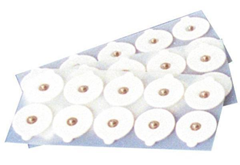
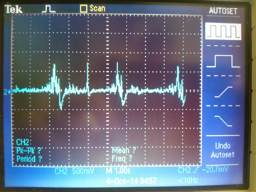
First Subsystem: EMG Sensor & Conditioning
Jeff
Differential
Amplifier
EMG Electrodes
Pre-Amp
LPF
Full Wave Rectifier
LPF
MCU
A/D
Fig 8: A waveform captured using Polulu muscle sensor v3. This is the expected output of our differential amplifier.
Fig 7: Surface Electrodes [5]
Notes:
1 minute
Specify the word differential
Pre-amp say & or with
Full wave may be one word
Check block contents
10 bit resolution on a/d

Slide 14
Second Subsystem: IMU Sensor & IMU Digital Processing
Christopher
Power
Data Signal
Bluetooth
Control
Hardware Block
Software Block
Armband
10V Rechargeable Battery
3.3V Regulator
MCU
Bluetooth TX/RX
Output Devices
EMG Sensor
IMU Sensor
IMU Digital Processing
Bluetooth TX/RX
SD Card Module
Pattern Recognition
Speaker
Signal Conditioning Circuitry
Controller
Standby Mode Flip Switch

Slide 15
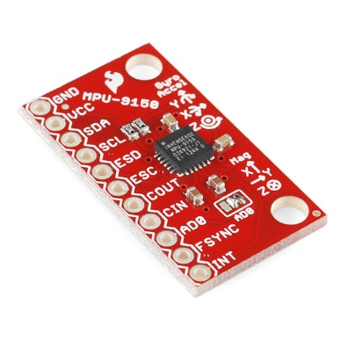
Second Subsystem: IMU Sensor & IMU Digital Processing
Christopher
Requirements of Sensor:
Inertial Measurement Unit (IMU) must contain:
Accelerometer: Measures the direction and magnitude of acceleration
Gyroscope: Measures angular velocity to help determine orientation
Magnetometer: Measures the current orientation relative to Magnetic North
I²C serial host interface for communication with microcontroller
Input to IMU Digital Processing System:
Acceleration including gravity
Angular velocity
Magnetic field strength
Output to Pattern Recognition System:
Velocity, Orientation
Gravity-free data
Fig 9: IMU MPU-9050 [5]
Notes:
2 min
Know how to calibrate it

Slide 16
Third Subsystem: Pattern Recognition & Controller
Christopher
Power
Data Signal
Bluetooth
Control
Hardware Block
Software Block
Armband
10V Rechargeable Battery
3.3V Regulator
MCU
Bluetooth TX/RX
Output Devices
EMG Sensor
IMU Sensor
IMU Digital Processing
Bluetooth TX/RX
SD Card Module
Pattern Recognition
Speaker
Signal Conditioning Circuitry
Controller
Standby Mode Flip Switch

Slide 17
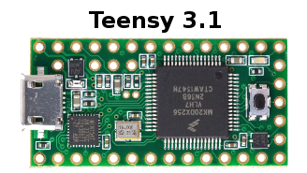
Third Subsystem: Pattern Recognition & Controller
Christopher
Summary: The pattern recognition system translates gestures to audio output by comparing inputs to stored patterns using KNN (k-nearest neighbors) algorithm. The result of the pattern recognition determines which audio message is sent via Bluetooth.
Requirements:
Differentiates between six distinct hand gestures to indicate signals: left, right, forward, backward, slow down, stop.
Interface with peripherals: sensors and Bluetooth module.
Interface with SD card containing speech library corresponding to gestures
Inputs:
Conditioned EMG Analog Signal
Position vector from IMU Digital Processing stage
Outputs:
Audio signal sent via Bluetooth module
Fig 10: Teensy 3.1 [6]
Notes:
2 min

Slide 18
Tasks
Shehzeen & Jeff
Design EMG signal conditioning circuitry
Determine optimum position for EMG electrodes for detecting electrical signals from muscles
Filter and amplify EMG signals
Calibrate sensor circuit design
Design envelope detector for EMG waveshaping
Sensor interface with microcontroller
Christopher
Program a KNN pattern recognition system in C++ for the microcontroller
Analyse the IMU data to determine orientation and a velocity vector
Shehzeen
Manage Bluetooth link between microcontroller and speakers
Jeff
Design voltage regulation circuitry

Slide 19
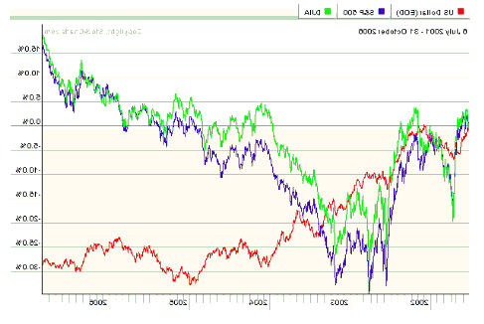
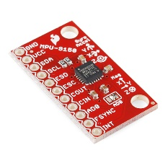
MDR Deliverables - November
Shehzeen
Working analog circuit implementation for measuring muscle activity data
Program to show waveform of EMG signals using the processor
Program to show simplified digital data from the IMU for different gestures
Basic pattern recognition program
Circuitry
Fig 11: Deliverable Components
“Left”

Slide 20
Questions?
Thank μ!

Slide 21
References
De Luca, Carlo J. "The Use of Surface Electromyography in Biomechanics."Journal of Applied Biomechanics (1997): 135-63. Human Kinetics Publisher Inc. Web. 5 Sept. 2014.
Artemiadis, P.K., and K.J. Kyriakopoulos. “EMG-Based Control Of a Robot Arm Using Low-Dimensional Embeddings.” Robotics, IEEE Transactions On 26.2 (2010) : 393-398. © 2010 IEEE
Veresano, Fabio. “A Guide to Using IMU (Accelerometer and Gyroscope Devices) in Embedded Applications.” Starlino Electronics. N.p., n.d. Web.
Sachs, David. "Sensor Fusion on Android Devices: A Revolution in Motion Processing." YouTube. YouTube, n.d. Web. 01 Oct. 2014.
Notes:
http://x.couver.us/index.php?main_page=product_info&products_id=1129

