Slide 1
Team E-μ
Midway Design Review – November 2014
Advised by Professor Baird Soules
Notes:
30 seconds

Slide 2
Team members
Shehzeen Hussain
EE
Professor Baird Soules
Advisor
Jeffrey Maloney
EE
Christopher Allum
CSE and EE
Notes:
30 seconds

Slide 3
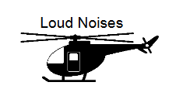
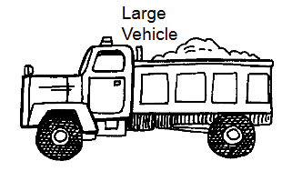
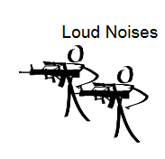
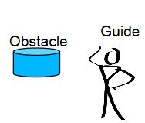
Re-Introduction
A wearable device to detect arm signals and relay information to a vehicle operator via recognizable pre-recorded voice commands
Such a system should:
Be portable and weigh under 5 pounds
Wireless communication within at least 10 meters
Work in low light levels
Work in high noise areas
Implement existing hand signals
Be intuitive and easy to use

Slide 4
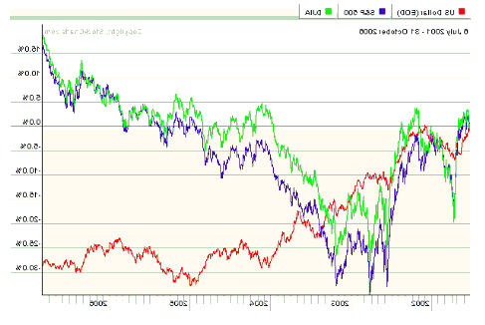
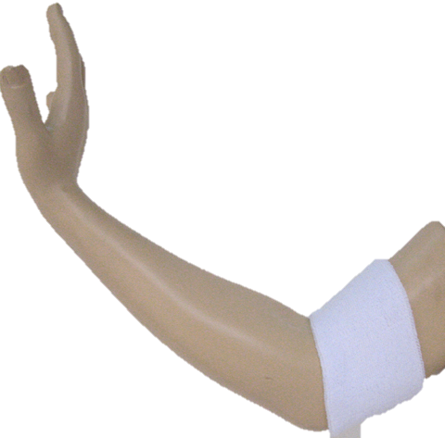
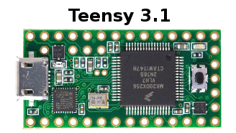
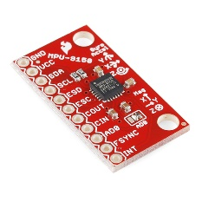
MDR Deliverables
Working analog circuit implementation for measuring muscle activity data
Program to show waveform of EMG signals using the processor
Program to show simplified digital data from the IMU for different gestures
Basic pattern recognition program
1
4
2,3
Circuitry
Fig 11: Deliverable Components

Slide 5
Alternative Uses
Generic platform for gesture recognition:
Similar to the Myo Armband
Interaction with Google Glass
Control of vehicles ex. quadcopter
More interactive gaming
Adaptable Features:
Bluetooth interface can be used for several different output devices.
Different types of data can be stored on the SD card depending on the application.
Robust pattern recognition system can be programed for different gestures.

Slide 6
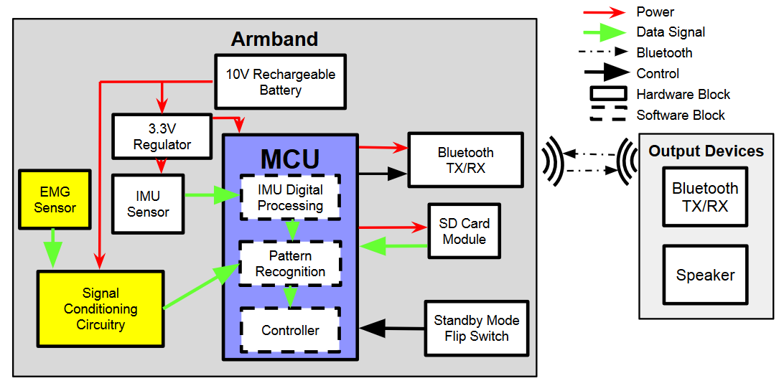
Original Block Diagram

Slide 7
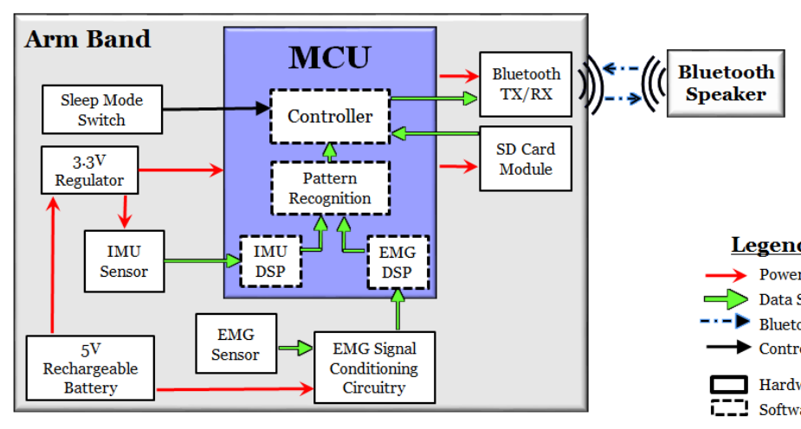
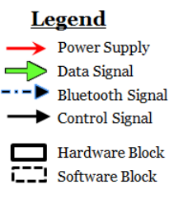
Updated Block Diagram

Slide 8
First Deliverable: EMG Circuit
Requirements:
Must sense muscle activity reliably.
Ability to don system within two minutes
Previous Input:
±5V from rechargeable battery
Two sets of EMG electrodes
Updated Input:
Power supply changed to 0 and 5V to match that of the teensy
Previous Output:
Rectified waveform envelope ranging from 0-5VDC.
Updated Output:
Amplified EMG signal with DC offset
Envelope detector replaced with digital filtering subsystem

Slide 9
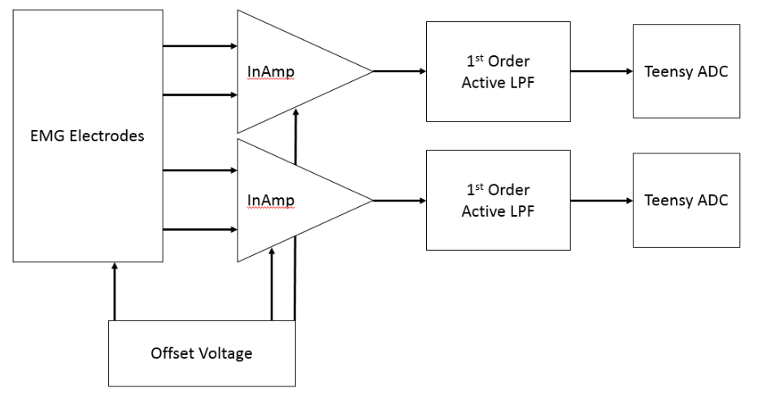
EMG Circuit Block Diagram

Slide 10
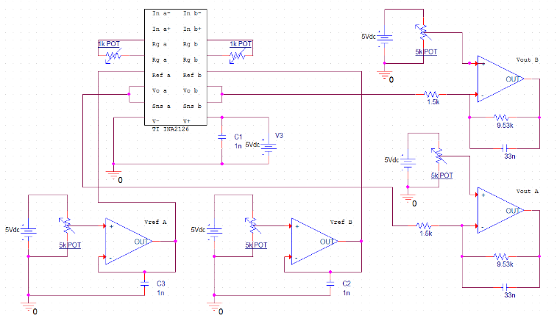
EMG Circuit Schematic
Electrodes
Electrodes

Slide 11
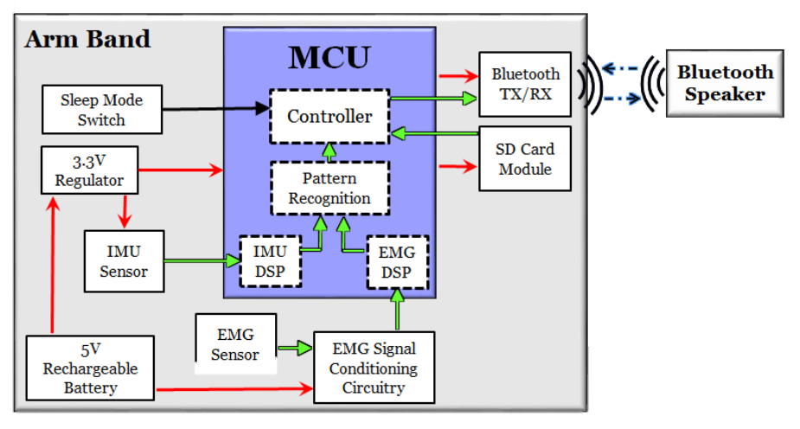
EMG Digital Processing
Overview of EMG Digital Signal Processing
EMG DSP
EMG Conditioning Circuitry
Time Domain
FFT to Frequency Domain
Pattern Recognition Subsystem
Standard Deviation
Digital Filter
Feature Extraction
Legend
Power Supply
Data Signal
Bluetooth Signal
Control Signal
Hardware Block
Software Block

Slide 12
Second Deliverable: EMG Digital Processing
EMG signals acquired using surface electrodes are composite of muscle fiber action potentials occurring at random intervals. Frequency spectrum of EMG signals are obtained in order to characterize the EMG signals for different gestures.
-Parser to read CSV waveform data into MATLAB for processing
-Perform Frequency Domain Analysis on sine wave input from function generator.
-Select sampling frequency (samples/second) based on the total number of samples collected over 2.5 seconds.
-Calculate and plot N point Discrete Fourier Transform of the signal by performing Fast Fourier Transform and thereby obtaining the frequency spectrum of the signal. FFT reduces computation by hundreds.
-Extract characteristic features of the signal from frequency spectrum, such as mean amplitude, standard deviation in amplitude, mod frequency (frequency of spectrum’s highest peak point).
-Attempt at noise filtering using FIR band pass filter in combination with welch hamming window and FFT methods.

Slide 13
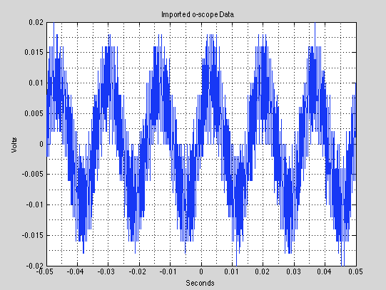
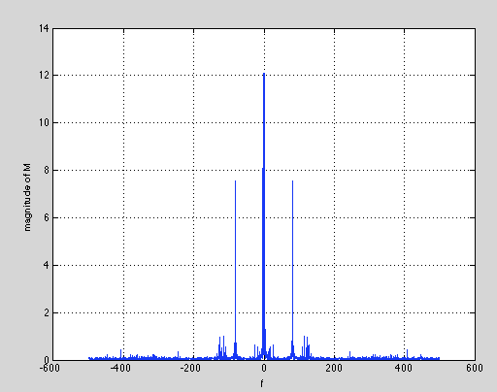
Sine Wave Input
FFT computes the discrete Fourier transform (DFT) of the input signal. The frequency spectrum is the squared magnitude of the complex FFT result.
Notes:
FFT computes the discrete Fourier transform (DFT) of the input
signal. If the length of input signal is a power of two, a
fast radix-2 fast-Fourier transform algorithm is used. If the
length of the input signal is not a power of two, a slower
non-power-of-two algorithm is employed. For arrays of signals
(matrices), the FFT operation is applied to each column.
The spectrum is the squared magnitude of the complex FFT result, normalized by the transform length.

Slide 14
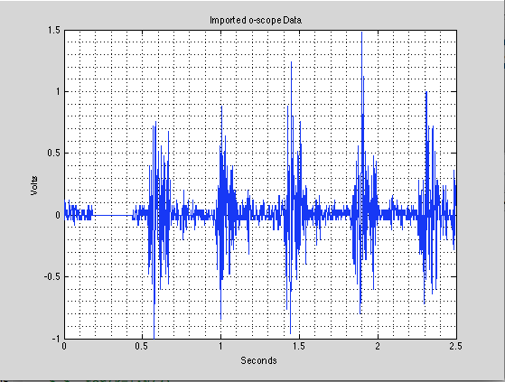
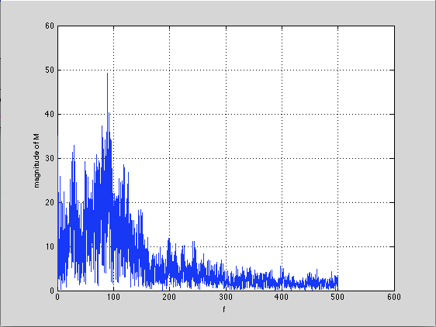
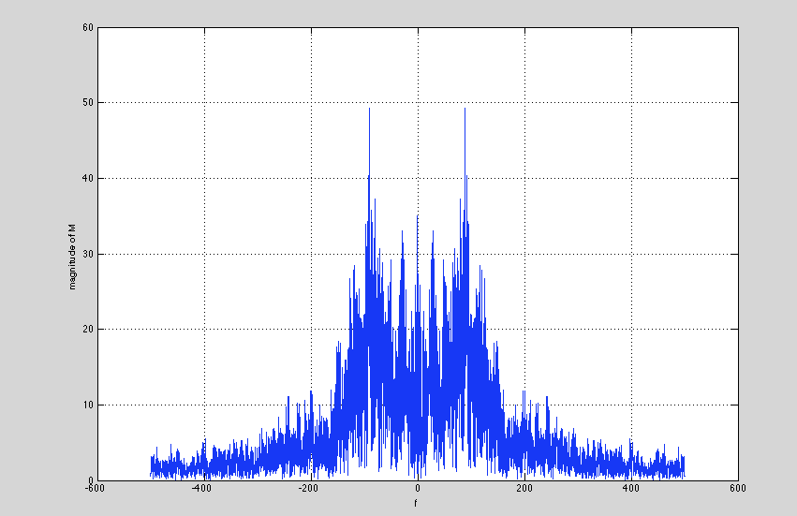
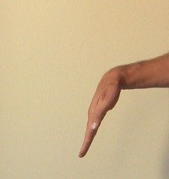
Wrist Flexion

Slide 15
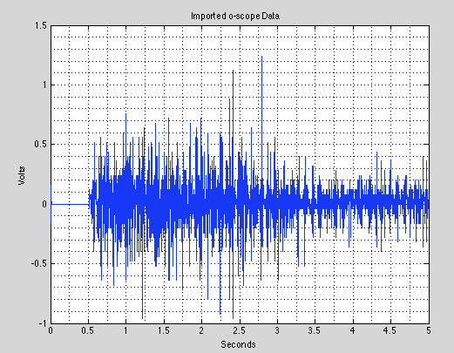
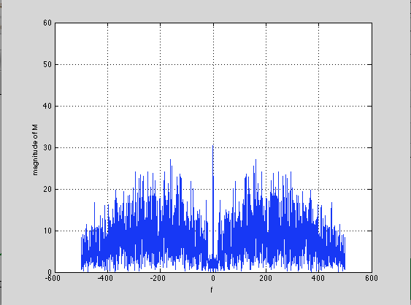
Fist

Slide 16
Characteristic Features
Gesture/ Input | Mean Magnitude | Standard Deviation in Magnitude | Mod frequency
Fist | 7.7034 | 4.6285 | 74 Hz
Wrist Extension | 6.1835 | 6.8170 | 80 Hz
Control (sine wave) | 0.0928 | 0.4206 | 49 Hz

Slide 17
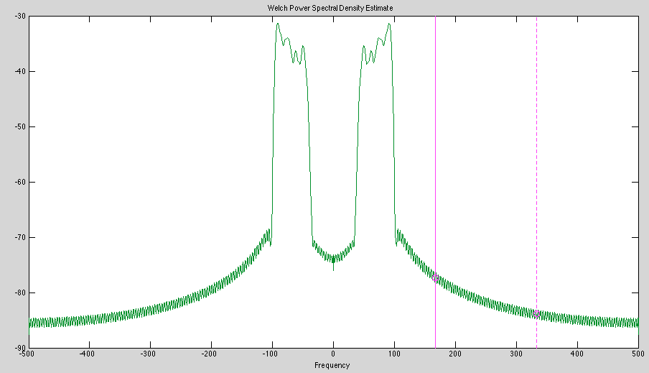
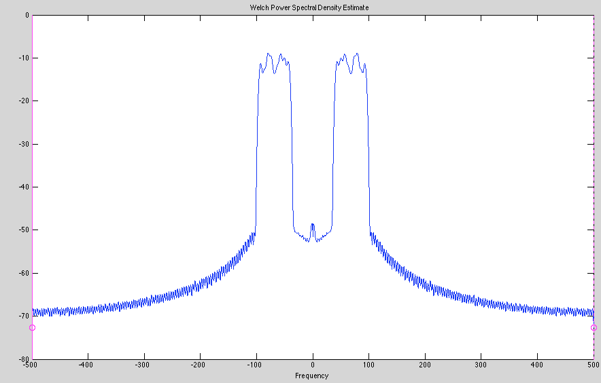
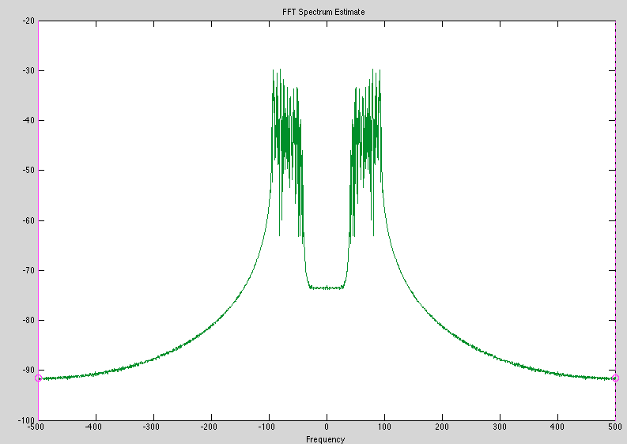
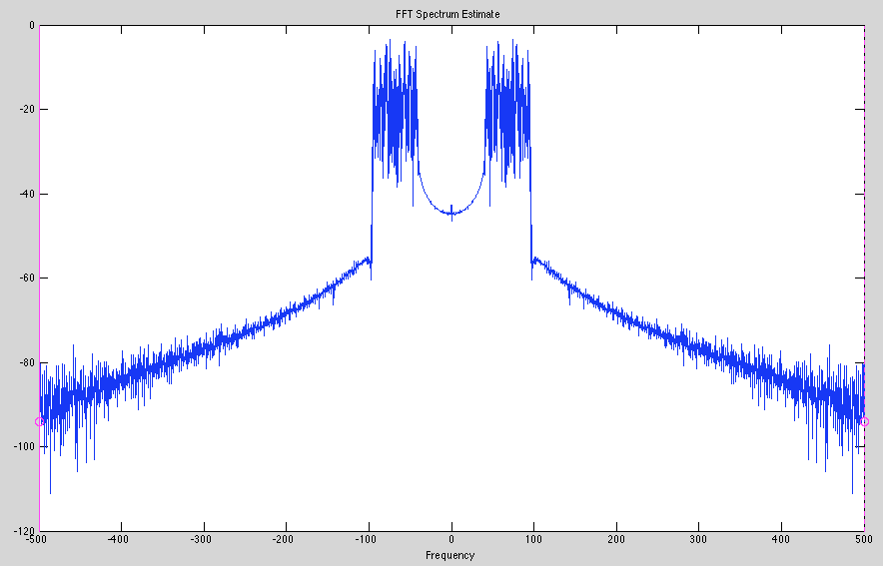
Digital Filter Tests
Extension
Fist
Extension
Fist
Extension
Fist
Extension
Fist
Extension
Fist
Notes:
Welch's method of averaged, overlapped, modified periodograms. The signal is sectioned into overlapping segments, each of length Nwind. The Window is applied to each section and the FFT is taken. The results are averaged together and scaled to get the final spectrum.
FFT Method
FFT computes the discrete Fourier transform (DFT) of the input signal. If the length of input signal is a power of two, a fast radix-2 fast-Fourier transform algorithm is used. If the length of the input signal is not a power of two, a slower non-power-of-two algorithm is employed. For arrays of signals (matrices), the FFT operation is applied to each column. The spectrum is the squared magnitude of the complex FFT result, normalized by the transform length.

Slide 18
Third Deliverable: Inertial Measurement Unit
Previous Requirements:
Inertial Measurement Unit (IMU) must contain:
Accelerometer: Measures the direction and magnitude of acceleration
Gyroscope: Measures angular velocity to help determine orientation
Magnetometer: Measures the current orientation relative to Magnetic North
I²C serial host interface for communication with microcontroller
Updated Requirements:
Inertial Measurement Unit no longer requires magnetometer

Slide 19
Inertial Measurement Unit (IMU)
Previous Outputs of Subsystem:
Velocity, Orientation
Gravity-free data
Updated Subsystem Outputs:
Angular Velocity, Jerk
Reasons for change:
gravity independent and easier to obtain
equally valid input from the pattern recognition subsystem

Slide 20
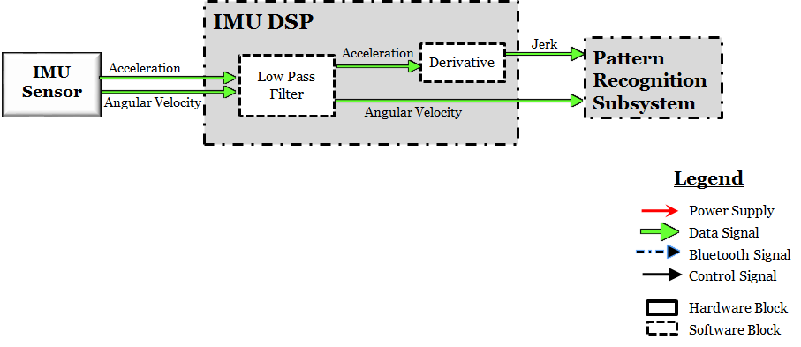
Inertial Measurement Unit (IMU)
Overview of IMU Digital Signal Processing

Slide 21
Fourth Deliverable: Pattern Recognition
Previous Requirements:
Differentiate between six distinct hand gestures to indicate signals: left, right, forward, backward, slow down, stop.
Interface with peripherals: sensors and Bluetooth module.
Interface with SD card containing speech library corresponding to gestures
Updated Requirements:
Will also need to recognize an empty gesture.
Separating pattern recognition system from controller entirely
Removing interface with both Bluetooth and SD card.

Slide 22
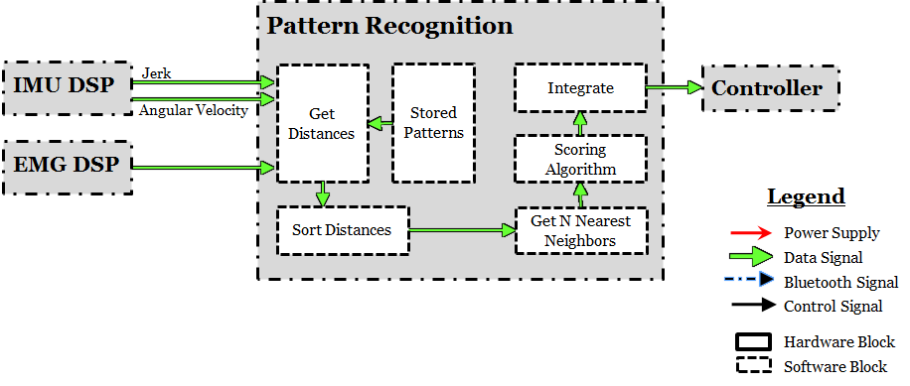
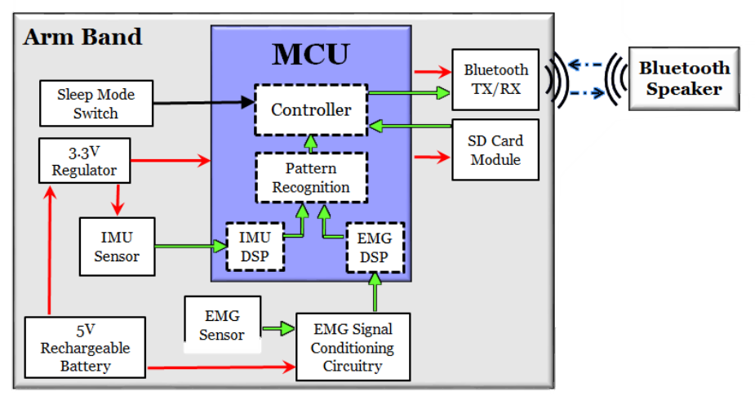
Pattern Recognition System
Overview of Pattern Recognition System

Slide 23
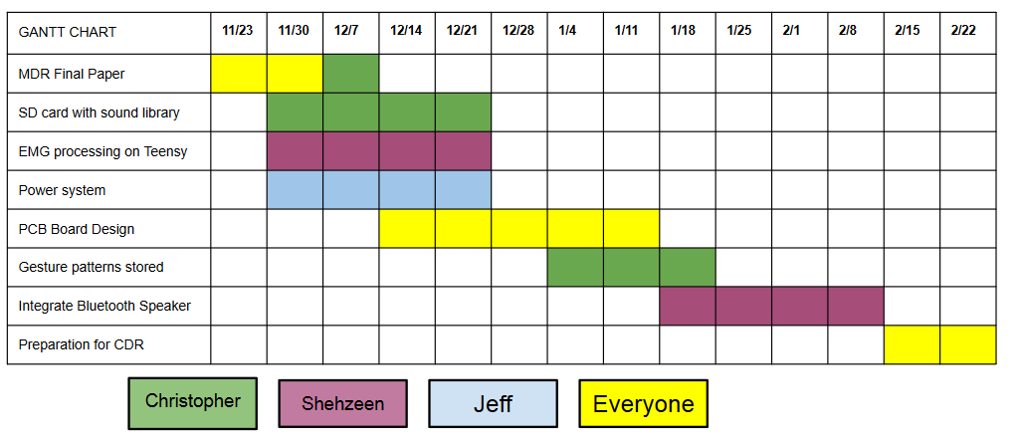
The Road Ahead

Slide 24
Overall Progress
Shehzeen & Jeff
Design EMG signal conditioning circuitry
Determine optimum position for EMG electrodes for detecting electrical signals from muscles
Filter and amplify EMG signals
Calibrate sensor circuit design
Design envelope detector for EMG wave shaping
Sensor interface with microcontroller
Jeff
Design voltage regulation circuitry
Christopher
Program a KNN pattern recognition system in C++ for the microcontroller
Analyze the IMU data to determine orientation and a velocity vector
Interface SD card
Record all necessary gesture data
Shehzeen
Manage Bluetooth link between microcontroller and commercial speaker

Slide 25
Questions?
Thank μ!

Slide 26
References
De Luca, Carlo J. "The Use of Surface Electromyography in Biomechanics."Journal of Applied Biomechanics (1997): 135-63. Human Kinetics Publisher Inc. Web. 5 Sept. 2014.
Artemiadis, P.K., and K.J. Kyriakopoulos. “EMG-Based Control Of a Robot Arm Using Low-Dimensional Embeddings.” Robotics, IEEE Transactions On 26.2 (2010) : 393-398. © 2010 IEEE
Veresano, Fabio. “A Guide to Using IMU (Accelerometer and Gyroscope Devices) in Embedded Applications.” Starlino Electronics. N.p., n.d. Web.
Sachs, David. "Sensor Fusion on Android Devices: A Revolution in Motion Processing." YouTube. YouTube, n.d. Web. 01 Oct. 2014.
Notes:
http://x.couver.us/index.php?main_page=product_info&products_id=1129

