Slide 1
Team E-μ
Final Product Review – April 2015
Advised by Professor Baird Soules
Notes:
30 seconds

Slide 2
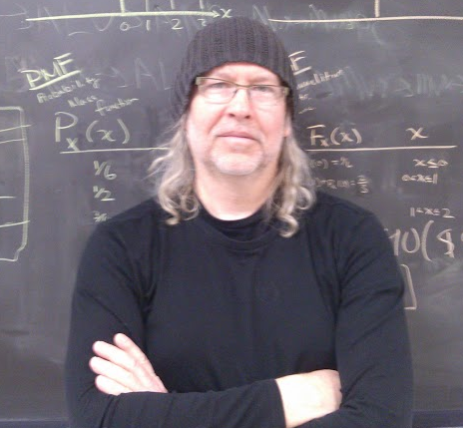
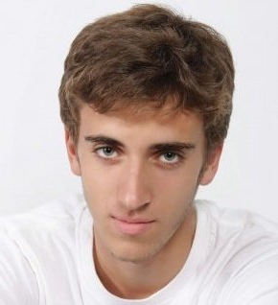
Team members
Shehzeen Hussain
EE
Professor Baird Soules
Brilliant Advisor
Jeffrey Maloney
EE
Christopher Allum
CSE and EE
Notes:
Soules needs a new picture!

Slide 3
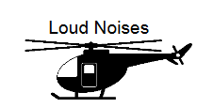
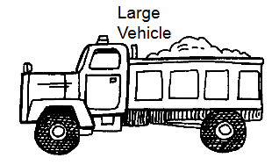
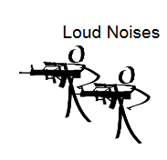
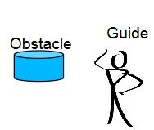
Introduction
A wearable arm device to detect arm signals and relay information to a vehicle operator via recognizable pre-recorded voice commands
Such a system should:
Be portable and weigh under 5 pounds
Wireless communication within at least 10 meters
Work in low light levels
Work in high noise areas
Implement existing hand signals
Be intuitive and easy to use

Slide 4
Specifications
A wearable arm device to detect arm signals and relay information to a vehicle operator via
recognizable pre-recorded voice commands
Such a system should: Result:
Be portable and weigh under 5 pounds Weighs 3.6 pounds
Wireless comm >= 10 meters Wireless comm at 10 meters
Work in low light levels Works in low light
Work in high noise areas Works in high noise
Implement existing hand signals Implements existing hand signals
Be intuitive and easy to use --
Battery Life of roughly 8 hours

Slide 5
FDR Deliverables
Completed? Deliverable
Electronics Enclosure
Power circuit with recharging system
Vehicular power supply for Raspberry pi
Make effective for multiple users
Printed circuit board
Improved pattern recognition
Alternative to disposable electrodes

Slide 6
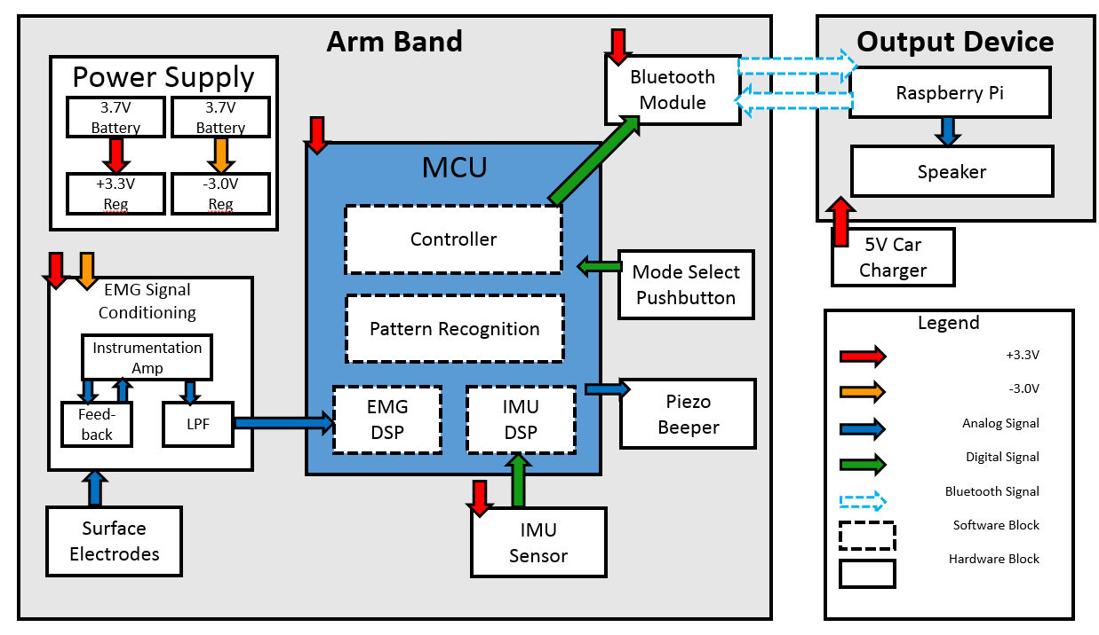
System Block Diagram

Slide 7
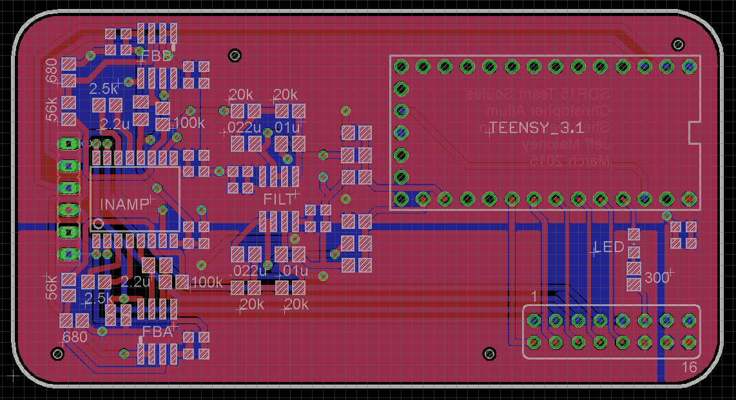
PCB Design

Slide 8
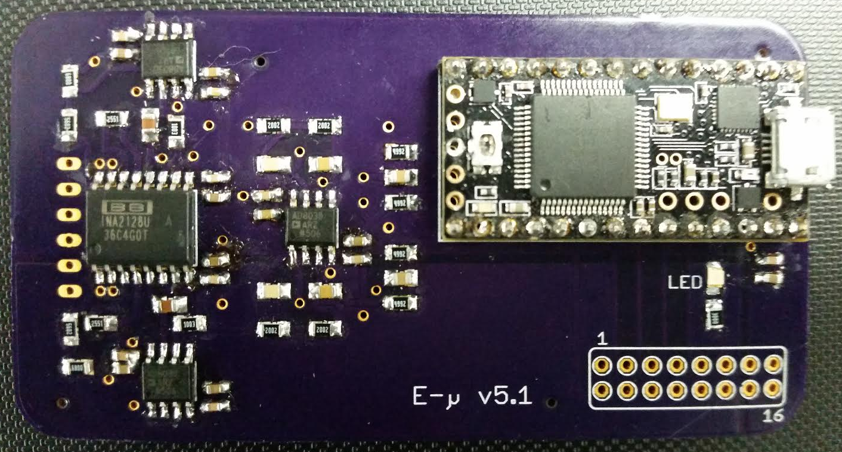
PCB Hardware

Slide 9
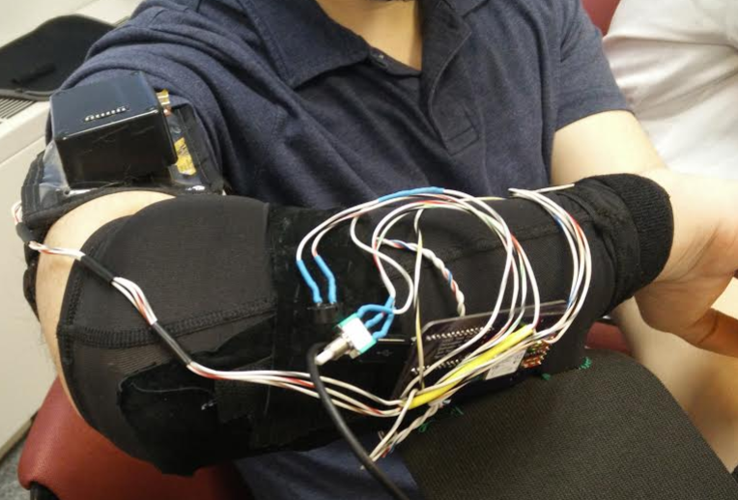
Final Product Picture

Slide 10
System Control Update
Mode Switching Implemented
1 push button switch
3 states:
sleep mode
run mode
training mode
Piezo Buzzer Indicates current state
sleep -1 beep
run -2 beeps
training - 3&4 beeps (training is split up into 2 phases)

Slide 11
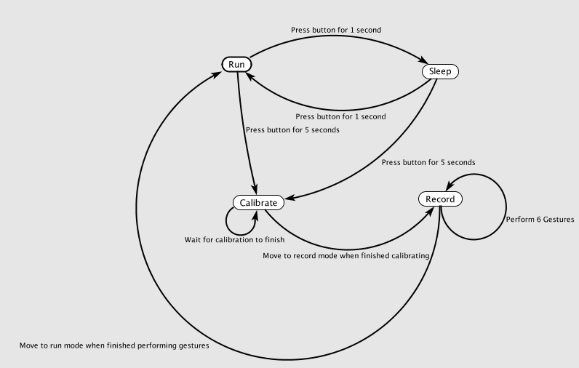
System Control Update

Slide 12
Updates to Pattern Recognition Subsystem
Training mode new features!
Calibration:
Sets the sensitivities of the individual sensors so that the features remain within a desired range, whether it needs to amplify or attenuate
Dynamic recording of new gestures:
- Records the gesture data for your individual set up
Post processing:
- Outlier removal operation based on standard deviation

Slide 13
Pattern Recognition Subsystem - Calibration
Added features:
Calibration mode
Average sensor values are stored in a moving window.
The average sensor value over the entire window is used to determine a sensitivity factor such that the sensor value becomes within the desired range.
Each feature is assigned a ‘weight’ that describes its influence in the pattern recognition.
Our current values, based on predicted value of feature:
jerk weight = 6;
angular velocity weight = 7;
emg amplitude weight = 1;
emg frequency root mean square weight = 5;
peak frequency (mod frequency) weight = 1;

Slide 14
Pattern Recognition Subsystem - Recording
Added features:
Record mode
Samples all of the sensors several times a second
After collecting samples, overwrites previous gesture data
Post processing is then performed to tidy the data
Currently, it stores a reading roughly every 400 milliseconds.

Slide 15
Pattern Recognition Subsystem - Post Proc.
Added features:
Post Processing
Outliers are found by:
find the average value of a feature for an entire gesture.
find the standard deviation for a given value
if the difference between that value and the average is not within a threshold based on the standard deviation, then replace that entire reading with very large values.
Currently, the threshold we are using checks in the value is within 2.3 standard deviations of the average value.

Slide 16
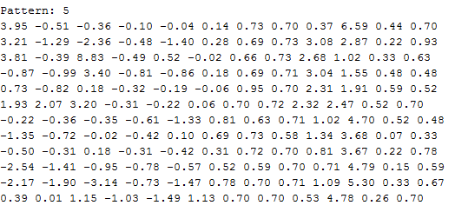
Pattern Recognition Subsystem - Post Proc.
Before

Slide 17
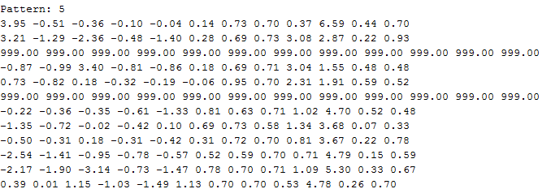
Pattern Recognition Subsystem - Post Proc.
Before

Slide 18
Pattern Recognition Subsystem - Results
Current Stance:
Overall, it does not yet perform as well as expected.
More work is needed to determine the effectiveness of this dynamic approach.
Possible things to try:
Add more samples per recording
More post processing
Alternative feature data

Slide 19
What Needs Work
Fine tuning of:
window size
outlier threshold
number of samples per recording
score window size
number of neighbors

Slide 20
Demo Day Goals
Primary Goals
Video of product in action
Improved Pattern Recognition
Increased reliability
More data

Slide 21
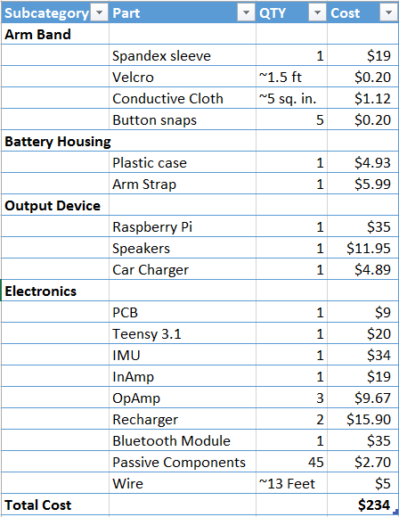
Total Cost

Slide 22
Questions?
Thank μ!

Slide 23
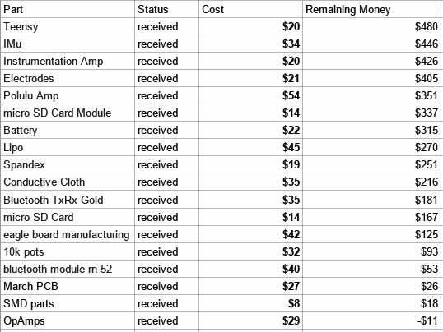
Budget Overview

Slide 24
System Block Diagram

Slide 25
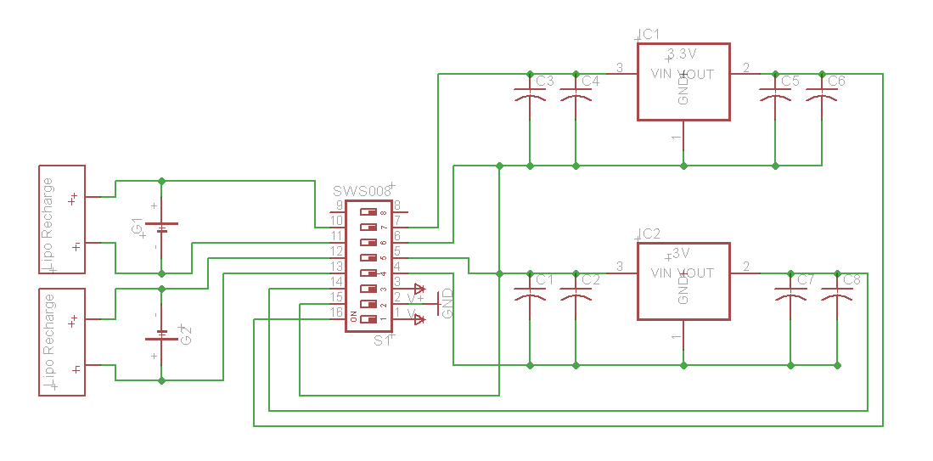
Power Supply

Slide 26
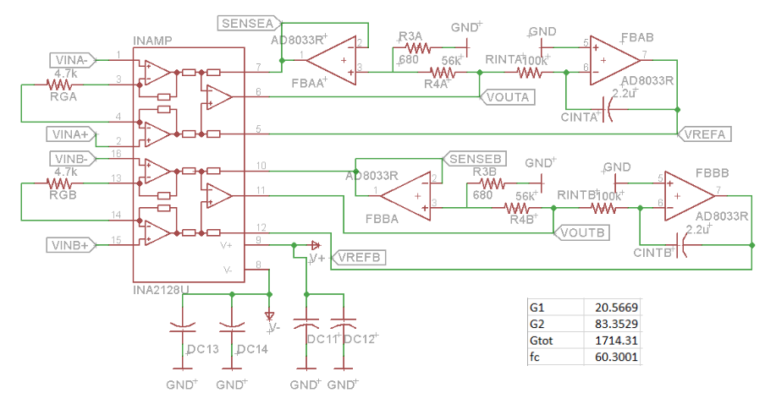
Amplifier Circuit

Slide 27
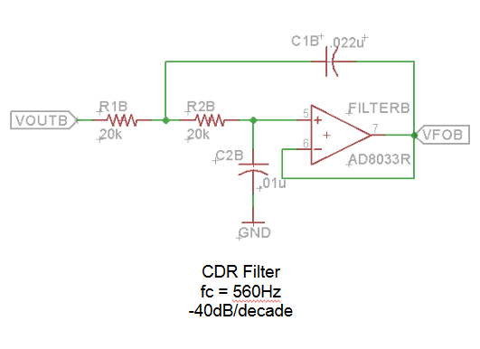
Anti-Aliasing Filter

