Slide 1
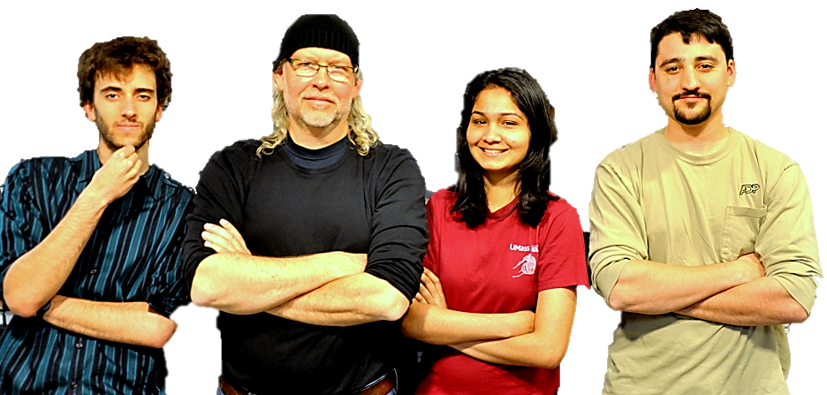
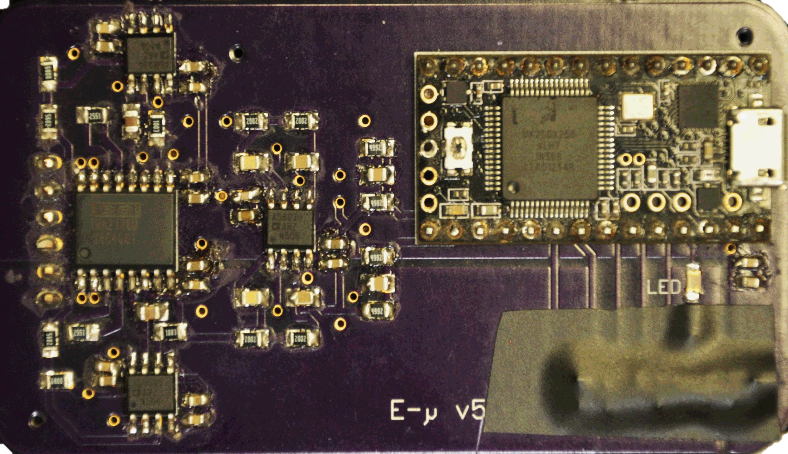
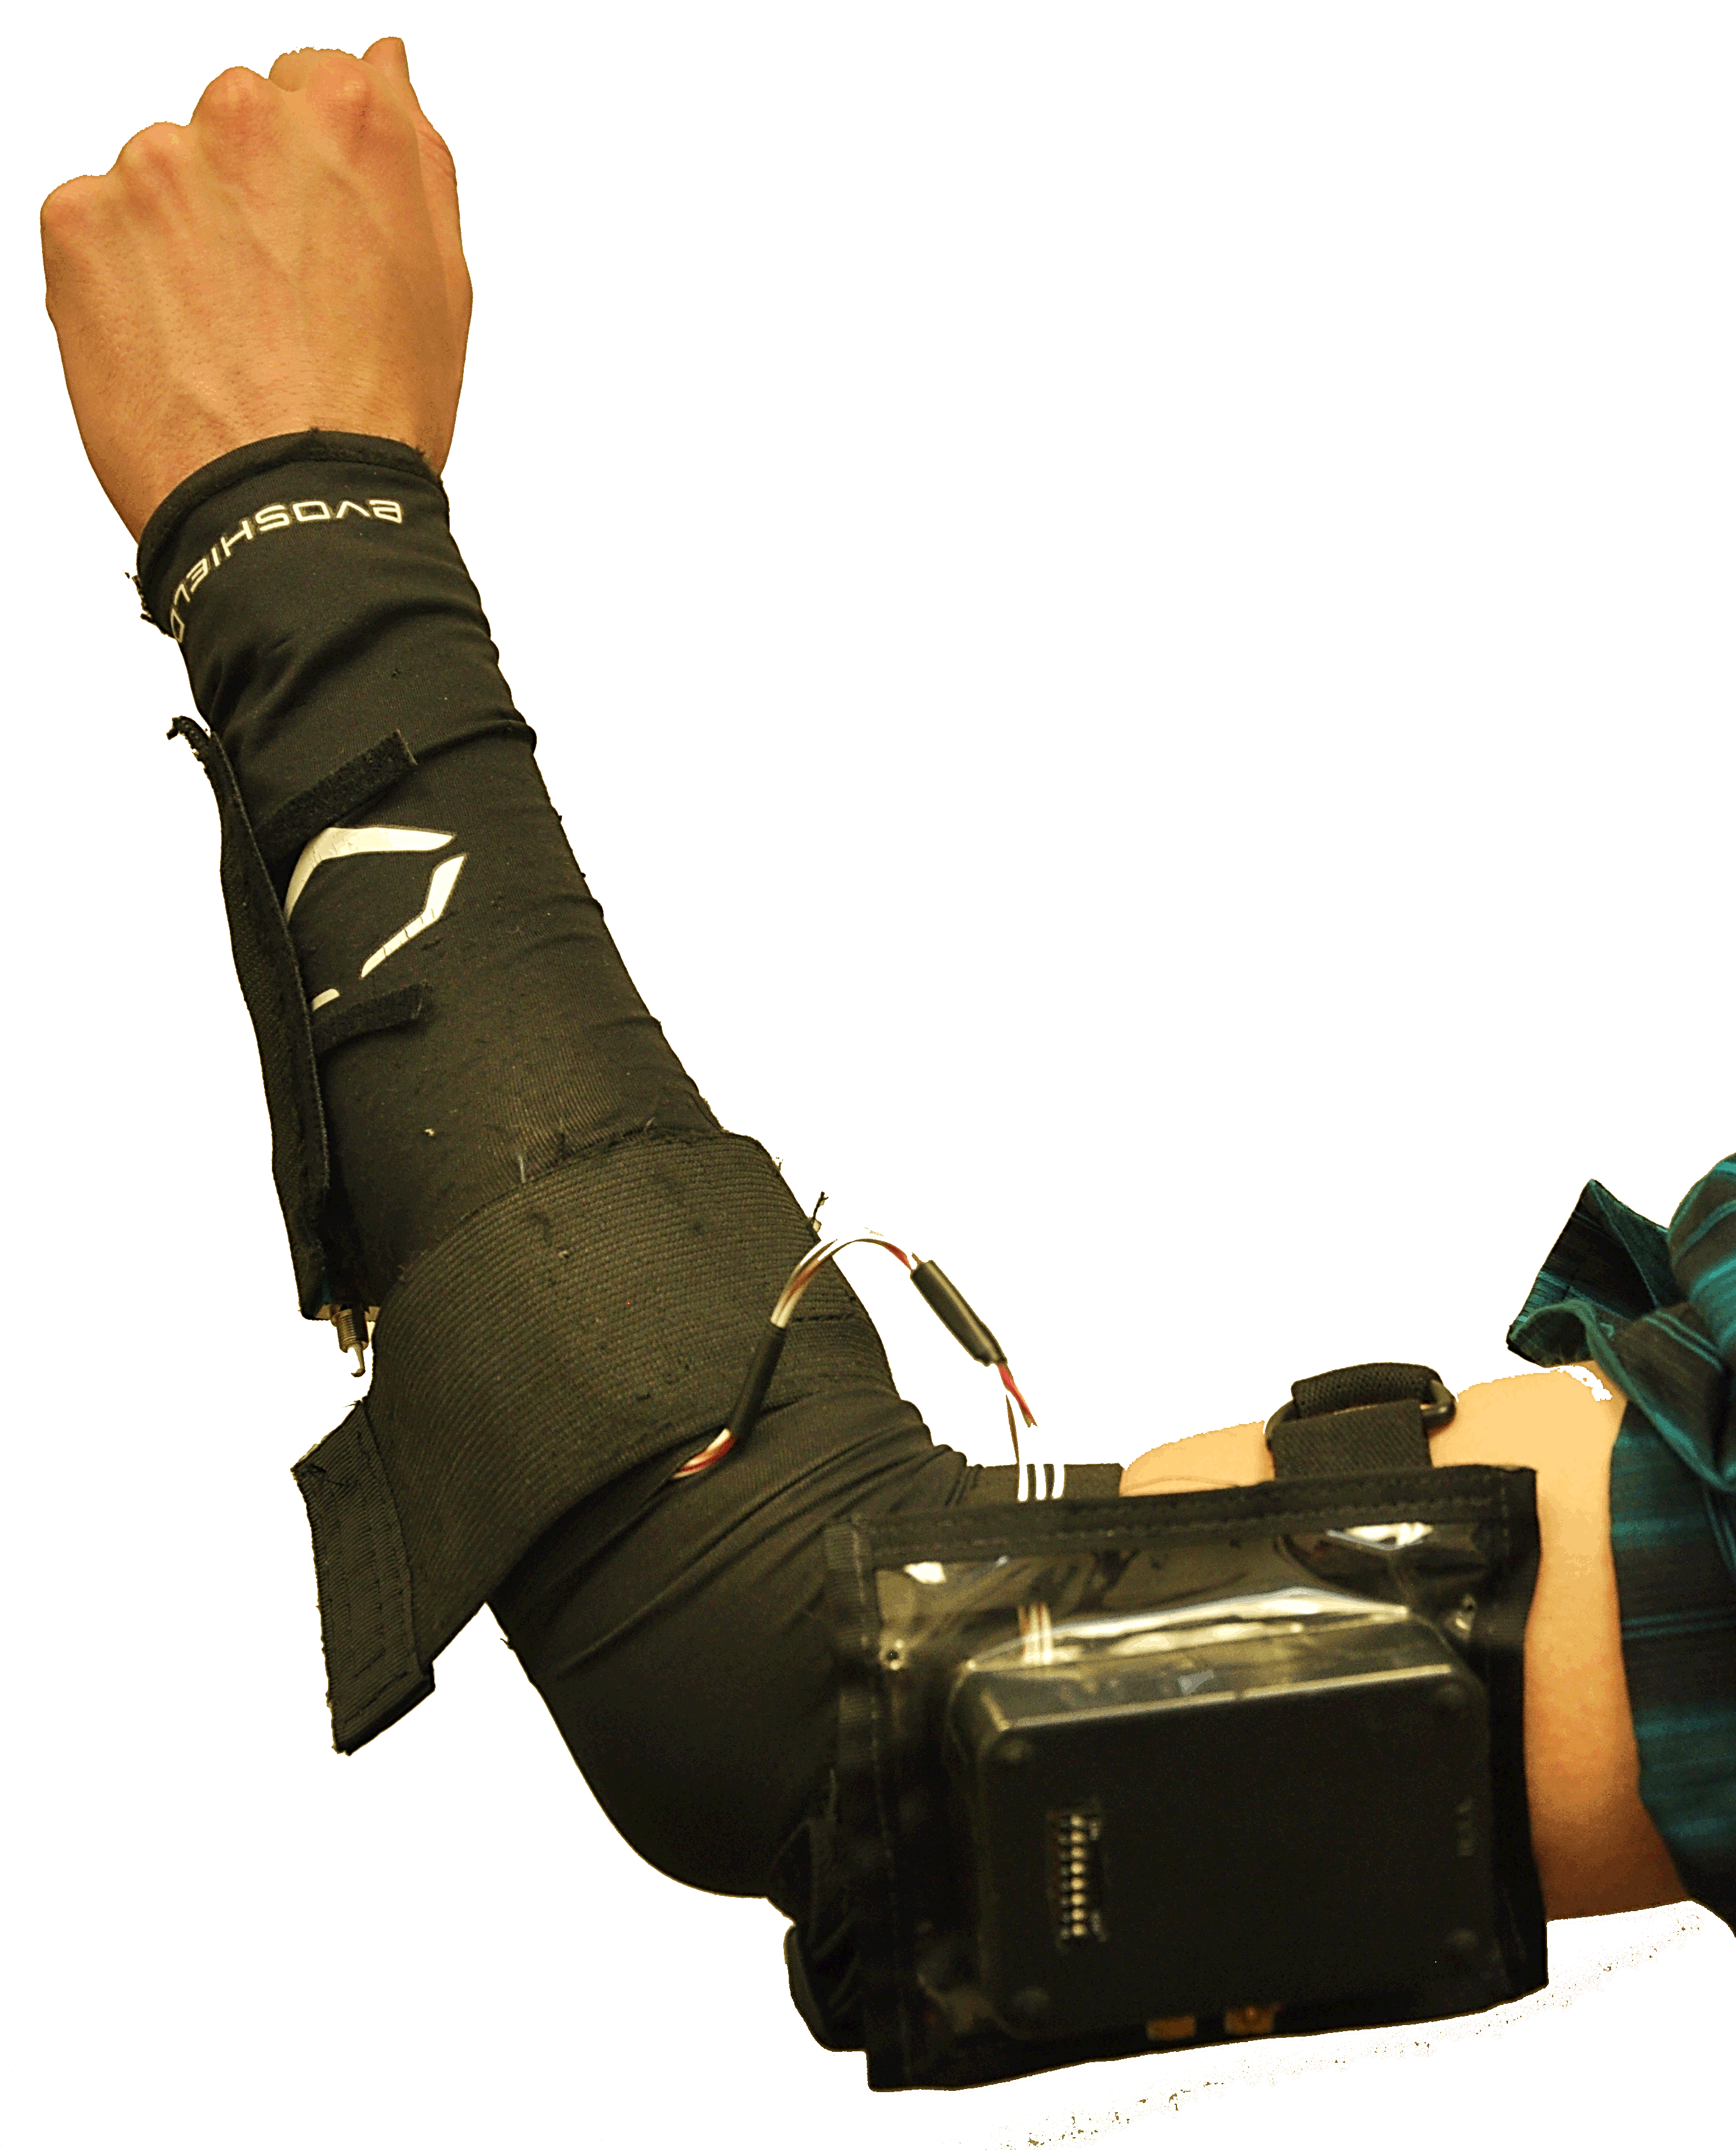
E-μ
E-µ Armband
Christopher Allum, Jeffrey Maloney,
Shehzeen Hussain
Faculty Advisor: Prof. Baird Soules
Abstract
System Overview
Miscommunication can quickly lead to accidents resulting in death or injury. The E-µ armband is a wearable device which serves as a supplemental interface between two people, with the purpose of reducing communication errors. As a test case, we assist in navigating large vehicles through difficult or heavily populated terrain. The device interprets a gesture by analyzing muscle activity and motion of the wearer’s arm on an embedded processor. Then, a voice command associated with the gesture is sent wirelessly over a Bluetooth connection to a speaker in the driver’s car.
A wearable device to detect hand signals and relay information to a vehicle operator via recognizable pre-recorded voice commands. The E-µ project consists of two major interfaces:
ARM BAND
● Inertial Measurement Unit (IMU): measures acceleration and angular velocity and sends data to the processor using the I²C protocol.
● Electromyography Sensor Circuitry: muscle signals are collected through reusable surface electrodes and then conditioned with analog filters and amplifiers before being fed to processor.
● Electromyography Signal Processing System: Fast Fourier Transform is performed on signals using the processor and features describing the signal are extracted from time and frequency domain.
● Bluetooth module: interfaces between microcontroller and car speaker.
● Two 3.7V Lithium Ion Battery Packs: rechargeable batteries.
Block Diagram
Arm Band
Output Device
Power Supply
BT Module
Raspberry Pi
3.7V
Battery
3.7V
Battery
MCU
Speaker
+3.3V
Reg
-3.0V
Reg
Controller
5V Car Charger
EMG Signal Conditioning
Pattern Recognition
Mode Select
Pushbutton
Legend
OUTPUT
An audio signal delivered by a speaker inside the car upon command from arm band.
● Car power adapter: powers the Raspberry Pi
● Raspberry Pi: processes Bluetooth message and outputs stored voice commands to speaker
Amplifier
EMG
DSP
IMU
DSP
Piezo
Beeper
+3.3V
-3.0V
Analog Signal
Digital Signal
Bluetooth Signal
Software Block
Hardware Block
Feed-
back
LPF
Surface Electrodes
IMU
Sensor
Specifications
Specification | Value
Weight | 1.5 kg
Height | 2 cm
Length | 40 cm
Battery Life | > 8 hours
Range | > 10 m
Hardware Cost | $240
Results
 | Forward | Reverse | Left | Right | Stop | Slow
User 1 | 100% | 100% | 80% | 100% | 100% | 80%
User 2 | 80% | 60% | 80% | 100% | 80% | 80%
User 3 | 100% | 100% | 40% | 60% | 100% | 100%
Overall | 93% | 87% | 67% | 87% | 93% | 87%
Acknowledgements
We could not have done this project without the support of UMass faculty, friends and alumni. We would like to give special thanks to:
Engineer Michael Mckinley from U.S. Bionics
Professor Umberger from the Kinesiology Dept.
Our advisors, Professors Krishna and Aksamija
Our awesome friends Omid Meh and Shamit Som
The system was tested by three users. Each user recorded five separate sets of each gesture and tested the success. Success was defined as the system outputting the correct command in under two seconds.
Department of Electrical and Computer Engineering
ECE 415/ECE 416 – SENIOR DESIGN PROJECT 2015
College of Engineering - University of Massachusetts Amherst
SDP15

Slide 2
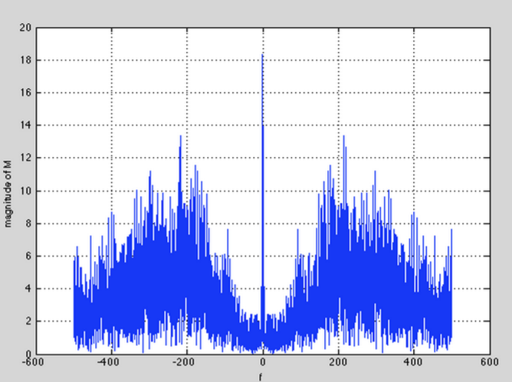
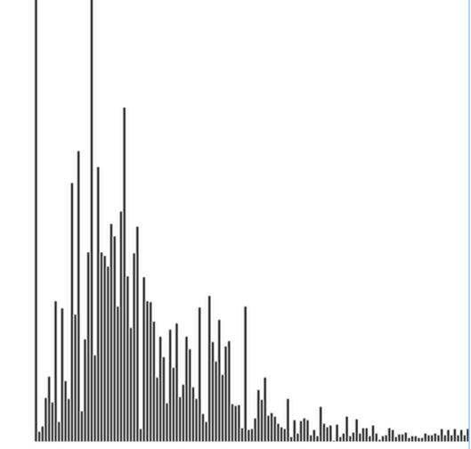
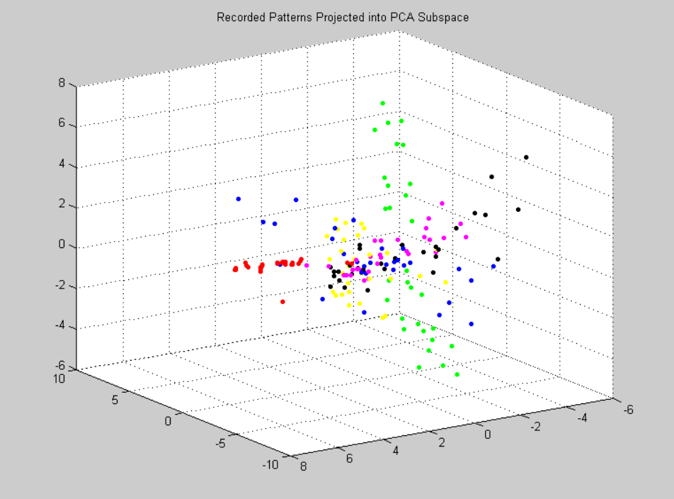
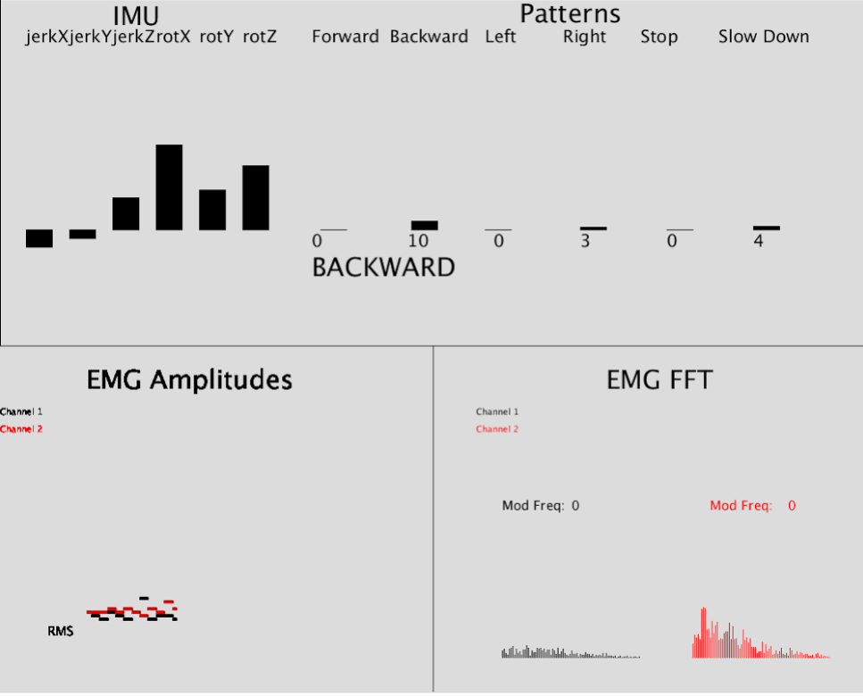
EMG Sensor Circuitry
EMG Digital Signal Processing
EMG Amplifier
EMG signals provide distinctive features in both time and frequency domain. EMG signals are composed of action potentials fired by muscle fibers when performing gestures. The features are extracted and compared for classification of samples and building of a gesture library.
● Mean Amplitude (Time & Frequency Domain): Captures signal strength.
● Root Mean Square of Amplitude (Time & Frequency Domain): Power of the signal calculated by squaring each data point, summing the squares, dividing the sum by the number of observations, and taking the square root of result.
● Number of Zero Crossings (Time Domain): Counting the number of times the amplitude of the signal crosses the zero line. A more active muscle will generate more action potentials causing more zero crossings in the signal.
● Mod Frequency (Frequency Domain): Fast Fourier Transformation is used to break the EMG signal into its frequency components. Mod frequencies detect highest peaks.
InAmp
Anti-Aliasing
LPF
MCU
A/D
Legend
EMG DSP
Pattern Recognition Subsystem
Legend
Feedback LPF
Analog Signal
Hardware Block
EMG Conditioning Circuitry
Time Domain Feature Extraction
FFT to Frequency Domain
Fs = 2kHz, N =256
Data Signal
Hardware Block
Software Block
The EMG circuitry conditions electrical signals from the surface of the skin for processing. Electrodes are placed on upper forearm near the elbow. These signals must be amplified independently from the other low frequency noise present at the surface of the skin.
Digital Noise Filter
Frequency Domain Feature Extraction
Pattern Recognition
Overview: The pattern recognition system uses the K-Nearest Neighbors Algorithm (KNN) to map the wearer’s motions to gestures. It takes in IMU data and EMG data and outputs a score for each gesture.
Causes of variability in gesture data include:
- Unique muscle characteristics
- Differing arm length between users
- Inconsistent sensor placement
To overcome this variability, we record new gestures upon each use. This allows for a more robust system. After completing a recording, all of the data is sent through a post-processing algorithm which removes outliers from the sample space.
EMG/IMU Data
Pattern Recognition
Pattern Scores
Calculate Distances
Stored Patterns
Moving Window
Sort
Distances
Get N Nearest Neighbors
Scoring Algorithm
Legend
Magnitude
Data Signal
Software Block
Fig: MATLAB Unprocessed Signal FFT
Frequency
Fig: Teensy Processed Signal FFT
Recorded Data and PCA
GUI/Processing Visualization
Recorded Patterns Projected into PCA Space
Forward
Backward
Left
Right
Stop
Slow
When in run mode, the user performs gestures that are recorded into the twelve dimensional signal space. While in run mode, the real time measurements are mapped to the same space and then compared against the recorded data. Pictured above is a three dimensional representation of a typical recorded data set and representation of greatest variance of each gesture compared to that of all gestures performed.
Cost
Audio Output Feedback
Part | Development Cost | Production Cost
IMU | 34 | 18.50
Electronics | 57 | 9.15
PCB | 27 | 2.07
MCU | 20 | 19.00
Batteries | 45 | 9.19
BT Module | 45 | 19.96
Total | 240 | 77.87
Vehicle operator receives audio commands inside the vehicle up to 10 meters in range from ground guide. Gestures are translated to commands sent wirelessly over Bluetooth link to car driver.
BlueSMiRF Gold Bluetooth Module:
● Processor sends commands to receiver via Bluetooth
Raspberry Pi connects to speakers inside car:
● Raspberry Pi powers from car charger and pairs wirelessly with E-µ.
● Python code plays sound files from SD card, based on the command

