Slide 1
Team E-μ
Comprehensive Design Review – February 2014
Advised by Professor Baird Soules
Notes:
30 seconds

Slide 2
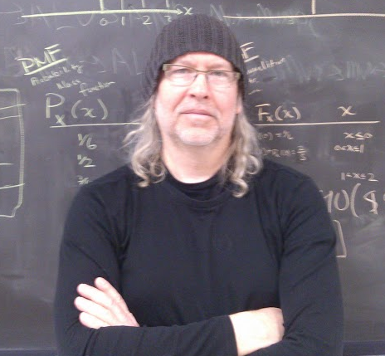
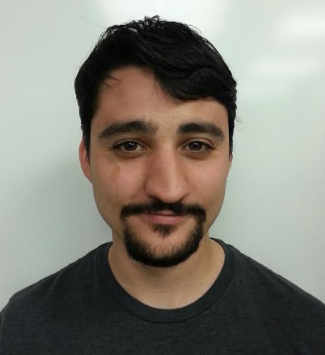
Team members
Shehzeen Hussain
EE
Professor Baird Soules
Advisor
Jeffrey Maloney
EE
Christopher Allum
CSE and EE
Notes:
Soules needs a new picture!

Slide 3
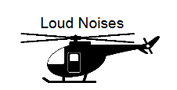
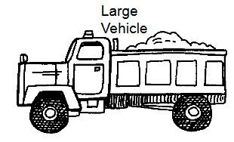
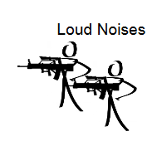
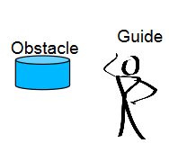
Re-Introduction
A wearable arm device to detect arm signals and relay information to a vehicle operator via recognizable pre-recorded voice commands
Such a system should:
Be portable and weigh under 5 pounds
Wireless communication within at least 10 meters
Work in low light levels
Work in high noise areas
Implement existing hand signals
Be intuitive and easy to use

Slide 4
CDR Deliverables
Fully functional pattern recognition
Emg sensing and digital signal processing in time and frequency domain
Real time feature extraction
Bluetooth capabilities
Power Supply
Circuitry
Fig 11: Deliverable Components

Slide 5
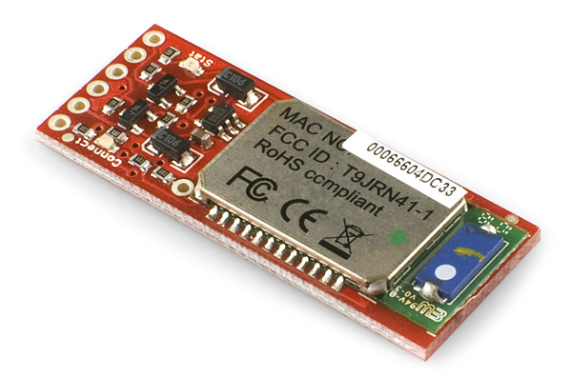
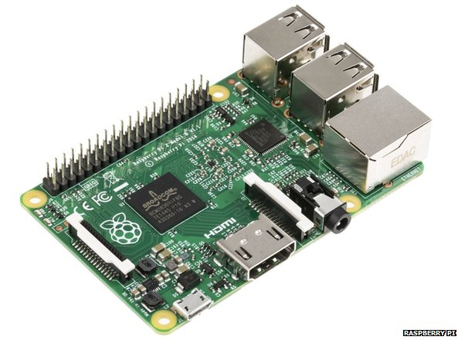
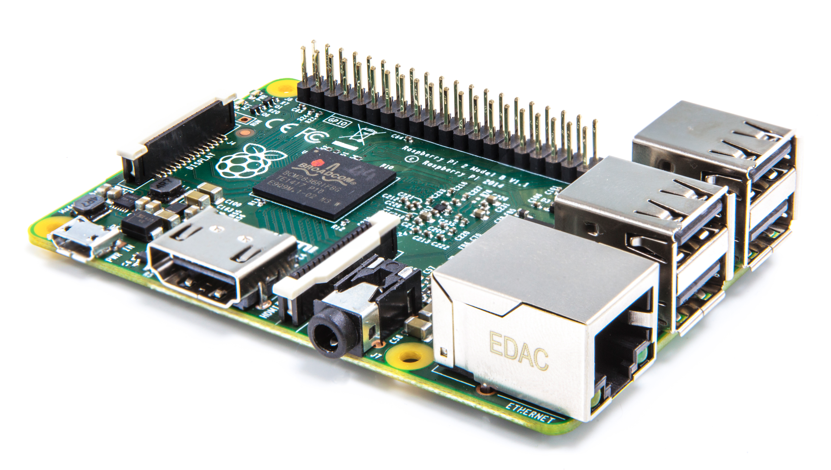
Design Changes: Bluetooth
Additional audio processing on the receiver end of the design (vehicle speaker) to receive audio packets increases cost of product.
BlueSMiRF Gold Bluetooth Module:
Teensy communicates commands to receiver via Bluetooth TX RX.
A2DP audio protocol not supported.
Raspberry Pi:
Device set to pair with arm band upon request.
Python code to play sound files stored in SD card upon command from the arm band.
Circuitry

Slide 6
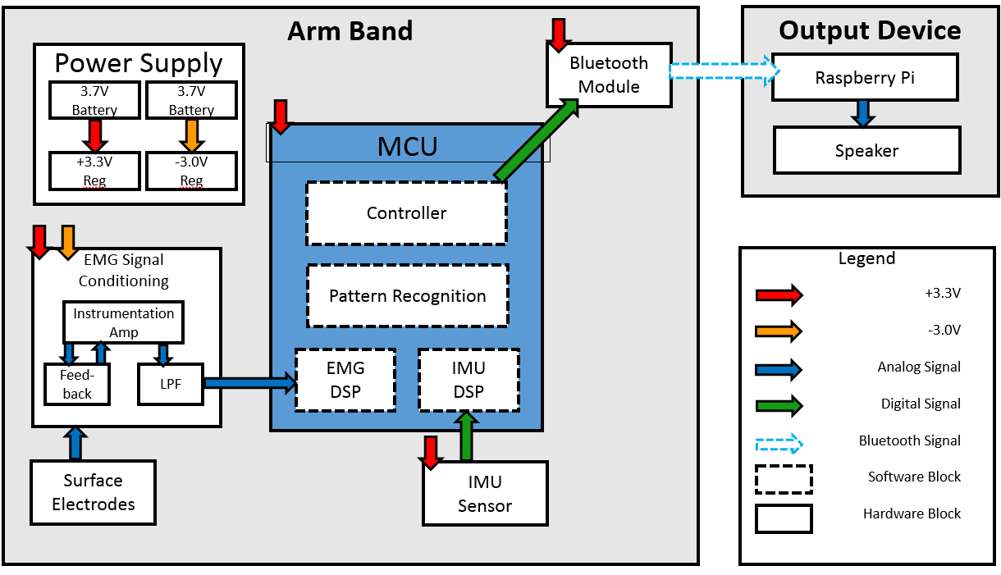
Updated CDR Block Diagram (TODO)

Slide 7
Pattern Recognition Subsystem Update
Added a maximum neighbor distance threshold
Previously had the gesture ‘stall’ to signify no gesture
Added input parameter weights sensitivity
Previously had no sensitivity factors
Accommodated algorithm for 12 features
Previously had 6 features.
Pre-existing features:
Three axes of jerk
Three axes of rotation
Added features:
Two channels of EMG amplitude
Two root mean square values
Two peak frequency values

Slide 8
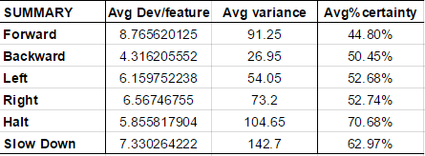
Performance Analysis
Certainty determined by percent of total score belonging to correct gesture within the score window totals.
An acceptable percentage of certainty is based on the average variance for that gesture. Higher variance means it requires a higher percent certainty.

Slide 9
Next Steps for Pattern Recognition Subsystem
Upcoming features:
Calibration mode
Sets the sensitivities so that the features remain within a desired range, whether it needs to amplify or attenuate
Alternative EMG features
The effectiveness of untested emg features will be determined

Slide 10
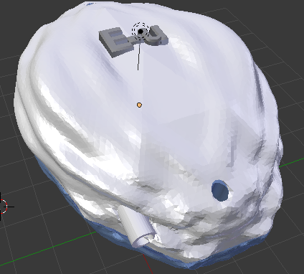
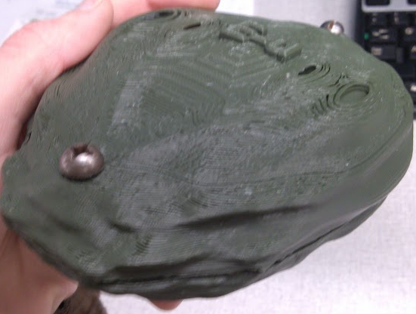
Preliminary Case Design

Slide 11
EMG Circuit Update
Recall MDR Challenges
DC offset drift
Low gain
Unpredictable behavior
Too many potentiometers
Design Changes
TI INA2128 replaces INA2126
Drift and saturation accounted for and removed*
Improved anti-aliasing filter
Bipolar power supply now used
*Texas Instruments. "Getting the Most out of Your Instrumentation Amplifier Design." TI Application Notes [Slyt226*] (n.d.): n. pag. Web.

Slide 12
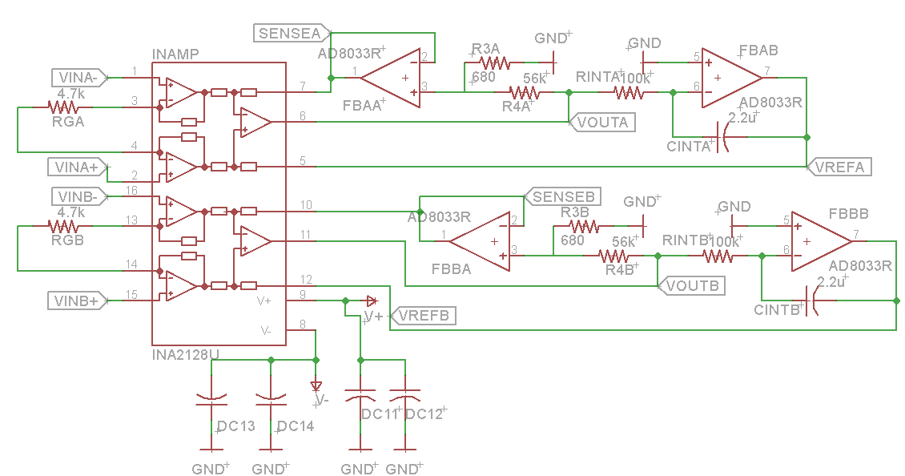
Feedback Networks
One feedback network eliminates the drift, while the other allows for higher overall gain.

Slide 13
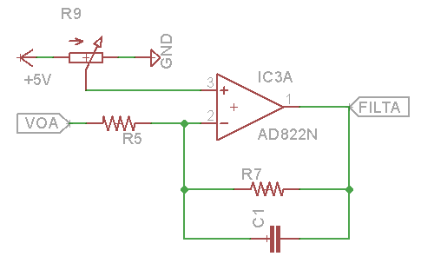
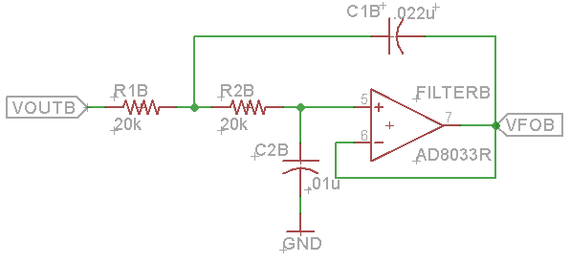
Sallen-Key Filter
MDR Filter
fc = 520Hz
-20dB/decade
CDR Filter
fc = 560Hz
-40dB/decade

Slide 14
EMG Digital Processing Update
Previously we implemented EMG DSP with MATLAB code
Arm based microcontroller now performs two real time FFT for two channels
We obtain real time features in both time domain and frequency domain
Time domain features
Mean of amplitudes
Number of Baseline Crossings
Variance (to be implemented)
Standard Deviation (to be implemented)
Root Mean Square of Amplitude
Frequency Domain Features
Mod frequency
Power of signal (RMS)
Variance (to be implemented)
Standard Deviation (to be implemented)

Slide 15
EMG Digital Processing Parameters
Root Mean Square (Time & Frequency Domain)
Mod Frequency (Frequency Domain)
Recommended quantification method by Basmajian and DeLuca
Calculated by squaring each data point, summing the squares, dividing the sum by the number of observations, and taking the square root
Number of Zero Crossings (Time Domain)
Counting the number of times the amplitude of the signal crosses the zero line
Based on the idea that a more active muscle will generate more action potentials, which will cause more zero crossings in the signal.
Fast Fourier Transformation is used to break the EMG signal into its frequency components.
Frequency components are graphed as function of the probability of their occurrence
So far we have acquired mod frequencies for detecting highest peaks.
Notes:
Represents 0.707 of one half of the peak-to-peak value.

Slide 16
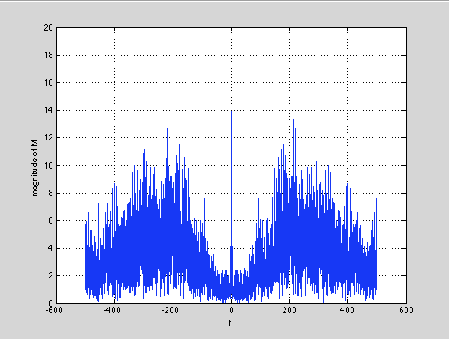
EMG Digital Processing: Noise Filtering
Average EMG can be used to quantify muscle activity in mV over time
Incoming analog signals are averaged to produce digitized values
Moving windows used as a digital smoothing technique
Smaller moving time window leads to less smooth the data
Fig: MATLAB Unprocessed Signal FFT
Fig: Teensy Processed Signal FFT

Slide 17
EMG Digital Processing:
Gesture/ Input | Channel 1 RMS | Channel 2 RMS | Channel 1 Mod frequency | Channel 2 Mod frequency
Stop | 6.7 | 10.1 | 104 Hz | 104 Hz
Slow Down | 1.5 | 8 | 104Hz | 104 Hz
Forward | 0.8 | 5 | 52Hz | 78Hz
Backward | 3 | 5 | 182Hz | 104Hz
Left | 2.8 | 3 | 130Hz | 104Hz
Right | 1 | 6.5 | 156Hz | 104Hz
Fig: EMG Parameter Value after Processing

Slide 18
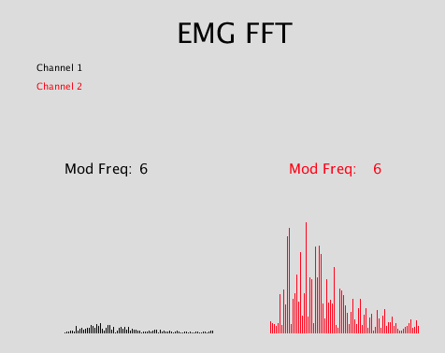
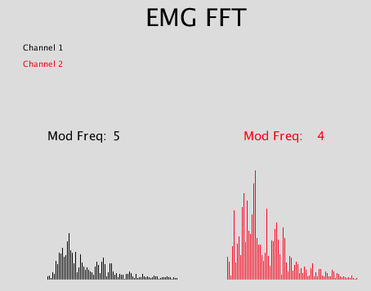
EMG Digital Processing:
Fig: Teensy Processed STOP Signal FFT
Fig: Teensy Processed SLOW DOWN Signal FFT

Slide 19
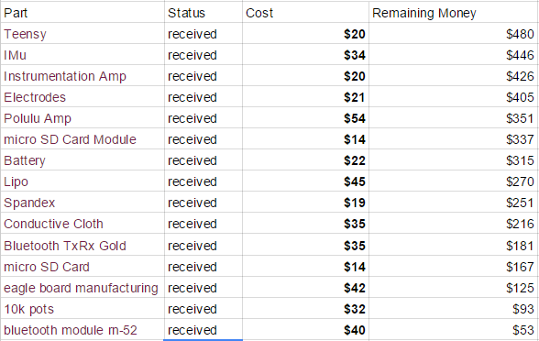
Budget Overview

Slide 20
Questions?
Thank μ!

Slide 21
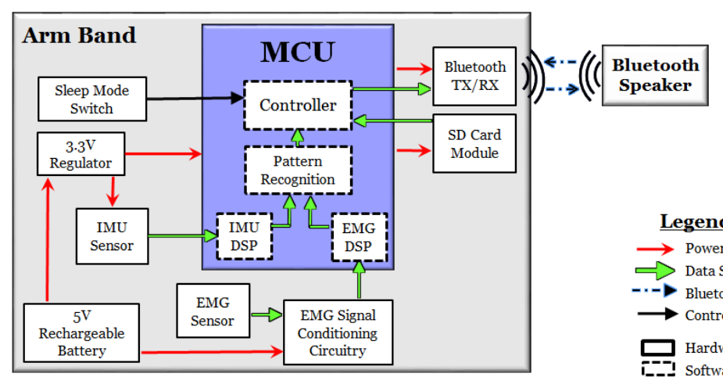
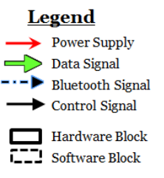
MDR Block Diagram

Slide 22
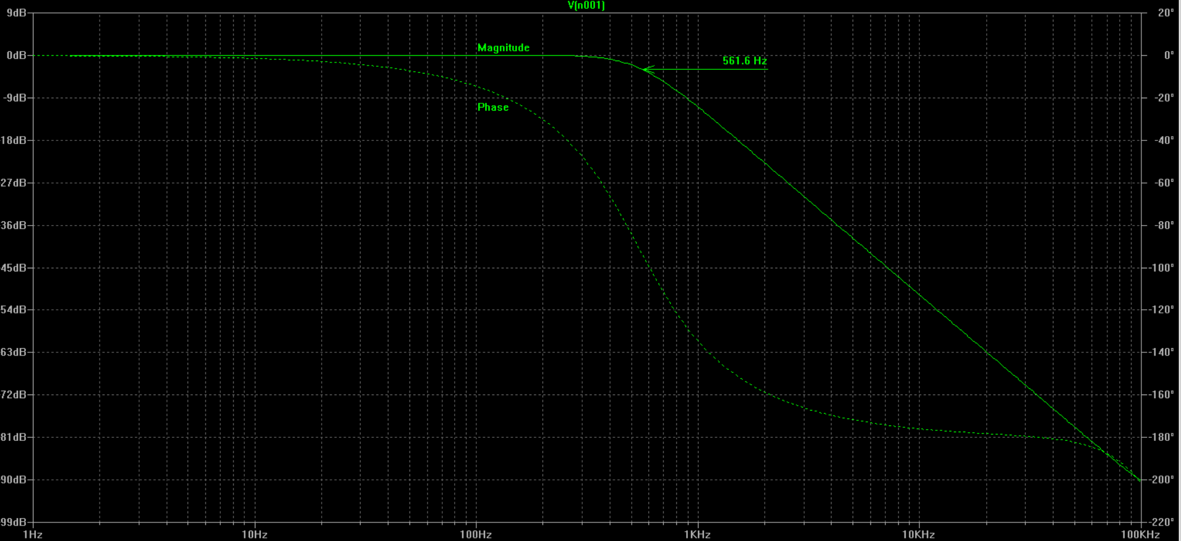
Sallen-Key Filter Simulation

Slide 23
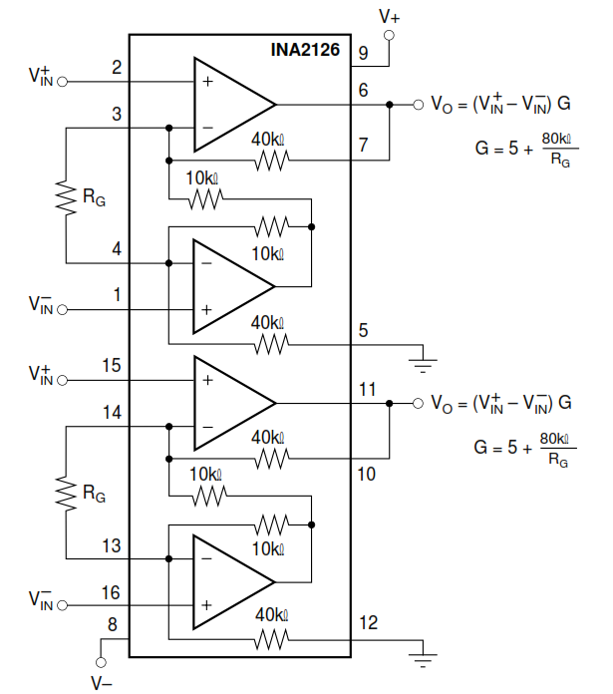
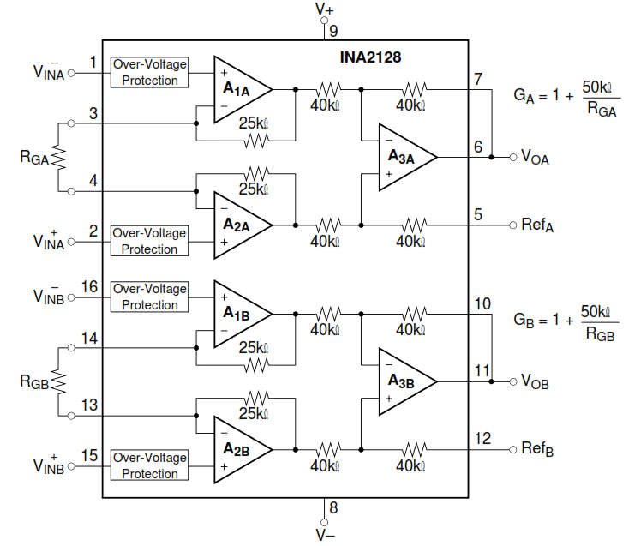
New Choice of Instrumentation Amplifier
Three amp design allows for more control over DC gain.
Old InAmp
New InAmp

Slide 24
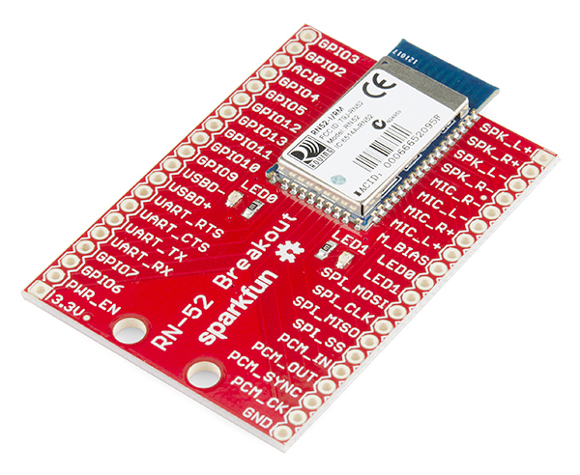
Design Changes: Bluetooth
Additional audio processing on the receiver end of the design (vehicle speaker) to receive audio packets increases cost of product.
BlueSMiRF Gold Bluetooth Module:
A2DP audio protocol not supported.
Cannot send audio data.
RN-52 Bluetooth Module:
Audio protocol supported but cannot initiate communication.
Cannot be master.
Circuitry

Slide 25
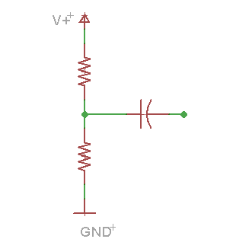

Slide 26
EMG Digital Processing
EMG signals acquired using surface electrodes are composite of muscle fiber action potentials occurring at random intervals. Frequency spectrum of EMG signals are obtained in order to characterize the EMG signals for different gestures.
-Perform Frequency Domain Analysis on sine wave input from function generator.
-Select sampling frequency (samples/second) based on the total number of samples collected over 2.5 seconds.
-Calculate and plot N point Discrete Fourier Transform of the signal by performing Fast Fourier Transform and thereby obtaining the frequency spectrum of the signal. FFT reduces computation by hundreds.
-Extract characteristic features of the signal from frequency spectrum, such as mean amplitude, number of zero crossings in time domain, root mean square of amplitude and mod frequency (frequency of spectrum’s highest peak point).
-Noise filtering using FIR band pass filter and averaging with moving window.

