Slide 1
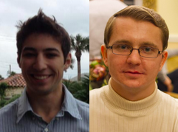
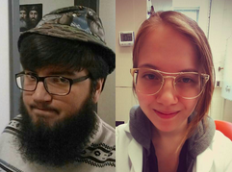

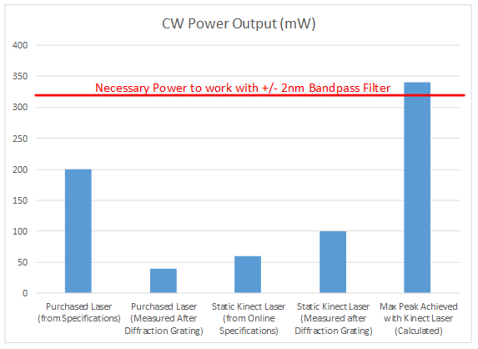
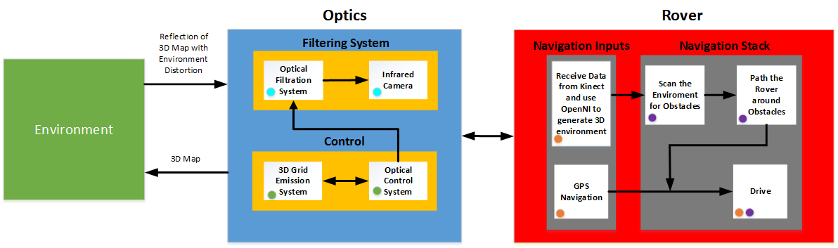
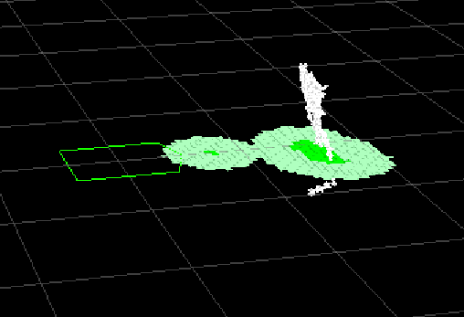
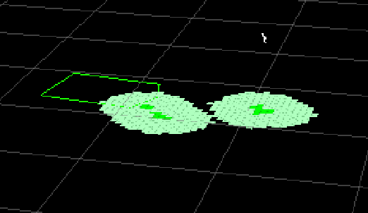
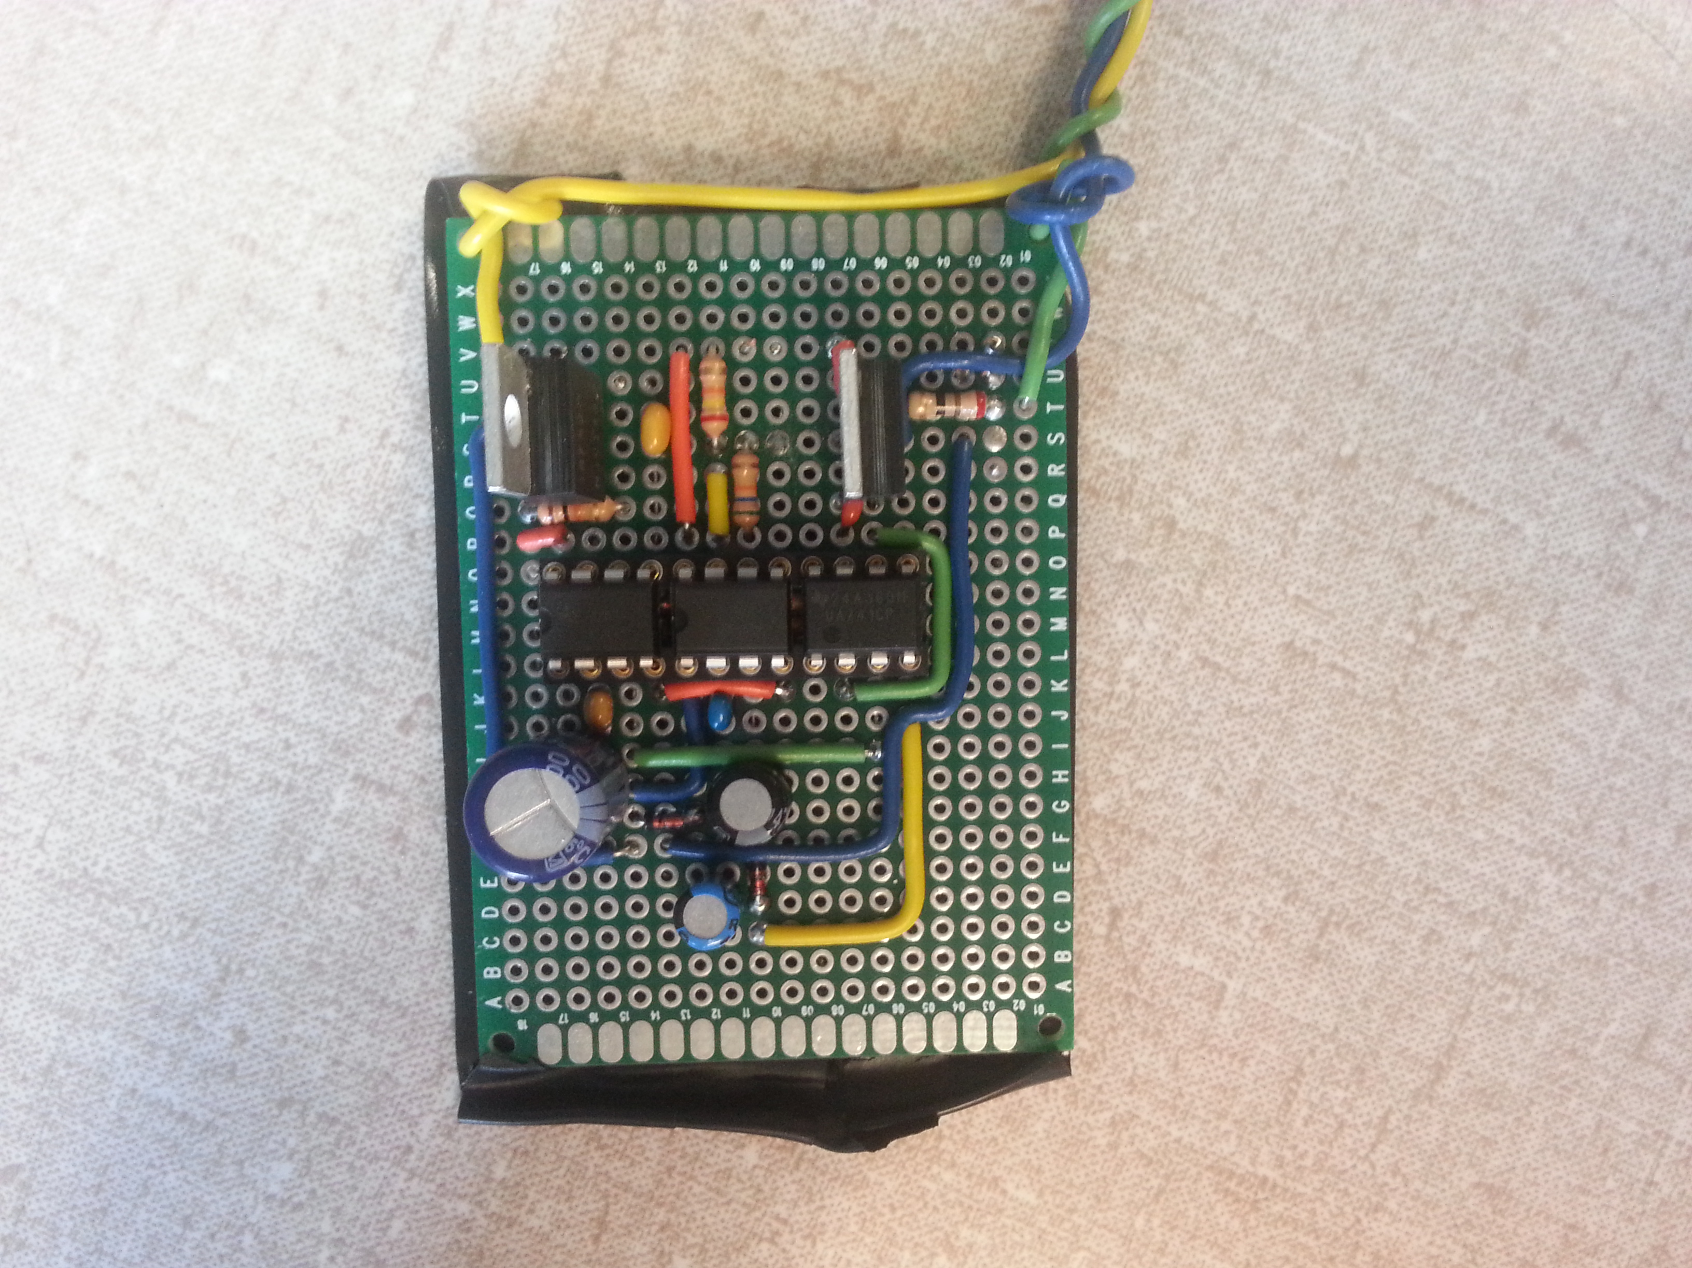
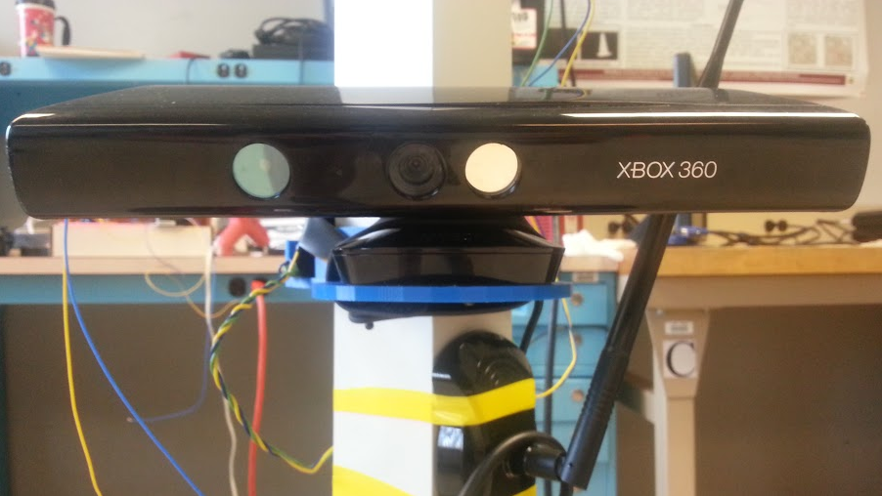
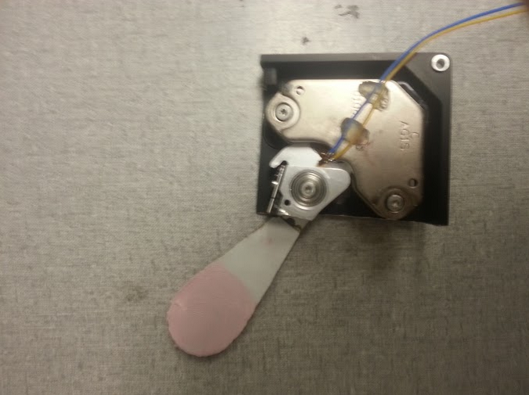
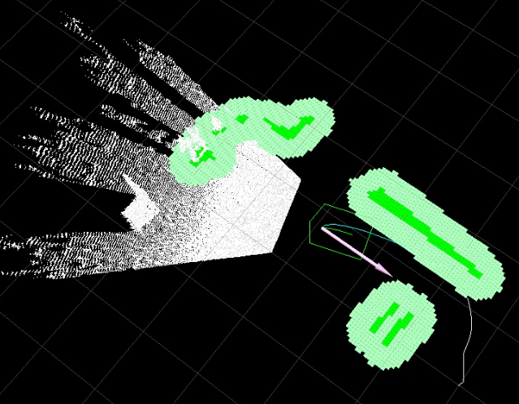
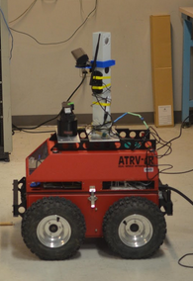

LESS: Low-Cost 3D Environment Sensing System
Gabriela Calinao Correa, Alexander Maerko, Alexander Montes McNeil, Timothy Tufts
Faculty Advisor: Prof. Mario Parente
Abstract
Operating In Direct Sunlight
LESS (Low-Cost 3-D Environment Sensing System) brings the convenient and affordable Microsoft Kinect 360 sensor from the living room to the backyard. Many hobbyists already use the Kinect sensor for their projects, but they are limited to indoor use because of the sun's interference on the sensor. Our system design employs inexpensive optical filtration methods in order to solve the problem of the sun on an off-the-shelf Kinect, while keeping our costs low enough for a hobbyist. To showcase the abilities of the LESS unit, we implemented outside obstacle detection and avoidance for the Microwave Remote Sensing Lab's (MIRSL) rover.
The Kinect uses two approaches to overcome the interference of direct sunlight.
By decreasing the spectrum of the sun with a bandpass filter, the total power of the sun observed by the camera is reduced
Then by increasing the instantaneous power of the laser diode it becomes stronger than the power of the sun in that part of the spectrum
Block Diagram
Observed power from the sun using varying bandpass filters
Power of different lasers on the Kinect 360. The rightmost meets the conditions for outdoor use
Results
The LESS has the ability to visualize objects outside in direct sunlight where the Kinect 360 cannot.
The ATRV-JR can successfully detect and avoid obstacles outside in direct sunlight.
Estimated retail cost of $300.
Modifying the Kinect laser freezes OpenNi 3D generation software after a short period of time.
System Overview
The Kinect 360 operates by projecting and sensing a map of points on the environment within its field of view.
However it is limited to indoor use because its laser diode operates in the same area of the EM spectrum where the sun is close to its peak power emission. The LESS solves this problem of interference by increasing the instantaneous power of the laser diode through a pulsing circuit and decreasing the amount of total power observed from the sun through a shutter and band pass filter.
Specifications
Field of View | Goal | Unmodified | Modified
Min Range | .55 m | .47 m | .52 m
Max Range | 2.5 m | 4 m | 3 m
Height | 1.07 m | .87 m | .84 m
Width | .65 m | 1.31 m | .8 m
Pulsing Circuit:
400 mW peak
at a 25% duty cycle
Bandpass Filter:
+/- 2 nm
Shutter:
IR Reflective Material
Our system is designed to run off of a 12 V 35 Ah car battery with tolerance for ~+/- 2 V
The rover system is comprised of two separate computers: one that drives the rover and one that steers.
The computer that drives is proprietary to the company that made the rover and we are able to interface with it through well established drivers.
The computer that steers the rover was (re)assembled by us and runs the popular Robot Operating System (ROS) such that we are in the position of a typical hobbyist.
Once installed, we just had to configure the sensor within ROS and tune according to our modified Kinect.
Shown to the right are an example of the rover navigation software in action as well as our final sensor configuration on the rover’s tower.
Acknowledgements
We would like to thank MIRSL, SDP14 Team AIR, Keval Patel, and Fran Caron. We would like to also thank Professors Jun Yan, William Leonard, Christopher Salthouse, Robert Jackson and Christopher Hollot. Most of all, we would like to thank our fearless advisor Professor Mario Parente.
Department of Electrical and Computer Engineering
ECE 415/ECE 416 – SENIOR DESIGN PROJECT 2015
College of Engineering - University of Massachusetts Amherst
SDP15

Slide 2
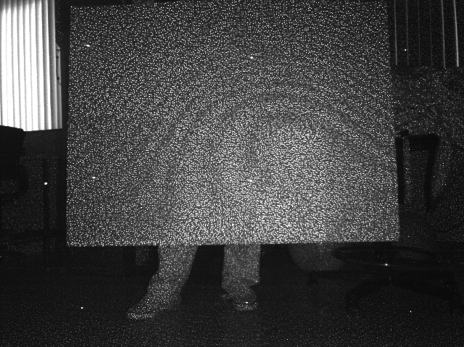
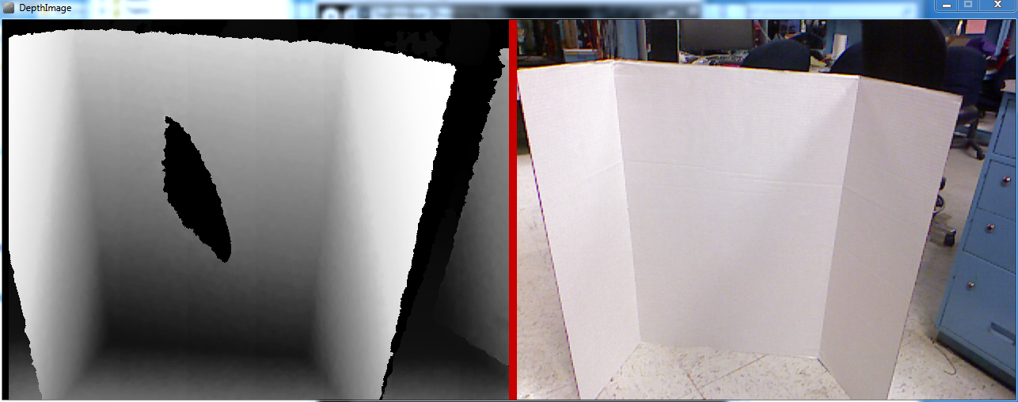
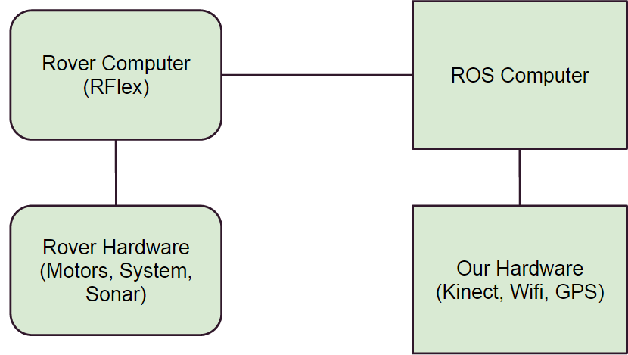
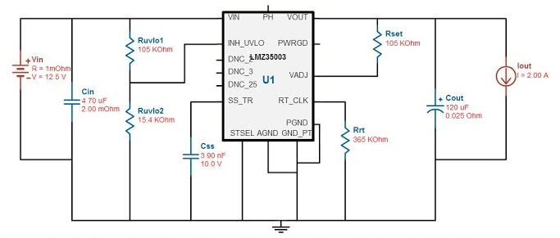
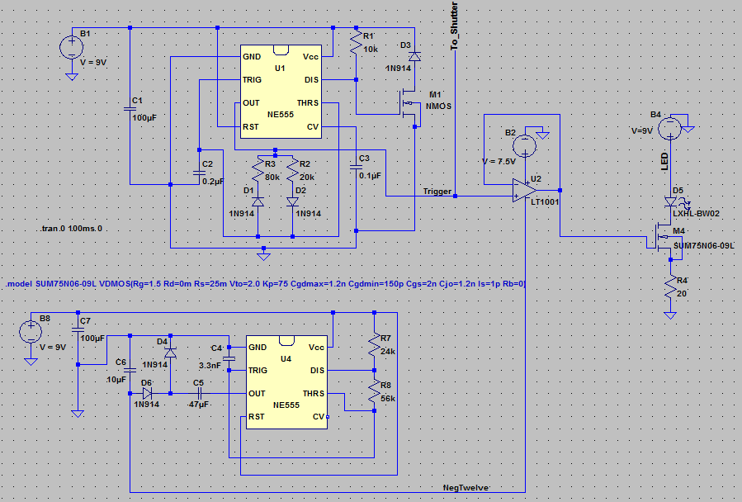
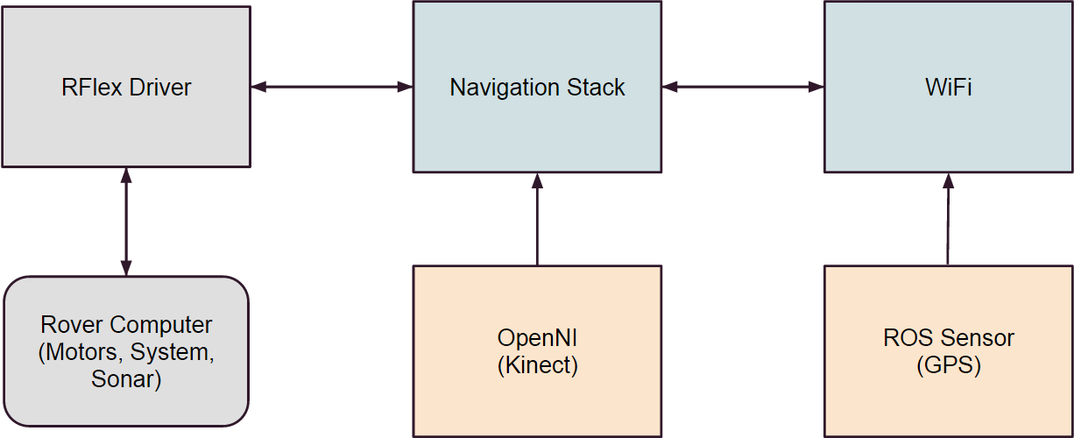
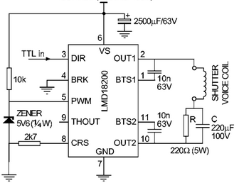
Kinect 360 Environment Generation
Kinect Experimentation
The very dedicated Kinect hacker community does not fully understand why the Kinect does not work outside. Instead of taking on this task, we decided to determine under what conditions it fails and to design our modifications around that. Shown below is our experiment using a second laser diode to determine the intensity at which the Kinect 360 can no longer preform.
The Kinect 360 senses the environment by projecting a pattern of points within its field of view. The pattern is non-symmetrical such that every possible 4x6 pixel subsection is unique. This pattern is then replicated 9 times in a rectangular grid. The Kinect 360 matches a pixel subsection on the environment against the same subsection at a known depth and analyzes the disparity. From this it can calculate physical distances and then generate a virtual 3D map of the environment.
We concluded that the 3D environment generation fails when the intensity of the second laser diode was approximately the same as the intensity measured at the output of the Kinect’s grid emission system. With this parameter we designed LESS to ensure this condition was never met outdoors.
Rover Hardware
Optic Control
The control circuitry for the optics has three main elements which are shown below.
In order to interface with the rover power supply, a 12V car battery, a power module was created. This power module accepts between 10.5 to 15V while supplying a steady 9.1V output and is shown below.
Proprietary Rover computer runs RFlex software to control all of the proprietary rover hardware.
Our assembled computer runs the robot operating system (ROS) with RFlex drivers.
ROS modules control all of the non-proprietary hardware
Due to old hardware, we had to completely rebuild the ROS computer from spare parts and also replace the car batteries that power the rover.
Rover Software
The design for the trigger which activates the laser and shutter is shown below. The final design uses a 400 mA peak through the laser forcing it to have a higher instantaneous intensity.
The shutter was inspired from the paper:
R. Scholten, 'Enhanced laser shutter using a hard disk drive rotary voice-coil actuator', Rev. Sci. Instrum., vol. 78, no. 2, p. 026101, 2007.
A collection of ROS modules known as the Navigation Stack controls the entire system of sensors and actuators
Sensors include RFlex driver that feeds out odometry info, the OpenNi package that reads the Kinect data, and the ROS Sensor that sends GPS information from an Android phone.
The only actuators are the motors that drive the rover which are controlled through the RFlex driver.
The Navigation Stack is capable of accepting GPS coordinates or keyboard commands.
All of this software runs on the ROS computer with some message passing through the RFlex drivers.
Cost
Development
Production
Part | Price
9x Kinect 360 | $ 135.00
Spare Lasers | $ 45.76
+/- 10nm Bandpass Filter | $ 34.50
+/- 2nm Bandpass Filter | $ 84.67
2x LMZ35003-EVM | $ 99.96
Total: | $ 399.89
Part | Price
Microsoft Kinect 360 | $ 15,000.00
+/-2 nm Bandpass Filter | $ 81,283.20
Hard Drive | $ 19,000.00
LMZ35003 | $ 10,282.50
LMD18200 | $ 9,112.50
NE555 | $ 230.00
Diodes | $ 777.00
Resistors | $ 30.29
Capacitors | $ 3,913.00
Production for 1000 Units: | $ 139,628.49

