Slide 1
Low-cost 3D
Environment
Sensing
System
Gabriela Calinao Correa
Electrical Engineering & Applied Mathematics
Timothy Robert Tufts
Computer Systems Engineering
Alexander Montes Mcneil
Electrical Engineering
Alexander Maerko
Electrical Engineering

Slide 2
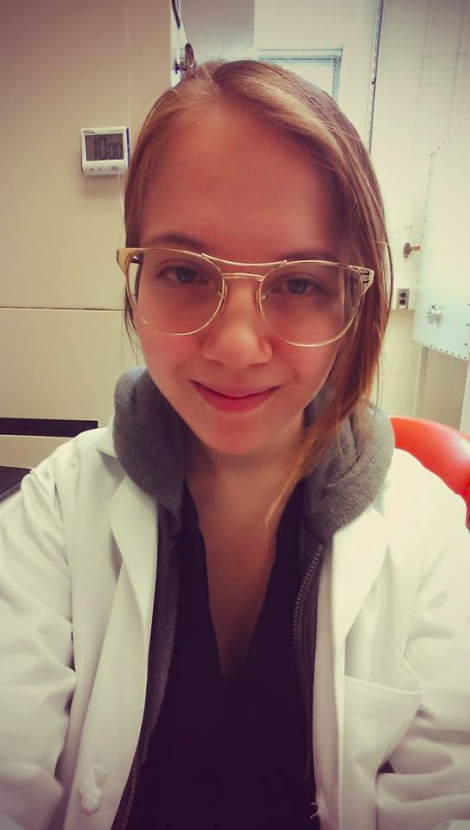
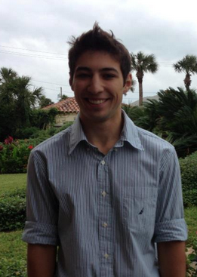
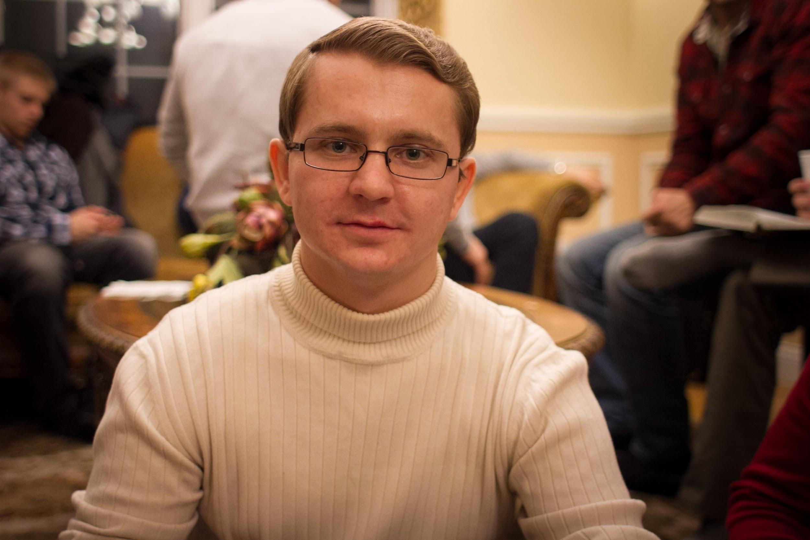
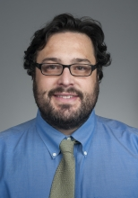
Team LESS
Timothy Robert Tufts
Computer Systems Engineering
Alexander Maerko
Electrical Engineering
Gabriela Calinao Correa
Electrical Engineering
Applied Mathematics
Alexander Montes McNeil
Electrical Engineering
Mario Parente
Advisor

Slide 3
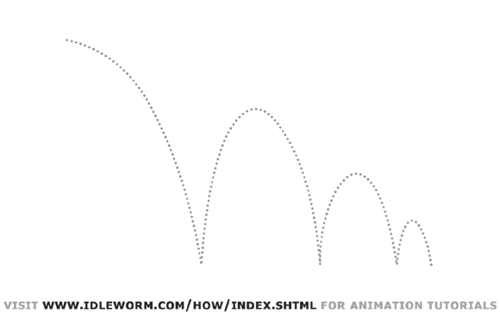
Background: Mars Rover
Obstacle Avoidance Attempted last year
Existing Sonar hardware was old and unreliable
We want to upgrade to a more powerful sensing system
Problems: Price and Outdoor Functionality
Tim
Notes:
For our SDP, we are continuing work on Professor Parente’s Mars Rover project.
Last year, Team AIR attempted obstacle D/A in their suite of additions, but the existing sonar was old and unreliable. They did however successfully add GPS Navigation and Object tracking with a stereoscopic camera.
The Mars Rover can now navigate to within 10 feet of a target and it was able to track a blue ball.
So this year, Parente has tasked us with building an Obstacle D/A system with new hardware. We have spent the semester so far investigating what type of sensing system we can use and decided that we want to switch to a light based system. This allows for high quality 3d sensing, while sonar would solely be detecting the presence of an obstacle so future groups will have more of an opportunity to do interesting projects. However, our two biggest constraints have turned out to be price and functionality in sunlight. We go more in depth on this issue when we analyze design alternatives, but this is important to the problem we are trying to solve.

Slide 4
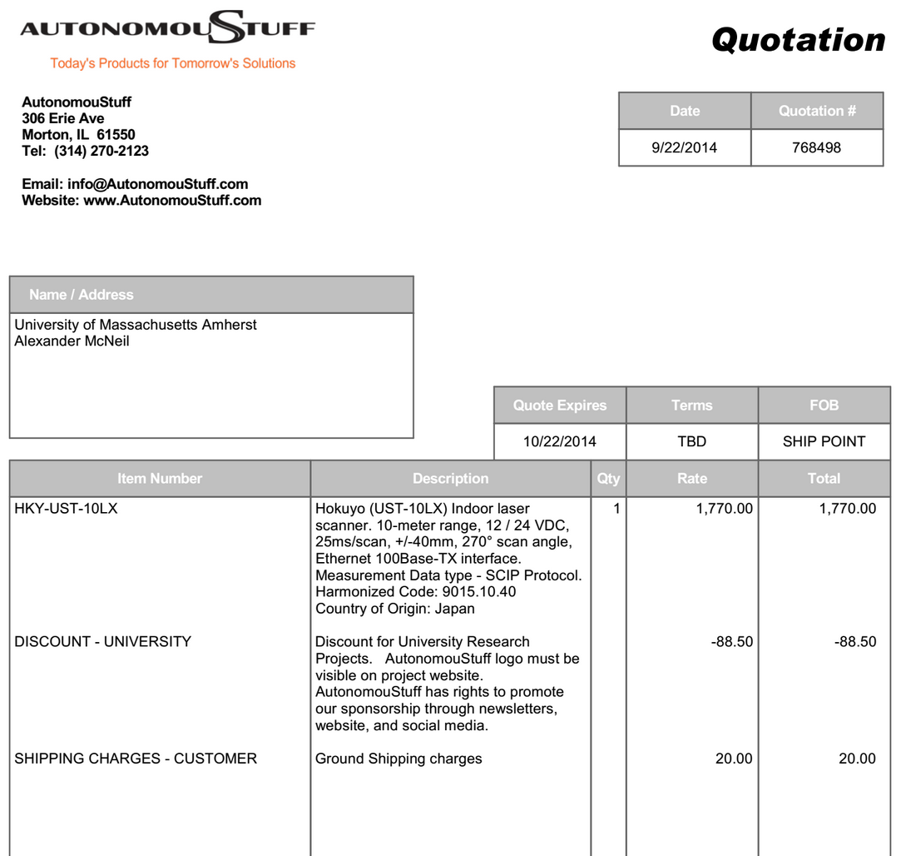
Problem
Light based sensor systems that work outside are
prohibitively expensive!
Tim
Notes:
We are in the same situation as a hobby roboticist, we need to sense the environment outside but we have a medium budget, and something like a 1.7k sensor is just too much, even with a University discount. And this sensor is just 2d, we would need to get some precision robotics to pan and tilt in order to get a 3d environment. If we wanted a standalone system we are looking at the very least 8k.
So we want to design a device that could be used by other people in this situation and we are going to show that it works by implementing it on the Mars Rover.

Slide 5
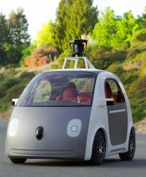
Significance
Emphasis on Autonomy in Society
Popularity of ‘Hackathon’ Culture
Serious Untapped Potential
Ela
Notes:
http://www.wired.com/2012/02/ff_hackathons/all/1#slideid-474920
http://recode.net/2014/05/27/googles-new-self-driving-car-ditches-the-steering-wheel/
http://www.globalrobots.com/guide.aspx
GOOGLE CAR
AMAZON WAREHOUSE
HACKATHONS

Slide 6
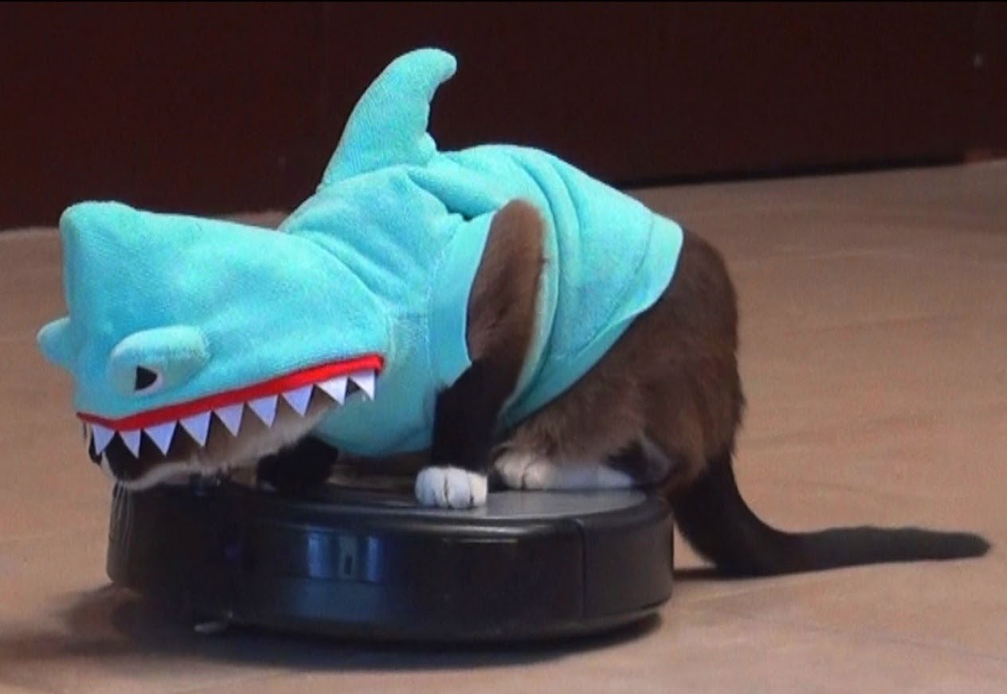
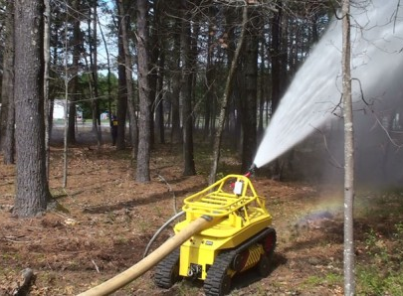
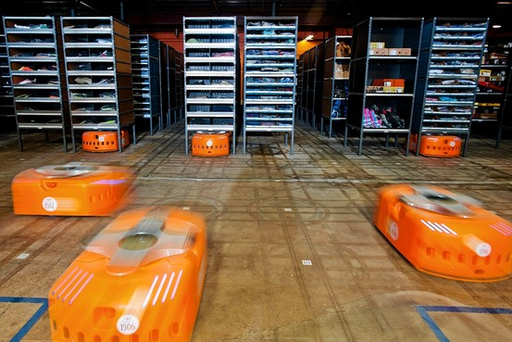
Context
Society:
Availability of Autonomous Devices
Individuals:
Hackers & Hobbyists
Pizza Delivery Bot
Firefighting Robots
iRobot Roomba®
Ela
Notes:
http://hackingroomba.com/

Slide 7
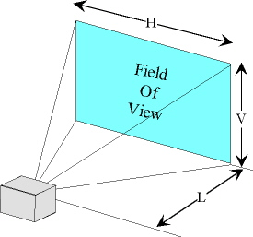
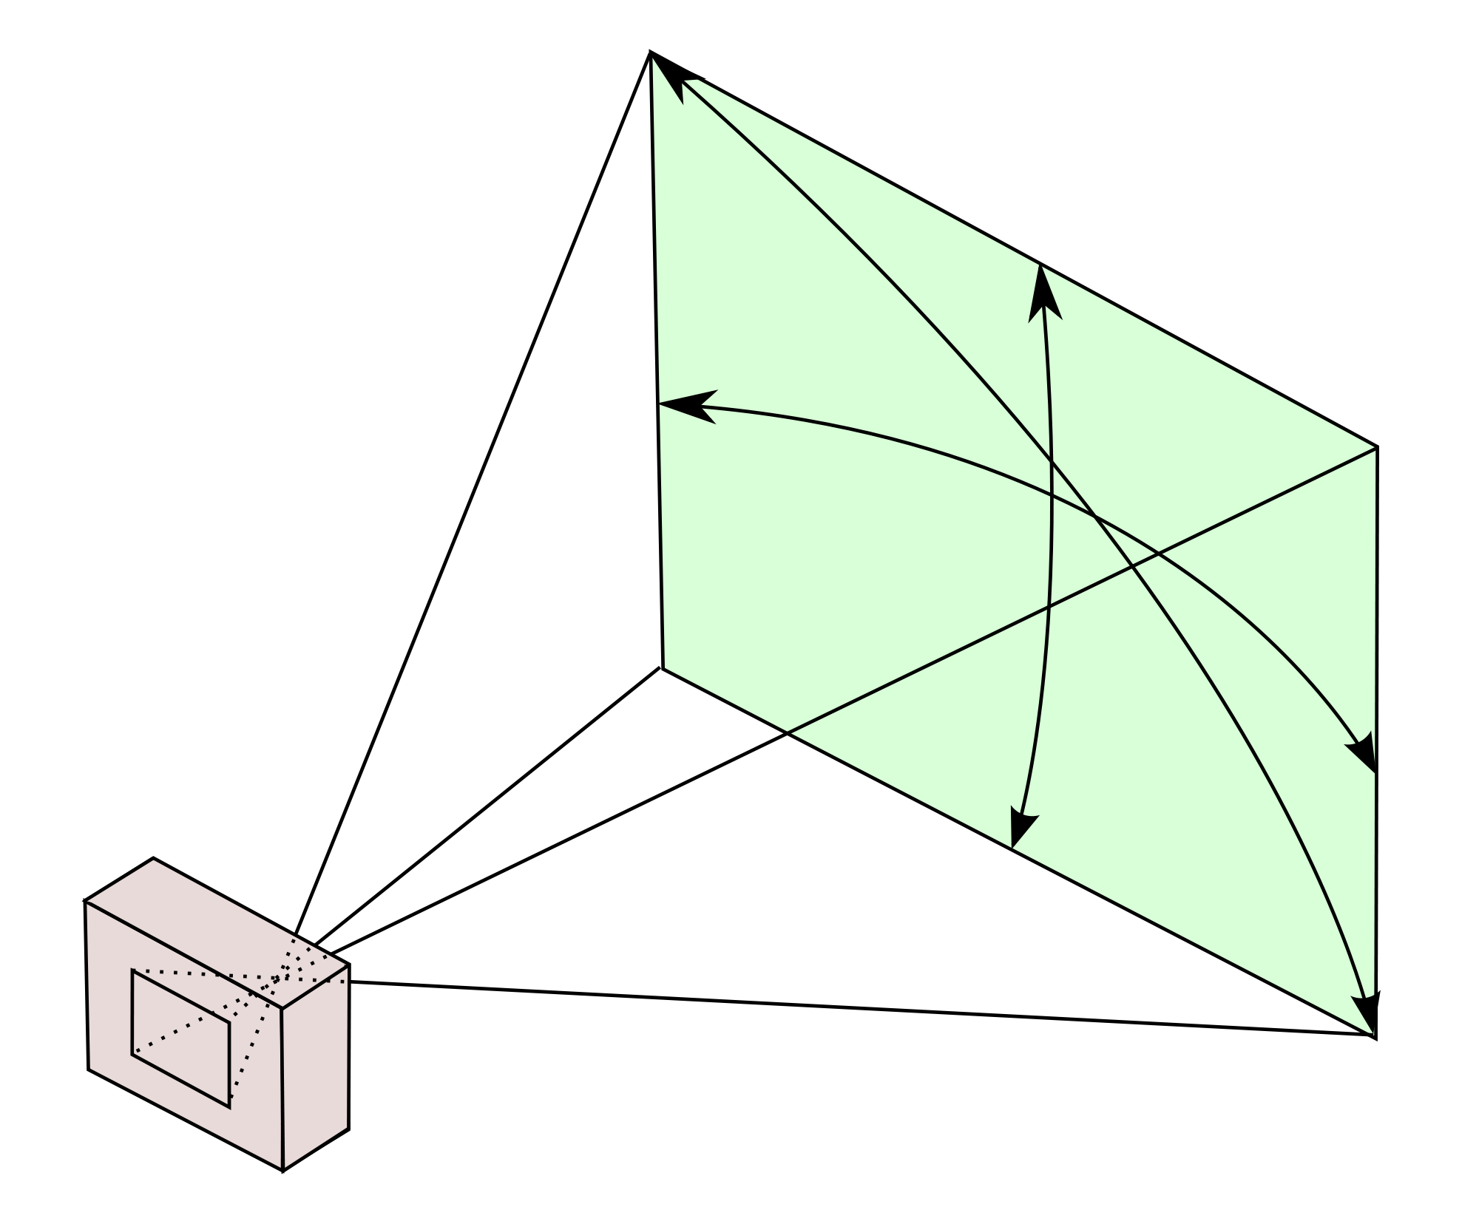
System Requirements
Optically Sense External Environment
L_{min} ≤ 0.5 m Θ_{H} ≥ 45°
L_{max} ≥ 4.0 m Θ_{V} ≥ 58°
Output real time 3D frames
Usable speed at least 1 m/s
Pixel value = Depth value
Cost under $500
Work in Full Sunlight
Ela
Notes:
Real time sensing of external environment
Output data in 3D grid/cloud of points format
MUST WORK IN SUNLIGHT, previous things do not work outdoors
Take FOV info from Optics subblock and we need to decide on a range and speed. (Looks like they have it go at .2 m/s) -T
Depth is distance to nearest object. Similar format as kinect, good for other people to use/

Slide 8
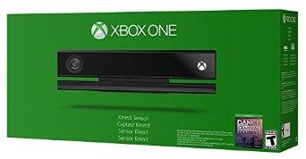
Design Alternatives
Lidar and Range Finder (sunlight)
Illuminates a target with a laser
Analyzes the reflected light by taking Phase Difference
Ultrasonic Systems (sunlight)
Ultrasonic Transducers for Marine Electronics & Sonar
Tesla
Kinect (Perfect cost - $150)
Doesn't work in direct sunlight
Alex

Slide 9
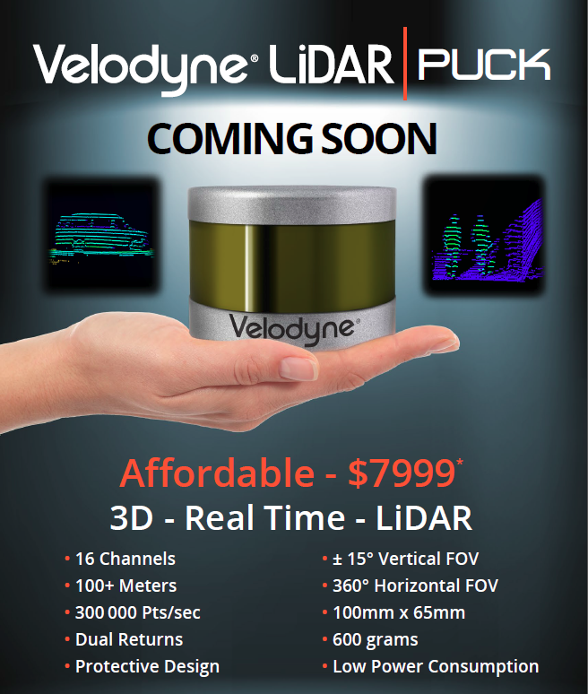
LIDAR Explained
Lidar is a general term but all forms of lidar involve sending light and analyzing some aspect of the return signal
The simplest LIDAR measures distance
Analyzes the time it takes for a light signal to leave and return to the unit
Operates in between the UV and Infrared spectrum of EM waves
Alex
Notes:
http://wwwnew.cs.princeton.edu/courses/archive/spring11/cos598A/pdfs/Himmelsbach08.pdf
How does lidar work in the sun: With such a broad term there are a broad range of solutions
Ex. lidar speed gun has a band pass filter of (+/-5 nm; 899 nm-909 nm)

Slide 10
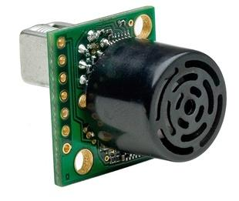
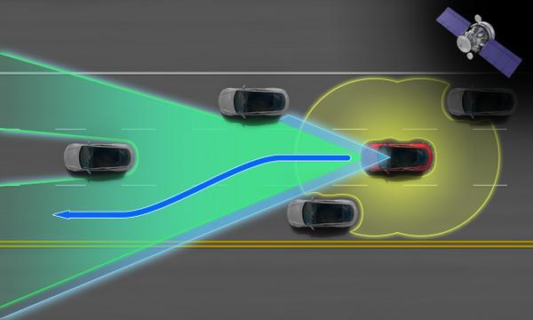
Ultrasonic Systems
$40
Alex
Notes:
Tesla system employs an array of different systems, including forward-looking radar, a camera with image recognition, as well as 360 degree sonar.
http://store.3drobotics.com/products/MB1240-XL-MaxSonar-EZ4
Ultrasonic - higher frequency and therefore can be used above ground and not precise on a 3D level.

Slide 11
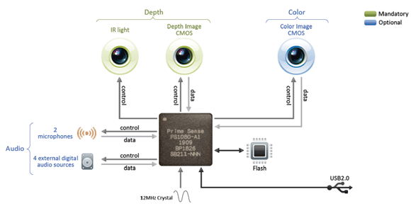
Kinect
Alex

Slide 12
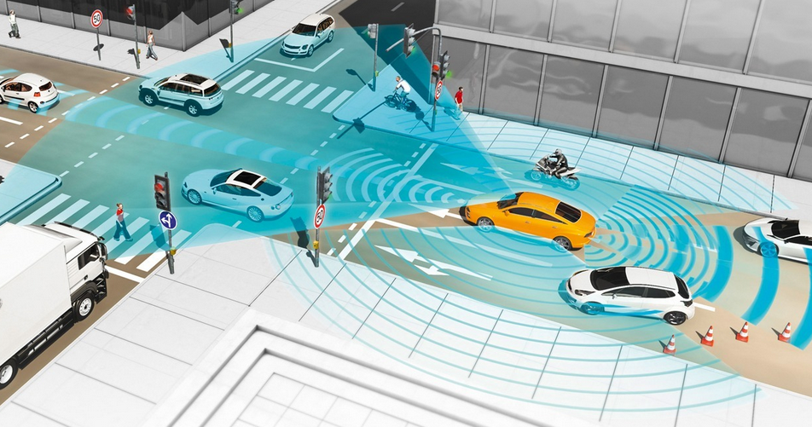
LESS Solution
The LESS brings a low cost 3D environment mapping system to your backyard
Design a system of optical improvements to filter out the suns interference with the system
Use a microcontroller to create a 3D depth chart of the environment and export in a familiar format
Alex
Notes:
The Kinect brings a low cost 3D environment mapping system to your living room
After that it works very similar to the Kinect, using it’s microcontroller to assemble a virtual 3D environment and export it to another system
The LESS will be tested on the Mars Rover and used for Object detection and avoidance while using it’s GPS navigation system

Slide 13
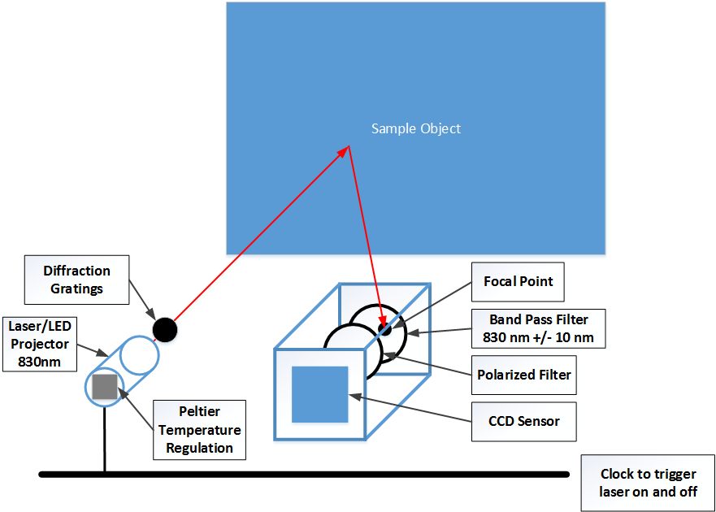
Sunlight Solution
Pulsed, Polarized Laser
Band Pass Filter
Polarized Lens
Normalizing
Alex
Notes:
Polarization
→ Reduces Solar Glare
Filtration
→ Removes irrelevant wavelengths
Pulsing of Laser
→ Higher instantaneous power
Normalizing the Sun’s Interference
→ Digitally removing the baseline noise of the system

Slide 14
Block Diagram
Alex

Slide 15
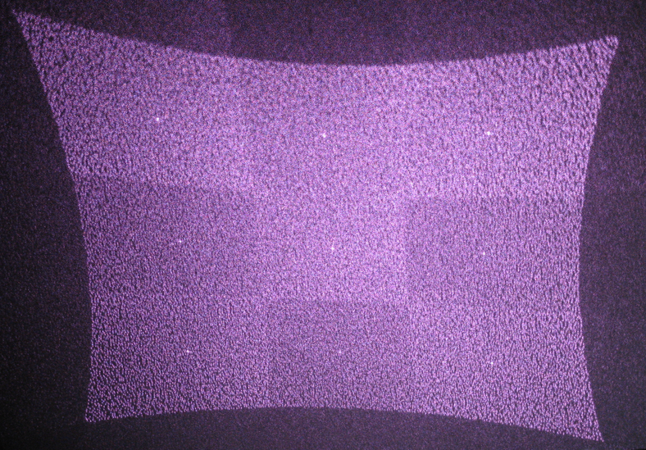
Subblock: Optics
Requirements:
Laser
PrimeSense Diffraction Grating
Reduce Interference by 90%
λ = 830 nm
T = constant ± 3°C
Depth Sensor
1200x960 pixels
30 FPS
Alex

Slide 16
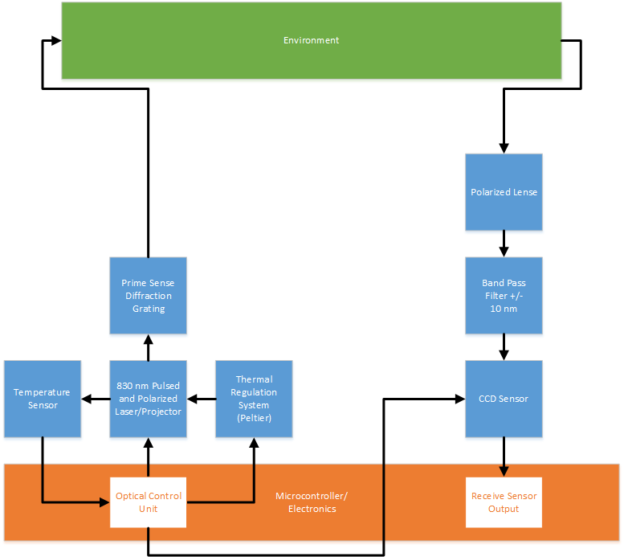
Alex

Slide 17
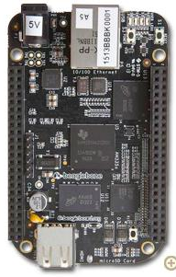
Subblock: Microcontroller/Electronics
Requirements:
Control Optics
Laser Pulsing, Temperature Sensor
BeagleBone Black (~$60)
512MB DDR3 RAM
4GB 8-bit eMMC on-board flash storage
3D graphics accelerator
NEON floating-point accelerator
2x PRU 32-bit microcontrollers
Alex
Notes:
http://beagleboard.org/black
Peltier Module controls temperature.
Parallel processing
Single depth frame is about 2MB, so even if we were to push 15 FPS, we are still within USB cable capacity.

Slide 18
Subblock: Data Processing
Requirements:
Input raw Optical Data
Filter Noise from Optical Data
Parallel Processing of Frames
Latency of ≤ 1 s
Throughput of 3 FPS
Output information for 3D mapping
Depth Frame
Ela
Notes:
powervr sgx530 GPU uses openGL

Slide 19
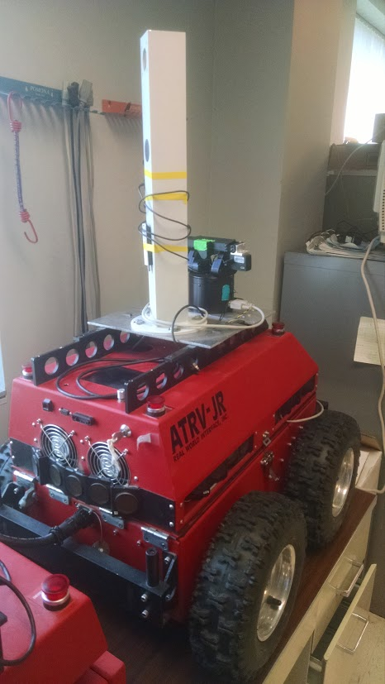
Subblock: Rover
Requirements:
Navigate to a Target Location
Within 10 feet (~3 meters)
Interface with the LESS unit
Detect and Avoid Obstacles
Range of 0.5 to 4 meters
Minimal Cost to Travel Speed
Travel at 0.2 m/s
Tim
Notes:
The Rover is almost like a mini project itself. We are going to showcase the functionality of our LESS unit by integrating it into the existing Rover. We will use the GPS installed last year to navigate to within 10 feet of a target location. While on the way, the LESS unit will feed data to the Rover’s onboard computer and I will write software to find obstacles in this data and then path around them. The detection will function from .5 to 4 meters and allow for the rover to travel at it’s current speed of .2 m/s. This appears to be the speed used last year from documentation, but like we said earlier, we want to allow for functionality up to 1 m/s so future groups won’t be held back by our design. That means the processing of my software needs to keep up with the data transfer rate from the LESS unit.

Slide 20
MDR Deliverables
Complete Optical Unit Schematic
→ Address the following design problems:
Is there an aberration to be accounted for on the CCD Sensor?
How will Polarization effect the field of view?
Does a higher intensity affect the value of local maximum in the PrimeSense diffraction pattern?
Design Thermal Control System for Laser
Confirmation of Rover Functionality
Test Drive in the Engineering Quad
Stream test data from Microcontroller to Rover
Design Artificial Test Data for Processing Software
Tim
Notes:
We won’t have all of the optics hardware for the end of the semester, but we will complete the optical unit schematic by addressing design questions such as:
On the same vein, we will have a schematic for the Thermal Control System for the Laser.
We need to confirm the functionality of the Rover. This will be done with a test drive in the engineering quad and we will provide a video of this.
In order to ease the integration process later on, we are going to stream some test data from the microcontroller to the rover. That way when we need to send actual data, the process is already well defined.
To allow for parallel design of software and hardware, we need to create a set of artificial test data for use in software development

Slide 21
Acknowledgements
Professor Jun Yan, UMass Physics Dept.
Professor Leonard
Professor Parente and MIRSL
SDP14 Team AIR
Notes:
Come up with a list of optical requirements and plan to solve them
note: polarizer correlation to field of view
aboration correction in the kinect
power and diffraction
June Yan and the UMass Physics Dept for help with the optics design
Professor Leonard for help with optics feasibility
Professor Parente and Microwave Remote Sensing Lab for donating the Rover and the Lab space
SDP14 Team AIR for their improvements made to the Rover

Slide 22
Notes:
http://blog.supermedia.com/media/questions.jpg

Slide 23
Sonar/Ultrasonic Systems Explained
Active sonar emits a sound and analyzes the echo of that sound
Mainly used underwater
Ultrasonic sensor systems uses the same method but at a much higher frequency
This makes it more suitable for use in the atmosphere

Slide 24
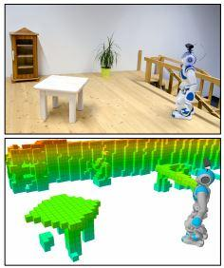
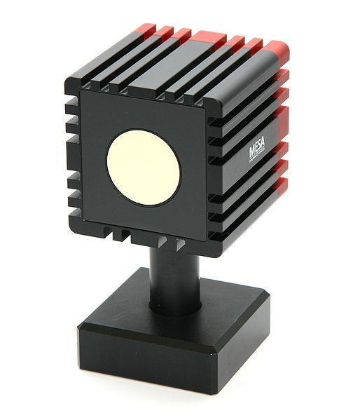
Design Alternatives
Real-Time Navigation in 3D Environments Based in Depth Camera Data
The Mesa Imaging SwissRanger 4000 (SR4000) is probably the most well-known ToF depth camera. It has a range of 5-8 meters, 176 x 144 pixel resolution over 43.6° x 34.6° field of view. It operates at up to 54 fps, and costs about $9,000. I've seen these used in a number of academic laboratories.
Alex

Slide 25
Outline
Background
Problem
Significance
Context
System Requirements
Design Alternatives
Block Diagram
MDR Deliverables
Acknowledgements/Citations
Questions
Ela

Slide 26
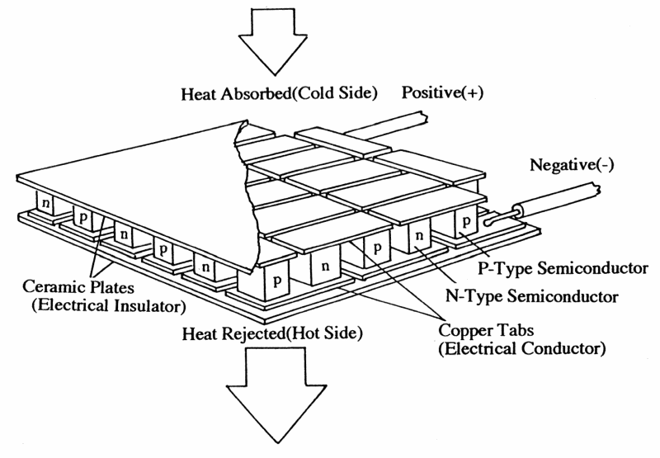
Stubs of faces for slides
Tim
Ela
Alex
Alex

Slide 27
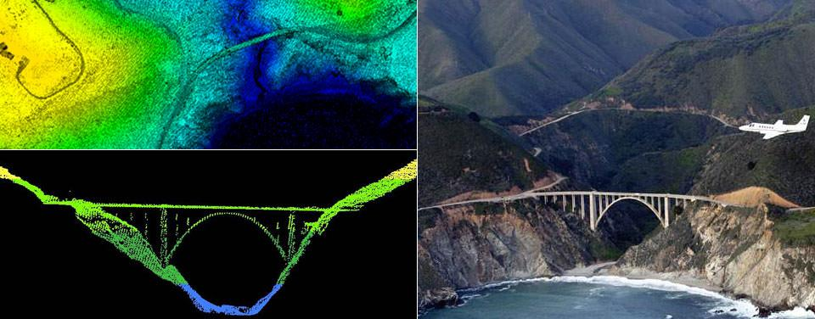
LIDAR
Alex
Notes:
LIDAR—Light Detection and Ranging—is a remote sensing method used to examine the surface of the Earth
LIDAR, which stands for Light Detection and Ranging, is a remote sensing method that uses light in the form of a pulsed laser to measure ranges (variable distances) to the Earth. These light pulses—combined with other data recorded by the airborne system— generate precise, three-dimensional information about the shape of the Earth and its surface characteristics.
A LIDAR instrument principally consists of a laser, a scanner, and a specialized GPS receiver. Airplanes and helicopters are the most commonly used platforms for acquiring LIDAR data over broad areas.

Slide 28
