Slide 1
Low-cost 3D
Environment
Sensing
System
Gabriela Calinao Correa
Electrical Engineering & Applied Mathematics
Timothy Robert Tufts
Computer Systems Engineering
Alexander Montes Mcneil
Electrical Engineering
Alexander Maerko
Electrical Engineering

Slide 2
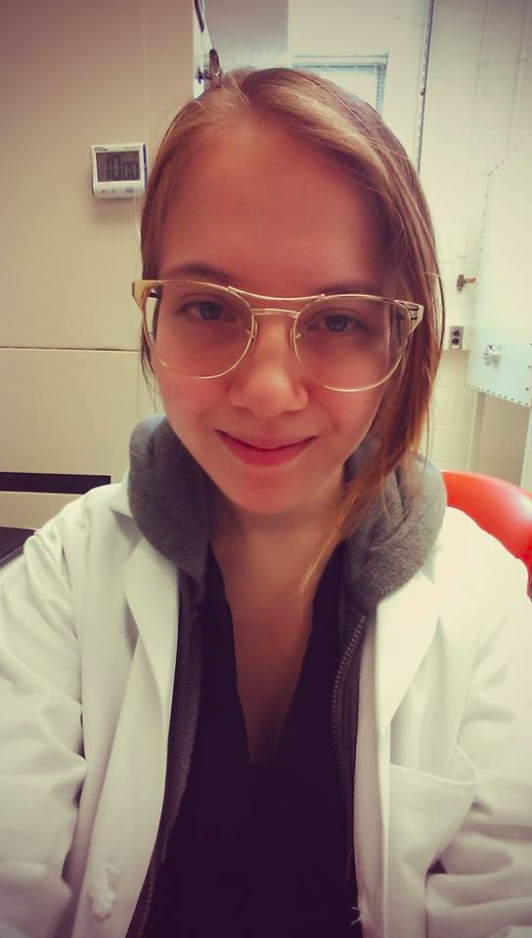
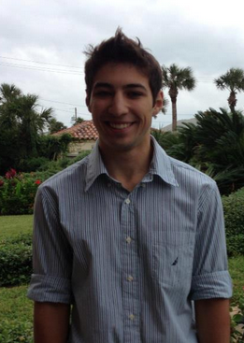
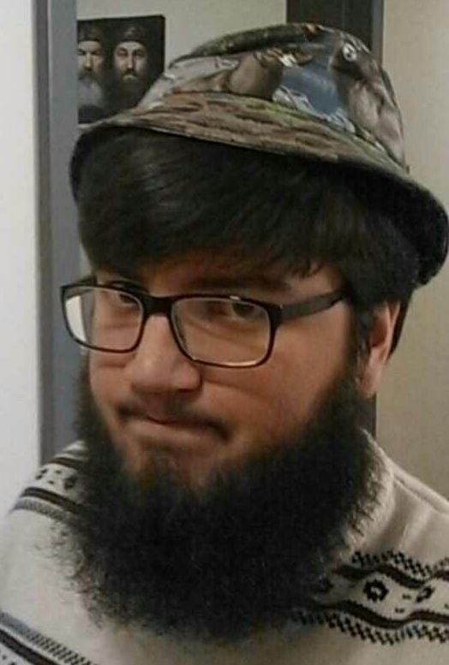
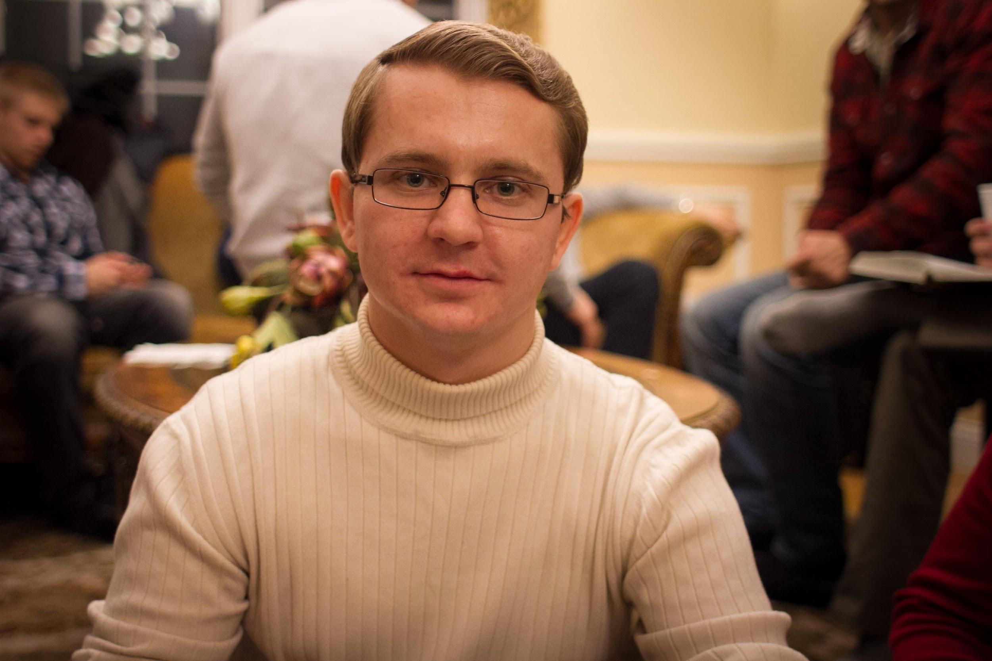
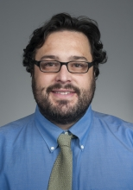
Team LESS
Timothy Robert Tufts
Computer Systems Engineering
Alexander Maerko
Electrical Engineering
Gabriela Calinao Correa
Electrical Engineering
Applied Mathematics
Alexander Montes McNeil
Electrical Engineering
Mario Parente
Advisor

Slide 3
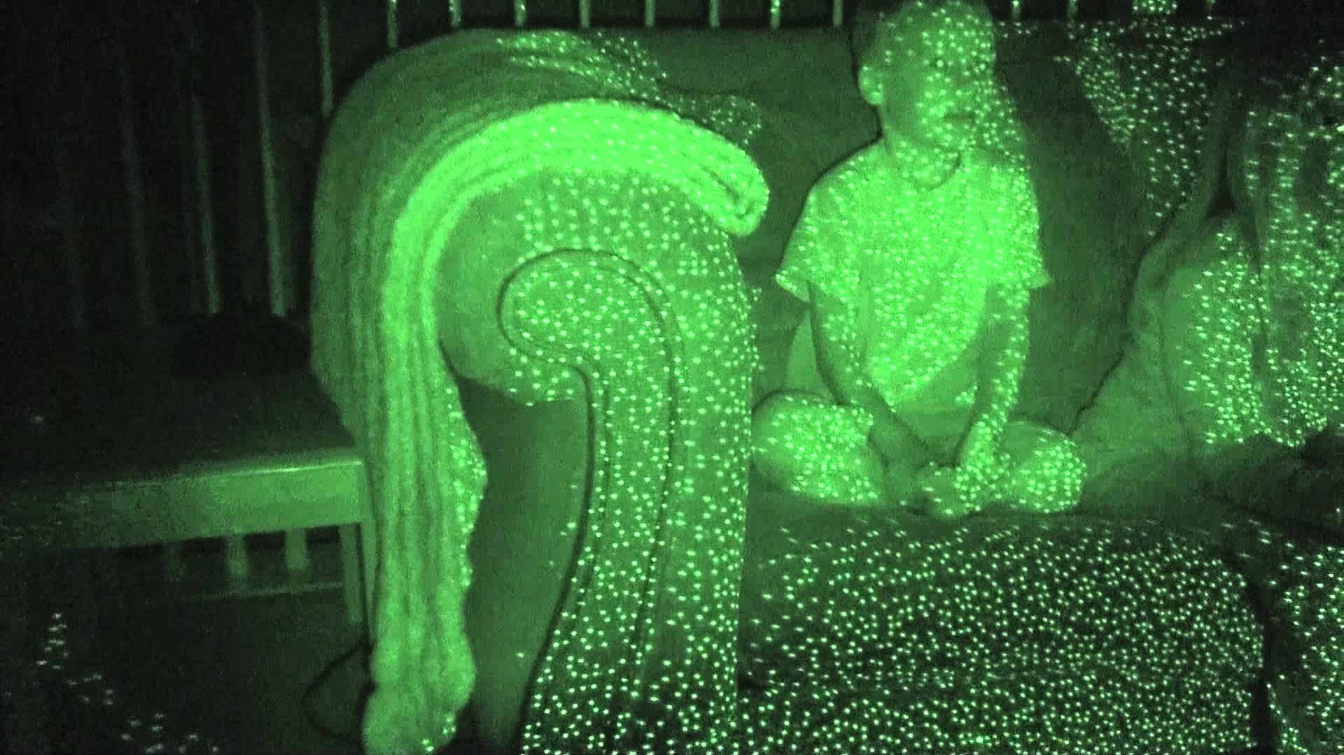
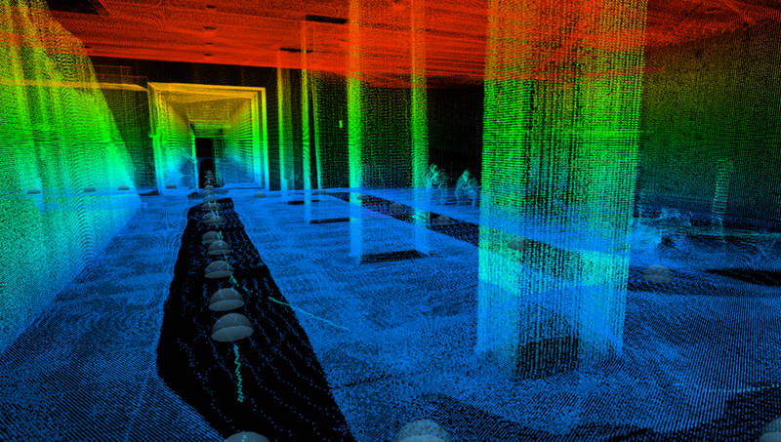
What is the Problem?
Technology for Outdoor 3D Mapping
Unaffordable
Affordable technologies work indoors
Remove Sun Interference
Ela

Slide 4
PDR to MDR
Reduced the scope of our project
Redesigned MDR goals
Split into two subteams
Aimed to provide more concrete deliverables
Tim
Notes:
After our PDR we got together and redesigned our project heavily with your feedback in mind. First of all, we reduced the scope of our project by cutting out the microcontroller. While the original goal was to provide a modular hardware component for hobbyists, we are now aiming to modify our Kinect so it can be used as if it were an off-the-shelf Kinect which we think is just as good considering the community of hobbyists that already use Kinects. This change reduces the amount of hardware in our system and frankly reduces the risk of something going wrong. It saves on our budget so we can buy better optical parts and allows us to focus on the more interesting challenges of the project.
We also took Professor Irwin’s advice and redesigned our MDR goals to take some of the pressure off of the Spring semester. We split into two subteams, Alex and Alex working with the Kinect optics and Ela and I working on the rover functionality. The Kinect subteam was aiming to design and start to build the modified Kinect for use outdoors. The Rover subteam was aiming to get the gps system up and running, and to get indoor obstacle detection and avoidance with the Kinect working.
So with our motivation in mind, Alex will present the technical changes we made to overall design.

Slide 5
New MDR Goals
Kinect Team:
New Laser Design
Characterize the capabilities of the Kinects 3D environment building
Design an optical filtration system which allows for the Kinect to work outside
Rover Team:
GPS system functioning
Indoor Obstacle Avoidance with Kinect
Alex
Tim
Notes:
After our PDR we got together and redesigned our project heavily with your feedback in mind. First of all, we reduced the scope of our project by cutting out the microcontroller. While the original goal was to provide a modular hardware component for hobbyists, we are now aiming to modify our Kinect so it can be used as if it were an off-the-shelf Kinect which we think is just as good considering the community of hobbyists that already use Kinects. This change reduces the amount of hardware in our system and frankly reduces the risk of something going wrong. It saves on our budget so we can buy better optical parts and allows us to focus on the more interesting challenges of the project.
We also took Professor Irwin’s advice and redesigned our MDR goals to take some of the pressure off of the Spring semester. We split into two subteams, Alex and Alex working with the Kinect optics and Ela and I working on the rover functionality. The Kinect subteam was aiming to design and start to build the modified Kinect for use outdoors. The Rover subteam was aiming to get the gps system up and running, and to get indoor obstacle detection and avoidance with the Kinect working.
So with our motivation in mind, Alex will present the technical changes we made to overall design.

Slide 6
Original Block Diagram
Alex

Slide 7
New Block Diagram
Alex

Slide 8
System Requirements
Accept GPS destination coordinates
Travel to destination within 3m
Avoid obstacles with modified Kinect
Travel at 0.2 m/s
Detect Stationary Obstacles within 0.55 to 2.50m
Modified Kinect
80% Outdoor Accuracy
Measure by comparison with unmodified Kinect
Filters reduce depth calculation accuracy
Ela

Slide 9
Optical Filtration System
Design Goals:
Understand the Kinects 3D generation technique
Create a system that filters out the necessary amount of sunlight for the Kinect to function completely outdoors
Set the parameters which the replacement laser must meet
Current Progress:
Characterized the capabilities of the Kinects 3D generation
Set the parameters for the Kinect
Designed the preliminary optical filtration system
Alex
Notes:
Design goal of this system is to understand the Kinects

Slide 10
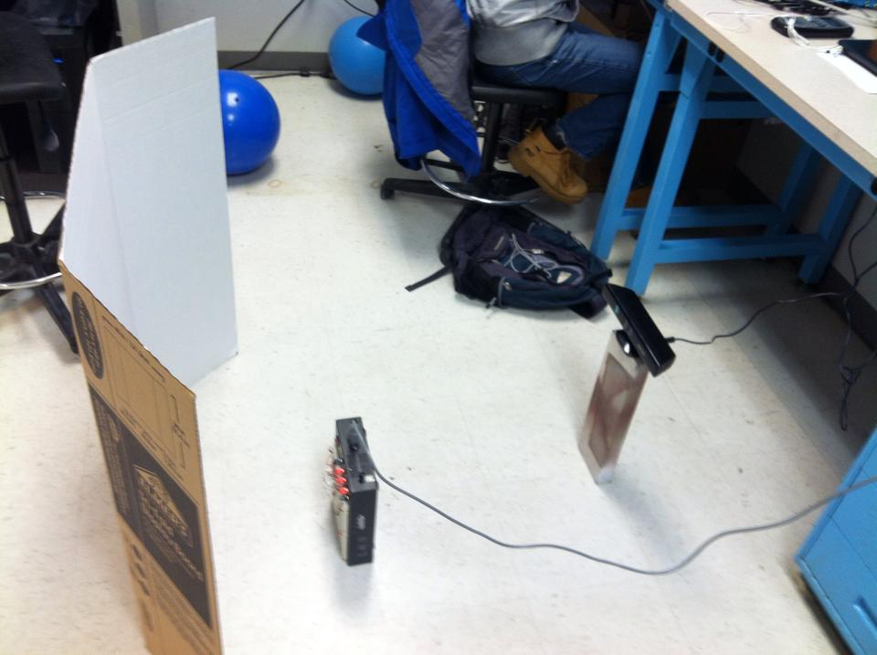
Demo: Optical Experiments
Test Infrared Camera
Emulate sun with IR source
Characterize the limits of Kinect’s 3D generation
IR → Depth Frame
Alex
Notes:
The optical experiments were designed to test the limit of the Kinect system and consisted of three steps.
Design and test a system that can match the intensity of the sun in outdoor use from the Kinect’s prospective.
Use the system find the amount of power that disrupts the Kinect’s 3D generation.

Slide 11
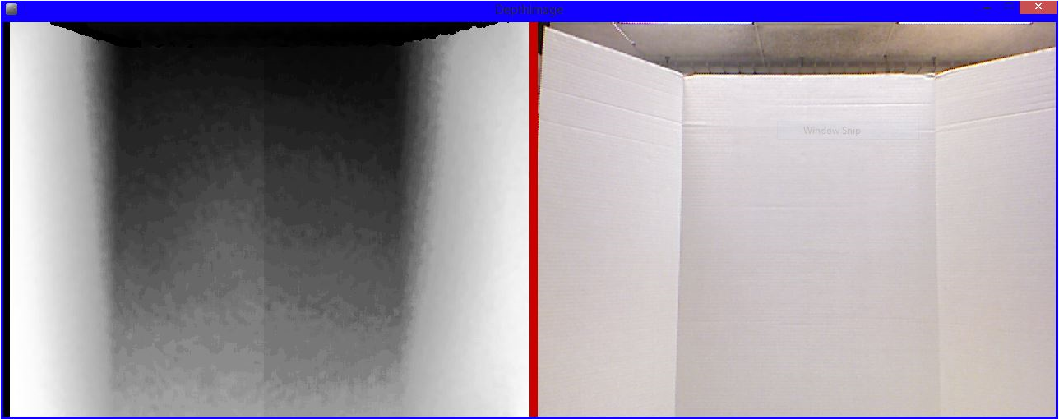
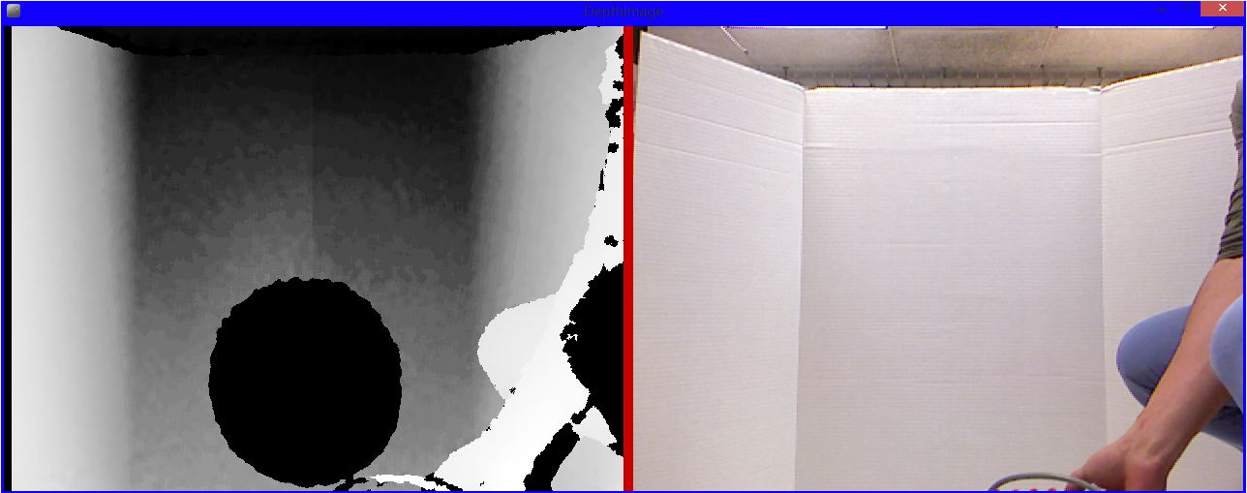
Demo: Characterize Kinect
Results:
The Kinect fails at 74 mW of power emitted from the Variable IR Source
Conclusion:
This is the slightly larger than the amount of power radiated from the Kinect
Alex
Notes:
Results:
The Kinect’s IR Camera records the maximum value for intensity in direct sunlight
The variable IR source can mimic this intensity
The Kinect fails at 73 mW of power emitted from the Variable IR Projector

Slide 12
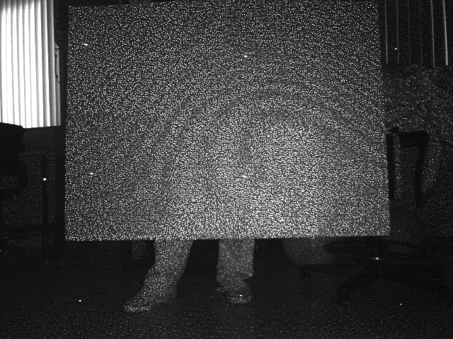
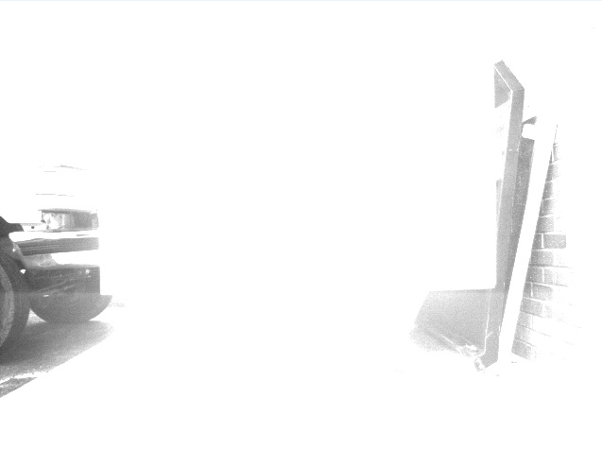
Demo: Characterize IR Camera
Kinect Indoors with IR Projector
Kinect outdoors in direct sunlight
Kinect Indoors without IR Projector
Kinect outdoors on a cloudy day
Alex
Notes:
White is the maximum value at 255

Slide 13
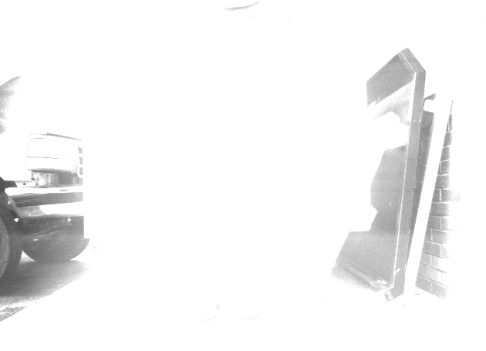
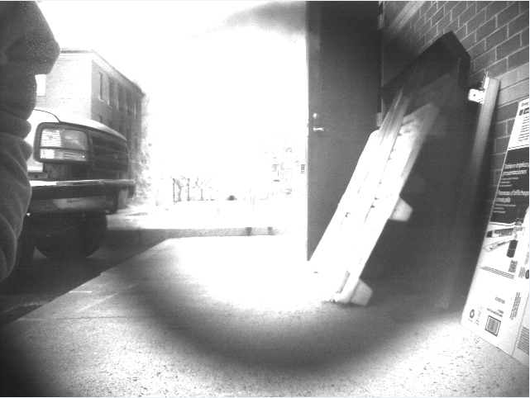
Demo: Band Pass Filter
Alex
Notes:
Held the Filter in front the Focal point of the Kinect

Slide 14
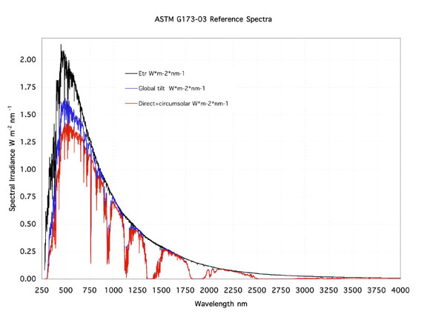
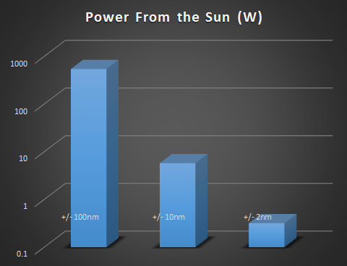
Requirements
The Kinect must function outdoors
3D Generation functions until 74 mWatts
The new optical system proposes 2 designs which combine the laser and filtering specifications to beat the power of the sun:
Using the +/- 10nm Bandpass filter and increasing the instantaneous power of the laser to 5.8 W
Using the +/- 2nm Bandpass filter and increasing the instantaneous power of the laser to 320 mW
Alex
Notes:
Aberations
Power spectral density of the sun, basically how is the suns light energy distributed through the vissible spectrum (the one we are interested in) we should get W/nm

Slide 15
Requirements
For the 80% Accuracy Calculation:
The Kinect calculates a disparity offset, focal length, lens center before starting 3D depth calculations
Alex
Notes:
For a normal stereo system, the cameras are calibrated so that the rectified images are parallel and have corresponding horizontal lines. In this case, the relationship between disparity and depth is given by:
z = b*f / d,
where z is the depth (in meters), b is the horizontal baseline between the cameras (in meters), f is the (common) focal length of the cameras (in pixels), and d is the disparity (in pixels). At zero disparity, the rays from each camera are parallel, and the depth is infinite. Larger values for the disparity mean shorter distances.
The Kinect returns a raw disparity that is not normalized in this way, that is, a zero Kinect disparity does not correspond to infinite distance. The Kinect disparity is related to a normalized disparity by the relation
d = 1/8 * (doff - kd),
where d is a normalized disparity, kd is the Kinect disparity, and doff is an offset value particular to a given Kinect device. The factor 1/8 appears because the values of kd are in 1/8 pixel units.

Slide 16
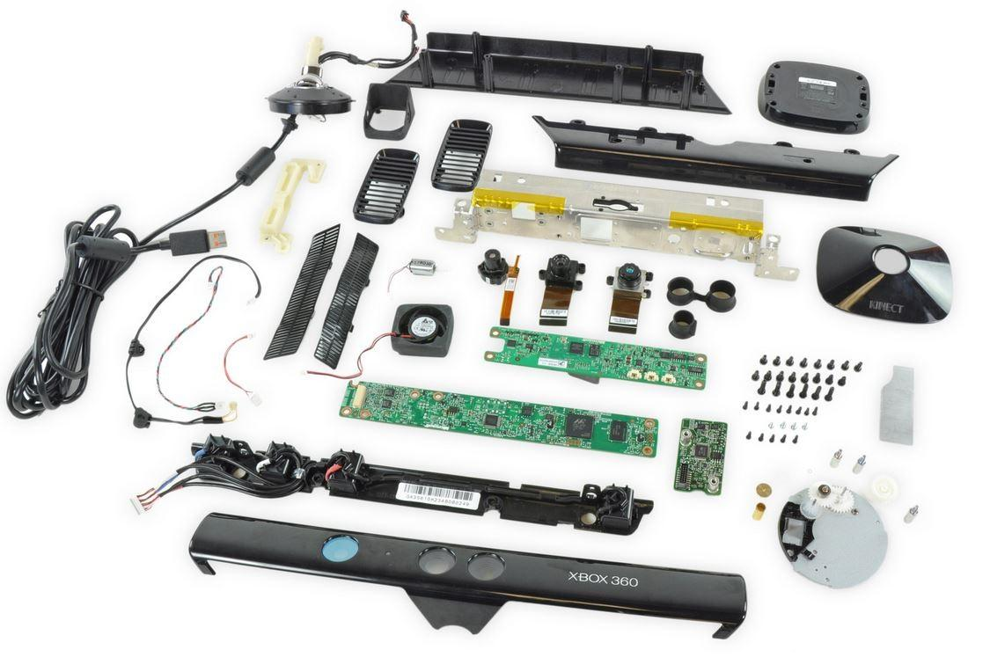
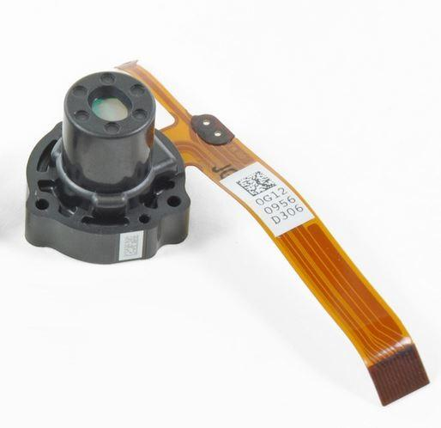
Kinect Dissection
Was able to obtain laser diode specs located inside projector assembly
Fail safe
Alex
Notes:
after seeing how things work inside kinect itself, i now have a good idea of how to proceed with the laser upgrade.

Slide 17
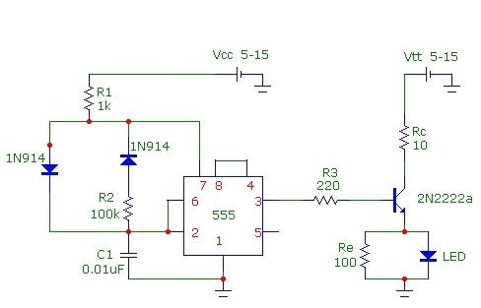
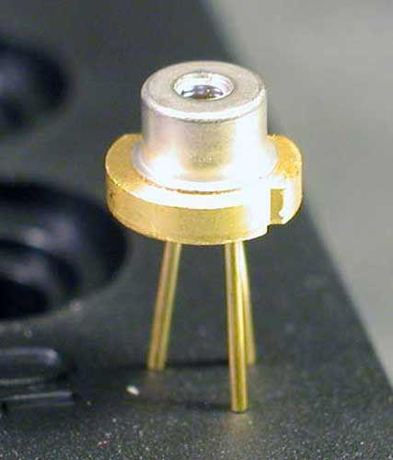
Optical System
Requirement: temperature 102 C
Kinect Laser: 60mW diode
New laser diode: operated at 700mW up to 1W
f ~ 1.4 KHz, Tp ~ 4 μs
Alex
Notes:
another option can be dy adding electrical filter between the camera output and the processing circuit. So that when we pulse the laser, we can isolate it against the sun’s unmodulated light.

Slide 18
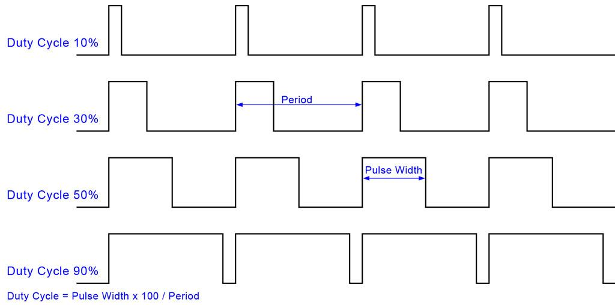
Optical System
Pulsing with 10% duty cycle solves heat issue
Design Choice: Heat Sink
Alex
Notes:
if pulsing with 10% duty cycle does not solve our issue of dissipated heat, we will attach heat sinks to the laser diode.

Slide 19
Optical Design Choice
Polarizer
Pros:
Allows the Kinect to operate in more diverse environments
Allows better calculations in situations with high glare
Cons:
Applies more aberrations to the IR Camera
Greatly Increases Cost
Shutter
Pros:
Intensity = Power/Area, Power = Energy/Time
Limits amount of intensity seen by the Kinect’s IR Camera
Cons:
Increases cost
Alex

Slide 20
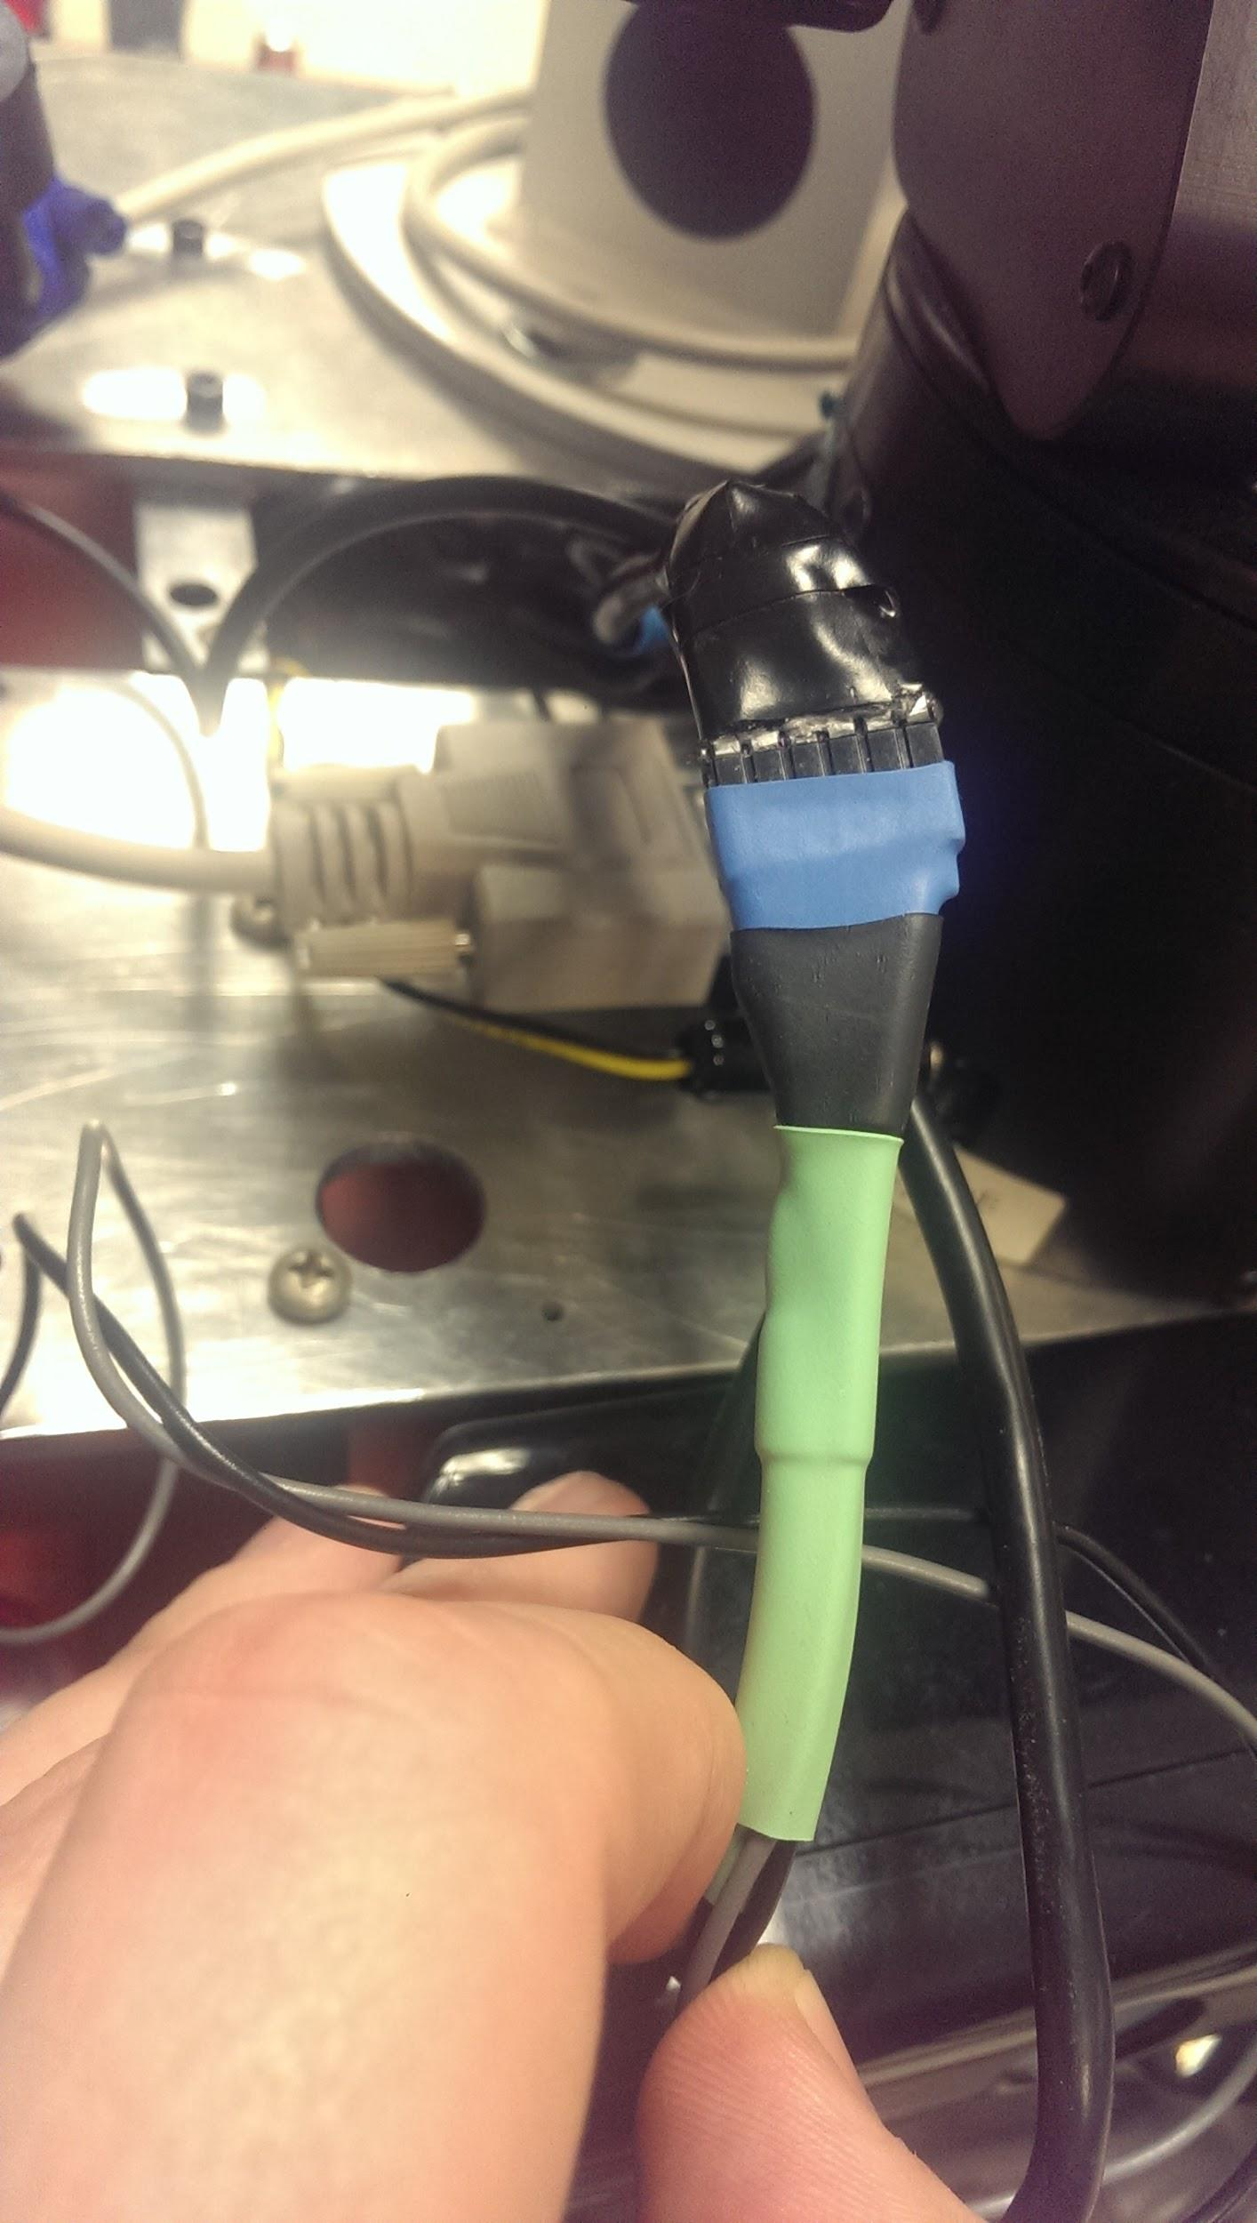
Kinect/Rover Interface
Special Xbox USB converted into normal USB + power
Battery
12V 35Ah X2
Unable to hold appropriate charge
Fully drained
Alex
Notes:
kinect is fully integrated with the rovel and does not require additional power source.

Slide 21
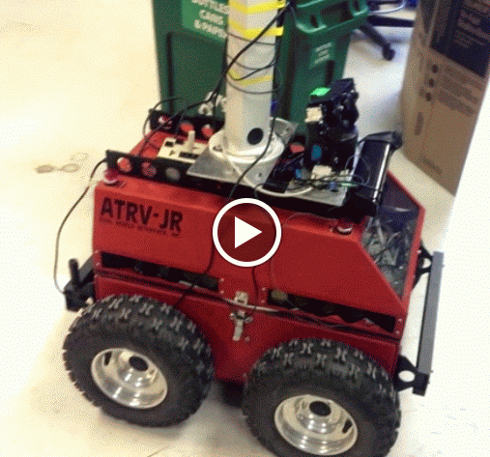
Rover Overview
{
}
Ubuntu Linux OS
ROS (Robot Operating System)
RFLEX Computer
specific for ATRV Jr.
Potential Problems
Crashing → New Hardware?
Outdated documentation
Updating manual is important
Main Computer
Ela
Notes:
Show rover internals, pointing out Main computer and RFlex Computer
RFLEX computer controls Joystick, System, and Motors
Main computer uses RFLEX drivers to connect and send instruction to RFLEX computer

Slide 22
Demo: Rover GPS
Connect Main computer to RFLEX computer
Initialize ROS core
Broadcast WiFi
Configure WiFi for external device connection
Design Choice:
Phone GPS system
Subblock Requirements:
Travel to Destination Within 3m (GPS accuracy)
Travel at 0.5m/s
Connect Android Phone
run app: ROS Sensor
input rover IP address
modify GPS Goals
Publishes Distance
getGPS
Sends rover to Destination
runGPSnav
Ela
Notes:
Internal computer connect to RFLEX computer -- Connect to USB outport (stitty)
Launch config file && movebase file
Broadcast Wifi connection from rover
post-apd config sets up Wifi so you can connect with it
connect android phone && run ROS Sensor app
Input rover IP Address, found through IFconfig
connect ROS Sensor → getGPS gets gps from phone and makes it a topic, get GPSnav gets gps locations from topic
Learned through code reading, previous team

Slide 23
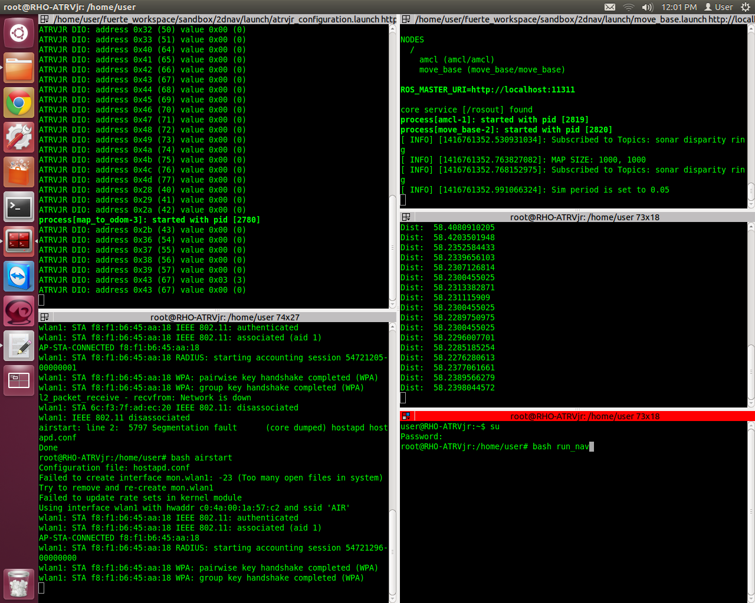
Move base
ROS core
GPS Processing
WiFi
Sends Rover to Destination

Slide 24
Demo: Rover GPS
Destination: MARcuS
Arrives at Destination
within tolerance
Tries to get within 1m
GPS accuracy is ~3m
Circles in front of Marcus at the end

Slide 25
Kinect Visualization
Stream Depth Data to the Rover
Requirements:
Range of 0.55 to 2.50 m
Min Height of 1.07 m
Min Width of 0.65 m
At least 0.25 Hz operating frequency
Design Choice!
Flip the Kinect orientation
Tim
Notes:
For indoor Kinect Visualization, these are our minimum requirements without much tuning to the navigation stack. The Range is determined by the default parameters in the ROS Nav stack. .55 meters is the range that every obstacle is buffered by, so if we can sense objects at least .55 meters away, the rover will know to slow down and avoid it. And if we tell it to avoid that buffer zone with a heavy weight, the only thing that will enter that deadzone is a moving object. The max range is 2.5 meters, because by default, that’s the farthest away that an object will be registered as an obstacle. Height and Width are constrained by the size of the rover, so we will see everything that can get in our way. Lastly, if the rover is moving at .5 m/s, an object will fully pass through the field of view undetected if the depth data is not updated at least once every 4 seconds.
How well we meet these requirements depends on where we mount the Kinect. In our demos we mounted on the front of the Rover because an off the shelf Kinect has a range of .5 to 4 meters. But we do not meet the Height and Width requirements, so we are planning to make a shelf for the Kinect on the tower and aim it slightly down. This way the dead spot on the Kinect is entirely overlapping the body of the Rover.
At min range: .43 have .35 vert, .45 horiz
At range: .71 have .58 vert, .8 horiz

Slide 26
Demo: Rover RVIZ
First Visual Data for Experiments
3D Table topview
3D Table sideview
Tim
Notes:
These are the screens I could get of the Kinect Visualization. The dark green color is a lethal object that is being avoided, the light green color is the .55 meter buffer zone. There is a lot of tuning that still needs to be done here, but we are going to be moving the kinect, so we just did a rough set up here.

Slide 27
Obstacle Avoidance
Using ROS navigation stack
Requirements:
Travel at 0.2 m/s
Detect Stationary Obstacles between 0.55 to 2.50m
Avoid Collisions
Tim
Notes:
We are using the standard ROS navigation stack which requires a boat load of configuration and tuning for the robot and sensors involved. But once that is done, you can write code that feeds x,y,z yaw,pitch,roll goals to the robot and it will navigate there while avoiding sensed obstacles automatically.
We set our required speed before PDR based off what we found in documentation. In reality we are going at .25 m/s stably with a goal of .5 m/s outdoors. The Stationary Obstacle range is again derived from the default parameters and the capabilities of our kinect. But overall, our prime objective is to avoid collisions.
While not technically a requirements, we aim to improve the performance as much as we can. As you can see in the following video, the Rover is able to avoid obstacles, but it’s not pretty.

Slide 28
Demo: Rover Videos
Tim

Slide 29
Schedule: MDR to CDR
Nov 24
Dec 15
Jan 20
Feb 20
MDR
End of Fall
Winter Break
Spring Semester
CDR
McNeil
Polarizer/Shutter Design
Order Optics
Assemble Optics
Risk Mitigation
Maerko
Make Kinect Mount
Pulsing Circuit
Assemble Optics
Risk Mitigation
Correa
Website
Rover Maintenance
Sensor Data Configuration
Final Report
Tufts
MDR Report
Rover Navigation
Rover Docs
Integrate Kinect

Slide 30
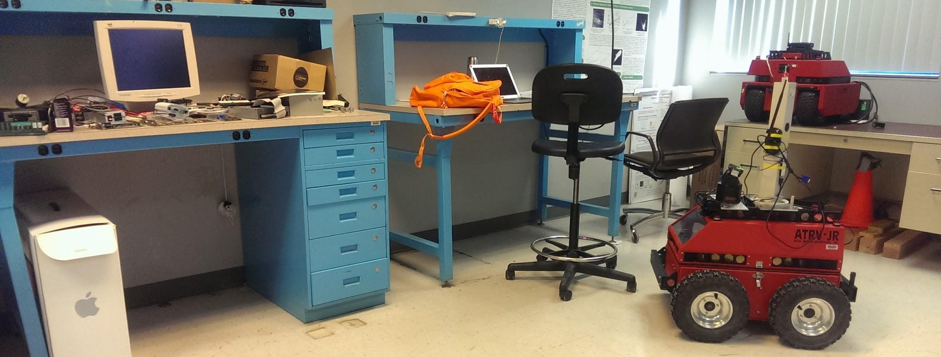
CDR Deliverables
Complete System Functionality
Modified Kinect able to calculate depth outside
Rover able to travel to a GPS location outside
Rover able to detect and avoid obstacles using the modified Kinect
Alex
Notes:
By the time CDR rolls around, Alex and Alex will have a modified Kinect that is able to calculate depth outside. Ela and I will have the navigation stack tuned and QOL improvements made to the gps system. Our subsystems are plug and play together by design but we have planned a period of time for integration because it’s possible for their to be complications. So at CDR the systems will be working together to make the rover travel to a given gps location and avoid obstacles detected by the modified Kinect..

Slide 31
Acknowledgements
Professor Jun Yan, UMass Physics Dept.
Professor Leonard
Professor Parente and MIRSL
SDP14 Team AIR
Keval Patel
Alex
Notes:
Come up with a list of optical requirements and plan to solve them
note: polarizer correlation to field of view
aboration correction in the kinect
power and diffraction
June Yan and the UMass Physics Dept for help with the optics design
Professor Leonard for help with optics feasibility
Professor Parente and Microwave Remote Sensing Lab for donating the Rover and the Lab space
SDP14 Team AIR for their improvements made to the Rover

Slide 32
Notes:
http://blog.supermedia.com/media/questions.jpg

Slide 33
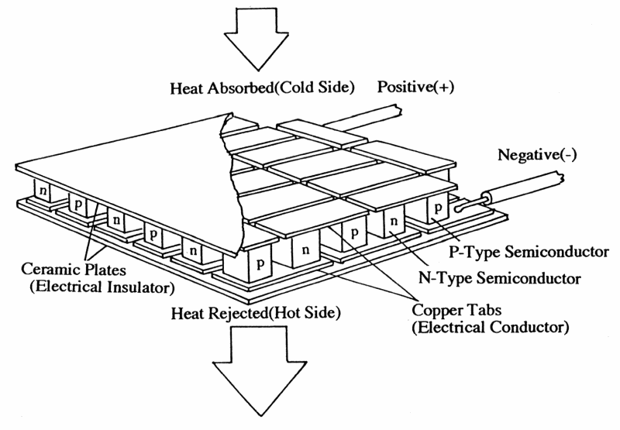
Stubs of faces for slides
Tim
Ela
Alex
Alex

