Slide 1
Low-cost 3D
Environment
Sensing
System
Gabriela Calinao Correa
Electrical Engineering & Applied Mathematics
Timothy Robert Tufts
Computer Systems Engineering
Alexander Montes Mcneil
Electrical Engineering
Alexander Maerko
Electrical Engineering

Slide 2
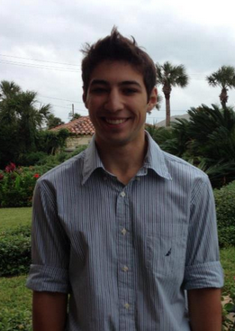
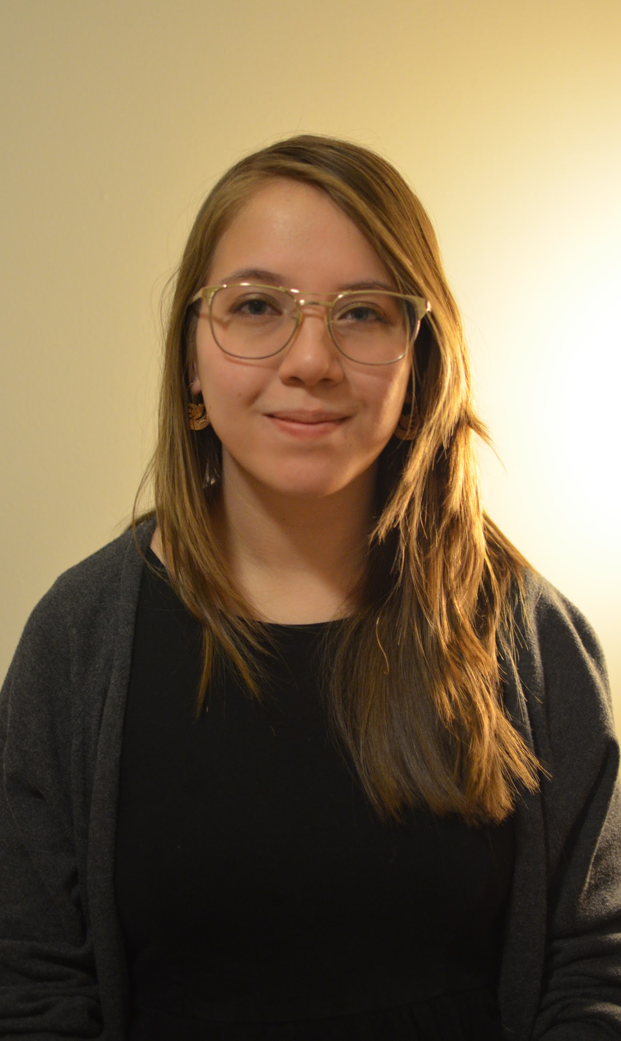
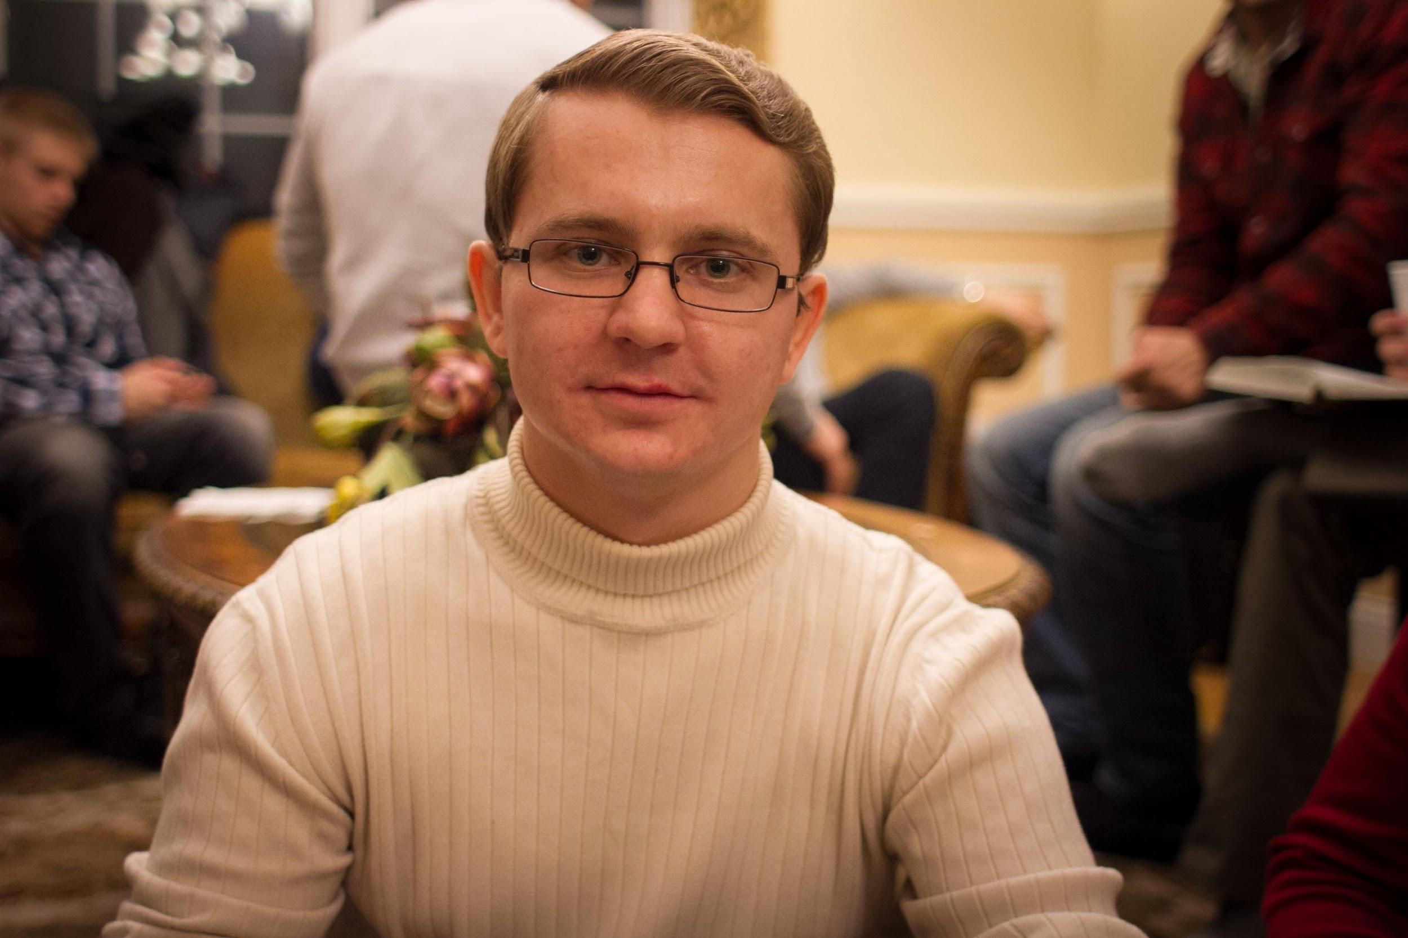
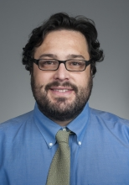
Team LESS
Timothy Robert Tufts
Computer Systems Engineering
Alexander Maerko
Electrical Engineering
Gabriela Calinao Correa
Electrical Engineering
Applied Mathematics
Alexander Montes McNeil
Electrical Engineering
Mario Parente
Advisor

Slide 3
Review Block Diagram

Slide 4
CDR to FPR Goals Review
Clean and reliable power interface
Updated Documentation
Kinect Shelf
Solder Board
Detection/Avoidance Tuning
Filtration Tuning
Design our demo for SDP day

Slide 5
Power Concerns
Using one battery is not reliable
Lasts ~1 hour from full charge
Uneven charging damages batteries
Unsure how batteries are connected
Behavior suggests Parallel
Recommend rebuilding old power supply

Slide 6
Overview of Optics
Pulsing
400 mW peak at 25% duty cycle
Incompatible with Kinect Software
VRM burned this passed weekend
Filter
±2 nm
Some field of view loss
Roughly +0.30 m shift in perceived depth
Shutter
Too much noise
Too much power

Slide 7
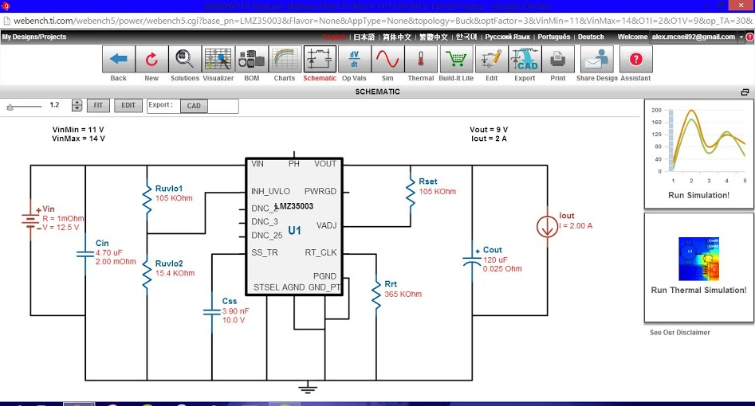
Overview of Optic Control
Consisted of three main designs:
Voltage Regulator Module
Trigger Generation
Driver to Laser
Driver to Shutter
Voltage Regulator Module

Slide 8
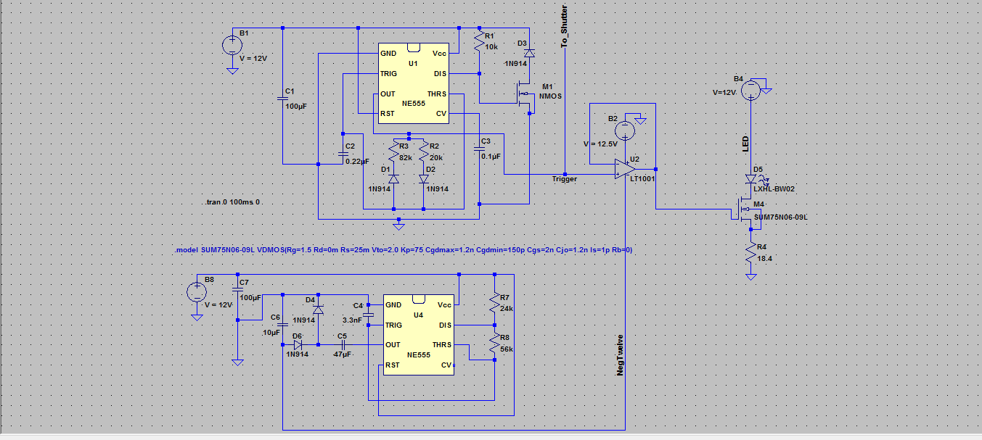
Trigger Generation

Slide 9
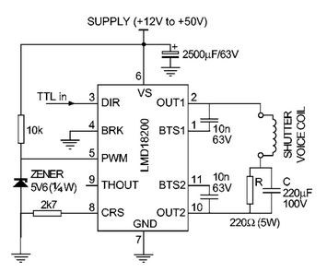
Driver to Shutter
Scholten, R. E. "Enhanced Laser Shutter Using a Hard Disk Drive Rotary Voice-coil Actuator." Review of Scientific Instruments 78.2 (2007): 026101. Web.

Slide 10
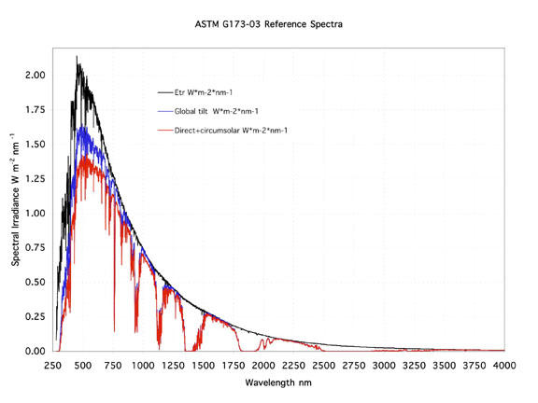
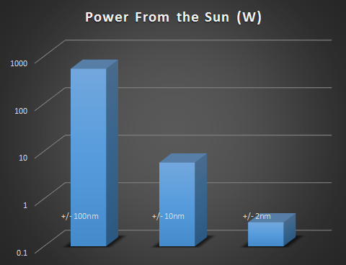
Optic Filtration
Filter:
+/- 2nm Bandpass filter and increasing the instantaneous power of the laser to >400 mW
Shutter:
Works in sync with the pulsing circuit to prevent any unnecessary saturation from when the laser is off
Chosen to absorb IR wavelengths

Slide 11
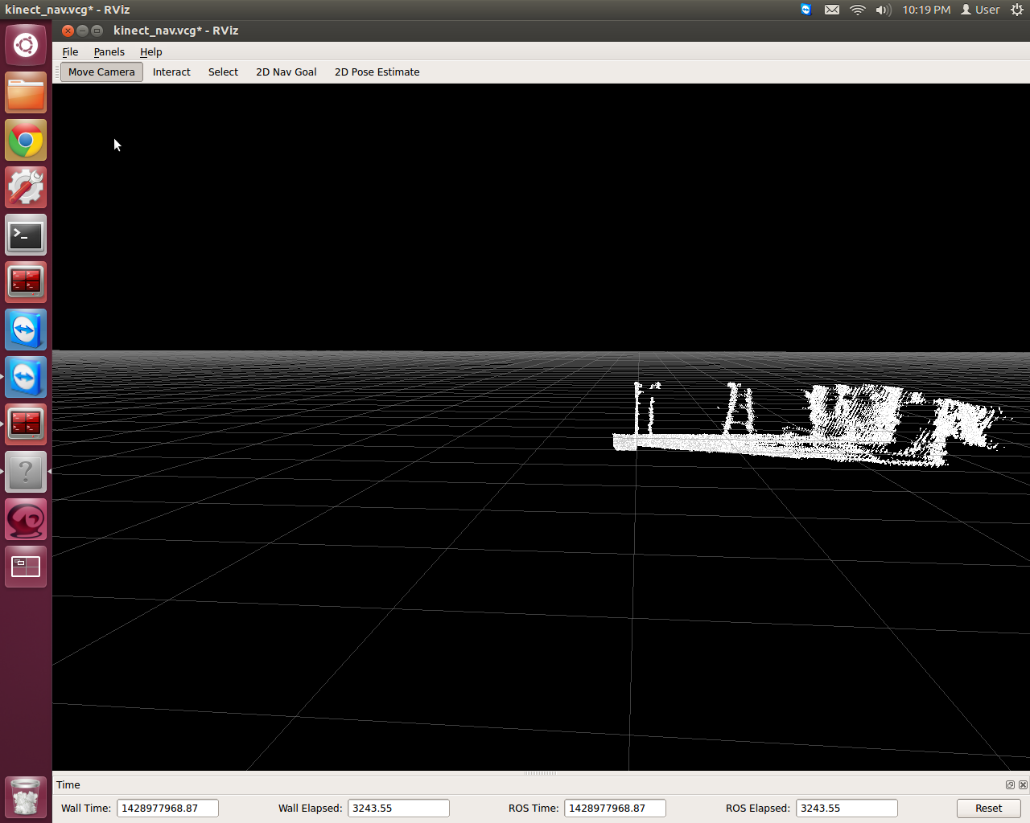
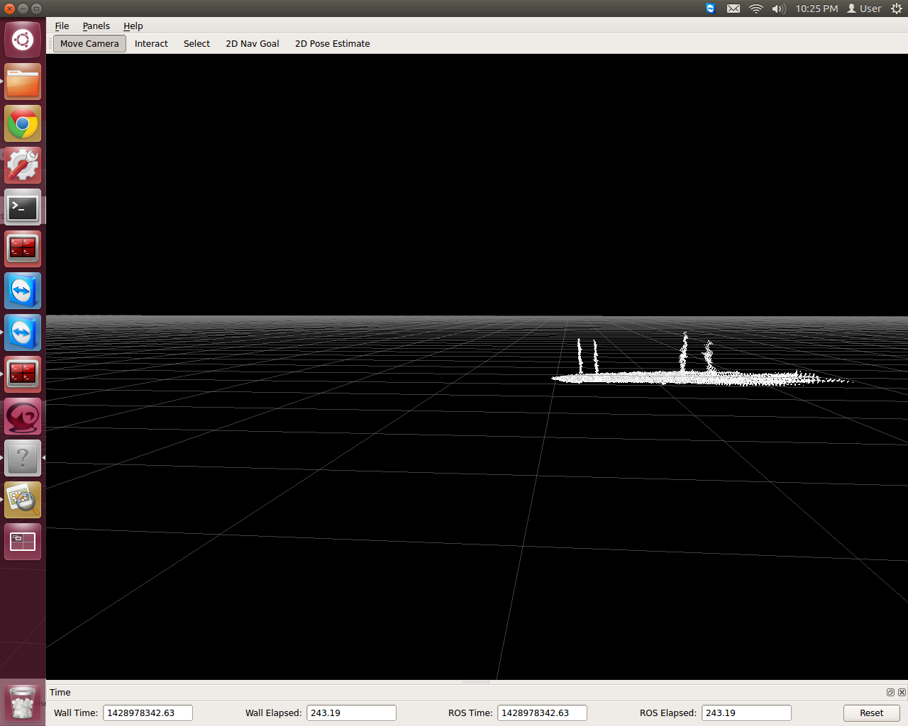
Distance Distortion

Slide 12
Laser Heat Sink
Copper Plate
regulates laser
similar to original design
weld glue
thermal paste
Cu & Al parts
Copper Nub
Peltier
Original Cap
Back of Laser Diode

Slide 13
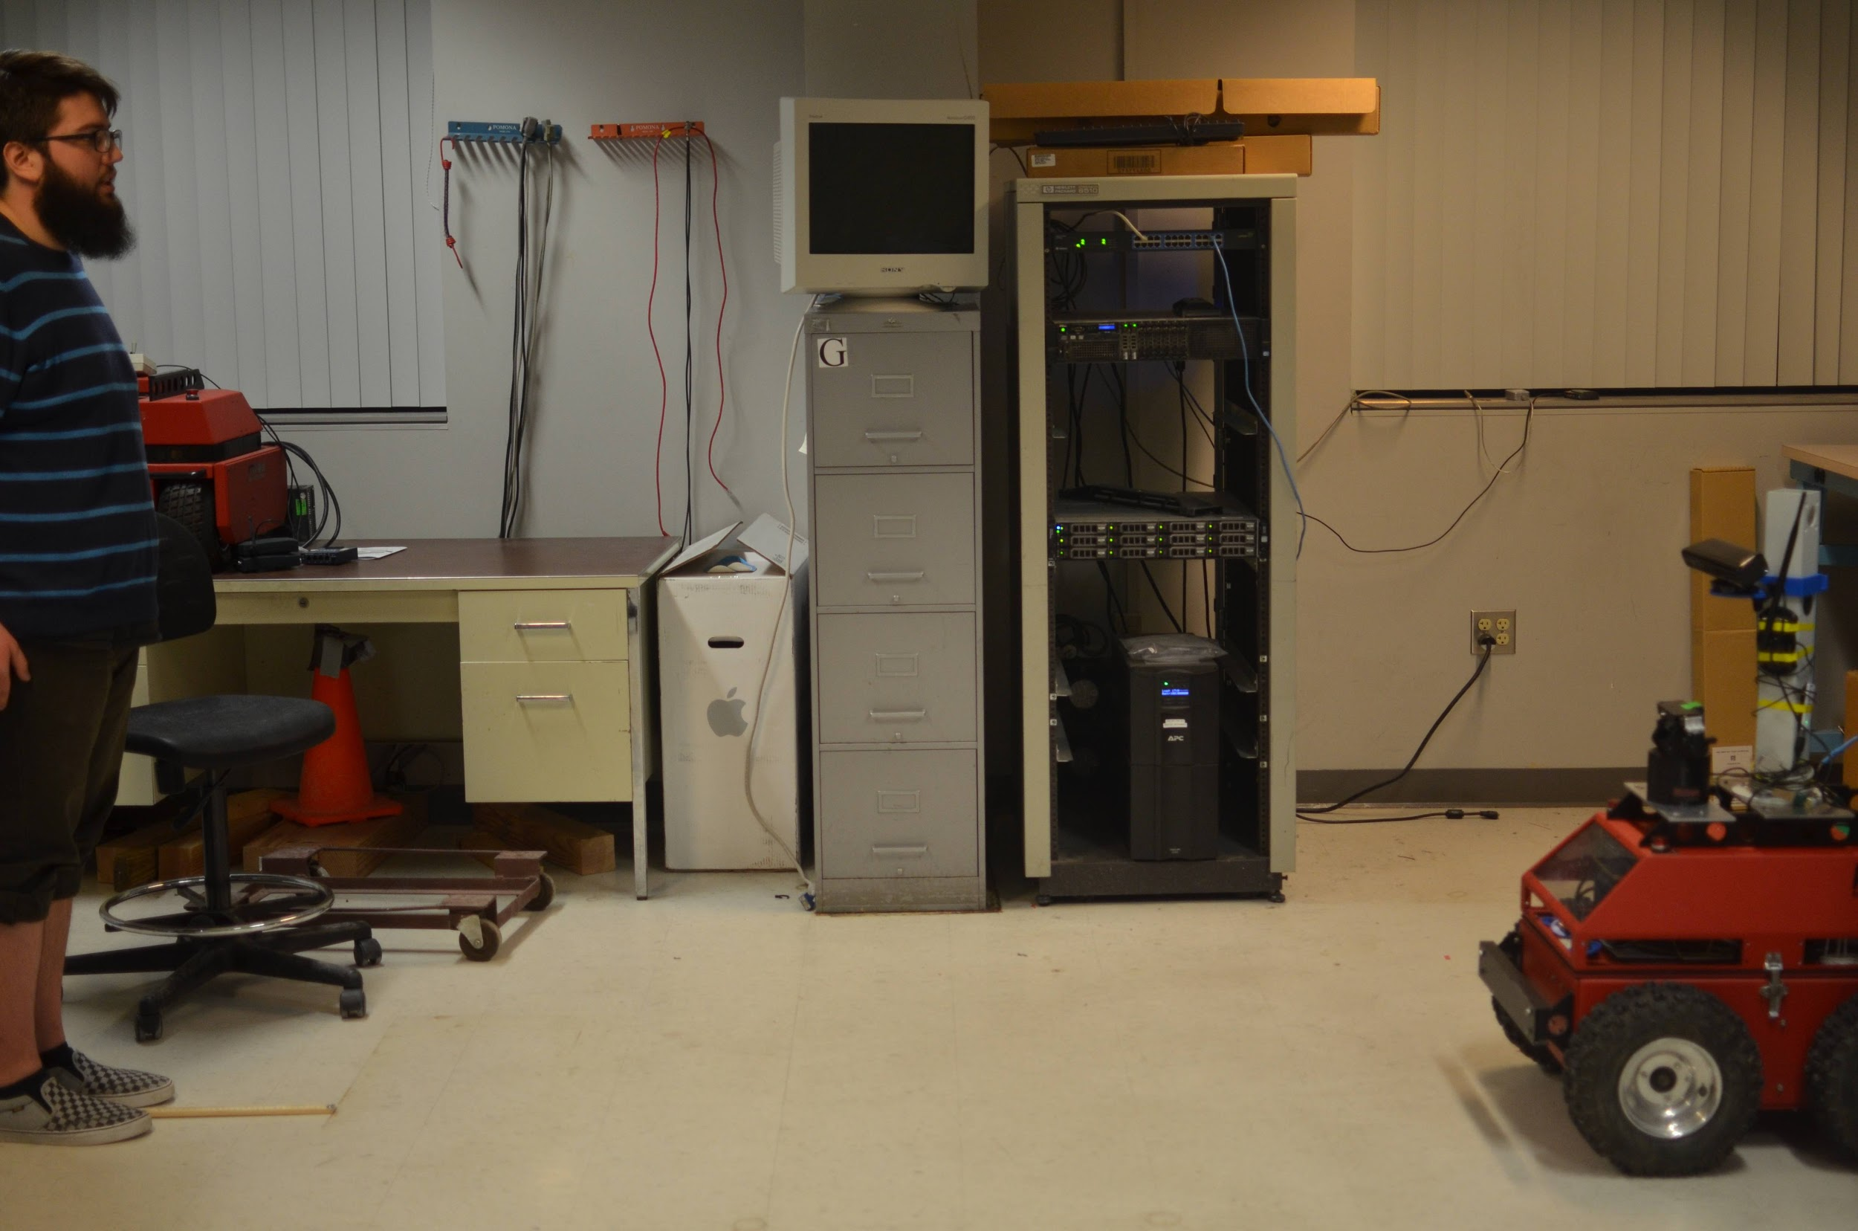
Field of View Measurements
Unmodified
Modified

Slide 14
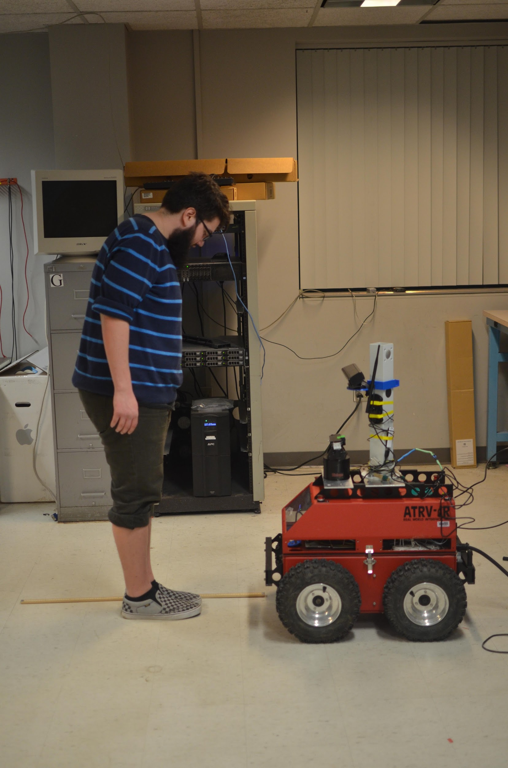
Field of View Measurements
Unmodified
Modified

Slide 15
Final Product Specifications
Requirements:
Range of 0.55 to 2.50 m
Min Height of 1.07 m
Min Width of 0.65 m
Pass a set of indoor/outdoor tests against an unmodified Kinect
Power off a 12 V 35 Ah car battery
Unmodified FoV:
.47 m min
>2.50 m max range (about 4 m)
.87 m height
1.31 m across min dist
Modified FoV:
.52 m min
>2.50 m max (about 3 m)
.84 m height
.80 m across min dist

Slide 17
Acknowledgements
Professor Jun Yan, UMass Physics Dept.
Professor Leonard
Professor Parente and MIRSL
SDP14 Team AIR
Keval Patel
Fran Caron
Professor Salthouse
Dan Bergman
Professor Jackson
Notes:
Come up with a list of optical requirements and plan to solve them
note: polarizer correlation to field of view
aboration correction in the kinect
power and diffraction
June Yan and the UMass Physics Dept for help with the optics design
Professor Leonard for help with optics feasibility
Professor Parente and Microwave Remote Sensing Lab for donating the Rover and the Lab space
SDP14 Team AIR for their improvements made to the Rover

Slide 18
Notes:
http://blog.supermedia.com/media/questions.jpg

Slide 19
Roverview Hardware
Rover Computer
(RFlex)
ROS Computer
Rover Hardware
(Motors, System, Sonar)
Our Hardware
(Kinect, Wifi, GPS)
Notes:
As this design review is all about subsystem integration and functionality, I am going to review the hardware and software structure of the Rover and focus on how our work integrates into the existing system.
First up is the Rover Computer. This computer runs the RFlex software that controls the Rover proprietary hardware. This hardware includes the motors, system (battery) and sonar.
The ROS computer is the computer that we assembled and installed back into the Rover. This runs ROS software with RFlex drivers to communicate with the Rover Computer. It was controls all of the non proprietary hardware that has been installed onto the Rover. This includes our Kinect as well as the wifi card and GPS device.
The master in this setting is the ROS computer. The RFlex computer can be used to manually drive the rover around, but in the normal functioning setting, the RFlex computer is just sending sensor data and receiving commands while the ROS computer decides what to do after processing the incoming data.
Our major contribution to Rover hardware is the modified Kinect as well as the newly built ROS computer.

Slide 20
Roverview Software
RFlex Driver
Navigation Stack
WiFi
Rover Computer
(Motors, System, Sonar)
OpenNI
(Kinect)
ROS Sensor
(GPS)
Notes:
Here is the pseudo-software structure of the Rover, I call it pseudo-software because it also includes hardware end-points. In this structure, the Navigation Stack is the master and it resides on the ROS computer. In fact, all of this is on the ROS computer except for the Rover Computer block. The Navigation Stack is a collection of ROS modules that work as a single unit to provide navigation based on sensors and actuators.
In this case, the sensors are the RFlex driver that feeds out odometry and system status information, the OpenNI package that reads in the Kinect data, and the ROS Sensor which is an android app that feeds out gps and accelerometer data, however we just subscribe to the gps.
The actuators are simple because it’s really only one thing. The Motors that move the rover around are controlled through the RFlex driver.
In terms of controlling the Navigation Stack, the two inputs are either a GPS coordinates file or keyboard controls depending on how you start it.
(NEED TO LOOK UP WHAT IS LAUNCHED IN CONFIG AND WHAT IS LAUNCHED IN MOVEBASE)

Slide 21
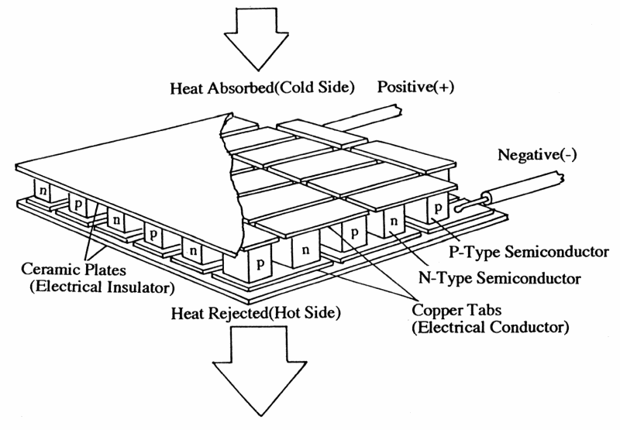
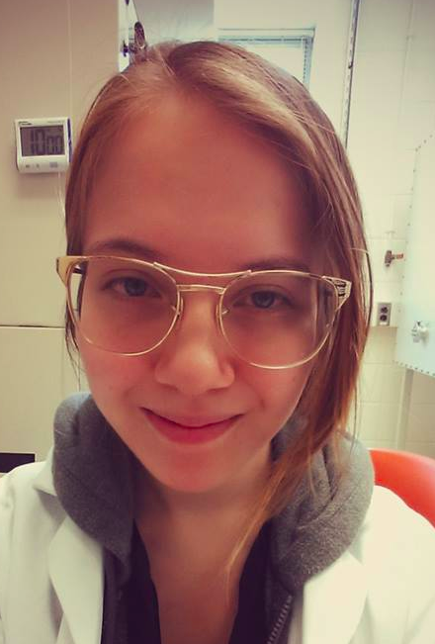
Stubs of faces for slides
Tim
Ela
Alex
Alex

