Slide 1
Final Product Review
Team14:
BMW Brainwave Manipulated Wagon
Notes:
Computer changed
--zijian
Explain what xueling doing-like left – looking at left blinking square
Welcome to our
--flowchart – block diagram explain briefly
--fpr
Enclose the car

Slide 2

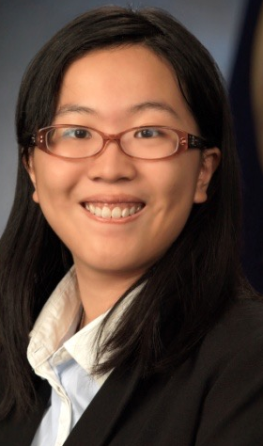

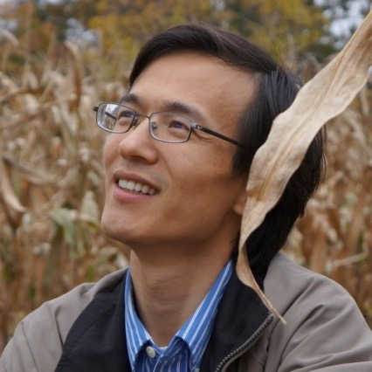

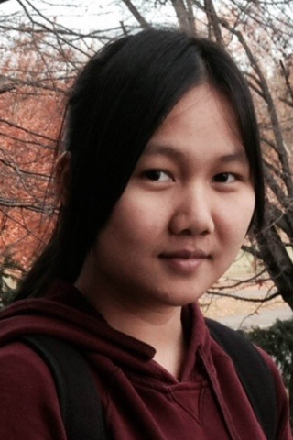
Team 14 Members
Zijian Chen
CSE
Tiffany Jao
CSE
Faculty Advisor:
Qiangfei Xia
Man Qin
EE
Xueling Zhao
EE

Slide 3
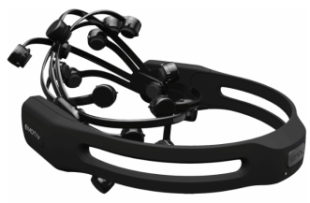
Block Diagram
Computer
EEG data
C# Application
(training)Alpha, beta power
Proprietary wireless 2.4GHz
Signal Processing
Emotiv EPOC
headset
(real time) Alpha, beta power
Database
(Training Data)
Bayesian
Classifier
(training)Alpha, beta power
SSVEP
Classifier
command
User Interface
Man Qin
Zijian Chen
Xueling Zhao
Bluetooth HC05
Tiffany Jao
Robotic Car
Arduino
Notes:
Input/out of each block

Slide 4
Improvement
Problem | Solution | Result
Wireless Interference | USB Extender | Stable headset-computer connection
Closed-Eye detection time: 4~5 s | FFT compute rate: 2/sec -> 4/sec | Detection time reduced to 2~3 s

Slide 5
Features
Original Features
Forward
Stop
New Features
Left Turn
Right Turn
Backward*
Notes:
Missing: now we can move left and right!
Better way to say delta time –(look for the word)
*special effect

Slide 6
Alpha and Beta power
Headset: EEG Voltage Data
Alpha wave: 8-12Hz & Beta wave : 13-30Hz
To calculate the alpha and beta power:
Sum up the power at each corresponding frequency
Alpha wave power increase as we close our eyes
Eye-Closed: Power vs. Frequency
Alpha
Power Amplitude
Beta
Frequency(Hz)
Notes:
Alpha and beta wave intro
What we use here?
Xueling add graph

Slide 7
Forward & Stop & Backward
Eye Open/Close Controlling
Close eyes until the car reacts/detect alpha high
Keep eyes closed after car stop until car backward
Car Forward
Car Stop
Car
Backward
Close eyes until the car reacts/detect alpha high
Close eyes until the car stops/detect alpha high
Notes:
Alpha and beta wave intro
What we use here?
*state diagram

Slide 8
Left & Right
SSVEP(Steady-State Visual Evoked Potentials)
the brain(occipital lobe) generates electrical activity at the same or multiple frequency of the visual stimulus
SSVEP vs Alpha and Beta wave
Detect dominant frequency for SSVEP
Detect power level for eye open/close
Stare at the stimulus until the expected frequency remained dominant consecutively
Left: 10 Hz & Right : 15 Hz
Notes:
How its different from alpha and beta wave?
Ssvep and alpha and beta wont overlap because when testing ssvep, our eyes are open. Which means that the alpha and beta power stays at steady level. So ssvep and alpha and beta wont overlap

Slide 9
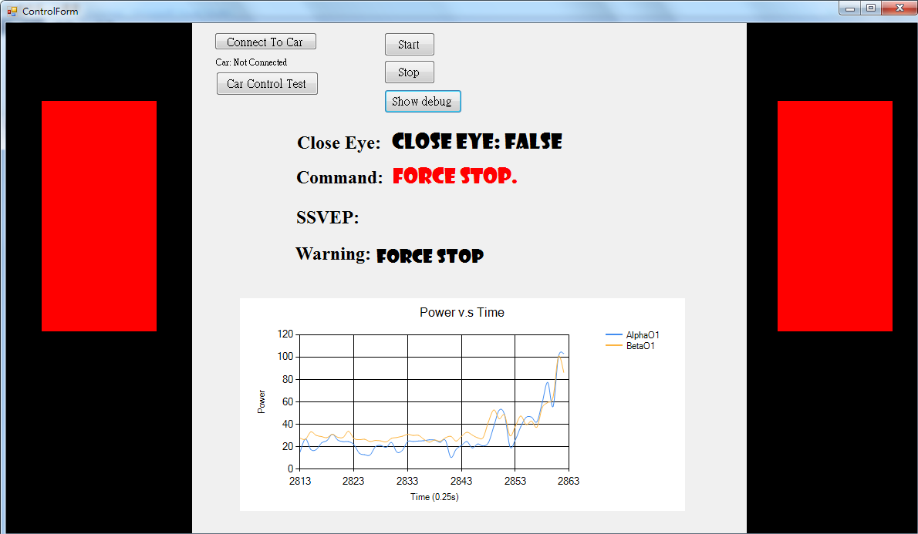
Graphical User Interface - Control
Start Command Detection
10 Hz
15 Hz
Notes:
☺

Slide 10
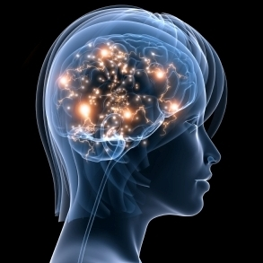
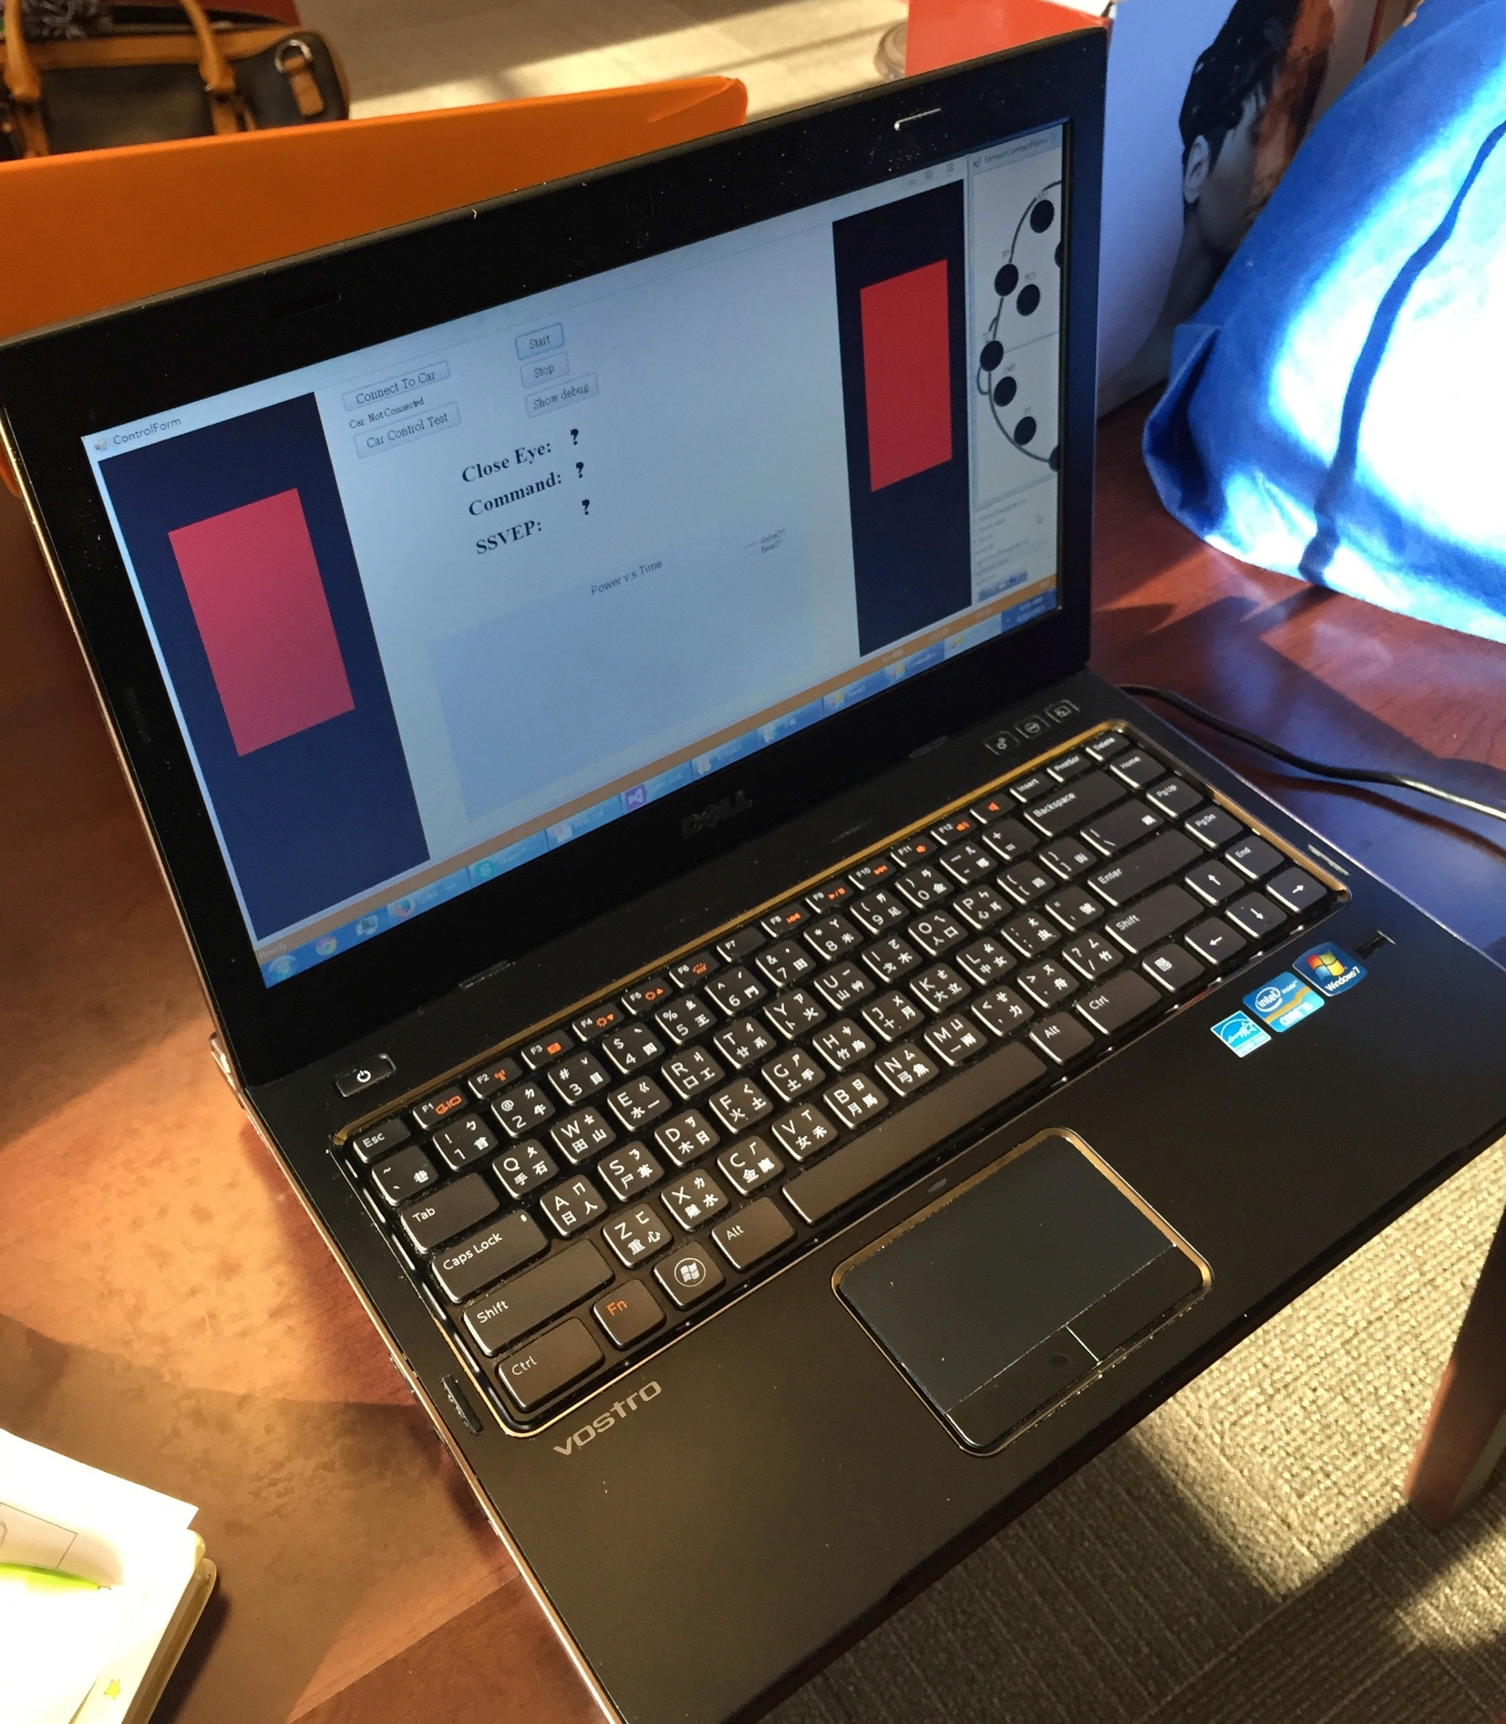
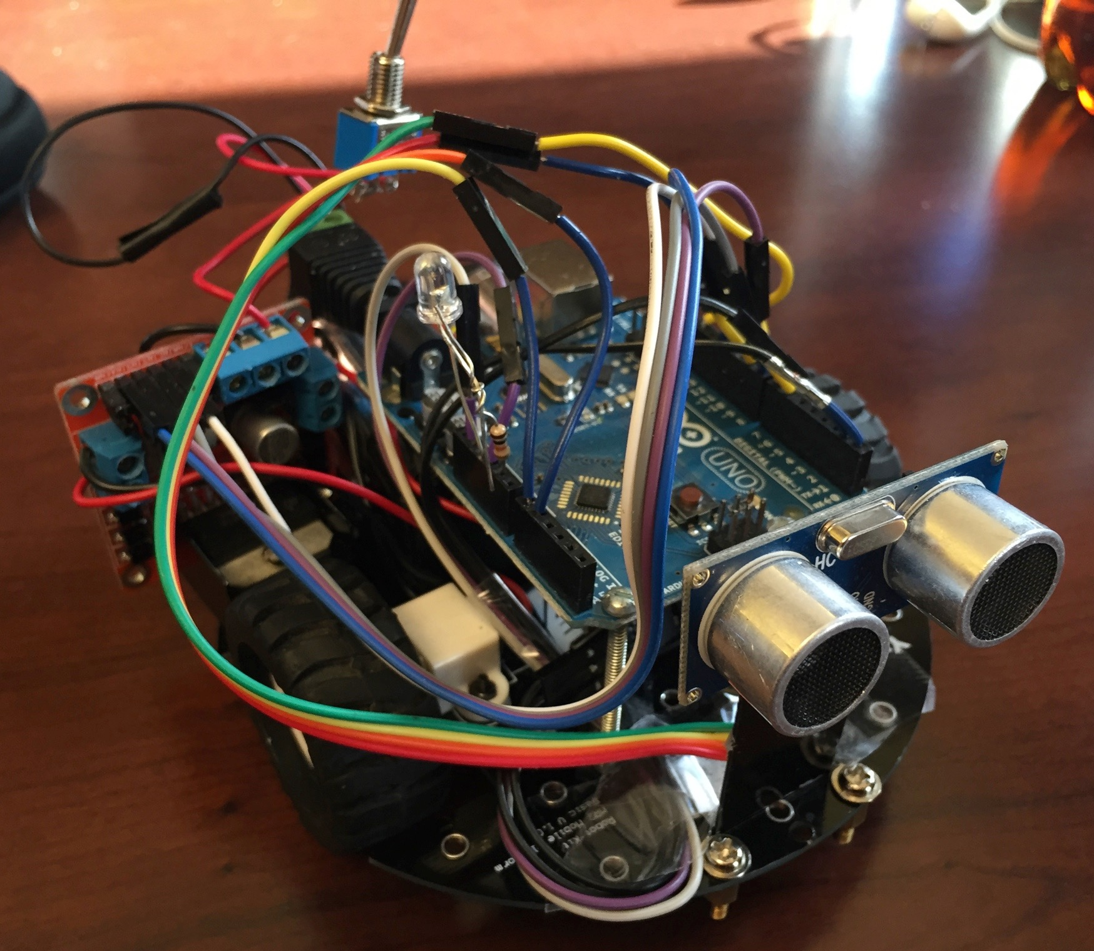
Final Product
Notes:
Two computer prepared.

Slide 11
Specification
Command | User Action | Accuracy | Avg. Detection Time
Forward | Close Eye if Car stop | 90.90% | 2.153 s
Stop | Close Eye if Car Move Forward
Left Turn | Look at 10 Hz light stimulus | 86.67% | 7.040 s
Right Turn | Look at 15 Hz light stimulus | 90.59% | 6.515 s
*Backward | Close eye for a significant longer time | 77.27% | 6.012s
* The car will stop before triggering backward.
Notes:
-too early/
Too much details (forward+stop+backward = close eyes - detection) (left/right -> SSVEP)
The user needs to close the eyes in order to trigger the forward/backward/stop
For the right/left turn, we would
Overall picture first
Need something related to the demo … detection time, is we can shorten the time?
See apple presentation to get idea
go over
Specification(s)

Slide 12
Demo
DEMO

Slide 13
Thank you
Questions?

Slide 14
Backup Slide
Notes:
Technical detail

Slide 15
SSVEP detection method
FFT of 4 seconds frame
0.25 seconds overlapping windows
Detect dominant frequency between 7Hz to 15Hz
Detect consecutive occurrence (5+)of expected frequency
Notes:
Ssvep 4s

Slide 16
Possible Source of Error
Alpha increase due to tiredness
Lead to trigger close-eye condition
Accidentally trigger SSVEP
User may see the blinking square even if they are not intend to

Slide 17
FFT COMPUTE RATE
QM EXPLAIN

