Slide 1
Midway Design Review
Team14:
BMW Brainwave Manipulated Wagon

Slide 2

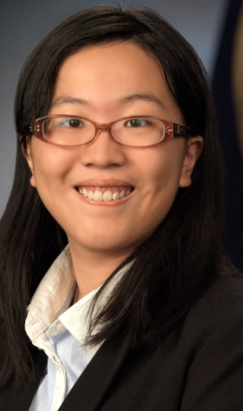
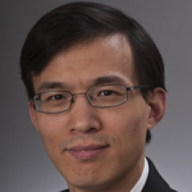
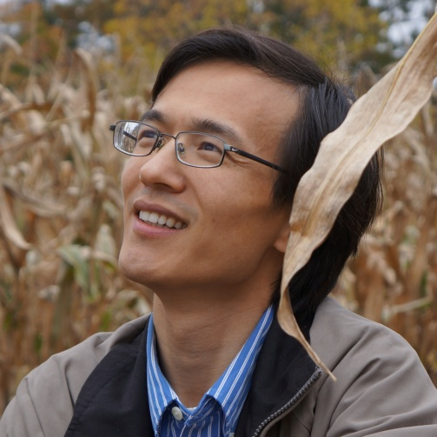

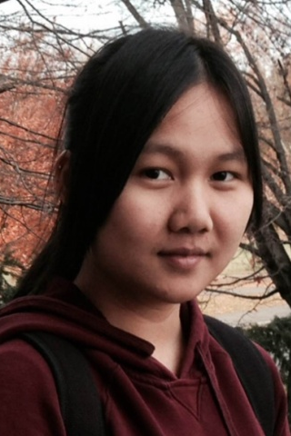
Team 14 Members
Zijian Chen
CSE
Tiffany Jao
CSE
Faculty Advisor:
Qiangfei Xia
Man Qin
EE
Xueling Zhao
EE

Slide 3
Outline
Review
System Requirement
Block Diagram
Individual Responsibility
MDR Demo
CDR Schedule

Slide 4

Review: Problem Statement
People with physical disability is relatively dependent on others
Limited strength to control wheelchair
Solution: BMW
Demonstrates brainwave (EEG) control using robotic car
Notes:
******

Slide 5
Outline
Review
System Requirement
Block Diagram
Individual Responsibility
MDR Demo
CDR Schedule

Slide 6
What is BMW?
A brainwave controlled robotic car!
Notes:
I am not sure if this slide is relevant. You want to point out a problem, what are the current solutions, their problems, and what your proposed approach, then you introduce the tools you are going to use (brain wave).

Slide 7
System Requirement
Computer application
GUI
Database
Compatible with different user
training system
Remote Car Controls:
move forward, speed up, stop, and etc.
Notes:
Should we mention the car in the system requirement?
Why 40 m
-- In this slide you want to introduce what you are going to build first before the system requirements. The system requirement is based on what your product is. You should include the car in the system requirement, because this is for the whole project.

Slide 8
Outline
Review
System Requirement
Block Diagram
Individual Responsibility
MDR Demo
CDR Schedule

Slide 9
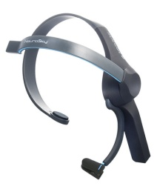
Block Diagram
TX Arduino Module
C# Application
Computer
Arduino/
Bluetooth v3.0
ThinkGear Packet
Signal Processing
USB serial Write
Neurosky
headset
MySQL Database
XBEE:TX
Command Algorithm
User Interface
Man Qin
Motor
Arduino
XBEE: RX
Zijian Chen
Robotic Car
Xueling Zhao
Tiffany Jao
Power Supply
Notes:
Enough Detail? Too much?

Slide 10
Block Diagram
TX Arduino Module
C# Application
Computer
Arduino/
Bluetooth v3.0
ThinkGear Packet
Data Analyze
USB serial Write
Neurosky
headset
MySQL Database
XBEE:TX
Command Algorithm
User Interface
Man Qin
Robotic Car
Motor
Arduino
XBEE: RX
Zijian Chen
Xueling Zhao
Power Supply
Tiffany Jao
Notes:
-he mentions about attention here
-send to arduino- output as led

Slide 11
Outline
Review
System Requirement
Block Diagram
Individual Responsibility
MDR Demo
CDR Schedule
Notes:
Xueling

Slide 12


Data Retrieval: Neurosky Headset
Thinkgear.dill
Poor Signal
Concentration/ Meditation
Alpha/Beta/Theta Power
Raw Data
Bluetooth v3.0
Neurosky Headset
Laptop
Retrieve attention level and corresponding raw EEG data
Save .txt file for further analysis

Slide 13
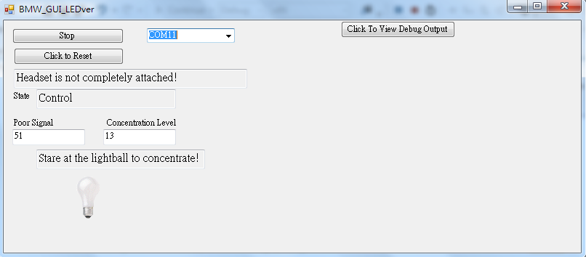
Graphical User Interface
Development language: C#
Warning message
Stimuli
Notes:
Pic
Multiple training sets not implemented ?
While Xueling has developed a C++ program to retrieve the data, I start to develop an graphical application using C#.
The choice of using C# is due to two reasons:
First, c++ does not have native support for advance graphical feature.
Second, Neurosky provided support c# in their developer tools. I can basically make .dll library call similar to the one make in c++
The purpose of graphical interface is to trigger a standard training interface.
It will display the program state – whether the user should still concentrate or not
It also have a standard stimuli to help user to place their focus during training state and we will gather user’s attention level during this time
And it will also display user’s current concentration level,
And some warning message on whether or not the user is wearing the headset properly or he/she would have to retrain because there doesn’t have enough data to use

Slide 14
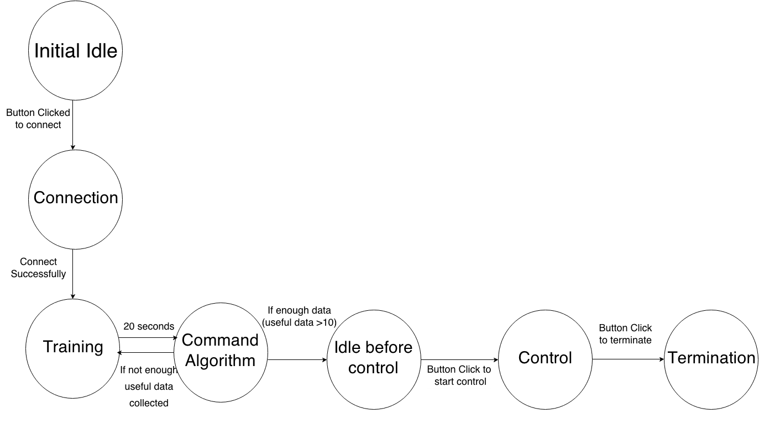
Graphical User Interface: State Diagram
Notes:
I would like to provides a basic overview of a general process of the interface.
Basically the program will try to connect with the headset after the user selects the serial COM port connecting to the headset.
And when the connection is established correctly, we will start training for 20 second and transition to command algorithm state, which Zijian will go over in detail later.
Sometime the headset may not be fully attached to the head during the training process, so the attention level could not be compute and those data are not used.
If we collect enough data, the program will move to an idle state before user click the button to start control.
User would terminate the program once they are done
Now I would leave Zijian to talk in detail about the command algorithm that we are using.

Slide 15
Command Algorithm
Attention Level
List
Sorting
Calculate Classify Point
Input point > 90 % * classify point
High Attention
Low Attention
Two consecutive low attention level
Concentrated
Not Concentrated
Notes:
Wider Range:
Measured Attention Level is still above 0.9 * Classifying Point
Consider as not concentrate only if the value is contiuoulsy falling below concentration for at
I feel like too much words include here – Xueling
Repeat mention attention level

Slide 16
Data Collection and Analysis
Why?
Multiple Commands
Achieve more reasonable algorithm
Notes:
QM

Slide 17
Data Collection and Analysis: Assumption
Different kinds of concentration:
Increased memory – High Theta (3.5 – 6.7 Hz)
Increased focus and awareness – High Alpha (11-14Hz)
Increased conscious thinking – High Beta (14-30 Hz)
"Brain Wave States & How To Access Them.”
Brainwaves Frequencies Change States of Consciousness. 1 Jan. 2005. Web. 22 Nov. 2014.

Slide 18
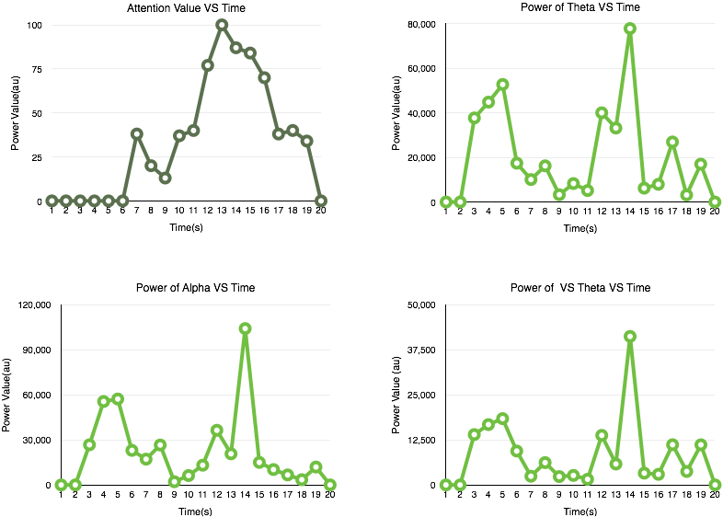
Data Analysis: Graph
*data is provided by the headset

Slide 19
Data Analysis: Challenges
No standard experiment is defined during data acquisition
Power spectrum is less stable than attention level
No way to know the time delay(FFT)
Power Spectrum are provided once per second (FFT)

Slide 20
FFT
Replace the attention level with other parameters
Corresponding alpha wave and attention level comparison
Matlab – perform FFT
C# will replace Matlab for FFT
Provide a platform for further experiment

Slide 21
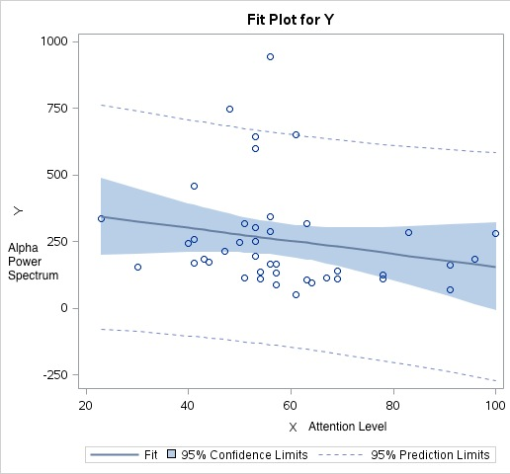
FFT Result: Alpha Spectrum vs Attention Level

Slide 22
Outline
Review
System Requirement
Block Diagram
Individual Responsibility
Software Training System
Research
MDR Demo
CDR Schedule
Notes:
DEMO:

Slide 23
Proposed MDR Deliverables
Demonstration of functioning algorithm
Controlling LED on/off
Stable result
Demonstration of graphical user interface
User determine control time
Display attention level

Slide 24
Outline
Review
System Requirement
Block Diagram
Individual Responsibility
Software Training System
Research
MDR Demo
CDR Schedule
Notes:
I will then talk in detail with our plan for CDR, and what we plan to deliver

Slide 25
Proposed CDR Deliverables
Remotely control robotic car
Improved Command Algorithm
Utilize FFT result and classifier
Try to replace attention level
More user-friendly training interface
Graph
Database for training interface
Notes:
-- be more specific, for example, do you want to use concentration or frequency? – Xia
-- give some details of the experiment (basic ideas like how many data sets we gonna use? Parameters? Critical thinking patterns? )- Xueling
For CDR, we will demonstrate the control on the car by making it move forward, stop and perhaps speeding.
Man will get the car and TX/RX ready, and we will integrate that with our application.
Meanwhile, to attempt to improve the command algorithm,
Xueling and Zijian are going to utilize our research to set up several proper experiments, utilizing Bayesian classifier and our FFT result
I will be helping them to integrate their algorithm onto the application.
I will also try to make my interface be more user-friendly – as well as adding database for training interface that Bayesian classifier may need to use, as well as possibly include multiple training option

Slide 26
Schedule: Ghatt Chart
 | 11/24/2014 | 11/30/2014 | 12/7/2014 | 12/14/2014 | 12/21/2014 | 12/28/2014 | 1/4/2015 | 1/11/2015 | 1/18/2015 | 1/25/2015 | 2/1/2015 | 2/8/2015 | 2/15/2015 | 2/22/2015
MDR draft report (All)
MDR final report (All)
XBEE TX/RX
Robotic Car
integration of robotic car and TX/RX
integration of RX and GUI (Tiffany+Man)
define experiment method (All)
FFT in c#
(Beysian) Classifier
Integration of FFT & Beysian with Training interface (Xueling+Tiffany+Zijian)
Peforming Experiment with alrogithm (Xueling+Tiffany+Zijian)
Database
GUI improvement
Notes:
This is our ghatt chart –
Basically we are going to use the rest of this semester to finish up the report and start to define our experiment method.
Then Xueling and Zijian will need to write function for FFT and Bayesian Classifier, and I will be helping them to integrate this functionality in our training interface. That will happen between winter break and first week of school.
And We will be performing experiment with different parameter.
Meanwhile, Man is going to get the TX/RX ready and build the robotic car doing the winter break, which then we will integrate with our original algorithm after the winterbreak
I will also be building the database and making improvement on GUI as the time progressed

Slide 27
Thank you
Any Question?

Slide 28
PDR Feedback
Why not use an embedded solution?
We decided to build C# application instead of embedded solution
Need to experiment to find a usable stimuli
Easy to set up an experiment interface with C# application
Notes:
-- do we have to address this, or we can just tell the whole story very then address these. You want to make sure the story is told coherently and smoothly without being distracted by nuance.
-- for story telling, I would suggest you introduce in the order of the demonstration. For example, the users will be exposed to the GUI, etc.
It

Slide 29
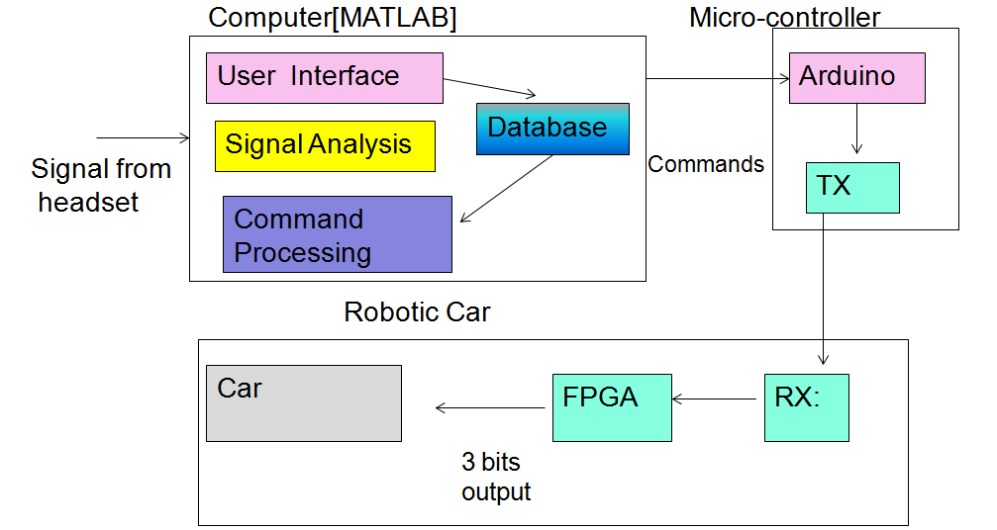
Previous Ver.
Notes:
****should we fix it at all…
--I do not think you have to include the old one.
- I put this one at the end … if the evaluators want to see it, we can pull it out. We don’t have to show them… maybe?

Slide 30

Naïve Bayes Classifier
Probabilistic classifier based on applying Bayes’ theorem.
Bayes Theorem:
Advantage :
Better performances when the amount of input is large
Easy to implement and requires O(n) run time.
A way to determine alpha and beta relationship with attention level
Notes:
What is Baye’s theorem. You should at least give a few word to explain it or an equation that helps the evaluators to understand. – Xueling Zhao

Slide 31
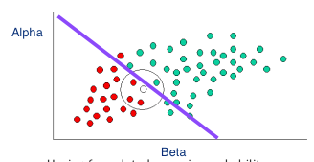
How To Use Naïve Bayes Classifier
P (High Attention) = 40 /60
P (Low Attention) = 20 / 60
Now , we have a new input X
P (X | High Attention)=1/ 40
P (X | Low Attention) 3 /30

