Slide 1
Comprehensive Design Review
Team14:
BMW Brainwave Manipulated Wagon

Slide 2






Team 14 Members
Zijian Chen
CSE
Tiffany Jao
CSE
Faculty Advisor:
Qiangfei Xia
Man Qin
EE
Xueling Zhao
EE

Slide 3
Outline
System Review
Demo Overview
CDR Demo
FPR Deliverables

Slide 4
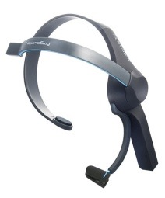
Previous Block Diagram
TX Arduino Module
C# Application
Computer
Arduino/
Bluetooth v3.0
ThinkGear Packet
Signal Processing
USB serial Write
Neurosky
headset
Database
XBEE:TX
Command Algorithm
User Interface
Man Qin
Motor
Arduino
XBEE: RX
Zijian Chen
Robotic Car
Xueling Zhao
Tiffany Jao
Power Supply

Slide 5
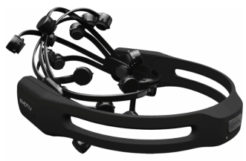
Revised Block Diagram
Computer
EEG data
C# Application
(training)Alpha, beta power
Proprietary wireless 2.4GHz
Signal Processing
Emotiv EPOC
headset
(real time) Alpha, beta power
Database
(Training Data)
(training)Alpha, beta power
Bayesian
Classifier
command
User Interface
Man Qin
Zijian Chen
Xueling Zhao
Bluetooth HC05
Tiffany Jao
Robotic Car
Arduino
Notes:
Input/out of each block

Slide 6
Current Control
Control using eye open/close
Alpha and beta power
Alpha power increases when close eyes
Use sensor around occipital lobe- visionary processing
O1

Slide 7
Signal Processing: FFT
Input: Raw EEG data from headset
C# library
Visualize raw EEG data in frequency domain
1 second frame － 128 samples
0.5 second overlapping window
Output: calculated alpha and beta total power
Alpha wave : 8 – 12 Hz
Beta wave: 13-30 Hz

Slide 8
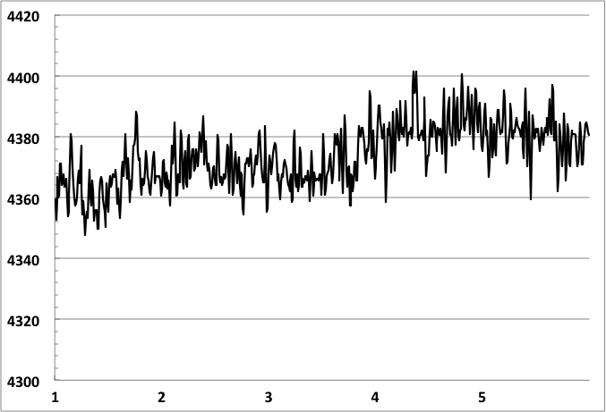
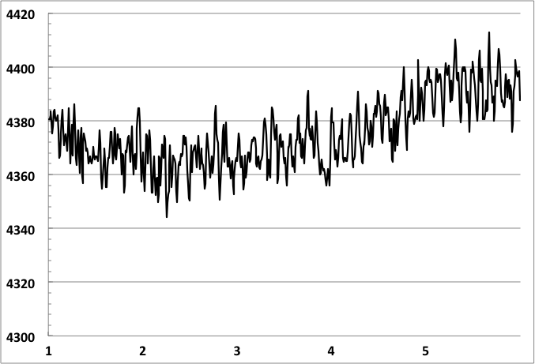
Before FFT: Raw EEG Data Voltage vs Time
Eye-Open
Voltage vs Time
Eye-Closed
Voltage vs Time
Voltage (uV)
Voltage (uV)
Time(Sec)
Fig1. (a)
Time(Sec)
Fig1. (b)
These two graphs are not meaningful as they are not indicting any information.

Slide 9
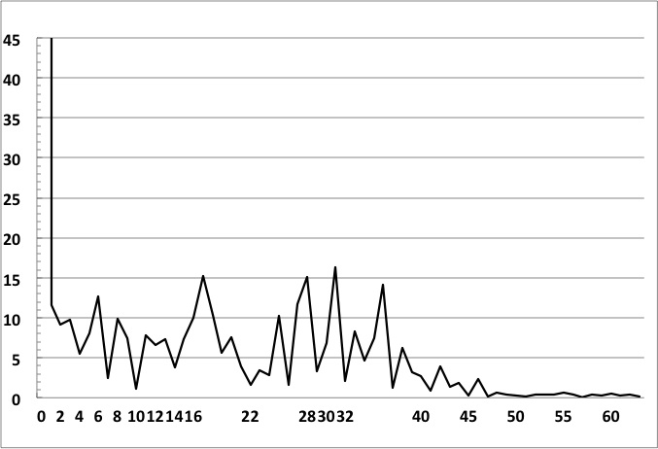
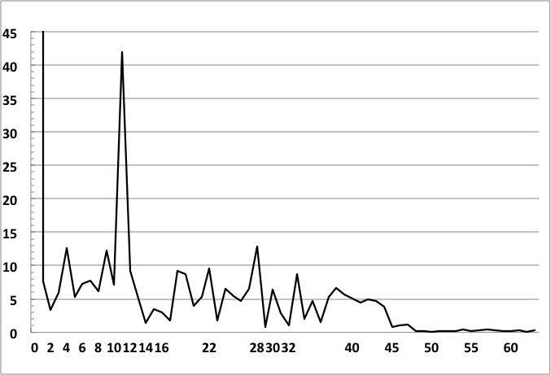
After FFT: Power vs Frequency
Eye-Open
Power vs Frequency
Eye-Closed
Power vs Frequency
Spike within alpha range
Power(Watt)
Power(Watt)
Frequency(Hz)
Fig2. (a)
Frequency(Hz)
Fig2. (b)
A dominant spike is observed in Fig2. (b) Eye-Closed.

Slide 10
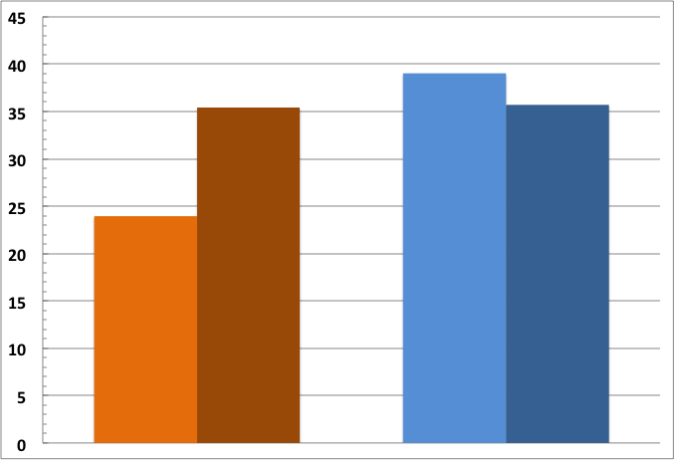
FFT: Alpha and Beta Power Comparison
Eye-Open vs Eye-Closed
Alpha
Beta
Power Level
Fig3. Alpha power increases obviously, while Beta power stays in similar level
Open
Closed
Open
Closed
Fig3.

Slide 11

Naïve Bayes Classifier
Probabilistic classifier based on applying Bayes’ theorem.
Bayes Theorem:
Why Naive Bayes Classifier :
Provide strong machine learning ability to adapt patterns
Run faster that other classifier, Need O(1) run time.
High accuracy for classification with small size of training set.

Slide 12
Naïve Bayes Classifier
How to Use ?
average of closed-eye alpha, beta
FindReference Point()
(Alpha,Beta,Trigger)
Real Time Data
AnalysisTrainingSet()
Database
(Training)
Update probability
(alpha, beta)
classify()
compare probability
of trigger on and off
output
(true/false)
Notes:
What is Baye’s theorem. You should at least give a few word to explain it or an equation that helps the evaluators to understand. – Xueling Zhao

Slide 13
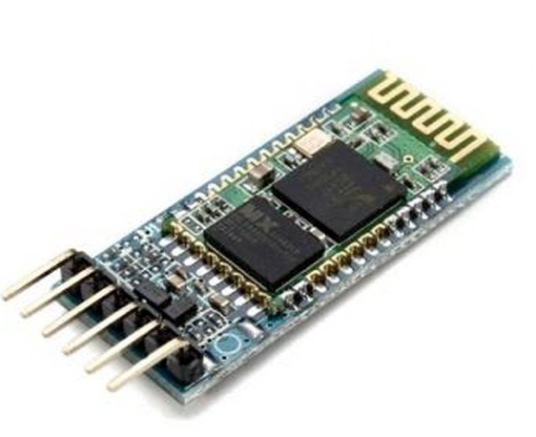
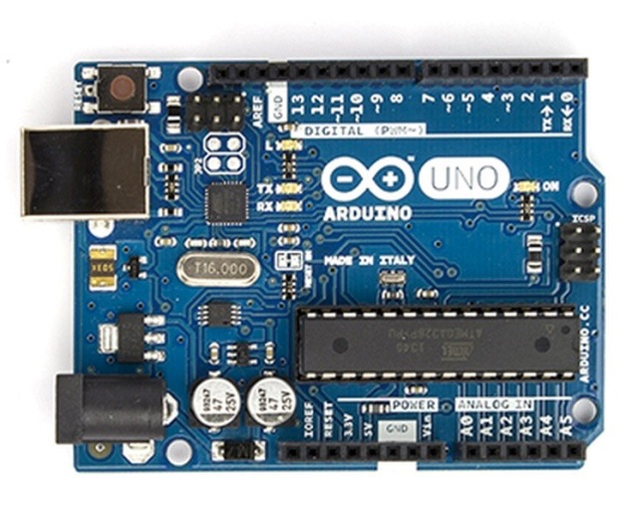
Remote Robotic Car
HC-5 Bluetooth Module
Arduino Uno

Slide 14
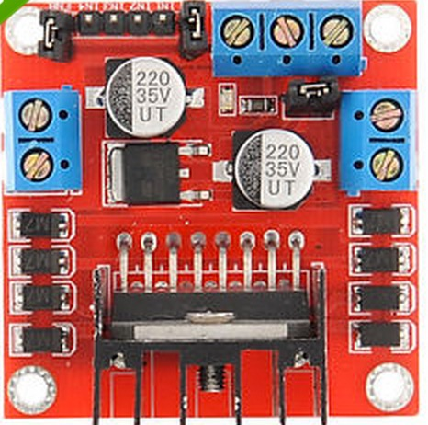
Remote Robotic Car
Power
L298N Motor Driver Board
Power Supply
Powered by 6 AA batteries which have
total voltage of 9v.
Digital Input
From Arduino
Output to motor

Slide 15
Remote Robotic Car
HC-5
bluetooth module
L298N Motor Driver Board
Arduino
6 AA Batteries power
2 Motors

Slide 16
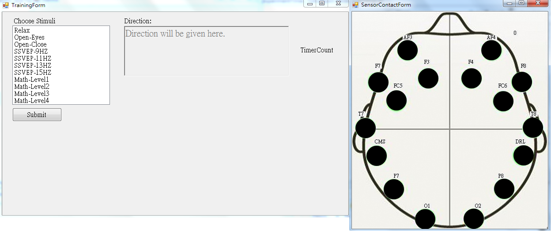
Graphical User Interface - Training

Slide 17
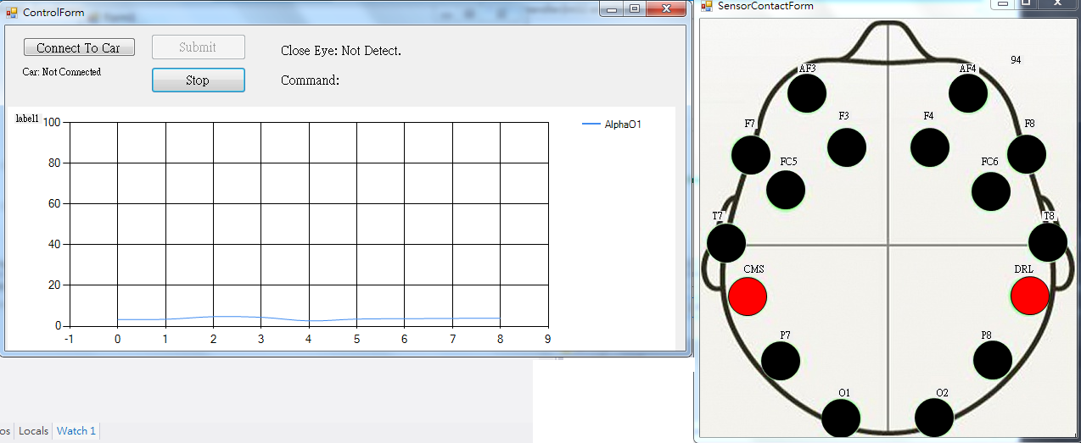
Graphical User Interface - Control

Slide 18
Outline
System Review
Demo Overview
CDR Demo
FPR Deliverables

Slide 19
Demo Overview
Utilize the brainwave to control the robotic car
forward/stop
What’s working | Issues
Data retrieval from Emotiv real time signal processing Bayesian classifier distinguished eye open/close state Software interfacing with robotic car | 1 second delay between car and the software Wireless interference misclassified result

Slide 20
Outline
System Review
Demo Overview
CDR Demo
FPR Deliverables

Slide 21
Outline
System Review
Demo Overview
CDR Demo
FPR Deliverables

Slide 22
Proposed FPR Deliverables
Minimize the amount of misclassified command
filter outlier in training set
Ability to classify another command
Turning
Minimize delay

Slide 23
Thank you
Questions?

Slide 24
Backup Slide

Slide 25
Naïve Bayes Classifier
Find Reference Point
Get the average alpha and beta from training set
Remove unusual-high alpha or beta data
Use to determine if alpha or beta is high or low
Notes:
What is Baye’s theorem. You should at least give a few word to explain it or an equation that helps the evaluators to understand. – Xueling Zhao

Slide 26
Naïve Bayes Classifier
AnalysisTranningSet()
Update Probability Table base on Training Set
P(H_Alpha|Trigger) | P(H_Alpha|NO_Trigger)
P(L_Alpha|Trigger) | P(L_Alpha|NO_Trigger)
P(H_Beta|Trigger) | P(H_Beta|NO_Trigger)
P(L_Beta|Trigger) | P(L_Beta|NO_Trigger)

Slide 27
Naïve Bayes Classifier
Classify
Calculate probability of trigger on
on ← argmax P(Y = t)∏P(Xi|Y = t)
Calculate probability of trigger off
off ← argmax P(Y = NO_t)∏P(Xi|Y = NO_t)
Compare on and off
return classified result

Slide 28
Why changes the headset?
It is needed to have more than 1 sensor for accurate measurement
2 references sensor

Slide 29
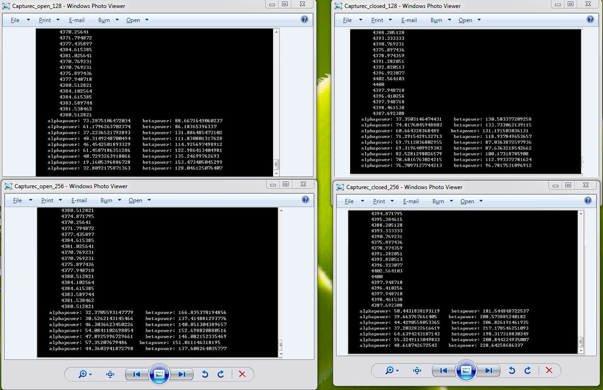
FFT 1-sec frame vs 2-sec frame

