Slide 1

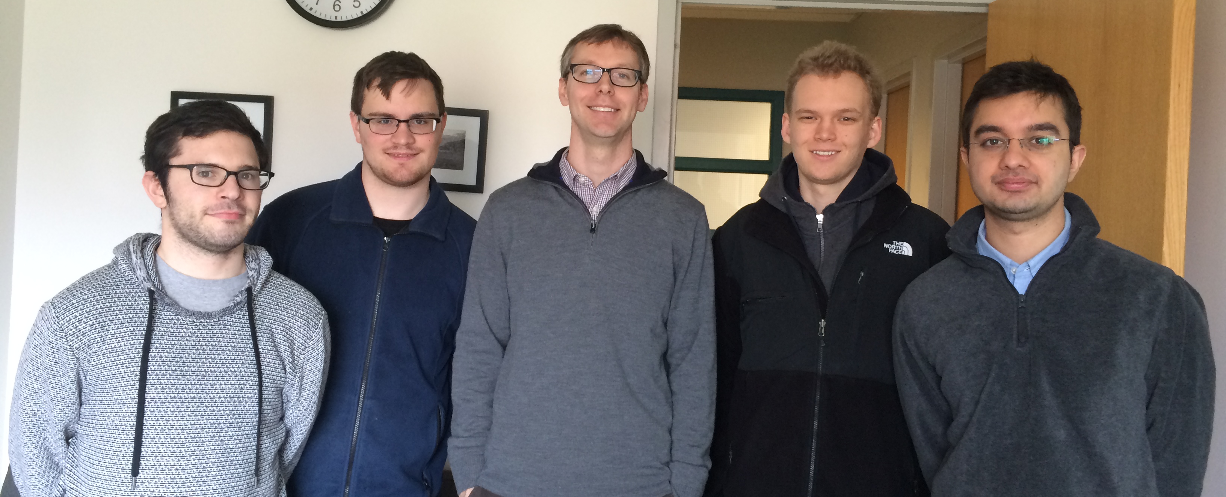
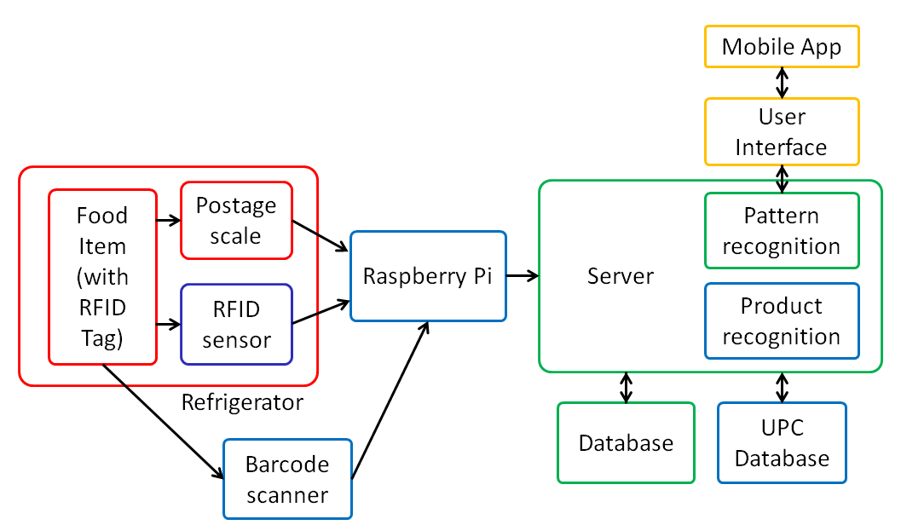
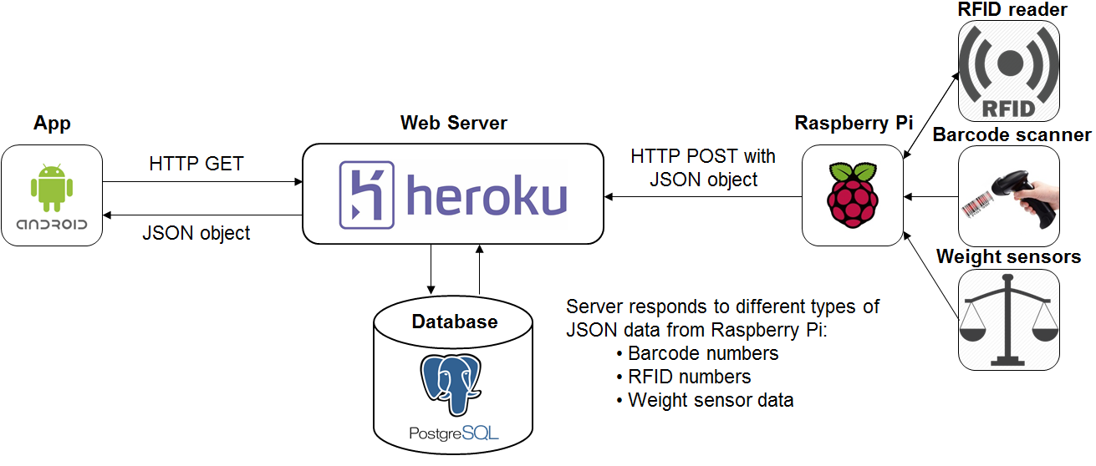

Frij
Andrew Paisner, Carlton Jones,
Amrit Khalsa, Shravan Nayak
Faculty Advisor: Prof. David Irwin
Abstract
Block Diagram
Frij is an RFID based smart refrigerator that keeps track of items that are stored inside it and generates a shopping list when an item is running low. The system uses a combination of weight and RFID data to determine when items are inserted into or removed from the refrigerator. With this data the system can compile grocery lists automatically and alert users when they run low on certain items. The current inventory and weight data is displayable on an Android app. Frij can easily be integrated with grocery delivery services.
System Overview
Specifications
Results
Parameter | Spec.
Resolution of scale | 3oz
Max. total weight | 20lbs
Max. items | 10
Item detection | 90%
RFID-Server Latency | <1s
Barcode-Server Latency | <1s
Server to android app latency | <0.5s
Overall system latency | <3s
Database query latency | 31ms
Frij can successfully keep track of multiple items, generate a shopping list, and alert the user when an item is low.
Acknowledgement
We would like to thank Prof. David Irwin, our project advisor. Also we would like to thank our evaluators, Prof. Soules and Prof. Kwon. Finally, we would like to thank to Fran Caron.
Department of Electrical and Computer Engineering
ECE 415/ECE 416 – SENIOR DESIGN PROJECT 2015
College of Engineering - University of Massachusetts Amherst
SDP15

Slide 2
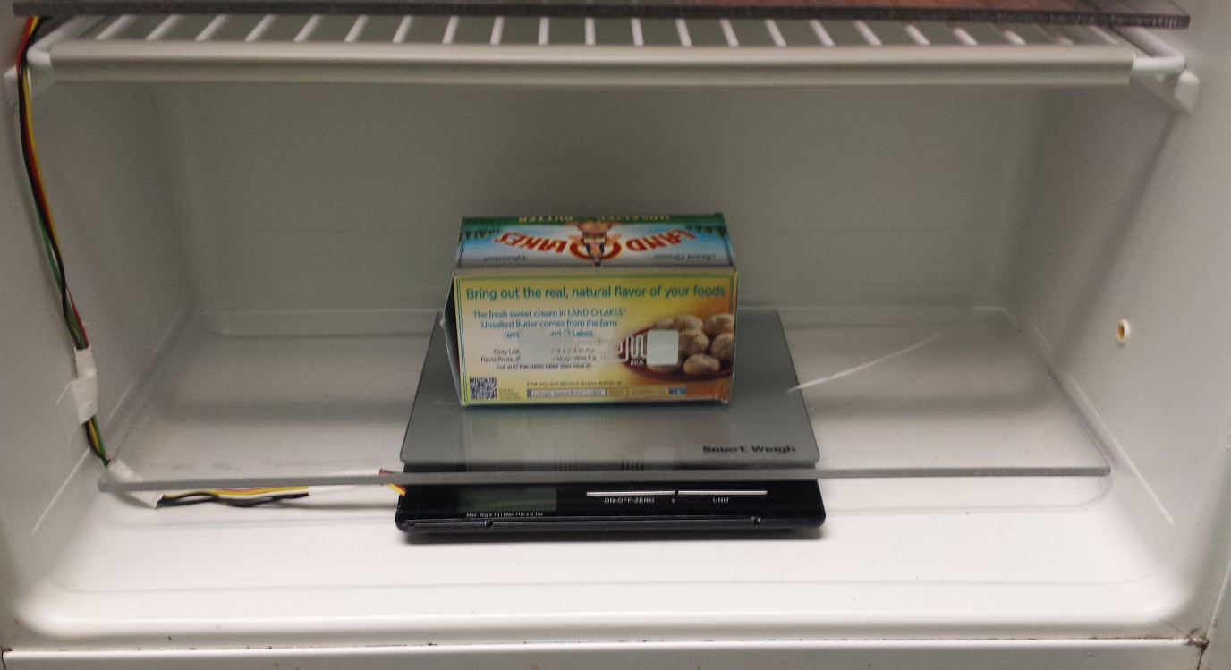
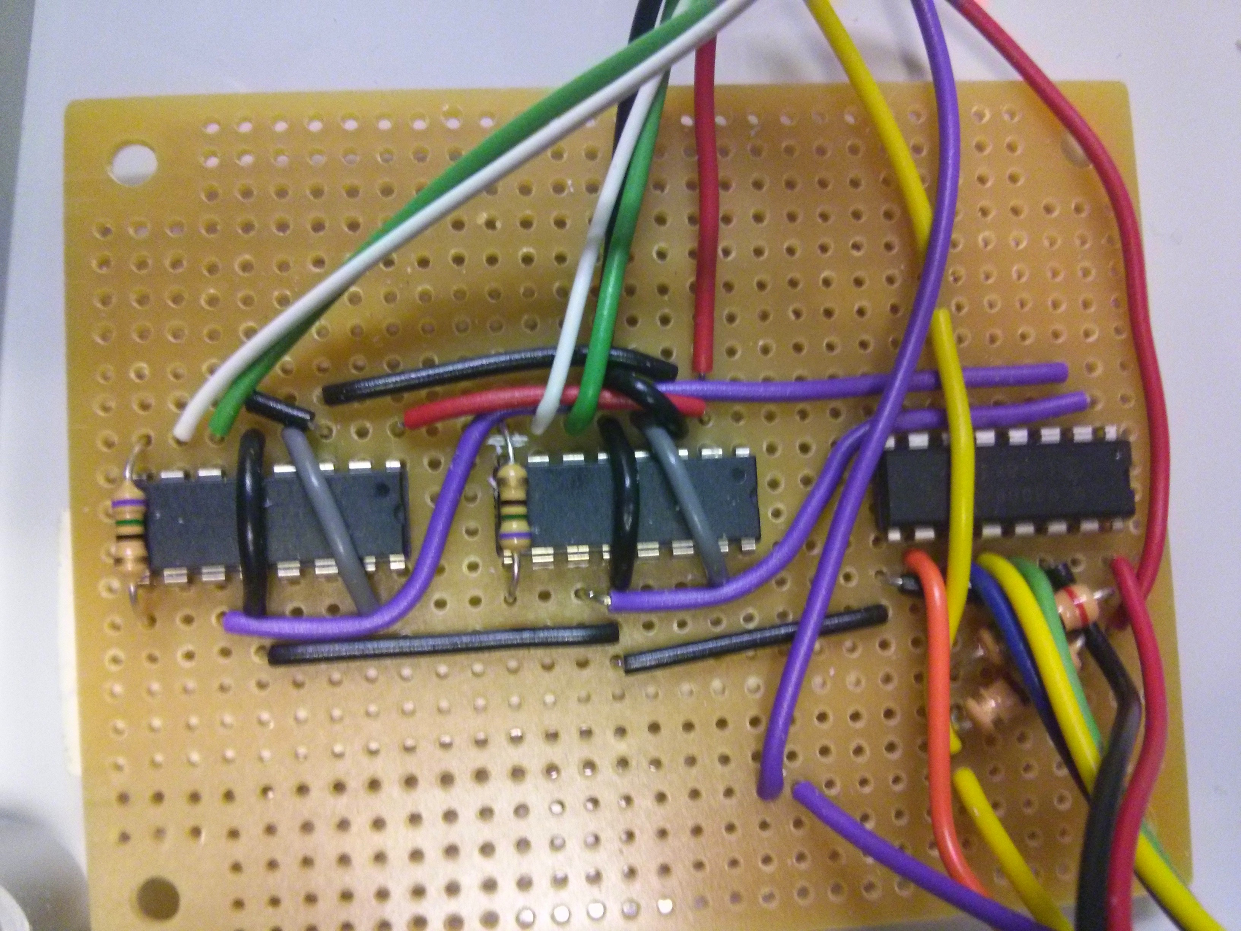
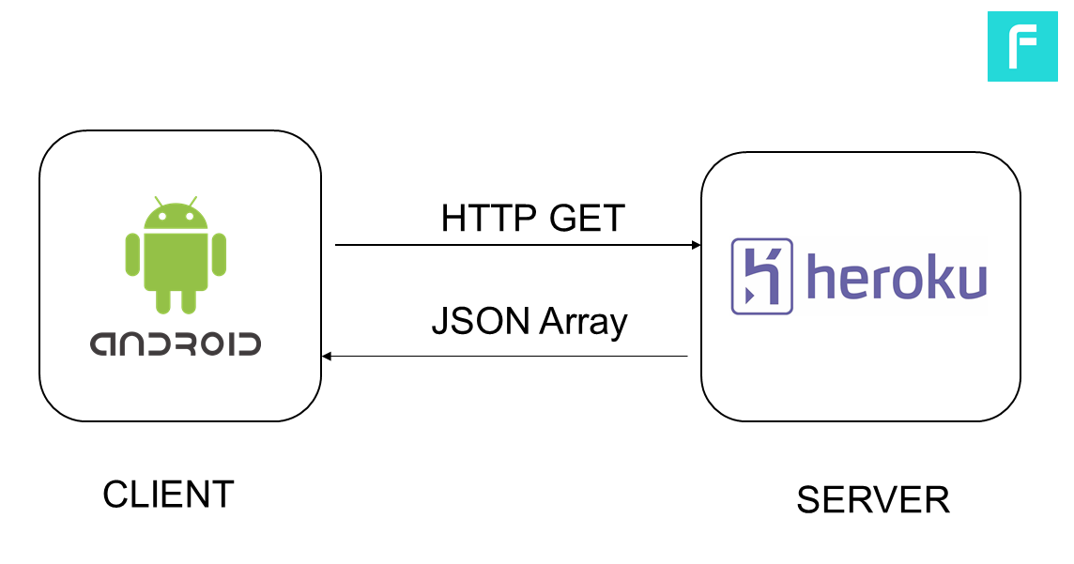
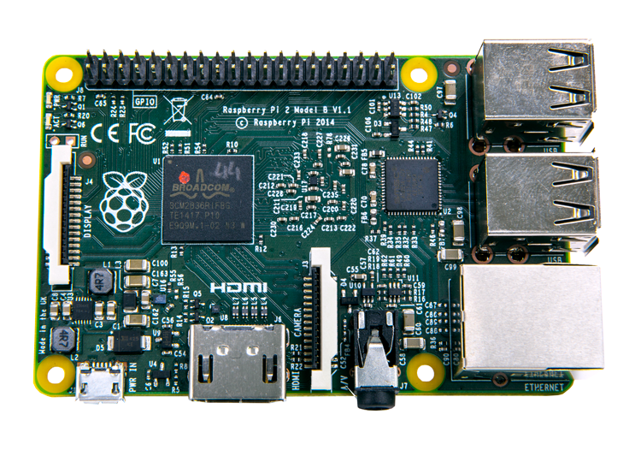
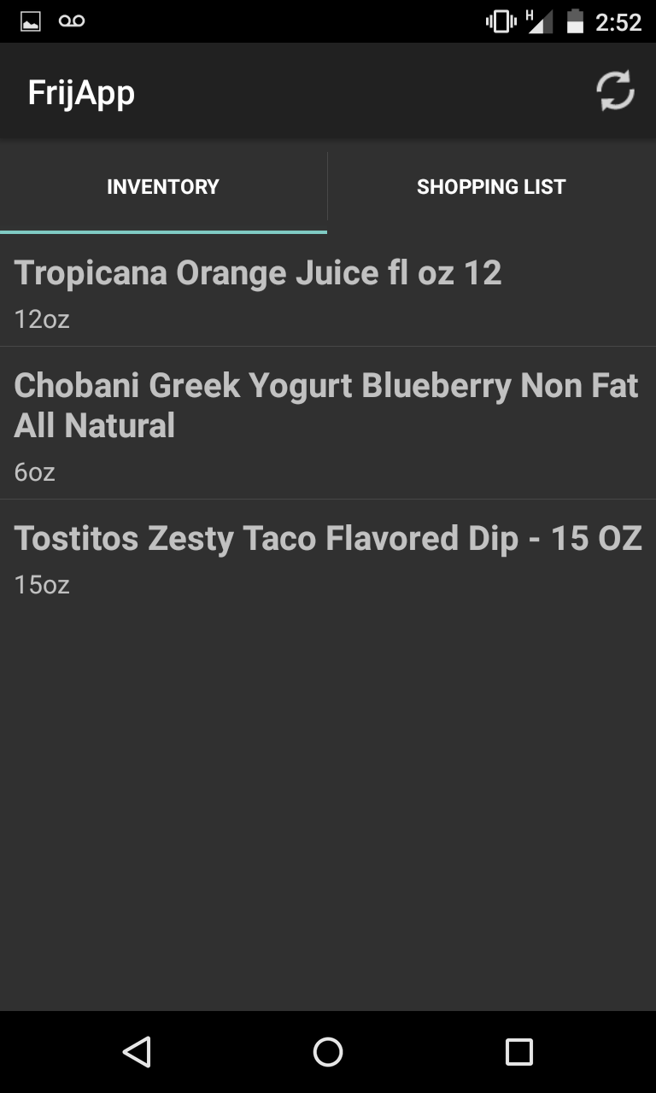
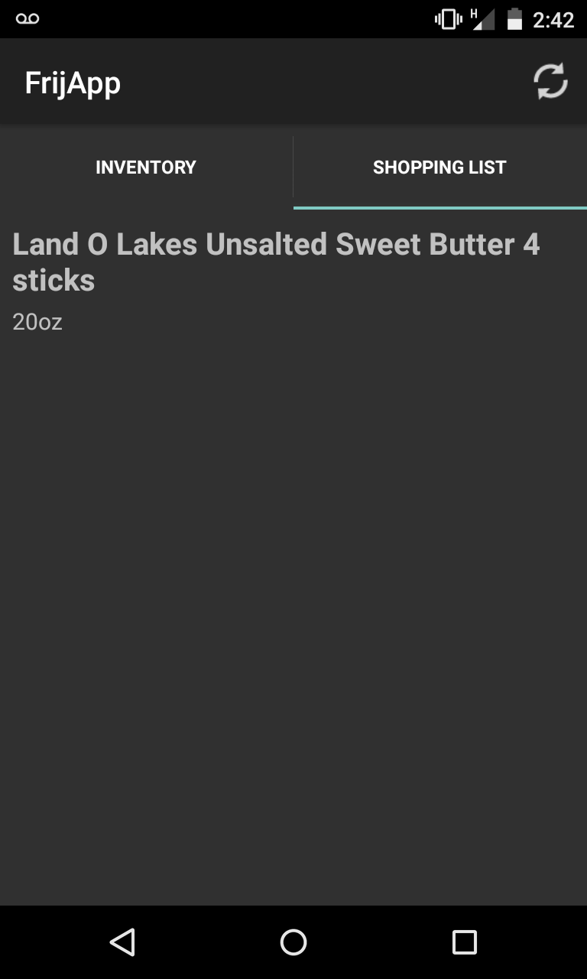
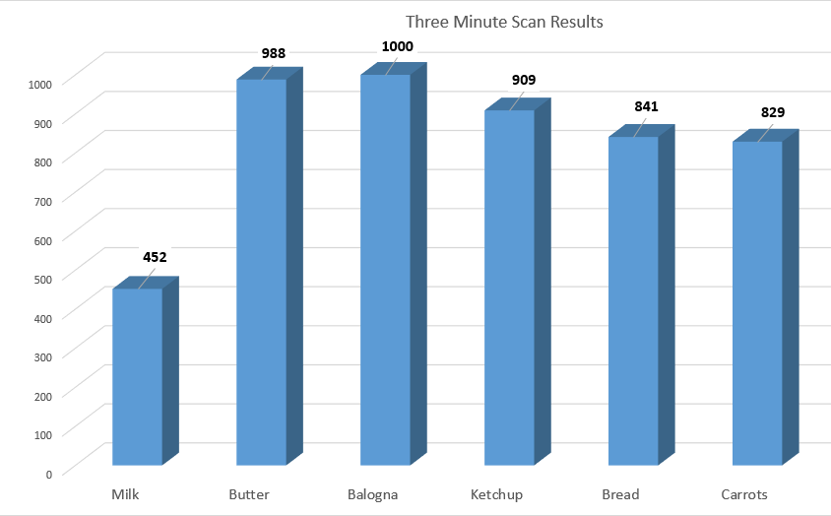
Android app communicates with the Heroku server
Displays current inventory and shopping list
Multithreaded architecture
Main user interface thread
One network thread for accessing the inventory
Second network thread for accessing the shopping list
Weight Sensors
Server/Database
Processes data from Raspberry Pi; sends data to app
Hosted on Heroku
Java HTTP web server (Jetty)
PostgreSQL database
Twilio alerts based on weight or absence of item
Thread #1
Example database entry
Thread #2
Three main components:
Weight scales
Amplification circuit
Door sensors
Queue
Barcode handler
JSONObject
Tag handler
Responds to web requests
Weight handler
Processes data from queue and interacts with database
Amplification circuit
Server runs two threads. Thread #1 receives JSON objects from Raspberry Pi and places them into a buffer for thread #2 to process.
RFID Reader, Barcode Scanner, and Raspberry Pi
Android App
Barcode, RFID tag and weight data is sent to the Raspberry Pi
Raspberry Pi constructs JSON objects and sends them via HTTP POSTs to the Heroku server
Product names are retrieved from UPC Database using barcode from barcode scanner
Cost
Development
Production
RFID Scan Test
Part | Price
RFID Reader | $165
Raspberry Pi 2 | $63
Scales and Parts | $80
RFID Tags (x10) | $2.39
Total | $308+
Part | Price
RFID Reader | $150
Raspberry Pi 2 | $56
Scales and Parts | $74
RFID Tags (x10) | $2.39
Total | $280+
Number of times an item was scanned by the RFID reader during a 3 minute interval

