Slide 1


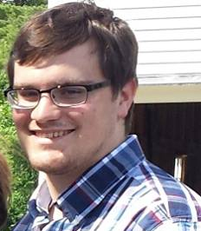

FRIJ
Andrew Paisner - EE
Carlton Jones - EE
Shravan Nayak -CSE
Amrit Khalsa – CSE
Adviser: Prof. David Irwin

Slide 2
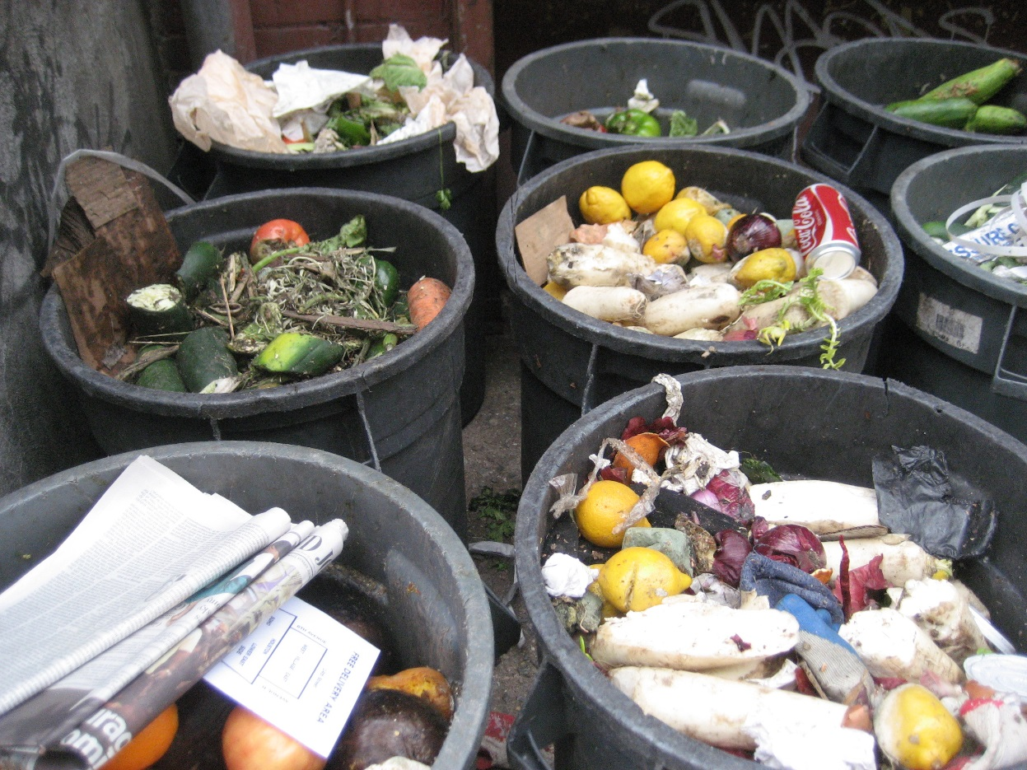
Problem Statement: Food and Time Waste
40% of food in the US goes uneaten^{[1]}.
25% of food and beverages bought by American families is thrown away^{[1]}.
The average American spends 273.7 minutes a week total shopping for and preparing food^{[2]}.

Slide 3
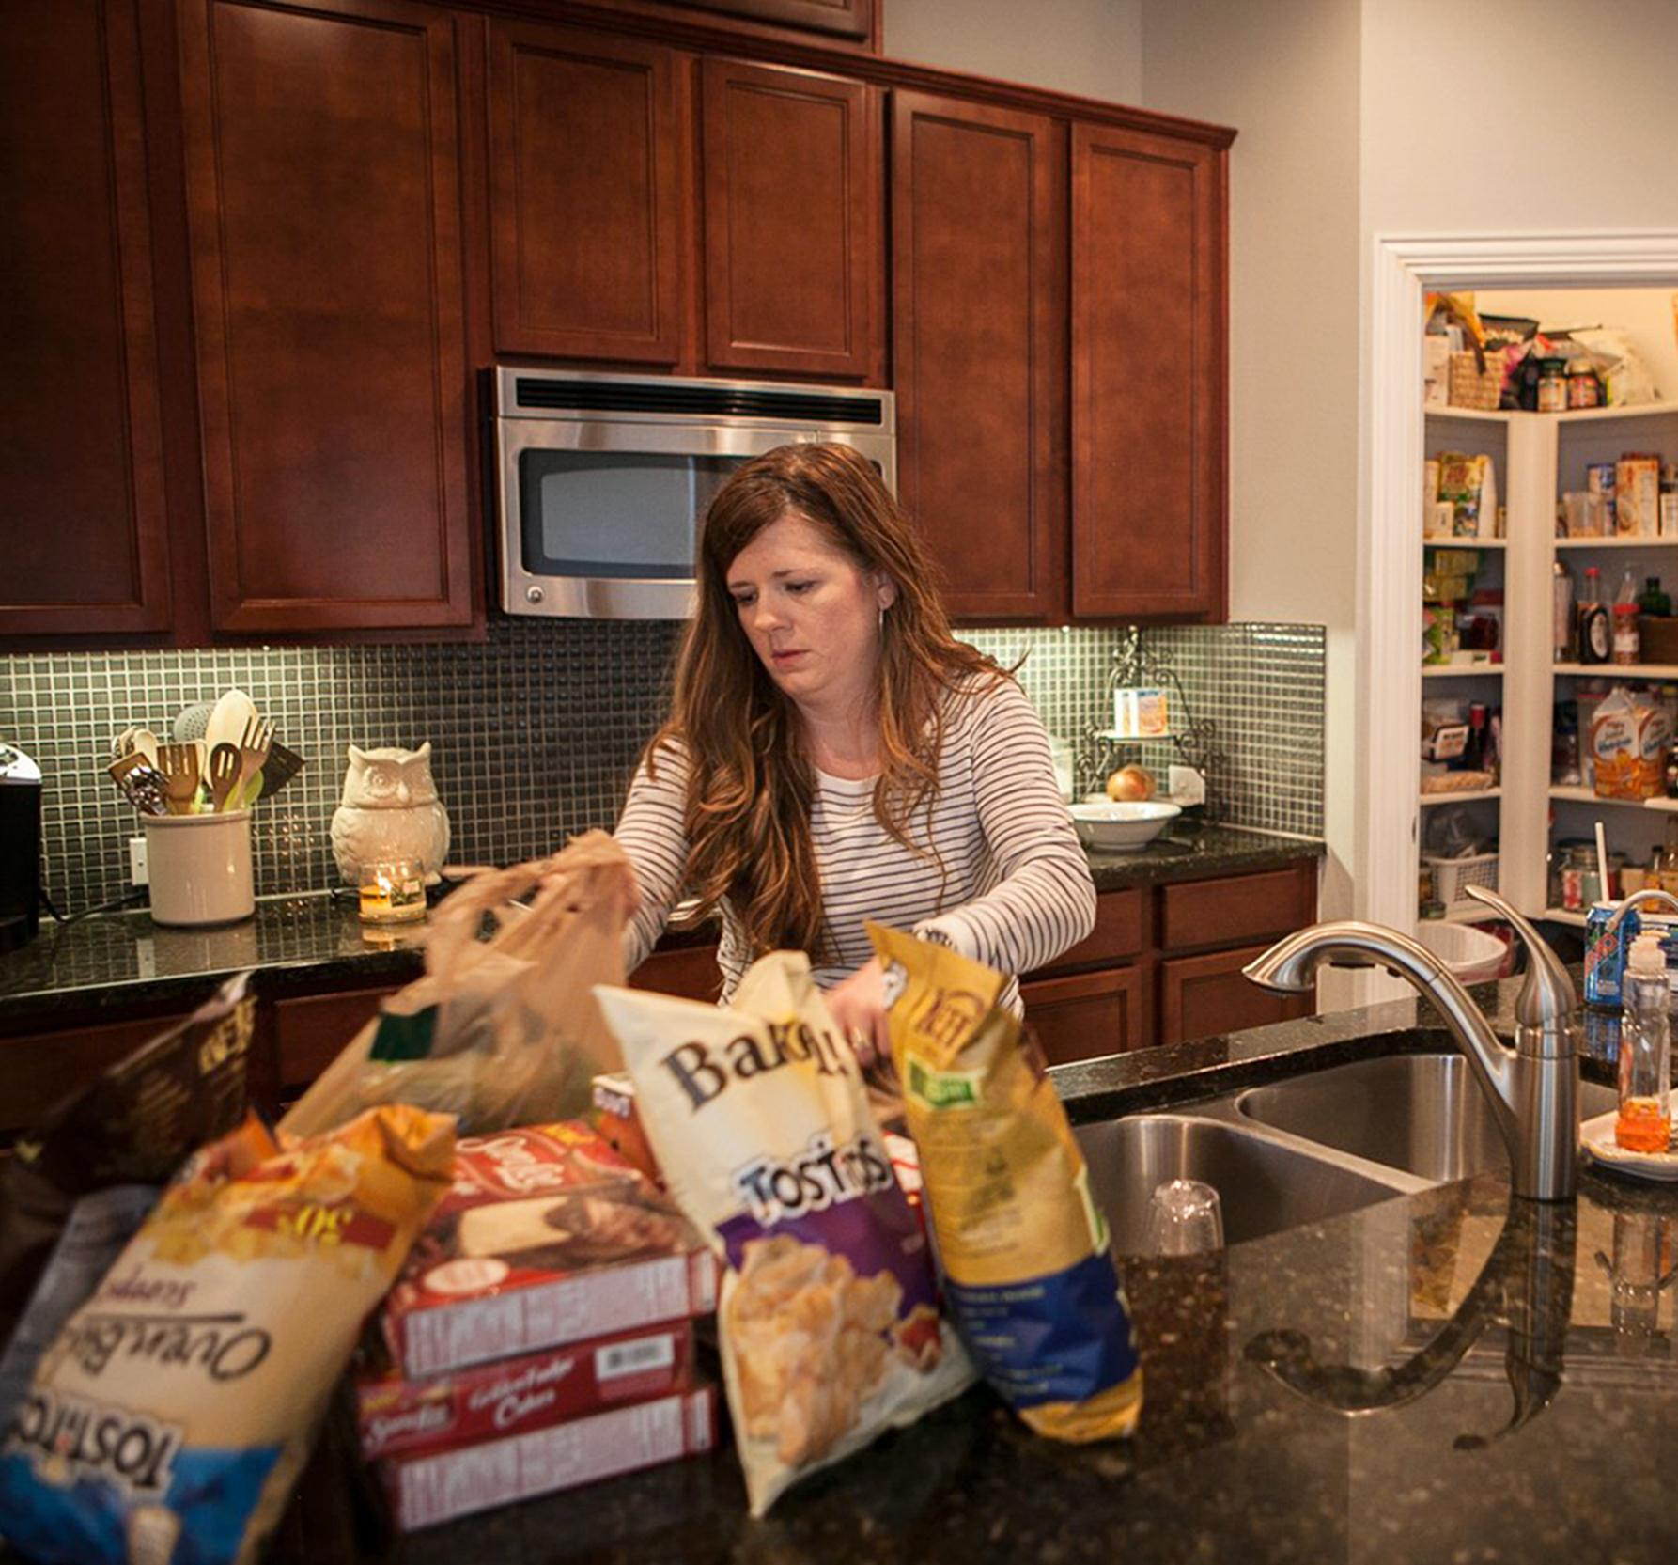
Problem Statement: Context
Food is an overused, underappreciated resource.
The average American wastes a considerable amount of time to feed themselves every day.
Both of these problems can be made more efficient on the household level.

Slide 4
Requirements Analysis:
Keeps track of food items.
Alerts you to missing items in real time.
Saves time planning and grocery shopping by making mobile grocery list.
Easier and quicker to use than current smart fridges.

Slide 5
Requirements Analysis:
Investments:
$500
Household inventory logging (Hardware)
Pattern recognition and food identification system (Software)
Returns:
Real time inventory
Automatically generated grocery list
Food spoilage alerts

Slide 6
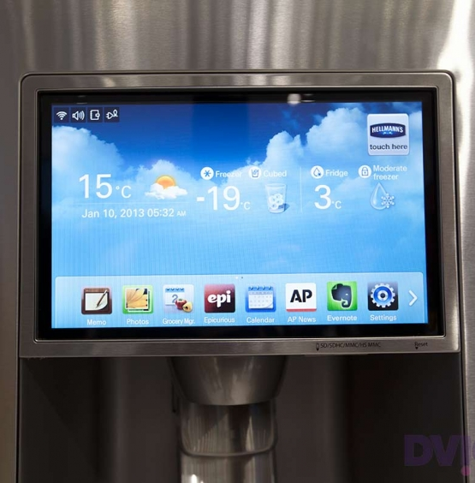
Design Alternatives
Handmade grocery list
Automatic food delivery (e.g. Peapod, milkman)
Manual input smart fridges (available)
Location-based smart fridges (available)

Slide 7
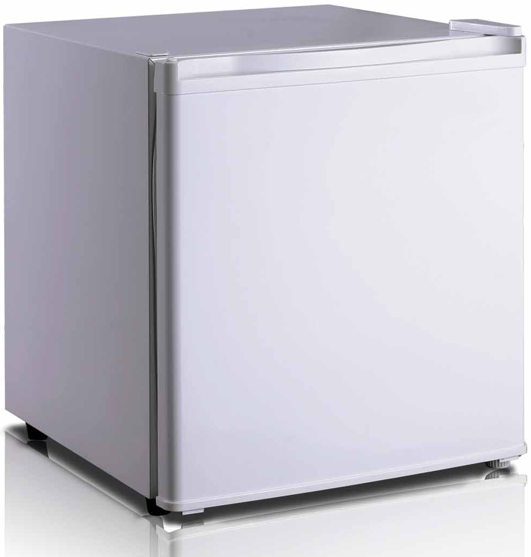
Our Solution: FRIJ
RFID inventory tracking
Automatic item recognition
Cloud based database
Predictive grocery list
Mobile app

Slide 8
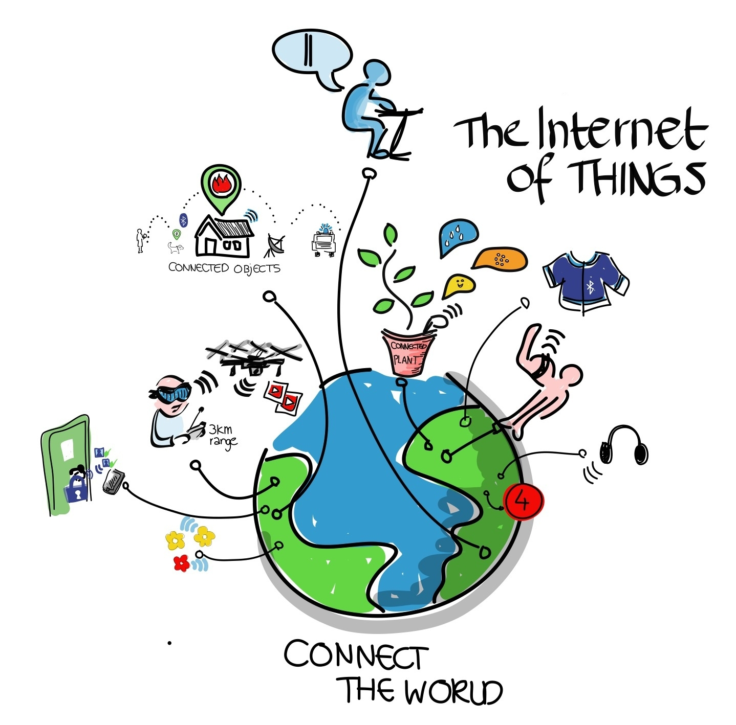
Motivation
Internet of Things(IoT) is a $2 trillion market ^{[3]}
RFID tagging is getting cheaper
Idea of Smart Fridges - 1990s
  Problems: Needs too manually input item or put it in the correct place

Slide 9
Block Diagram
Block 1: Carlton Jones - EE
Block 2: Andrew Paisner - EE
Block 3: Shravan Nayak -CSE
Block 4: Amrit Khalsa - CSE
Mobile App
User Interface
Refrigerator
Server
Food Item
(with RFID Tag)
Weight sensor
Pattern recognition
Raspberry Pi
RFID sensor
Product recognition
Database
UPC Database
Barcode scanner

Slide 10
Block 1: Carlton Jones
Accurate RFID tag reading inside of refrigerator, without interference by other food items or refrigerator body
Weight sensors to determine how much of a food item is left and when items are inserted or removed
Sensors send data to Raspberry Pi
Installing hardware in/on refrigerator unobtrusively
Integrating with power source or using battery power

Slide 11
Work Plan: Carlton Jones
High frequency or ultra high frequency RFID scanner
  At least 13.56MHz, ~1m read distance, frequency hopping to read 10-30 tags at once
  Note: Probably a large part of the budget
Passive RFID tags
  Small enough to be attached to small food items
Custom built scales
  One on each shelf, so that any item placed in the refrigerator will be weighed
  Easily made using load sensors under custom shaped plates

Slide 12
Block 2: Andrew Paisner
Product recognition
  Associates an RFID tag, barcode, and weight with a food item
  Recognizes when items enter and leave
UPC database interface and processing
  Looks up scanned barcode in UPC database
  Parses UPC data into a generic form - e.g. Great Value 2% Reduced Fat Milk 1 gal to food type: milk, size: 1 gallon

Slide 13
Work Plan: Andrew Paisner
Barcode Reader
  Will be connected to the Raspberry Pi via USB
  For each item that is scanned an RFID tag is paired with that item
  Barcodes and RFID tag numbers will be stored in a database on the server
Raspberry Pi
  Once the barcode data is scanned it is transmitted to a server and associated with an RFID tag
UPC Database
  Product names and possible weight data are retrieved from UPC Database

Slide 14
Block 3: Amrit Khalsa
Server:
  Listens for data from Raspberry Pi
  Responds and sends data to/from Android app
  Appropriately saves data to database
  Implement security measures for confidentiality, integrity and authentication
Database:
  Has at least three tables: inventory, statistics, and users
  Uses API to insert into or to query database tables
Algorithms:
  Link weight sensor data to item removed/inserted
  Detect when an item has been permanently removed
  Pattern recognition: produce consumption analysis from data
  Produce grocery lists, graphs, or other analysis on consumption

Slide 15




Work Plan: Amrit Khalsa
Heroku cloud platform
Heroku PostgreSQL or MySQL add-on
Either Java, node.js or both
  Java for CPU bound tasks and database
  interface
  node.js for network I/O
  Both: use node.js for communication and
  Java for everything else. Integrate using API.

Slide 16
Block 4: Shravan Nayak
Requirements:
  App development- Android app
  User Login
  Display real time inventory
  Auto generate a grocery list
  Manually add/remove items
  Alerts user when item needs to be restocked
Future Add-ons:
  Image search for food items
  Auto order a product via Peapod/Amazon
  Recipe based on items in the fridge
  Encryption using 256 bit key

Slide 17
Work Plan: Shravan Nayak
Android App
  Platform- Android SDK
  UI- Ionic Framework
  Java, XML, Java Script
  Communication between the Android API, Heroku server, and database
  Client-server between API
  UI displays real time inventory- Socket IO
  Grocery shopping list- alert user- Twilio API

Slide 18
MDR Deliverables
RFID reader reading tags in refrigerator
RFID reader and weight sensors communicating with Raspberry Pi
Barcode scanner with UPC API lookup
Server that will store and remove food items, weights, and their barcode/RFID data
Develop the UI for the app and communicate with the server.

Slide 19
Citations
1: http://www.nrdc.org/food/files/wasted-food-ip.pdf
2: http://www.ers.usda.gov/media/149404/eib86.pdf
3: http://www.zdnet.com/internet-of-things-market-to-hit-7-1-trillion-by-2020-idc-7000030236/

Slide 20
Optional Additional Designs
Works with supply side RFID
NFC tags
Receipt parsing via OCR
Interface with grocery delivery services (i.e. automatic ordering)
Interface with Paprika recipe manager
Non-refrigerated inventory (automatic or manual)
Scan items as the are thrown out to ensure accuracy
Compatible with Weight Watchers or similar

Slide 21
Individual Responsibilities
Andrew Paisner
Product recognition, UPC database interface and parsing.
Carlton Jones
RFID tags and sensor, weight sensor, refrigerator integration.
Shravan Nayak
Interface between Raspberry Pi and server and Android application.
Amrit Khalsa
Interface between database and server, pattern recognition.

