Slide 1

CDR Presentation
Team Frij

Slide 2


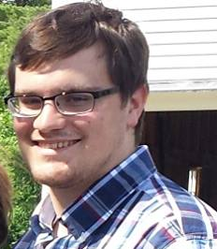

Team FRIJ
Andrew Paisner - EE
Carlton Jones - EE
Shravan Nayak -CSE
Amrit Khalsa – CSE
Adviser: Prof David Irwin

Slide 3
The Frij – Goals Reiterated
RFID and weight sensors keep status of food items in the Frij
Accurate and easy product identification via interface with UPC (barcode) database
Server/Database stores inventory for easy access and generates shopping list
App displays current inventory and accesses database-generated shopping list

Slide 4
The Frij – Quantitative Goals
Resolution of scale: 3 ounces
Able to weigh up to 20 lbs of products
Able to track at least 10 items
90% accuracy in detecting items in the fridge
RFID to server latency: <1s
Barcode to server pi latency: <1s
Server to android app latency: <500ms
Overall system latency: <3s

Slide 5
Block Diagram from PDR
Block 1: Carlton Jones - EE
Block 2: Andrew Paisner - EE
Block 3: Shravan Nayak -CSE
Block 4: Amrit Khalsa - CSE
Mobile App
User Interface
Refrigerator
Server
Food Item
(with RFID Tag)
Postage scale
Pattern recognition
Raspberry Pi
RFID sensor
Product recognition
Database
UPC Database
Barcode scanner

Slide 6
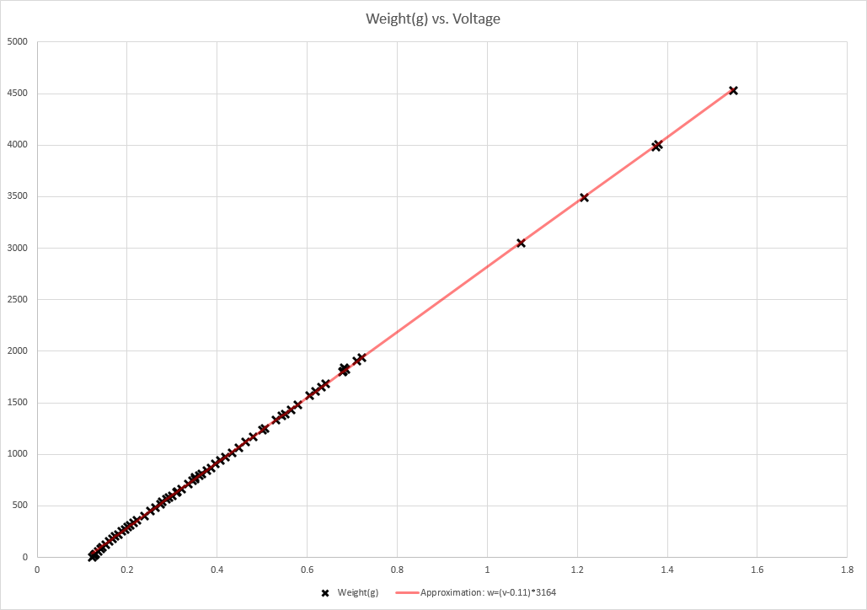
Block 1: Carlton Jones – Scale
Ordered 5kg/11lb rated postal scale
  Intend to install another one on bottom shelf
Bridge feeds INA 125P instrumentation amplifier
Read by Pi via ADC
Built work-around for
auto-off feature
Measured and plotted
weight vs voltage
  Estimated formula:
  w=(v-011)*3164
  Small fluctuations, <1oz

Slide 7
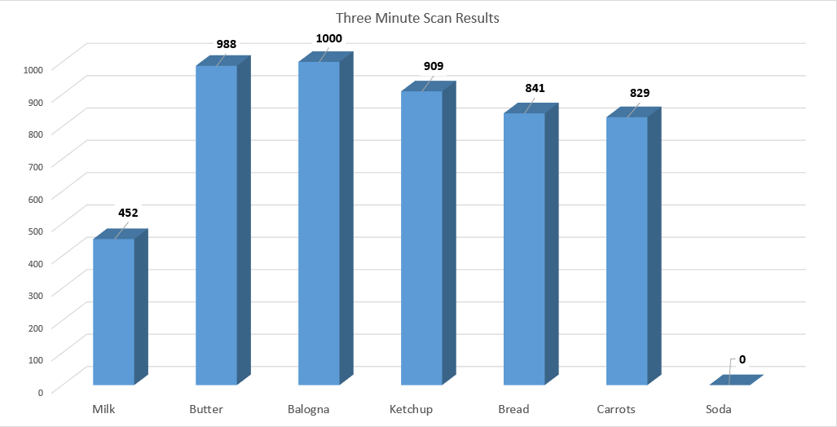
Block 1: Carlton Jones – RFID Tags
Installed RFID Reader in refrigerator
Adhered tag to various items, ran for ~3 minutes
  Milk (liquid in plastic bottle) scanned ~45% as often as easiest items
  Soda (in metal can) does not scan at all
Scans items on other
shelves and behind
most items
Will scan more than
ten tags at once

Slide 8
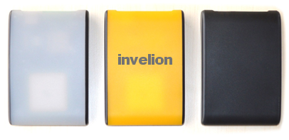
Block 2: Andrew Paisner – RFID Reader
Wrote code to mimic RFID reader’s Windows sample program in Linux for Raspberry Pi
  Polls for tags in range of reader, writes them to file
Sends list of tags in JSON array to server, with current total weight and new UPC codes
  Determines if weights and codes have changed since last posting to server
Repeats process once the server has acknowledged data

Slide 9

Block 3: Amrit Khalsa – Server
Server now links barcode, RFID tag, and weight data together
  Links based on ordering and timing
Server now sends shopping list to App based on missing items
Server now multithreaded
Observed latency for executing queries: 31ms

Slide 10
Block 3: Amrit Khalsa – Server
Main thread
Consumer thread
RPQueue
Barcode handler
EPC tags handler
JSONObject
Weight handler
Responds to web requests
Processes data from web requests and interacts with database

Slide 11
Block 3: Amrit Khalsa – Server
RFID tag and weight data consistency
For each received EPC tag…
  Check if active (already in Frij)
  Check if inactive (returning)
  If not in list, associate with first tagless item
  Mark missing items inactive
For each new weight data…
  Check if new
  Else check if new weight is < stored weight Update stored weight
  Else check if new weight > stored weight, find difference and update weight for most recently entered item

Slide 12
Block 4: Shravan Nayak – App
Shopping list integration
  App sends an HTTP GET request to the url of Heroku server
  Heroku server sends a JSON array containing the JSON objects to the app which contains the current inventory
  Items that have been outside the fridge for a certain duration are automatically added to the shopping list
  Heroku server also sends a JSON array containing the JSON object to the app which contains the shopping list
Real time weight
  Android app is also able to display the real time weight of the items in the fridge
Observed latency : <500ms

Slide 13
Proposed CDR Deliverables
Hardware features completed
  Installed in refrigerator unobtrusively
  USB (or other) weighing scale
  Accurate weight sensing (can be compared to UPC)
  Integrated power supplies
Pi sends RFID data and is connected via Wifi
Accurate product description from UPC lookup
Server and database with product history and intelligence algorithms
Android UI with complete functionalities
  Incorporating shopping list generated by server
Notes:
13
13
13

Slide 14
Accomplished CDR Deliverables
Hardware features completed
  Installed in refrigerator
  Very accurate postage scale
  Scale and RFID reader tested for accuracy
Raspberry Pi sends RFID tags, weight, and barcode data
Server and database with product history
Android UI with complete functionalities
  Incorporating shopping list generated by server
Notes:
14
14
14

Slide 15
Intended FDR Deliverables
Hardware features clean and perfected
  Second postage scale for bottom shelf
  Power supplies and data cables neatly integrated into refrigerator
Pi begins on refrigerator startup and connects to local Wi-Fi automatically
Understandable and accurate product names
Server and database with intelligent algorithms to suggest grocery items
Incorporating alerts on the android app when item is running low or consumed
Notes:
15
15
15

