Slide 1
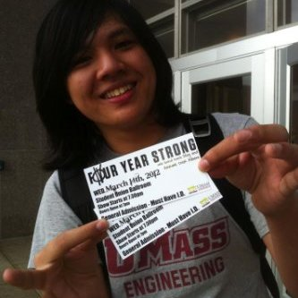
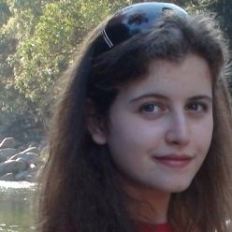
Team AutoTabber
Taryk Alsagoff (CSE)
Michael Murphy (EE)
Michaela Shtilman-Minkin (CSE)
Matthew Wojick (EE)
Notes:
Everybody

Slide 2
Our Vision
AutoTabber
A frustration-free system for producing tabs in minutes
Notes:
Michaela

Slide 3
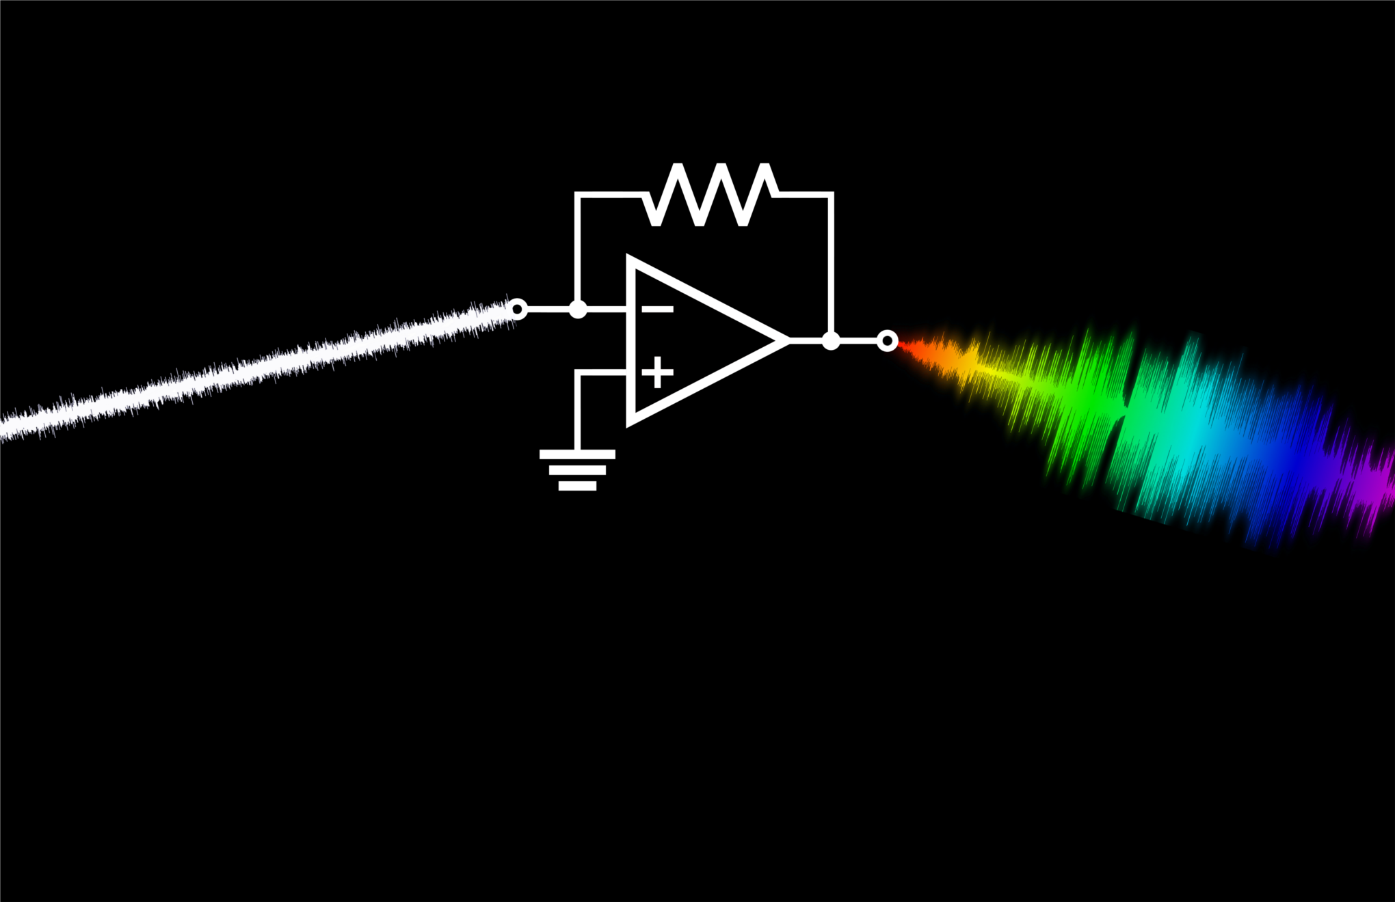
First Things First… …some music education!
Notes:
Michaela

Slide 4
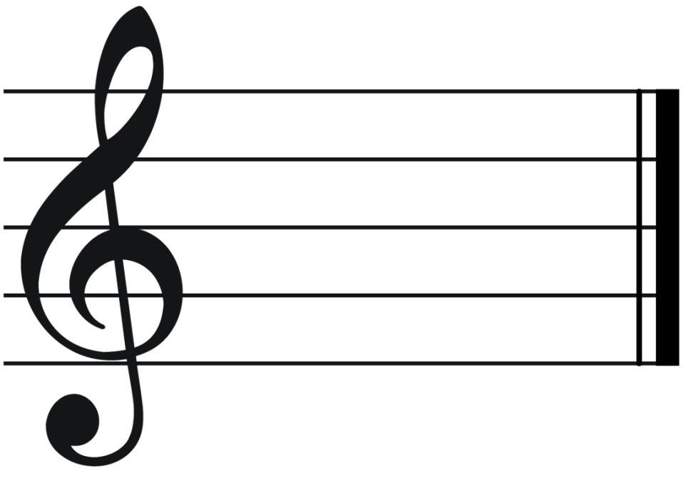
Formal Music Notation
Notes:
Taryk

Slide 5
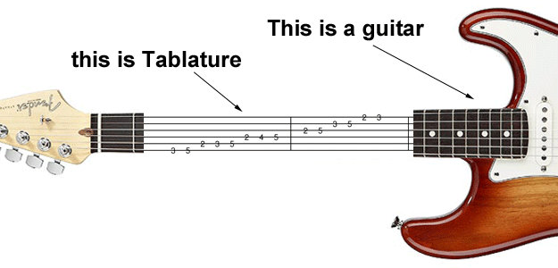
What makes guitar different?
Tabs!
Notes:
Taryk
1:1 mapping of where a guitarist needs to place his/her fingers on the neck of the guitar (fretboard) in order to play the right note
Spend more time clearly explaining how a tab corresponds to the fretboard
Keyword: VISUALLY ANALGOUS

Slide 6
Tabs vs. Sheet Music
The same notes may map to completely different tabs.
Notes:
Michaela

Slide 7
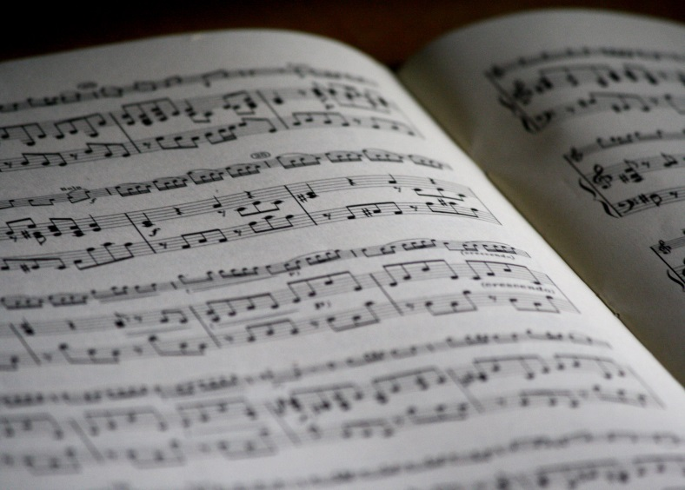
Why not sheet music?
Sheet music is hard to read, tabs are much easier
Notes:
Michaela

Slide 8
While it is possible to read sheet music…
Requires musical training
Doesn’t specify frets
Isn’t widely available
When it is, it usually costs $$
Notes:
Michaela

Slide 9
Why Tabs Rock
Precise
Easy to read
Widely distributed
Require no formal musical training to interpret
Can range from simple to complex
Notes:
Michaela

Slide 10
The Status Quo
People currently tab…
Manually (On paper or typed)
Using software
Guitar Pro (De-facto commercial)
Power Tab (Freeware)
TuxGuitar (Freeware)
Aria Maestosa (Freeware)
Tabular (Commercial)
More…
Notes:
Taryk

Slide 11
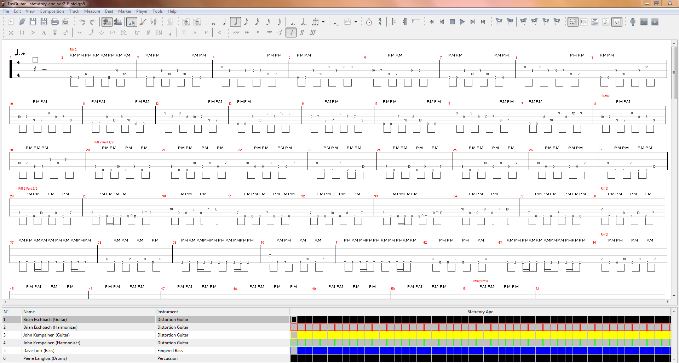
Current Software
Notes:
Taryk

Slide 12
Our Vision
AutoTabber
A frustration-free system for producing tabs in minutes
Notes:
Matt

Slide 13
Our Goal
Combine existing technologies in a novel way
A system that automatically generates tablature WITHOUT permanently modifying or damaging the guitar.
Notes:
Matt

Slide 14
Benefits
Rapid transcription
User-friendliness
More people writing tabs
Increased productivity
Notes:
Matt
Select predictions: notes that it is confident in will choose a note
Notes that it is not confident in will create a selection of notes for the user to choose from (like smart phone keyboards

Slide 15
Requirements
GUI
Automatically generate tablature
Baseline: single, consecutive notes
e.g. Mary Had a Little Lamb, Yankee Doodle
No guitar modifications
Make a modular, easily installed product
Notes:
Matt
Extension to the project could include trying to detect more complicated signals (like chords), but right now we are just focusing on single notes
Can use on multiple guitars

Slide 16
I/O
Inputs
Vibrations from guitar strings
Outputs
Tabs
MIDI (for playback)
Notes:
Matt

Slide 17
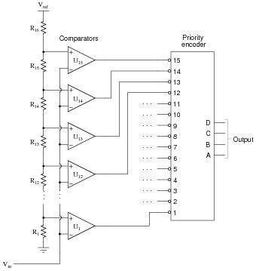
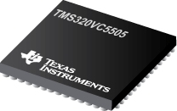
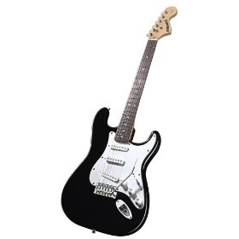
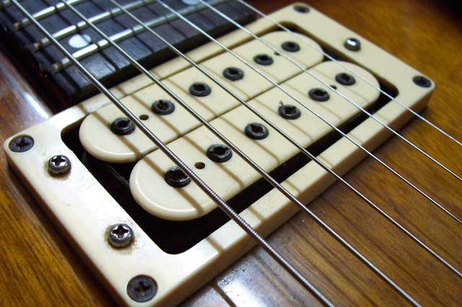
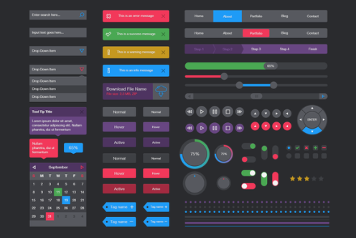
Block Diagram
MCU
AFE
DSP
Pickup
UI
Guitar
Notes:
Mike

Slide 18
Our team
Michael Murphy
Pickup & microcontroller
Matthew Wojick
Analog front end & microcontroller
Michaela Shtilman-Minkin
DSP Software & Algorithms
Taryk Alsagoff
UI Software & Algorithms
Notes:
Mike

Slide 19
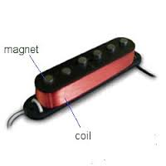
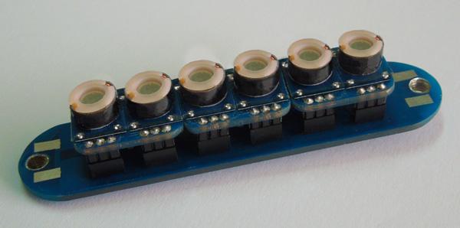
Block 1: Pickup
Hexaphonic pickup
Identify individual strings
Small
Sensitive and accurate
Notes:
Mike

Slide 20
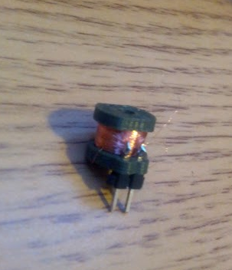
Block 1: MDR Deliverable
Pickup
Purchase and prototype
Generate & propagate signal to AFE
Notes:
Mike

Slide 21
Alternative Pickup Designs
Piezoelectric pickup
expensive & undesirable modification
Optical pickup
Has been shown to preform poorly
Notes:
Mike

Slide 22
Block 2: Analog Front-End (AFE)
Pre-amp
Amplify incoming signal
Analog to Digital Conversion
Sample at most 20kHz rate
16 bit ADC
Notes:
Matt
Split pickup will give around 1mV, where as normal pickups are around 100mV
16 bit: standard for ADCs, MCU also uses 16 bit, higher not necessary, but lower than 16 might not sample lower sound levels accurately
20kHz for highest note on the highest string to be detected
Lower strings need lower sample rate because there is a smaller gap between different notes

Slide 23
Block 2: MDR Deliverables
Analog Front End (AFE)
Purchase chip
Amplify signal from pickup
Notes:
Matt

Slide 24
Block 3: Microcontroller (MCU)
FFT
MCU for FFT in hardware
TI 5000 series has FFT coprocessor
1,024 bins in hardware
Notes:
Mike

Slide 25
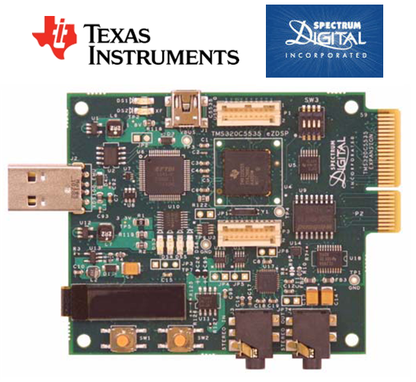
Block 3: MDR Deliverables
Microcontroller
Research and purchase a chip that can FFT
Notes:
Mike

Slide 26
Block 4: DSP software
Data
Interpretation
Analysis
Packaging
Notes:
Michaela

Slide 27
Block 4: MDR Deliverables
Interpretation: Note recognition
Identify a single, recorded note with its corresponding time stamp
Notes:
Michaela

Slide 28
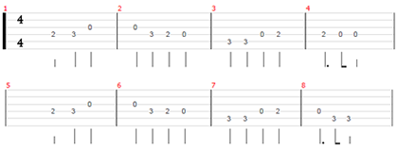
Block 5: GUI
Notes:
Taryk

Slide 29
Block 5: MDR Deliverables
Display
GUI with tabs display
Notes:
Taryk

Slide 30
MDR Deliverables - Summary
Pickup
Purchase and prototype
Generate & propagate signal to AFE
Analog Front End (AFE)
Amplify signal from pickup
Microcontroller
Hardware that can FFT
Note recognition
Identify a single note with its corresponding time stamp
Display
GUI with tabs display
Notes:
Michaela
Pickup
Mike – purchase as well as prototype own. Will generate and propagate signal to Matt (AFE)
Analog Front End
Matt – will amplify signal from pickup with minimal noise and no clipping to send to microcontroller.
Microcontroller
Mike and Matt – will have functional hardware FFT to send signals to Michaela (DSP)
Note recognition
Michaela – able to identify single note with timing and send it to Taryk (GUI)
Display
Taryk – will have rudimentary GUI to display note packages from Michaela and ugly tab

Slide 31
Trial by Fire
Q&A

