Slide 1
MDR
Advisor
Professor Pishro-Nik
Evaluators
Professor Jackson & Professor Kundu

Slide 2
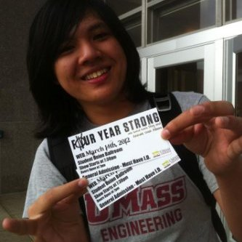
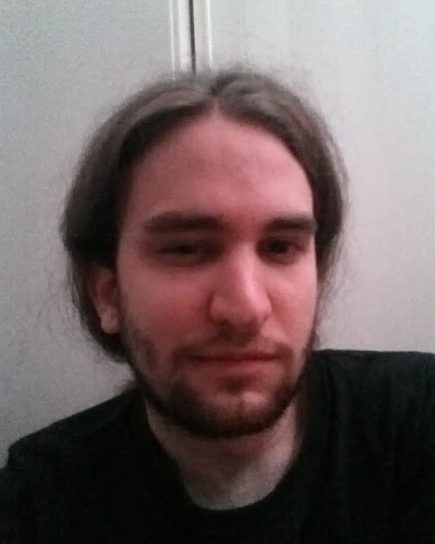
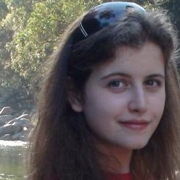
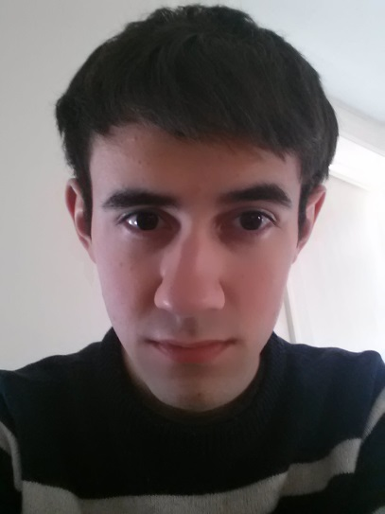
Team AutoTabber
Taryk Alsagoff (CSE)
GUI
Michael Murphy (EE)
Pickup & MCU
Michaela Shtilman-Minkin (CSE)
Signal Processing & Algorithms
Matthew Wojick (EE)
AFE & MCU
Notes:
Everybody

Slide 3
What is AutoTabber?

Slide 4
System Requirements: Overview
Automatically generate tablature from guitar
Baseline: single, consecutive notes
e.g. Mary Had a Little Lamb, Yankee Doodle
Must have GUI
No guitar modifications
Make a modular, easily installed product
Output from amplifier must be < 1V
MCU must be able to FFT signals close to instantaneously

Slide 5
PDR Feedback
Wavelet transform
Typically only used for image processing
Alternative: time stamp from MCU and/or note onset in software
Displacement
Block diagram
Fixed!

Slide 6
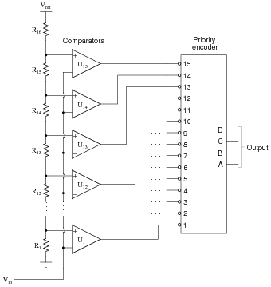
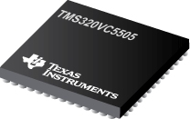
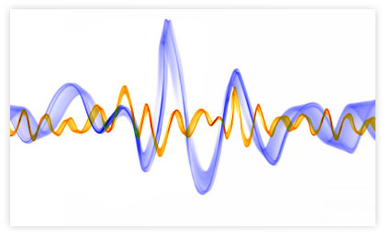
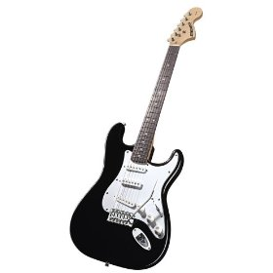
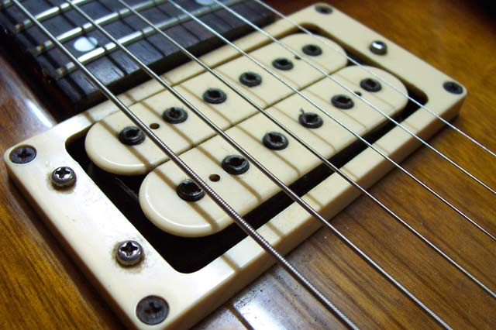
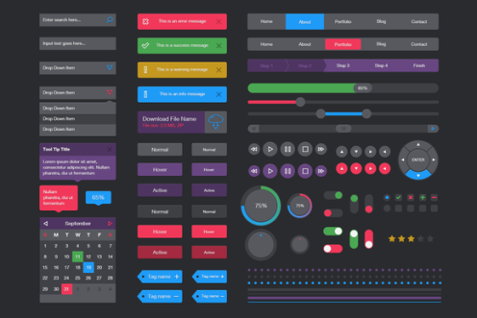
Our Previous Block Diagram
MCU
AFE
DSP
Pickup
UI
Guitar
Notes:
Mike

Slide 7
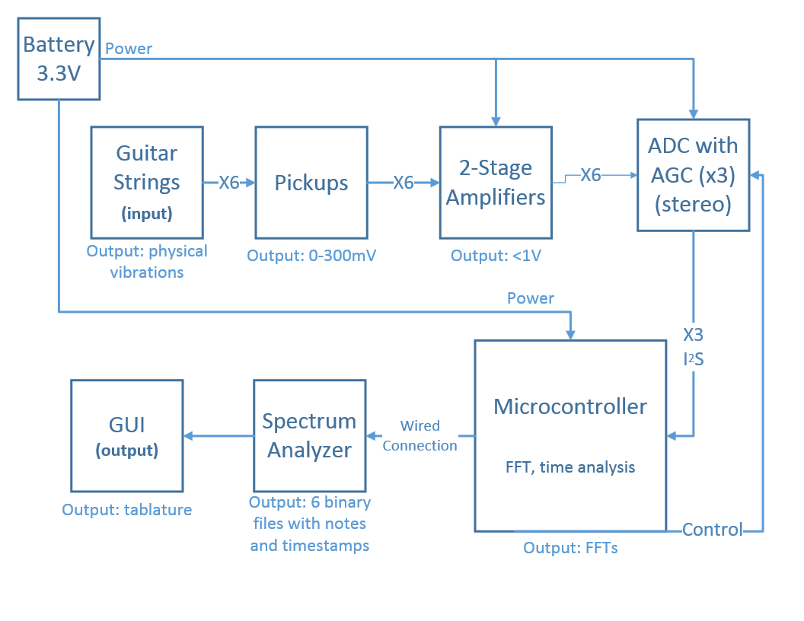
New and Improved Block Diagram

Slide 8
MDR Deliverables - Summary
Pickup
Purchase and prototype
Generate & propagate signal to AFE
Analog Front End (AFE)
Amplify signal from pickup
Microcontroller
Hardware that can FFT
Note recognition
Identify a single note with its corresponding time stamp
Display
GUI with tabs display
Notes:
Michaela
Pickup
Mike – purchase as well as prototype own. Will generate and propagate signal to Matt (AFE)
Analog Front End
Matt – will amplify signal from pickup with minimal noise and no clipping to send to microcontroller.
Microcontroller
Mike and Matt – will have functional hardware FFT to send signals to Michaela (DSP)
Note recognition
Michaela – able to identify single note with timing and send it to Taryk (GUI)
Display
Taryk – will have rudimentary GUI to display note packages from Michaela and ugly tab

Slide 9
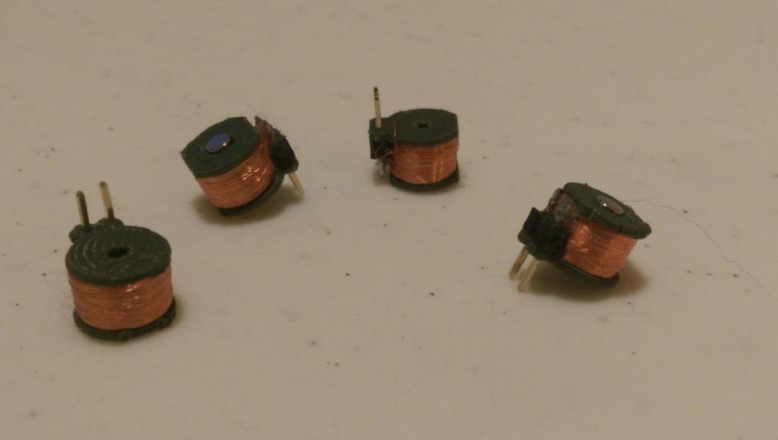
Pickups
Must detect vibrations from strings
Successfully picks up signal from string
Coil mounts 3D printed spools
Not affected by adjacent strings
Fixed high frequency oscillations
Need to compare different size pickups

Slide 10
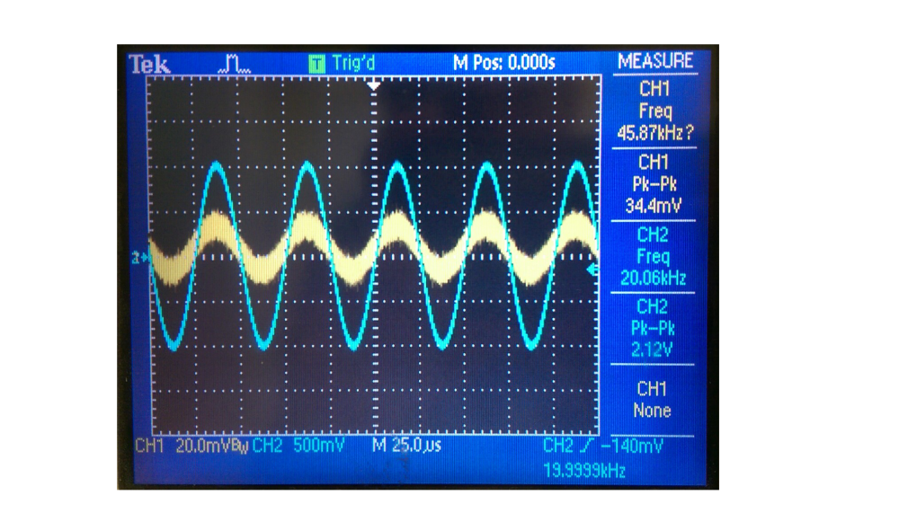
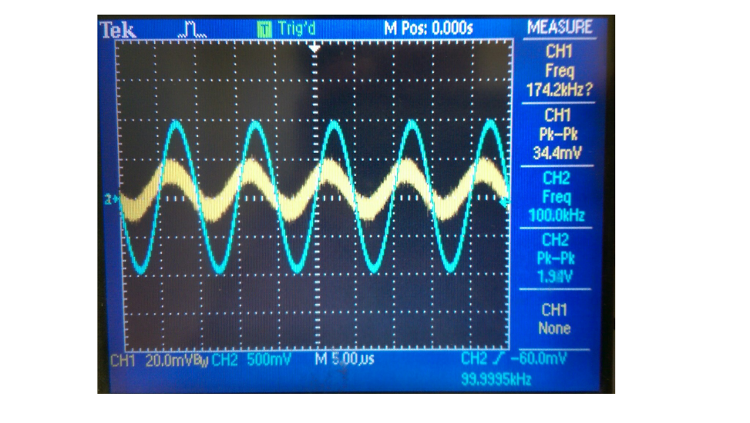
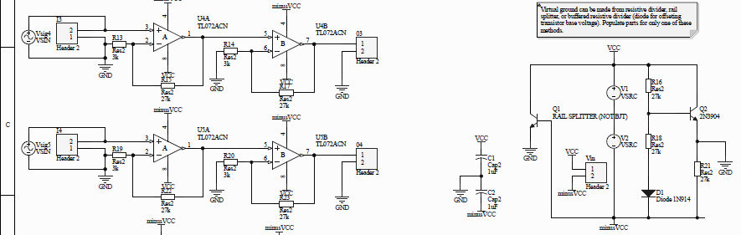
Amplifier Stage
Must amplify input from pickups
Need GBW for ~20kHz and ~100 gain
Two stage TL072 (or TL082) for 10 gain on each stage works up to 100kHz
Ordered better ones for single stage use

Slide 11
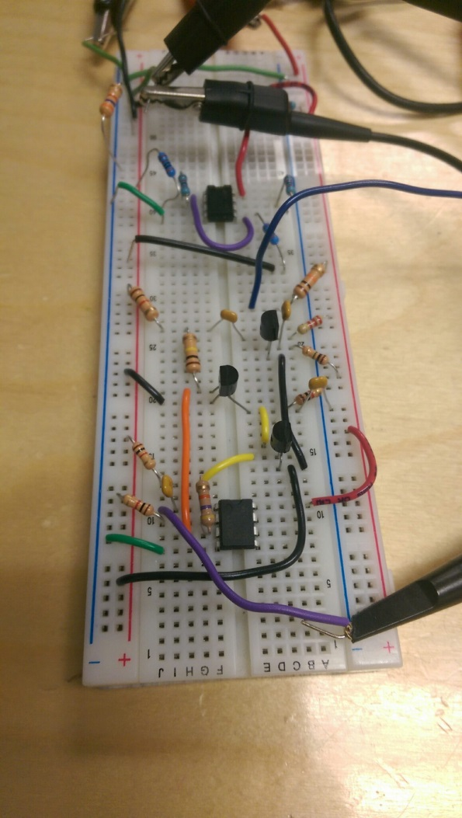
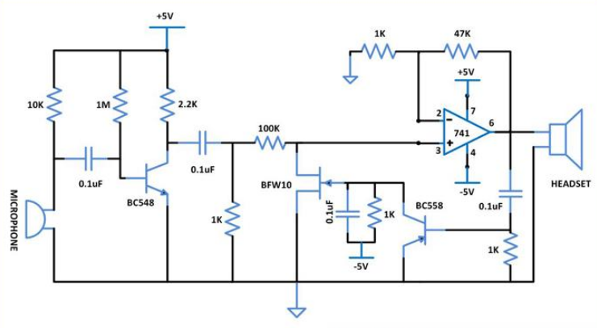
AGC Amp
Might need automatic gain control in this stage
Only if ADC ones are not sufficient
Current one works, but has a problem with slew rate

Slide 12
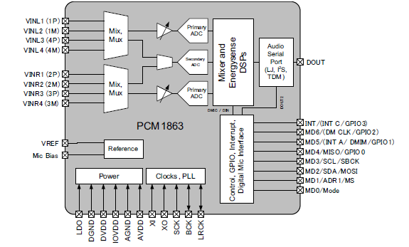
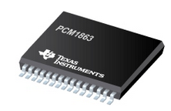
ADC
Should take signal from amp and sample at 44.1kHz
PCM1863 from TI
both SPI and I²S (for audio) interfaces
192 kHz max sample rate
Energysense Signal Detection

Slide 13
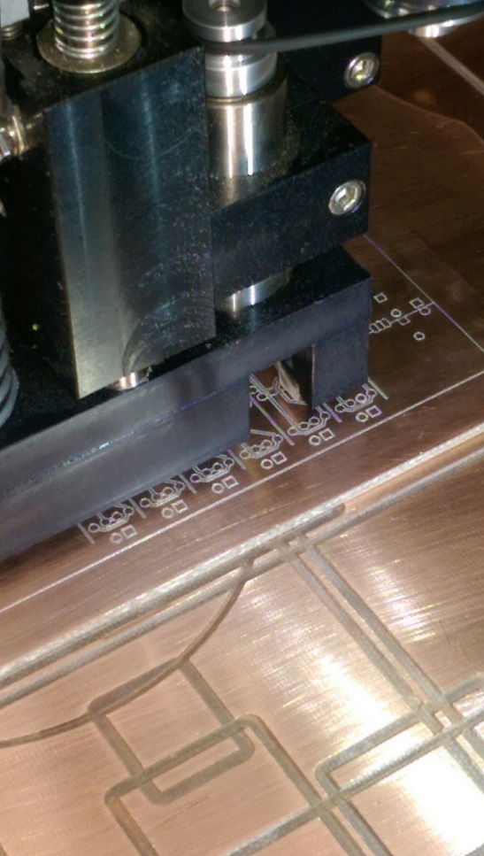
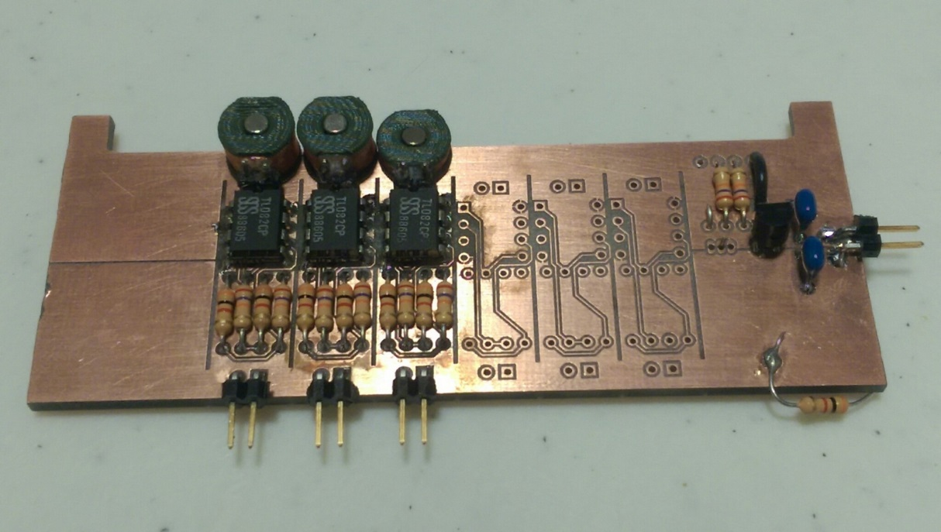
Pickups + Amps
PCB created with milling machine

Slide 14
Demo of Pickup + Amp

Slide 15
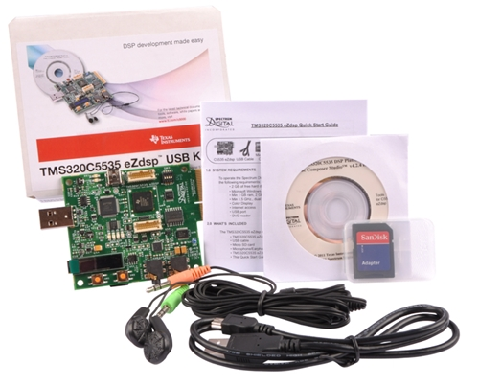
Microcontroller
Should take signal from ADC and perform FFTs
TMDX5535 eZdsp Development Kit
With C5535 processor

Slide 16
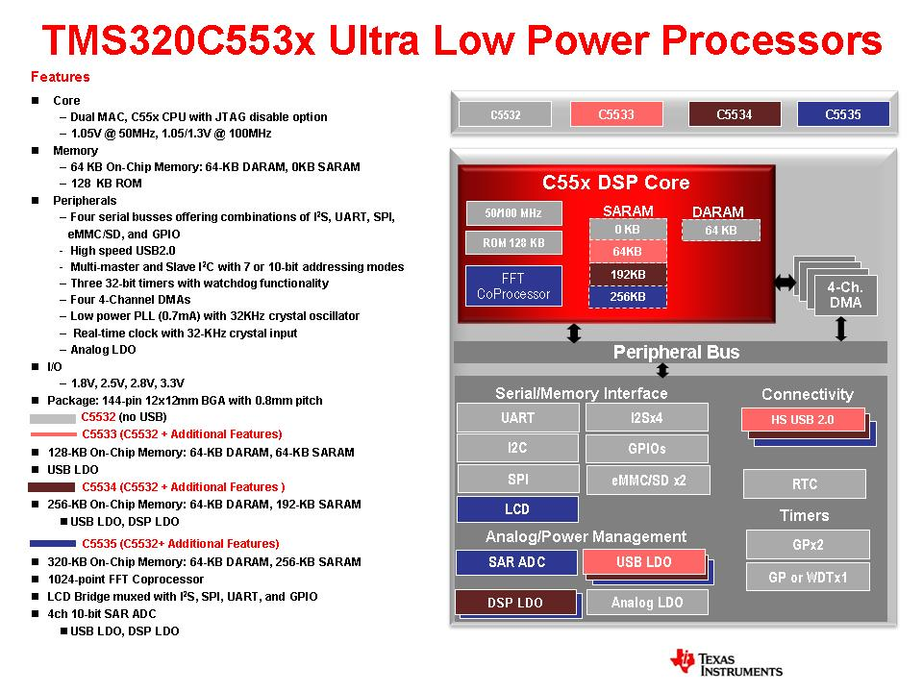

Slide 17
Signal Processing
Simulated signal processing in Python
Pass in .wav and string name
Use Welch Method for estimating the fundamental
Estimate power of the signal at different frequencies though periodgram spectrum estimates
Find closest fret to fundamental
"Evaluating the Online Capabilities of Onset Detection Methods“ by Sebastian Böck, Florian Krebs and Markus Schedl in Proceedings of the 13th International Society for Music Information Retrieval Conference (ISMIR), 2012
http://ismir2012.ismir.net/event/papers/049_ISMIR_2012.pdf
B string, 7th fret:
370.59 detected, closest match 369.99 (F#4)

Slide 18
GUI
Basic GUI
File I/O
OO framework
Defined interfaces
Problems with Qt framework
Problems with wxWidgets
Java Swing
Javascript (web)
SQL Database

Slide 19
MDR Deliverables - Summary
Pickup
Purchase and prototype: Prototype works, no need to buy
Generate & propagate signal to AFE: YES
Analog Front End (AFE)
Amplify signal from pickup: YES
ADC: Received samples
Microcontroller
Hardware that can FFT: Requested sample for chip/ dev. board
Note recognition
Identify a single note with its corresponding time stamp: YES
Display
GUI with tabs display: File I/O is implemented, some bugs

Slide 20
Team Responsibilities (2014-2015 Schedule)
Mike
Get data for different sized pickups
Configure DSP chip
Interface DSP with software
Prototype fabrication

Slide 21
Team Responsibilities (2014-2015 Schedule)
Matt
Design single stage amps, continue with AGC, work on ADCs
Datasheets
Configuring
Testing
Interface AFE with DSP

Slide 22
Team Responsibilities (2014-2015 Schedule)
Michaela
Determine timestamps for onset of all notes (presented in FFT form) in a given stream
Determine fundamental frequency and fret for each note
Package data to be displayed on GUI

Slide 23
Team Responsibilities (2014-2015 Schedule)
Taryk
User-friendly interface
File I/O
Tablature editing capabilities for the user
Display of data sent from spectrum analyzer

Slide 24
Proposed CDR Deliverables
Mike
DSP configuration
“Hello World”
Matt
Analog design
Michaela
Break up note stream into individual notes
Identify timestamp of note onset, and fundamental frequency
Output: timestamp, string, fret
Taryk
GUI display and editing of sample tablature

