Slide 1
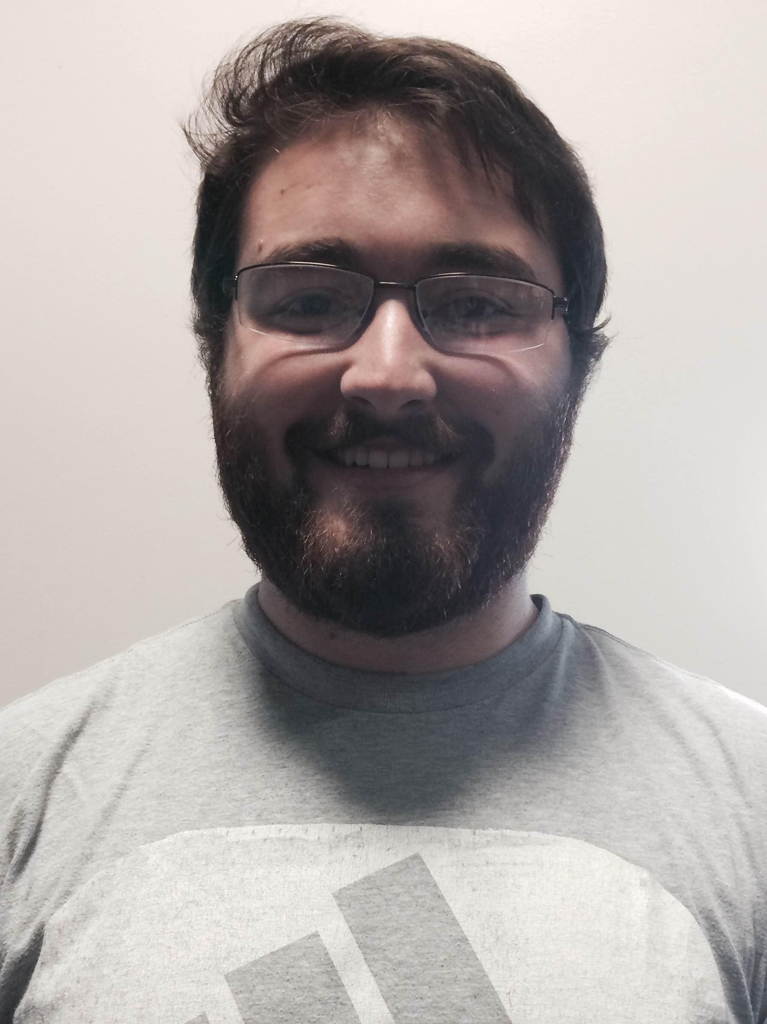
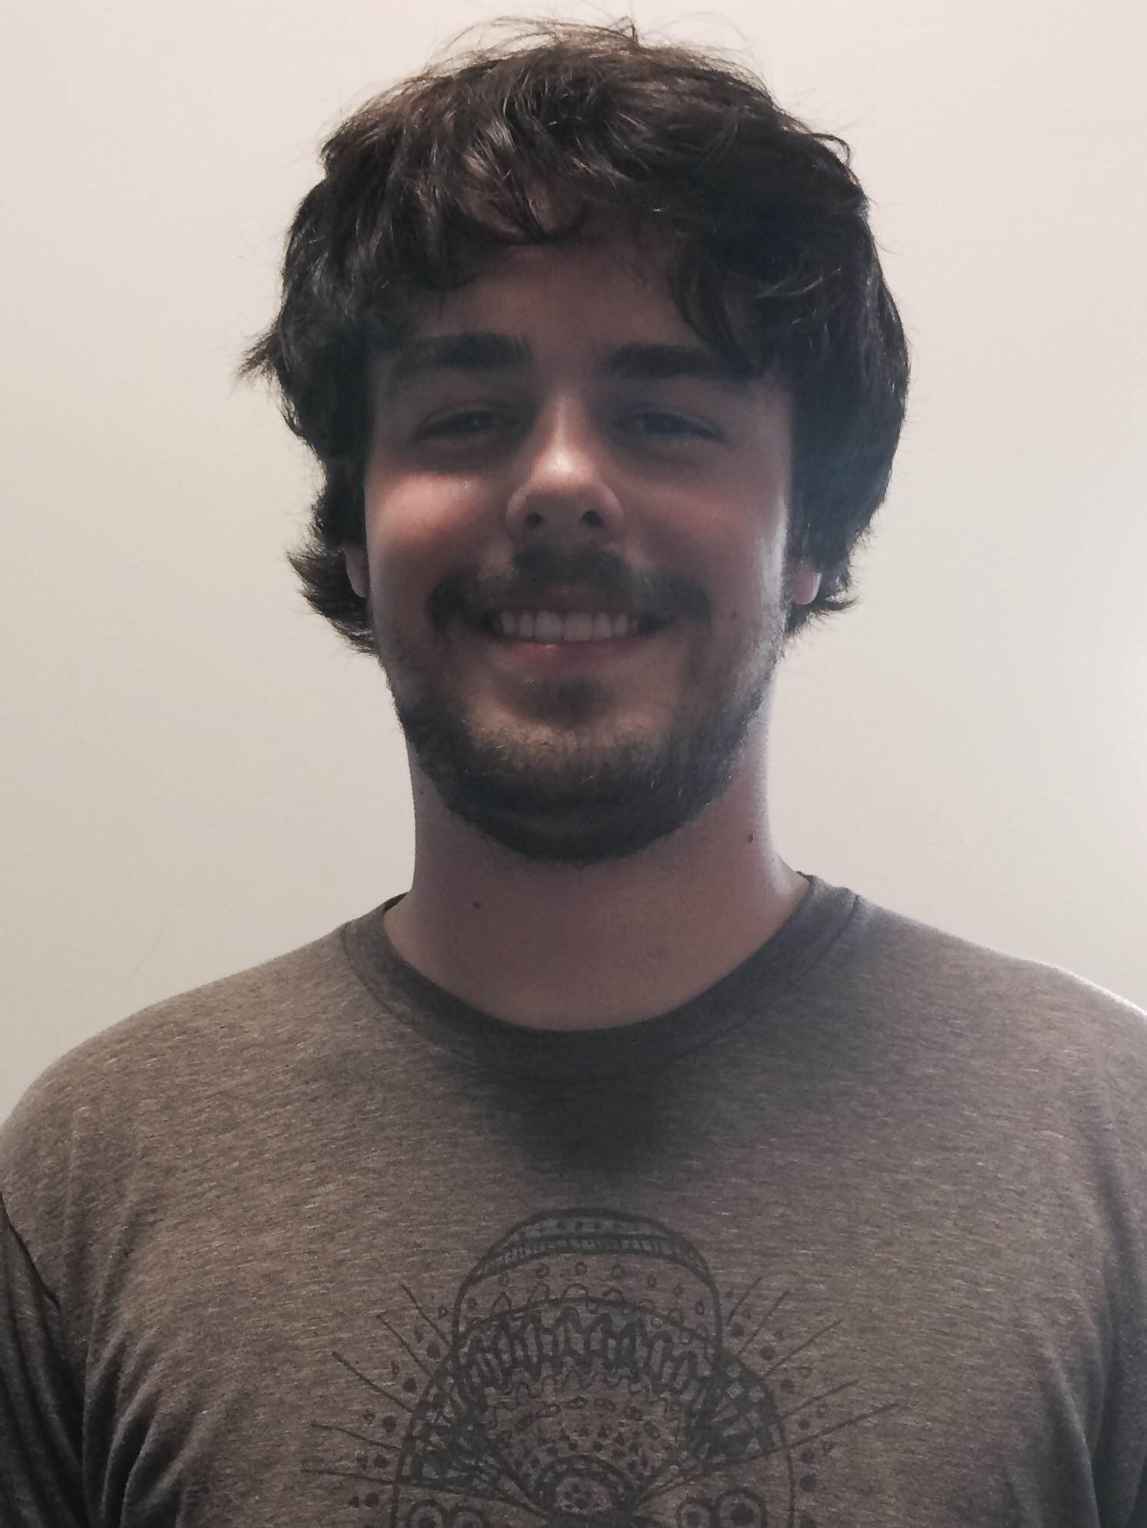
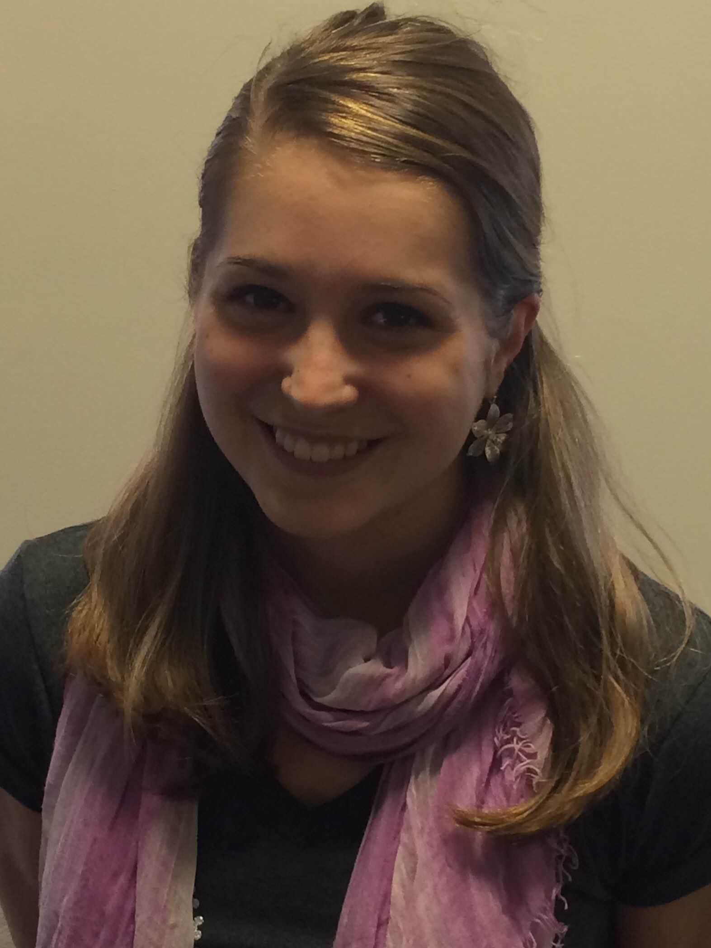
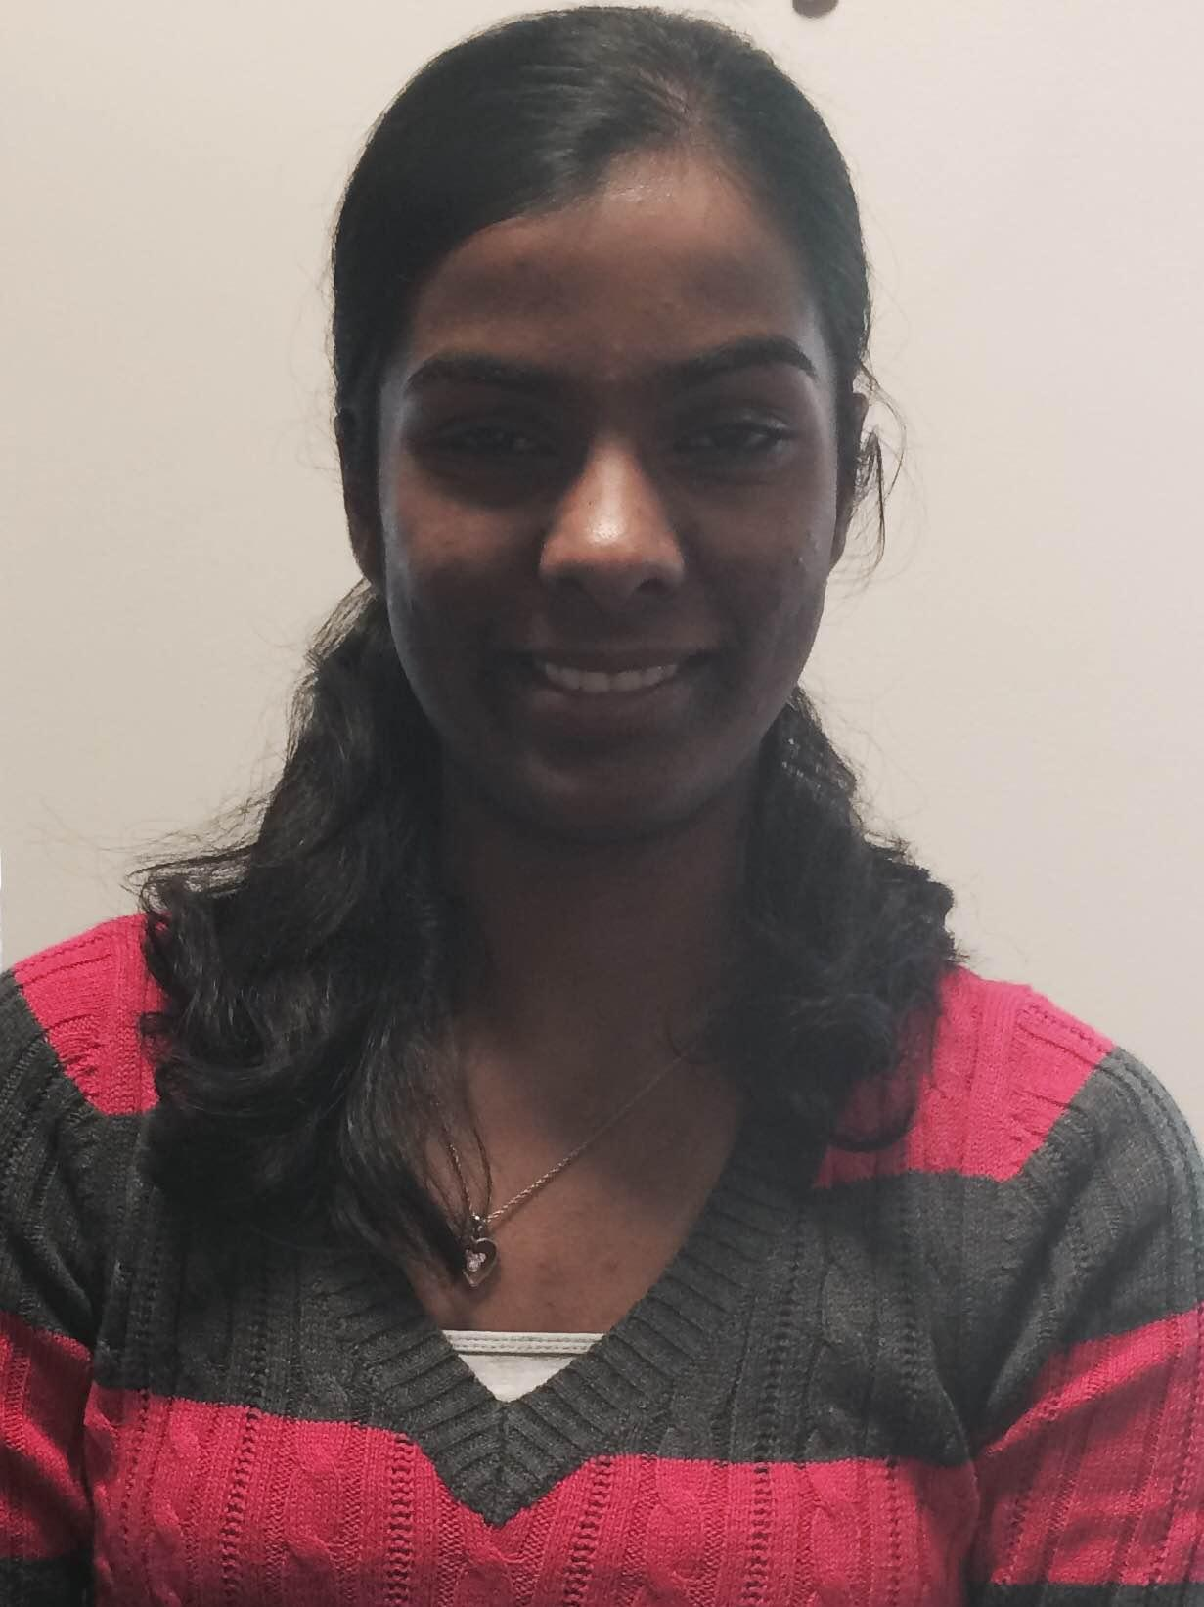
BLuEye
Steve Fialli, EE
Tom Kelly, EE
Krista Lohr, CSE
Divya Reddy, CSE
Advisor: Professor Aura Ganz
1

Slide 2
Goals
Develop a system that enables independent indoor and outdoor navigation for the visually impaired
Easy to use and access
Inexpensive
Practical for facilities to deploy
Potential for widespread implementation
Steve
2

Slide 3
What is the problem?
The most common problem faced by visually impaired people is the inability to navigate in unfamiliar environments.
Many solutions for obstacle avoidance but not for complex navigation
Need system that can be easily implemented in various environments at a low cost
Increase accessibility for the blind
Steve
3

Slide 4
How significant is this problem?
About 285 million people in the world are visually impaired
39 million are blind
246 million have moderate to severe visual impairment.
It is predicted that the numbers will rise up to 75 million blind and 200 million visually impaired by the year 2020.
Approximately 6,670,000 visually impaired people reported in the United States. (National Federation of the Blind, 2012)
3,412,900 between the ages of 18 and 64
Steve
4

Slide 5
Effect on Groups
This has a huge effect on the visually impaired population because it provides independence and ultimately furthers integration into society.
Increased career and education opportunities
Improved accessibility
Divya
5

Slide 6
Design Alternatives
Human Aid
Guide Dog
GPS
NavEye (2014 SDP)
PERCEPT
Divya
6

Slide 7
Why not?
Human Aid
Lack of independence
Expensive to hire someone if family/friends are unavailable
Guide Dog
Inconvenient
Not useful for precise or complicated navigation
GPS
While it can navigate easily outdoors, it is not precise enough for indoor navigation
Divya
7

Slide 8
Why not?
NavEye
Focused on localization rather than navigation
Focused only on indoor environments
PERCEPT
Uses RFID for navigation
User needs to touch their device to the tag for instructions, meaning only short range communication
Cannot provide localization information
Focused only on indoor environments
Divya
8

Slide 9
Our Solution
Scenario:
User arrives in environment covered by our system and opens device application
User navigates application using assistive technology (i.e. Voiceover, TalkBack) and chooses from a list of destinations (indoor or outdoor).
User receives frequent voice instructions to direct toward destination.
Instructions include direction and distance.
“Wrong Turn” notification when path correction is necessary.
Notification when user arrives at destination.
Krista
9

Slide 10
Our Solution
System of short and long range Bluetooth Low Energy (BLE) beacons set up in Marcus Hall and Engineering Quad.
BLE compatible device (Apple or Android) application communicates with beacons.
Localization calculated using
RSSI values from beacons
Orientation sensor inside mobile device
Algorithms in application compute shortest path to destination.
Translated to voice instructions.
Vision Free User Interface
Krista
10

Slide 11
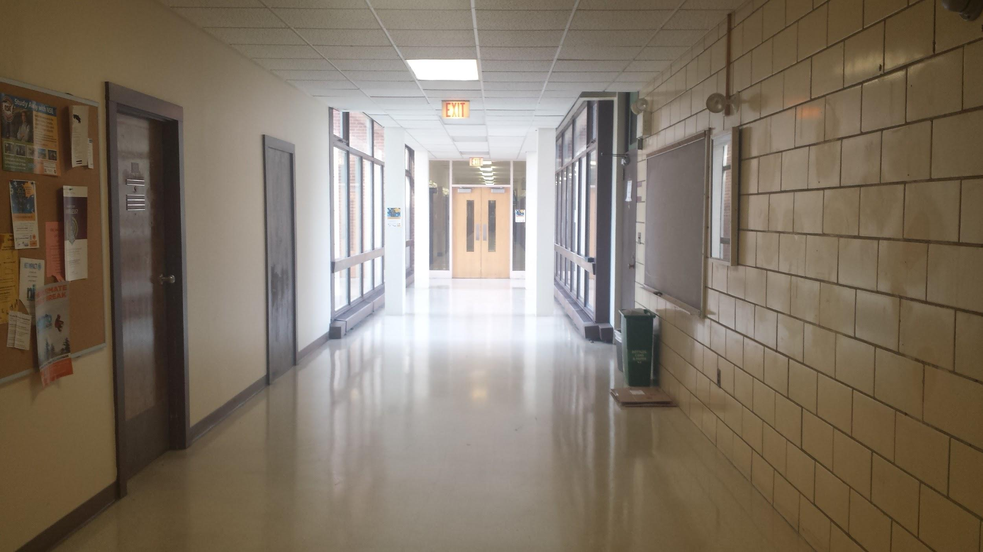
Indoor
Beacon Deployment
User
Krista
11

Slide 12
Outdoor
Beacon Deployment
User
Krista
12

Slide 13
Requirements Analysis: Inputs and Outputs
Input(s)
User input (requested destination)
Packets sent from beacon to BLE enabled device
Outputs
Application’s message to notify user of location
Tom
13

Slide 14
System Specifications
Successful navigation without visual information
Localization estimation accurate to 5 feet
Continuous beacon coverage of entire Engineering Quad (no dead zones)
Easy to understand and sufficiently frequent voice instructions
Compatible with Apple and Android devices
Low maintenance (long lasting power source, weather resistance)
Tom
14

Slide 15
Architecture
Divya
15

Slide 16
Indoor Block Diagram
Mobile Device
Phone Application
Orientation Sensor
Speaker
BLE Receiver
Marcus Hall Floor Plan
Visionless User Interface
Voiceover/ TalkBack
Gimbal Series 10 BLE Beacon
Divya
16

Slide 17
Outdoor Block Diagram
Mobile Device
GPS
Phone Application
Orientation Sensor
Speaker
BLE Receiver
Campus Map
Visionless User Interface
Voiceover/ TalkBack
Estimote BLE Beacon
Divya
17

Slide 18
User Architecture
User’s Device:
Guides the user using assistive technology software
TalkBack ------Android
VoiceOver --- iPhone
Will use a map to find the location
GPS-----------------outdoors
embedded map--- indoors
Divya
18

Slide 19
Environment Architecture
Beacon Transmitters:
Beacons transmit data packets at defined time intervals
Packets include beacon identification
RSSI value used to calculate distance to beacon
Divya
19

Slide 20
Hardware
Steve
20

Slide 21
Bluetooth Low Energy (Bluetooth SMART)
Less power consumption than classic Bluetooth technology.
Less power means practical battery life
No need to pair devices, as with classic Bluetooth
Listening to BLE device has minimal impact on battery life of user device
Steve
21

Slide 22
Beacons
Bluetooth Low Energy (BLE) beacons with Universal Unique Identifier (UUID) deployed throughout environment to serve as reference nodes.
Received Signal Strength Indicator (RSSI) used to determine distance between user node and reference nodes.
Beacons will have defined coordinates and can be used in calculations for user localization.
Steve
22

Slide 23
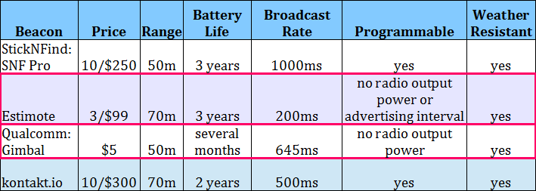
Beacon Choices
Tom
23

Slide 24
Gimbal Series 10 Beacons (Indoor Application)
Battery life: 3 months – 1 year (3V CR2032 cell battery)
Range: Maximum 50 meters, but adjustable through the SDK for more accurate areas.
Transmit Rate: 645 ms
Cost: $5 each
Tom
24

Slide 25
Estimote Beacons (Outdoor Application)
Range: 70 meters
Battery Life: 3 Years
Beacon Interval: 200 ms
Weather Resistant?: Yes
Cost: $33 each
Tom
25

Slide 26
Deployment
Tom
26

Slide 27
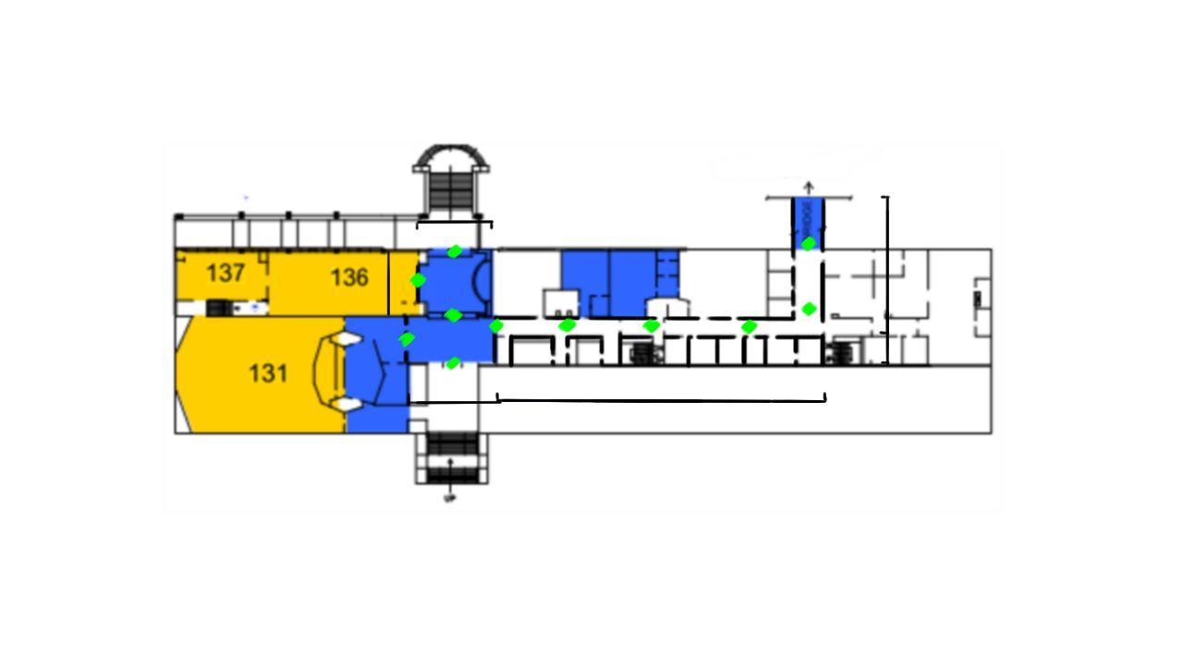
Gimbal Series 10 Beacon Deployment
29 ft
72 ft
29 ft
11.5 ft
18 ft
52.5 ft
18 ft.
60 ft.
Tom
27

Slide 28
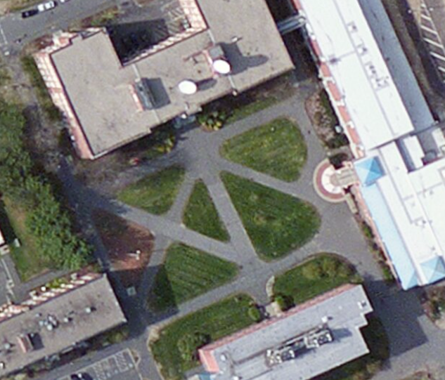
Outdoor picture
Estimote BLE Beacon Deployment
Steve
28

Slide 29
Software
Krista
29

Slide 30
Application Using Qt
Qt provides cross-platform support and can be used to design an application with one code that works for both Android and iOS.
Our code will be implemented on both platforms
Code written in Java
Qt has a framework for mobile devices which includes several libraries relating to both iOS and Android
Bluetooth will be used to communicate between the BLE beacons and the mobile device
Cost: free
Krista
30

Slide 31
User Interface
Several menus will help to user pick between different location options
Main menu with “Choose Destination” button
Next menu will display building options, each a separate button
Next menu will display destination options (room number, restroom, etc.), each a separate button
Once a destination is picked, a map will be displayed showing where the user is in their environment (for debugging purposes)
The application will automatically determine if the user is indoor or outdoor
Krista
31

Slide 32
Algorithms
Steve
32

Slide 33
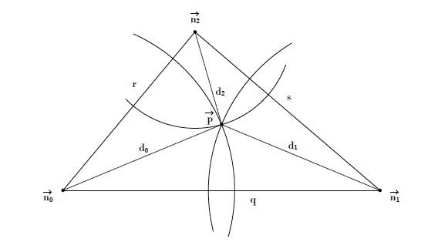
Localization
Localization based on node distance from 3 or more reference nodes with defined coordinates
Trilateration (3 reference nodes)
Linear system of equations can be used to find coordinates of user node.
Multilateration (more than 3 reference nodes) can be used for increased accuracy.
Steve
http://web.ist.utl.pt/ist150077/doc/localization.pdf
33

Slide 34
Navigation (Indoor)
Entrances to classroom and facilities(bathrooms) will be represented as “nodes” on the embedded map
The shortest path will be calculated using an algorithm
The path will represent the hallway
The approximate distance to destination will be calculated using the paths between each node
Voice command will translate distance between each node.
Instructions will be translated until user reaches final destination.
Divya
34

Slide 35
Navigation (Outdoor)
The engineering quad can be represented as a graph with nodes and weighted pathways
The entrance to each building and other landmarks will be nodes on the graph
The distance between these specified nodes will be the weight of the pathways
Paths will only be made on existing walkways in the quad
Shortest path will be determined using an algorithm
Voice instructions will be given when shortest path is determined
Instructions will direct users from one node to the next until destination is reached
Krista
35r

Slide 36
Moving Forward
Tom
36

Slide 37
Challenges
Hardware:
Figuring out the best placement of beacons to maximize accuracy as well as cost efficiency
Translating RSSI values to real distances
Software:
Interfacing between the beacons and the phone.
Using RSSI values to figure out the direction the user is moving.
Algorithm:
Using a mix of trilateration and increasing/decreasing signal strengths to map out the area of navigation.
Finding fastest route to destination.
Tom
37

Slide 38
MDR Deliverables
Navigation method complete for indoor and outdoor application (algorithms for determining fastest path to destination)
Main function of visionless user interface complete
Indoor beacon deployment
Communication established between beacon and mobile device
Localization programs
Tom
38

Slide 39
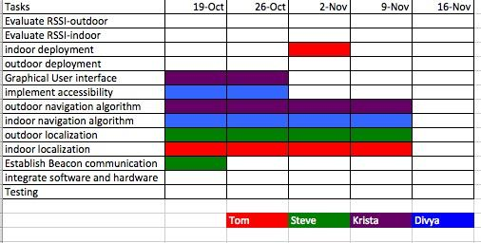
Gantt Chart
39

Slide 40
Individual Responsibilities
Steve Fialli
Outdoor localization and beacon deployment
Outdoor beacon RSSI evaluation
Outdoor Orientation
Thomas Kelly
Indoor localization and beacon deployment
Indoor beacon RSSI evaluation
Indoor Orientation
Krista Lohr
Outdoor navigation algorithm
User Interface main menu and outdoor map
Multi Platform
Divya Reddy
Indoor navigation algorithm
Indoor map
Accessibility
40

Slide 41
Software Projects
Patron Queueing System (2004)
Remote Controlled Home (2004)
Network Embedded Systems (2004)
Project METS (2005)
Wireless Music Sharing (2006)
BUNI (2006)
iPlanAhead (2010)
The Wireless Jukebox (2007)
Praser (2012)
NavEye (2014)
41

Slide 42
Sources
Lighthouse International
http://www.lighthouse.org/research/statistics-on-vision-impairment/prevalence-of-vision-impairment/
National Federation of the Blind
https://nfb.org/blindness-statistics
Localization in Wireless Sensor Networks, Francisco Santos
http://web.ist.utl.pt/ist150077/doc/localization.pdf
42

