Slide 1
BLuEye
Advisor: Professor Aura Ganz
1

Slide 2
Team Members
Tom Kelly, EE
Communication established between beacon and mobile device, Indoor beacon deployment
Steve Fialli, EE
RSSI Characterization,
Localization methods,
Indoor Beacon Deployment
Krista Lohr, CSE
Outdoor navigation,
Outdoor Map, User Interface main menu
Divya Reddy, CSE
Indoor Navigation algorithm, Indoor Map
2

Slide 3
What is the problem?
The most common problem faced by visually impaired people is the inability to navigate in unfamiliar environments.
Many solutions for obstacle avoidance but not for complex navigation
Need system that can be easily implemented in various environments at a low cost
Increase accessibility for the blind
Tom
3

Slide 4
BLuEye
System of short and long range Bluetooth Low Energy (BLE) beacons set up in Marcus Hall and Engineering Quad.
BLE compatible device application communicates with beacons.
Vision Free User Interface
Localization calculated using
RSSI values from beacons
Orientation sensor inside mobile device
Algorithms in application compute shortest path to destination.
Translated to voice instructions.
Divya
4

Slide 5
Scenario
User arrives in environment covered by our system and opens device application
User navigates application using assistive technology (i.e. Voiceover) and chooses from a list of destinations (indoor or outdoor).
User receives frequent voice instructions to direct toward destination.
Instructions include direction and distance.
“Wrong Turn” notification when path correction is necessary.
Notification when user arrives at destination.
Krista
5

Slide 6
Requirements
User and Facilities Requirements
Easy to use and access
Inexpensive
Practical for facilities to deploy
Compatible will Apple devices
System Requirements
Voice instructions will be given every 15 seconds in outdoor environment and every 10 seconds in indoor environment
Complete beacon coverage (communication with at least 4 beacons)
Provide location that is accurate to 3 feet
Provide beacons with a battery life of at least 3 months (2 years for outdoor)
Steve
6

Slide 7
System Design
Overview
7

Slide 8
Indoor Block Diagram
Real Time
User
Visionless User Interface
Gimbal Series 10 BLE Beacon
Voiceover
choose
destination
Shortest Path Algorithm
Instruction Generation
Localization
user location
Offline
Digital Space
Gimbal RSSI Characterization
8

Slide 9
Outdoor Block Diagram
Real Time
User
Visionless User Interface
Estimote BLE Beacon
Voiceover
GPS
choose
destination
Shortest Path Algorithm
Instruction Generation
Localization
user location
Offline
Estimote RSSI Characterization
9

Slide 10
MDR Deliverables
Tom: Communication established between beacon and mobile device, Indoor beacon deployment
Steve: RSSI Characterization, Indoor beacon deployment, Localization Algorithm
Krista: Main Function of iPhone User Interface, Outdoor Navigation Algorithm
Divya: Indoor Navigation algorithm
10
Notes:
add this to each of the sides of MDR

Slide 11
Communication Between Beacons and Mobile Device
Tom: communication between beacons and mobile device
11

Slide 12
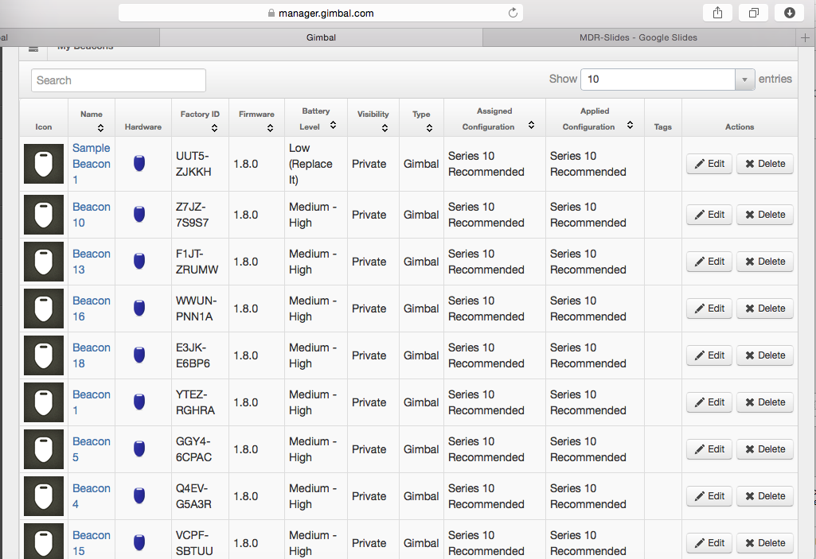
Connecting Beacons to Gimbal
Through the Gimbal website you are able to create unique beacon ID’s for each bluetooth beacon.
Each beacon is labeled Beacon 1 - Beacon 20, and on the outside of each Beacon is labeled with Sharpie in order to quickly identify each beacon.
Tom: communication between beacons and mobile device
12

Slide 13
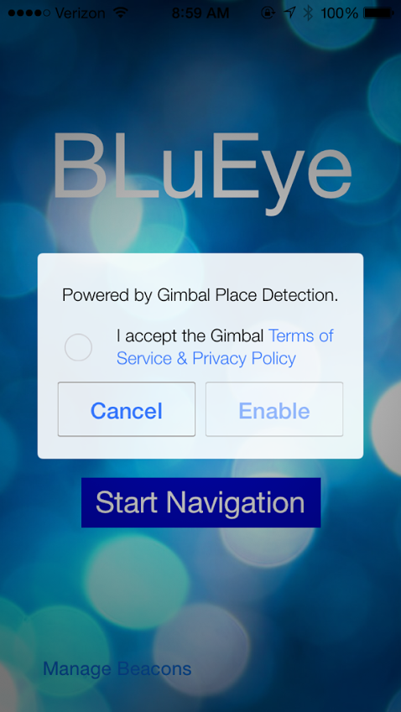
Connecting Application to Gimbal
Incorporating the code from the SDK’s provided by gimbal into our user interface, we were able to make our app gimbal enabled to connect to our BLE beacons
Once this was achieved, our application was able to start receiving values from the beacons
Tom: communication between beacons and mobile device
13

Slide 14
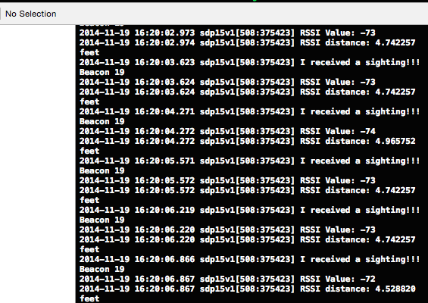
Receiving RSSI Values Through Xcode
Using Gimbal SDK’s, we used a method receivedSighting
This method is called every time the bluetooth antenna receives a signal from the BLE beacons
Gives values of time, RSSI, Beacon ID, and an added feature that converts the RSSI value into distance
Tom: communication between beacons and mobile device
14

Slide 15
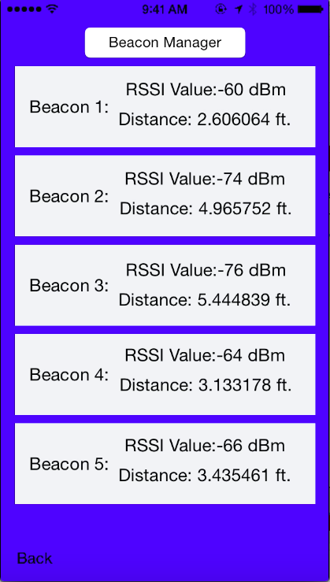
Adding to User Interface to Display Beacon Sightings
Adding to interface to manage beacons
Click manage beacons to go to Beacon Manager Page
Using the receiveSightings method and UILabel’s in Xcode, displayed the RSSI values and RSSI converted to distances on the interface.
Updates continuously with each instance of receiveSightings
Tom: communication between beacons and mobile device
15

Slide 16
Indoor Beacon Deployment
Tom & Steve: indoor beacon deployment
16

Slide 17
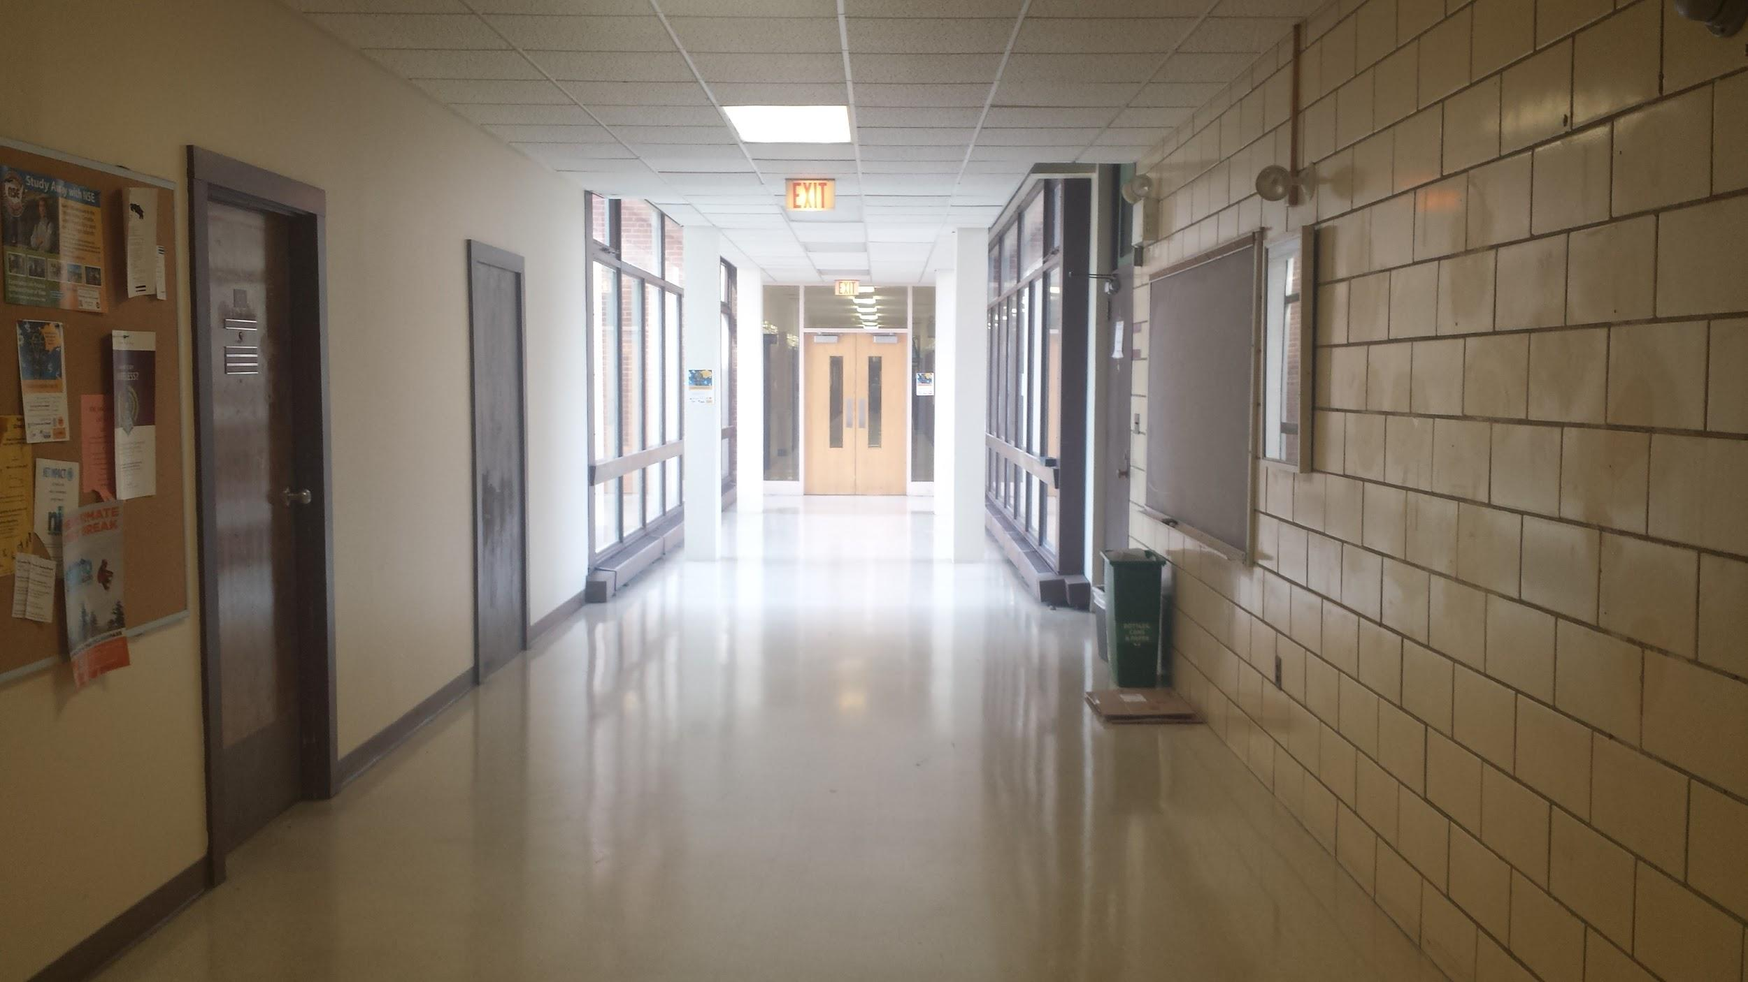
Indoor Deployment
Beacon Deployment
USER
17
Notes:
digital space

Slide 18
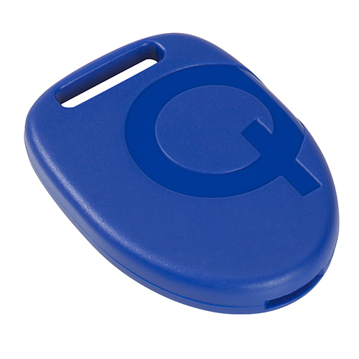
Indoor Beacon Deployment
Labeled each beacon Beacon 1 - 20, so as the beacon ID’s increase, you increase down the hallway.
A beacon was placed at each destination, providing extra dense coverage of the hallway
From each point in the hall, you are able to receive signals from at least 4 beacons
Much trial and error occured to find the best placements to maximize signal strength
Tom & Steve: indoor beacon deployment
18

Slide 19
MDR Deliverables
Tom: Communication established between beacon and mobile device, Indoor beacon deployment
Steve: RSSI Characterization, Indoor beacon deployment, Localization Algorithm
Krista: Main Function of iPhone User Interface, Outdoor Navigation Algorithm
Divya: Indoor Navigation algorithm
✓
19
Notes:
add this to each of the sides of MDR

Slide 20
RSSI Characterization
Steve: RSSI characterization
20

Slide 21
RSSI Characterization
General model for characterizing RSSI values
RSSI[dBm] = -10nlog(d) +A[dBm]
d = distance from beacon
n = constant dependent on environment
A[dBm] = RSSI value measured 1 meter from
beacon
“Trilateration Based Localization Algorithm for Wireless Sensor Network”
http://www.ijisme.org/attachments/File/v1i10/J04470911013.pdf
Oguejiofor O.S., Aniedu A.N., Ejiofor H.C., Okolibe A.U.
Steve: RSSI characterization
21

Slide 22
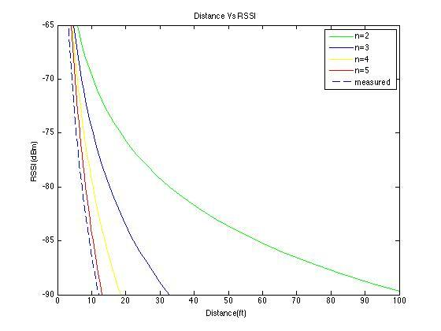
Steve: RSSI characterization
22
Notes:
RSSI vs Distance

Slide 23
RSSI Data
Steve: RSSI characterization
23

Slide 24
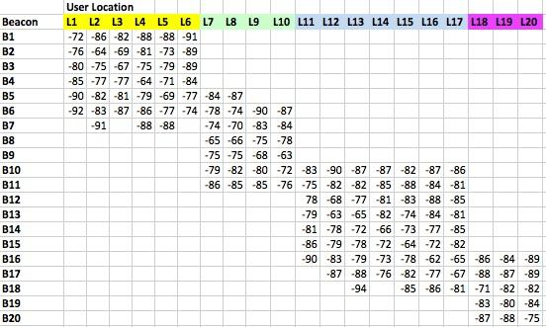
RSSI Data
Steve: RSSI characterization
24

Slide 25
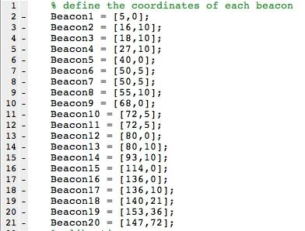
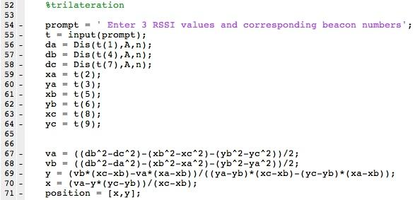
Convert RSSI to distance in feet
Define coordinates for the beacons
Return user location (X and Y Coordinates)
Steve: RSSI characterization
25

Slide 26
Localization Algorithm
Steve: localization algorithm
26

Slide 27
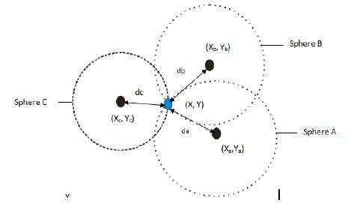
Localization Algorithm
Algorithm for 2 dimensional trilateration used
Inputs to the algorithm
Distance from user node to at least 3 beacons
X,Y coordinates of each beacon
Algorithms for RSSI characterization and trilateration were tested in Matlab with user defined inputs
“Trilateration Based Localization Algorithm for Wireless Sensor Network”
http://www.ijisme.org/attachments/File/v1i10/J04470911013.pdf
Oguejiofor O.S., Aniedu A.N., Ejiofor H.C., Okolibe A.U.
Steve: localization algorithm
27

Slide 28
MDR Deliverables
Tom: Communication established between beacon and mobile device, Indoor beacon deployment
Steve: RSSI Characterization, Indoor beacon deployment, Localization Algorithm
Krista: Main Function of iPhone User Interface, Outdoor Navigation Algorithm
Divya: Indoor Navigation algorithm
✓
✓
28
Notes:
add this to each of the sides of MDR

Slide 29
User Interface
Krista: main function of user interface
29

Slide 30
Title Page
When the user opens the application, he/she will see the screen to the right
Title of application: BLuEye
Start Navigation button
To choose a destination, the user will click the “Start Navigation” button, which will lead him/her to the next page
Krista: main function of user interface
30

Slide 31
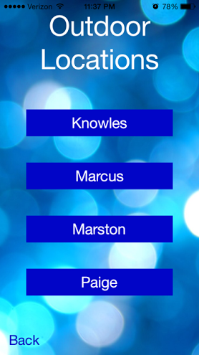
“Outdoor Locations” Page
After clicking the “Start Navigation” button, the user is given the option of four outdoor destinations (Knowles, Marcus, Marston, Paige)
Once clicking one of the buttons:
Google maps with drawn route
Voice instructions
Bottom left corner has a “Back” button to bring the user back to the title page
Krista: main function of user interface
31

Slide 32
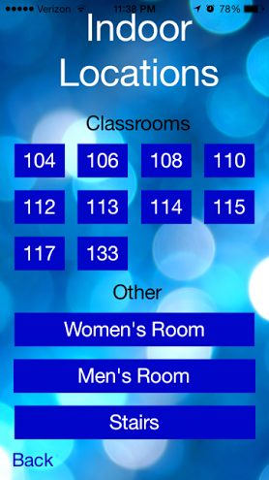
“Indoor Locations” Page
Once the user reaches the building, he/she is given options of indoor locations
Shown to the right are options within Marcus
Once clicking one of the buttons:
Floor plan with drawn route
Voice instructions
Bottom left corner has a “Back” button to bring the user back to the “Outdoor Locations” page
Krista: main function of user interface
32

Slide 33
Outdoor Navigation Algorithm
Krista: outdoor navigation algorithm
33

Slide 34
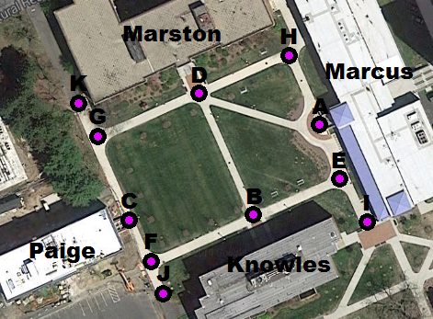
Map of Quad with Nodes
The engineering quad has a simple set of straight pathways between the buildings
Nodes placing:
Intersection of
pathways
Corners
Building entrances
Path ends
Route is determined by
connecting the nodes
Krista: outdoor navigation algorithm
34

Slide 35
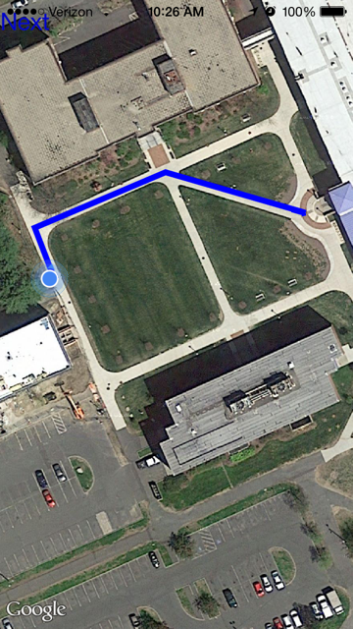
Map with Route
A route is determined based on the user’s current location
The blue line on the map gives a visual of the route that will be described to the user with voice instructions
This map will be shown after the “Outdoor Locations” page
The “Next” button on the top left will be clicked when the destination is reached so the user can choose an indoor location
Krista: outdoor navigation algorithm
35

Slide 36
MDR Deliverables
Tom: Communication established between beacon and mobile device, Indoor beacon deployment
Steve: RSSI Characterization, Indoor beacon deployment, Localization Algorithm
Krista: Main Function of iPhone User Interface, Outdoor Navigation Algorithm
Divya: Indoor Navigation algorithm
✓
✓
✓
36
Notes:
add this to each of the sides of MDR

Slide 37
Indoor Navigation Algorithm
Divya: indoor navigation algorithm
37

Slide 38
Indoor Navigation
Single Source Shortest Path Problem
The process of finding the shortest path from a source vertex “b” to all the other nodes within the graph
“10.2 Dijkstra’s Algorithm”
Divya: indoor navigation algorithm
38

Slide 39
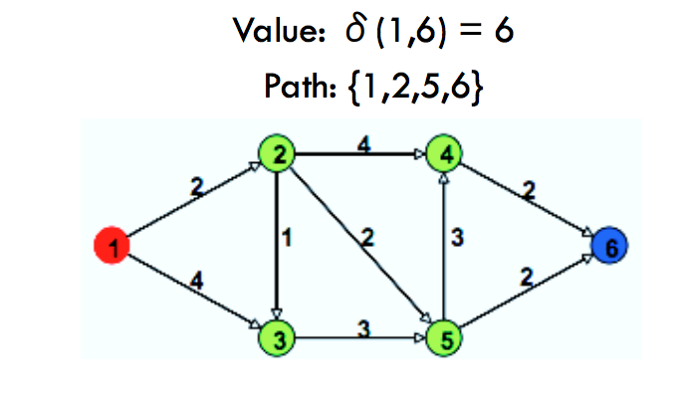
Dijkstra’s Algorithm
A solution to the single-source shortest path problem using graph theory
Input: Weighted Graph (ex: G{E,V})
Source vertex (ex: “b”) such that all the edge weights of the node are non-negative
Output: Length of the shortest paths from the given source vertex(“b”) to all the other vertices within the graph
“Dijkstra’s Algorithm”
Divya: indoor navigation algorithm
39

Slide 40
Why use Dijkstra’s?
Currently being used in a wide verities of applications
Traffic Information Systems are the most prominent
Routing Systems
Mapping
MapQuest
Google Maps
Divya: indoor navigation algorithm
40

Slide 41
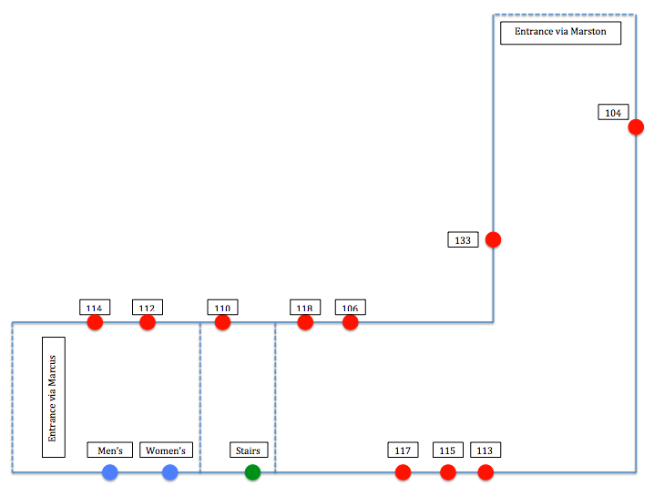
Marcus First Floor
Divya: indoor navigation algorithm
41

Slide 42
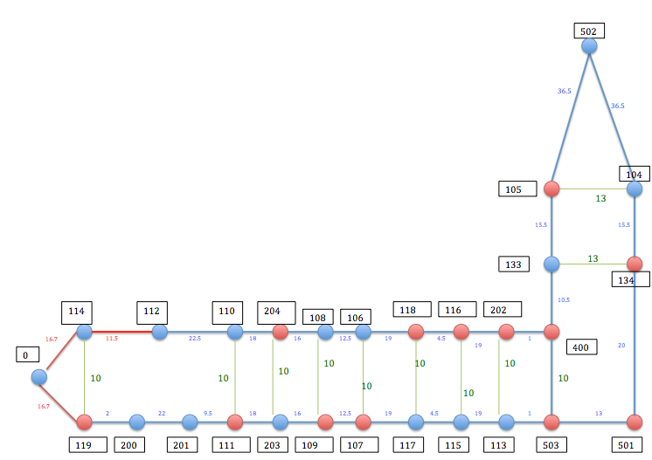
Dijkstra’s Node Graph
BlueNodes: Destination
Red Nodes: Non-Destination Nodes
Divya: indoor navigation algorithm
42

Slide 43
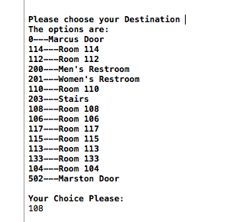
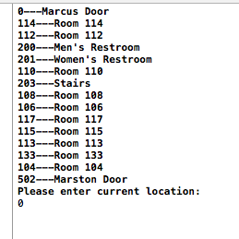
Dijkstra’s Implementation
Will be implemented in the Indoor Navigation Process
Allows users to tell the application their current location and their destination
Input: Current location of the User, Destination Location
Output: Distance(feet), Shortest path from source to destination
Divya: indoor navigation algorithm
43

Slide 44
Codes for Rooms
•0 = Marcus Door
•114 = Room 114
•112 = Room 112
•200 = Men’s Restroom
•201 = Women’s Restroom
•110 = Room 110
•203 = Stairs
•108 = Room 108
•106 = Room 106
•117 = Room 117
•115 = Room 115
•113 = Room 113
•133 = Room 133
•104 = Room 104
•502 = Marston Door
Divya: indoor navigation algorithm
44

Slide 45
Example
Shortest Path From: Stairs to Room 104
Input: Current Location = 203, Destination:104
Divya: indoor navigation algorithm
45

Slide 46
Example
Shortest Path From: Stairs to Room 104
Input: Current Location = 203, Destination:104
Output: 203 109 107 117 115 113 503 501 134 104
Distance: 120.5 feet
Divya: indoor navigation algorithm
46

Slide 47
User Interaction
User interacts with the mobile application via Voiceover.
Current location will be determined by nearest beacon RFID signals
User will have to choose between given options for destination location using the user interface
User does not have to physically enter or memorize any room code number
Divya: indoor navigation algorithm
47

Slide 48
MDR Deliverables
Tom: Communication established between beacon and mobile device, Indoor beacon deployment
Steve: RSSI Characterization, Indoor beacon deployment, Localization Algorithm
Krista: Main Function of iPhone User Interface, Outdoor Navigation Algorithm
Divya: Indoor Navigation algorithm
✓
✓
✓
✓
48
Notes:
add this to each of the sides of MDR

Slide 49
CDR Deliverables
Indoor System
Program shortest path algorithm in xcode
Instruction generation
Voiceover
User location (localization) complete
Improved accuracy with RSSI values
Outdoor System
Estimote RSSI Characterization
Localization complete
Instruction generation
Voiceover
49
Notes:
use block diagram to illustrate

Slide 50
Gantt Chart
50

Slide 51
Questions?
51

Slide 52
Sources
“Trilateration Based Localization Algorithm for Wireless Sensor Network”
http://www.ijisme.org/attachments/File/v1i10/J04470911013.pdf
Oguejiofor O.S., Aniedu A.N., Ejiofor H.C., Okolibe A.U.
“10.2 Dijkstra’s Algorithm”
https://www.cs.auckland.ac.nz/software/AlgAnim/dijkstra.html
“Dijkstra’s Algorithm”
http://math.mit.edu/~rothvoss/18.304.3PM/Presentations/1-Melissa.pdf
52

