Slide 1
Final Product Review
BLuEye
Advisor: Professor Aura Ganz
Department of Electrical and Computer Engineering

Slide 2
Team Members
Tom Kelly, EE
Communication established between beacon and mobile device, Indoor beacon deployment
Steve Fialli, EE
RSSI Characterization,
Localization methods,
Indoor/Outdoor Beacon Deployment
Krista Lohr, CSE
Outdoor navigation,
Outdoor Map, User Interface main menu
Divya Reddy, CSE
Indoor Navigation algorithm, Indoor Voice Instructions,Indoor Map
Department of Electrical and Computer Engineering

Slide 3
BLuEye
System of short and long range Bluetooth Low Energy (BLE) beacons set up in Marcus Hall and Engineering Quad.
BLE compatible device application communicates with beacons.
Vision Free User Interface
Localization calculated using
RSSI values from beacons
Algorithms in application compute shortest path to destination.
Translated to voice instructions.
Department of Electrical and Computer Engineering

Slide 4
Scenario
User arrives in environment covered by our system and opens device application
User navigates application using assistive technology (i.e. Voiceover) and chooses from a list of destinations (indoor or outdoor).
User receives frequent voice instructions to direct toward destination.
Instructions include direction and distance.
Notification when user arrives at destination.
Department of Electrical and Computer Engineering

Slide 5
Material Cost
Product | Cost
20 Gimbal Beacons | $ 100.00
(3 Estimote Developer Kit) x 2 | $ 200.00
Apple Developer Kit | $ 100.00
Total Cost : $400.00
Department of Electrical and Computer Engineering

Slide 6
System Design
Overview
Department of Electrical and Computer Engineering

Slide 7
Indoor Block Diagram
Real Time
User
Visionless User Interface
Gimbal Series 10 BLE Beacon
Voiceover
choose
destination
Shortest Path Algorithm
Instruction Generation
Localization
user location
Digital Space
Gimbal RSSI Characterization
Offline
Department of Electrical and Computer Engineering

Slide 8
Outdoor Block Diagram
Real Time
User
Visionless User Interface
Estimote BLE Beacon
Voiceover
GPS
choose
destination
Shortest Path Algorithm
Instruction Generation
Proximity
user location
Department of Electrical and Computer Engineering

Slide 9
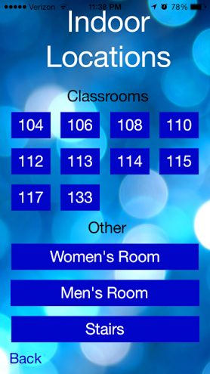
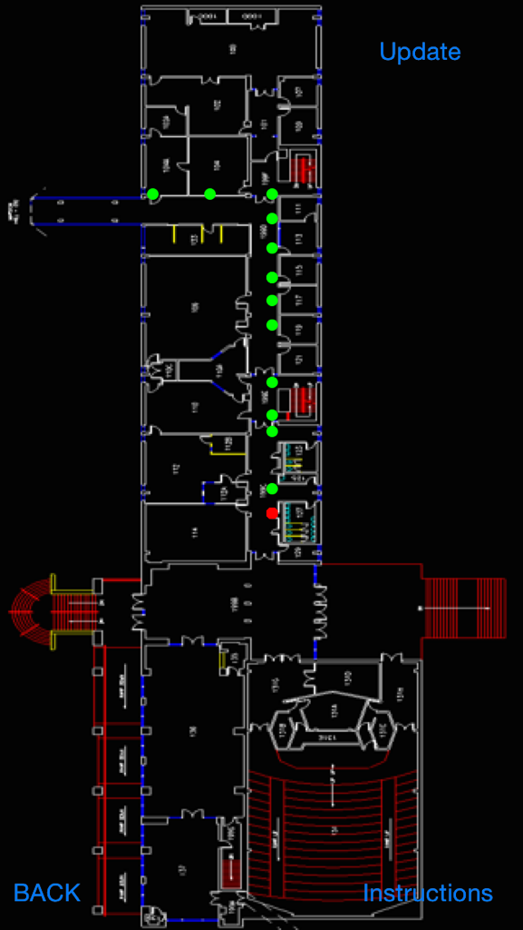
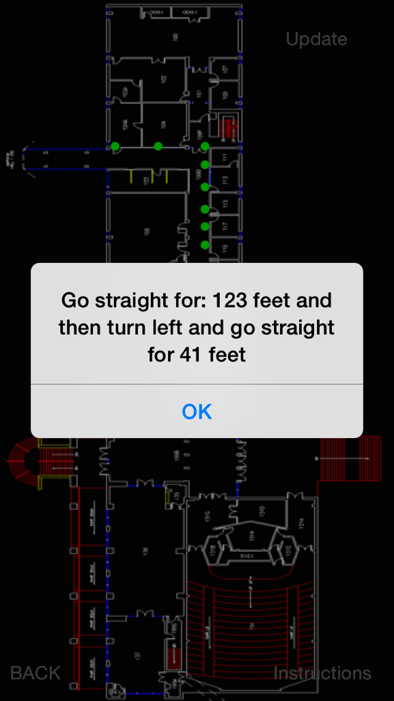
Indoor Navigation UI Interface
Department of Electrical and Computer Engineering

Slide 10
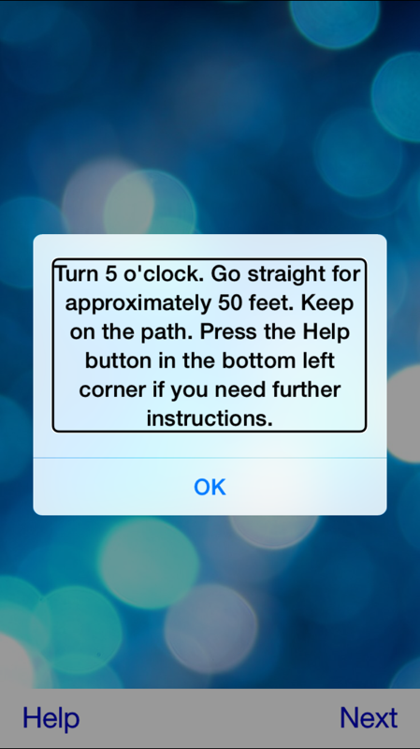
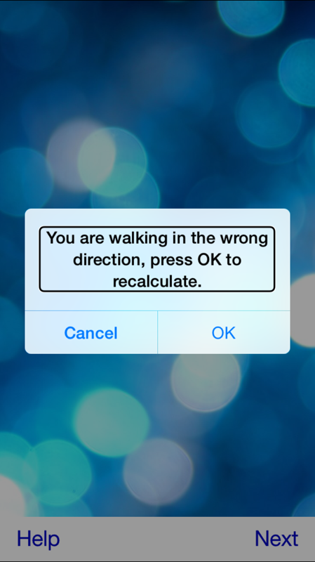
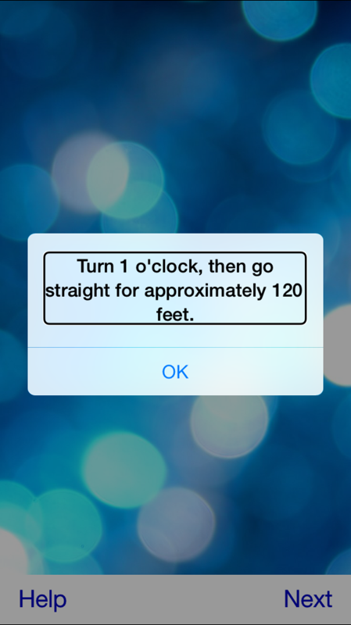
Outdoor Navigation UI Interface
Department of Electrical and Computer Engineering

Slide 11
Assumptions
User can distinguish between a sidewalk and grass
User can distinguish between a fire door and a wall
User will hold phone at Up Right Position while they are walking
User will be trailing on the Right Side of the Hallway
User will be walking with a cane to avoid unexpected objects (Orientation training)
Department of Electrical and Computer Engineering

Slide 12
Proposed FDR Deliverables
Deploy Estimote beacons in the Marcus lobby
Optimize Localization: Indoor & Outdoor
Smooth Transition between Indoor and Outdoor
Real Time Navigation Instruction both Indoor and Outdoor
Additional Testing to improve accuracy
Additional Feature
Arrival Alert
Outdoor Help Button
Department of Electrical and Computer Engineering

Slide 13
Demo Outline
Outdoor Navigation
“Directional” Navigation
“Wrong Turn”
Guidance to Destination
“HELP” Button
Transition Between Outdoor and Indoor
Indoor Navigation
Guidance to Destination
Arrival Alert
Department of Electrical and Computer Engineering

Slide 14
Demo Time
Department of Electrical and Computer Engineering

Slide 15
Questions?
Department of Electrical and Computer Engineering

Slide 16
RSSI Characterization
General model for characterizing RSSI values
RSSI[dBm] = -10nlog(d) +A[dBm]
d = distance from beacon
n = constant dependent on environment
A[dBm] = RSSI value measured 1 meter from
beacon
“Trilateration Based Localization Algorithm for Wireless Sensor Network”
http://www.ijisme.org/attachments/File/v1i10/J04470911013.pdf
Oguejiofor O.S., Aniedu A.N., Ejiofor H.C., Okolibe A.U.
Department of Electrical and Computer Engineering

Slide 17
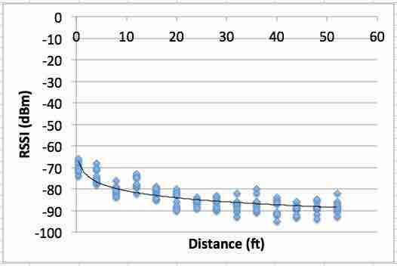
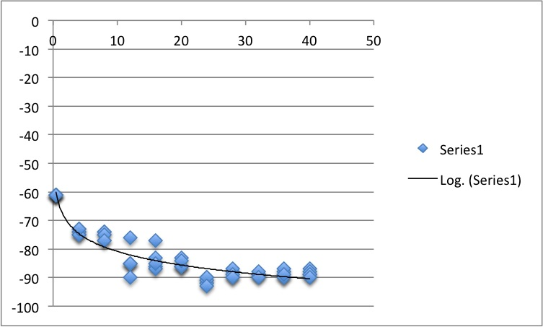
Indoor (Gimbal) Beacons
Outdoor (Estimote) Beacons
n = 2.78
n = 3.28
Department of Electrical and Computer Engineering

