Slide 1
BLuEye
Advisor: Professor Ganz
1

Slide 2
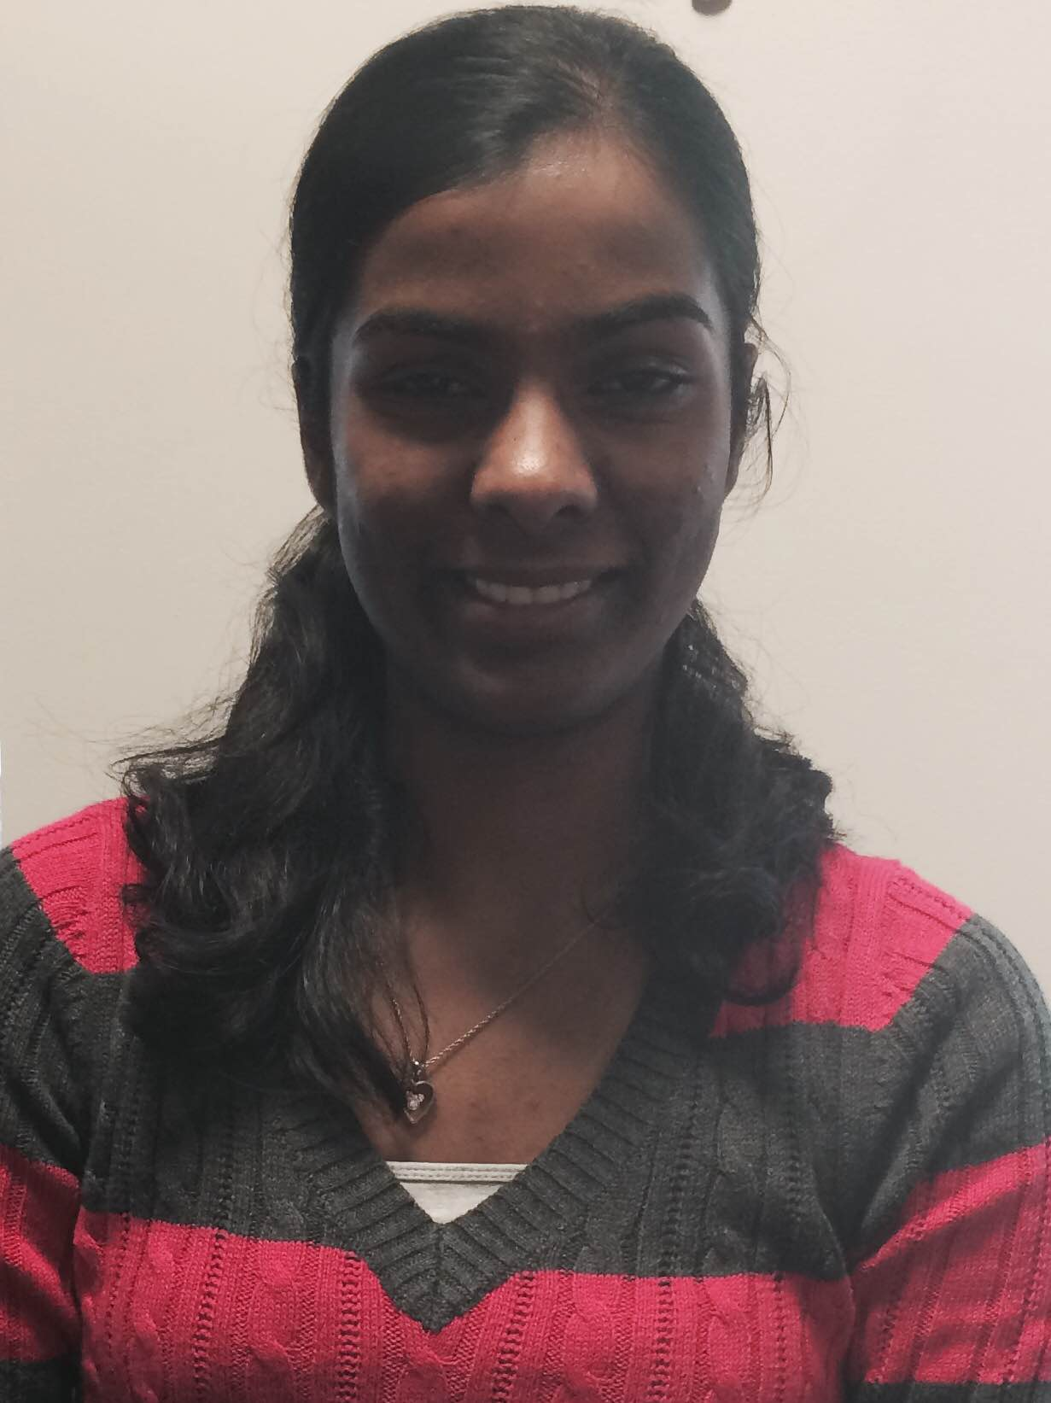
Team Members
Tom Kelly, EE
Integration of subsystems, Localization methods
Steve Fialli, EE
RSSI Characterization,
Localization methods,
Indoor Beacon Deployment
Krista Lohr, CSE
Outdoor Voice Instructions, Accessibility
Divya Reddy, CSE
Indoor Voice Instructions, Indoor Map Integration
2

Slide 3
BLuEye
System of short and long range Bluetooth Low Energy (BLE) beacons set up in Marcus Hall and Engineering Quad.
BLE compatible device application communicates with beacons.
Vision Free User Interface
Localization calculated using
RSSI values from beacons
Algorithms in application compute shortest path to destination.
Translated to voice instructions.
Steve
3

Slide 4
Scenario
User arrives in environment covered by our system and opens device application
User navigates application using assistive technology (i.e. Voiceover) and chooses from a list of destinations (indoor or outdoor).
User receives frequent voice instructions to direct toward destination.
Instructions include direction and distance.
Notification when user arrives at destination.
Tom
4

Slide 5
System Design
Overview
5

Slide 6
Indoor Block Diagram
Real Time
User
Visionless User Interface
Gimbal Series 10 BLE Beacon
Voiceover
choose
destination
Shortest Path Algorithm
Instruction Generation
Localization
user location
Offline
Digital Space
Gimbal RSSI Characterization
Steve, Tom, Divya
6

Slide 7
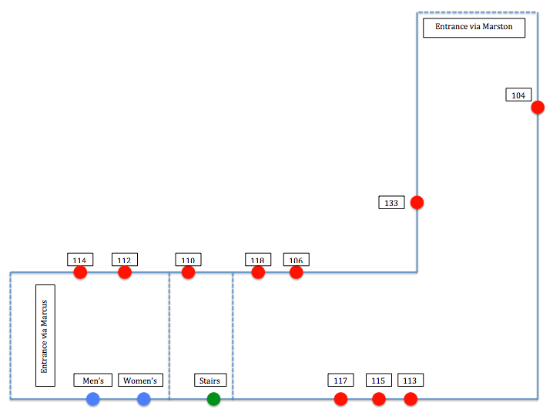
Indoor Navigation Choices
Divya
7

Slide 8
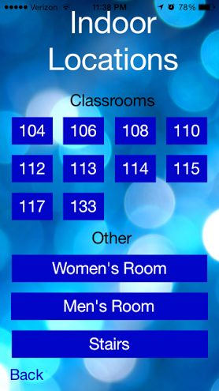
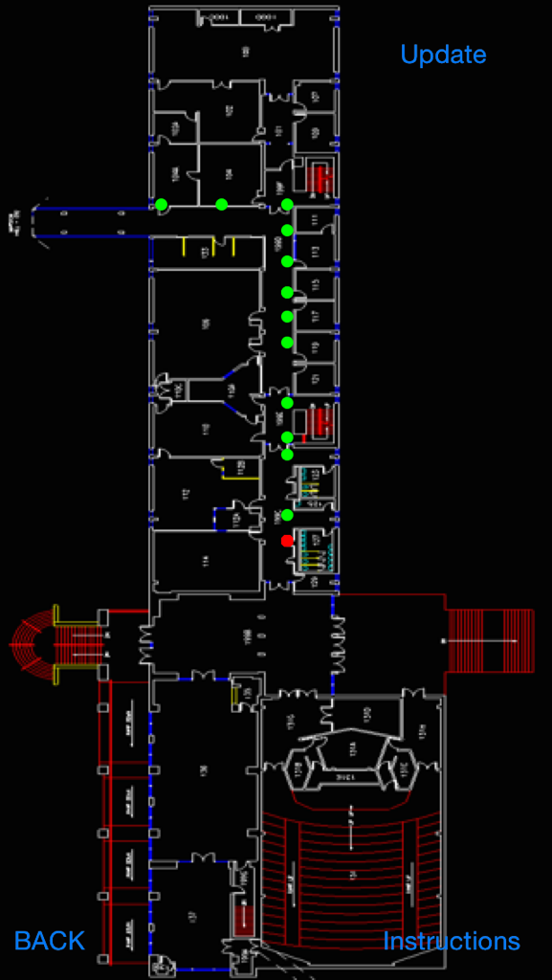
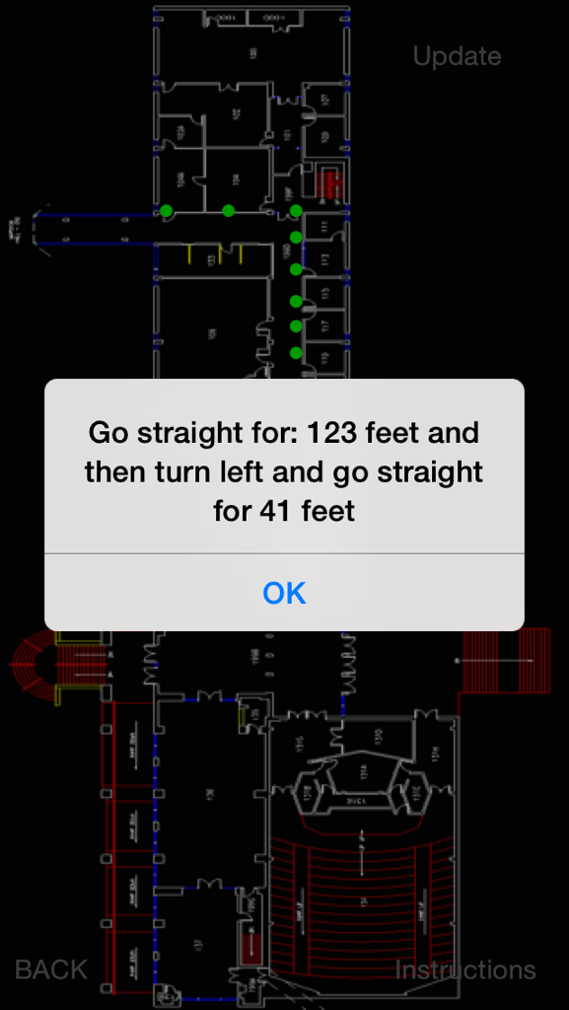
Indoor Navigation UI Interface
Divya
8

Slide 9
Outdoor Block Diagram
Real Time
User
Visionless User Interface
Estimote BLE Beacon
Voiceover
GPS
choose
destination
Shortest Path Algorithm
Instruction Generation
Localization
user location
Offline
Estimote RSSI Characterization
Krista
9

Slide 10
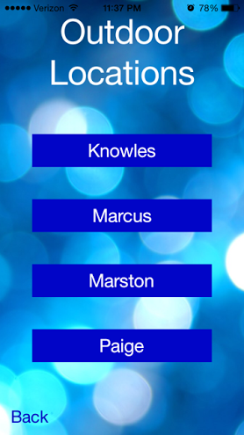
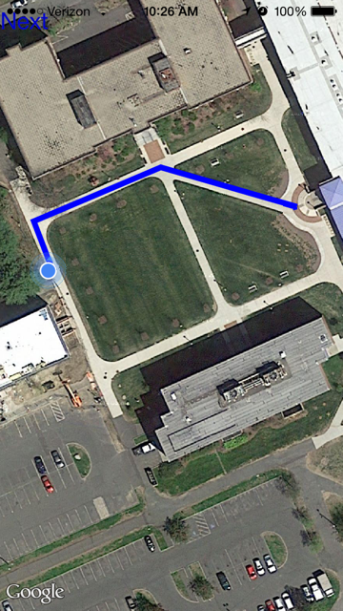
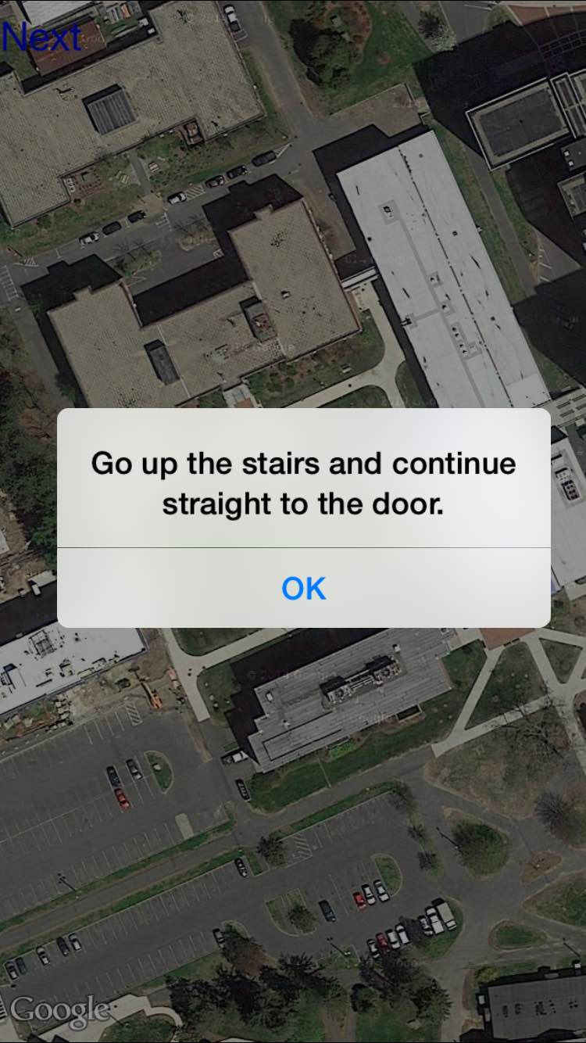
Outdoor Navigation UI Interface
Krista
10

Slide 11
Accessibility Using Voiceover
Title
Voiceover reads the label
ex. “Outdoor Locations”
Buttons
Voiceover reads button label + “button”
ex. “Marcus button”
A hint is given to let user know what button does
ex. “Choose Marcus as outdoor destination.”
Krista
11

Slide 12
Proposed CDR Deliverables
Indoor System
Program shortest path algorithm in Objective-C
Instruction generation
Voiceover
User location (localization) complete
Improved accuracy with RSSI values
Outdoor System
Estimote RSSI Characterization
Localization complete
Instruction generation
Voiceover
Steve, Tom, Divya, Krista
12

Slide 13
Demo Time
13

Slide 14
FDR Deliverables
Deploy Estimote beacons in the lobby Marcus
Optimize Localization: Indoor & Outdoor
Smooth Transition between Indoor and Outdoor
Real Time Navigation Instruction Accuracy both Indoor and Outdoor
Additional Testing to improve accuracy
14

Slide 15
Individual Responsibilities
Krista:
Improve Real Time Navigation Instructions for Outdoor
Divya:
Improve Real Time Navigation Instructions for Indoor
15

Slide 16
Individual Responsibilities
Steve:
Optimize Outdoor Localization
Smooth Transition between Indoor and Outdoor
Tom:
Optimize Indoor Localization
Deploy Estimote Beacons in the lobby of Marcus
16

Slide 17
Questions?
17

Slide 18
RSSI Characterization
General model for characterizing RSSI values
RSSI[dBm] = -10nlog(d) +A[dBm]
d = distance from beacon
n = constant dependent on environment
A[dBm] = RSSI value measured 1 meter from
beacon
“Trilateration Based Localization Algorithm for Wireless Sensor Network”
http://www.ijisme.org/attachments/File/v1i10/J04470911013.pdf
Oguejiofor O.S., Aniedu A.N., Ejiofor H.C., Okolibe A.U.
18

Slide 19
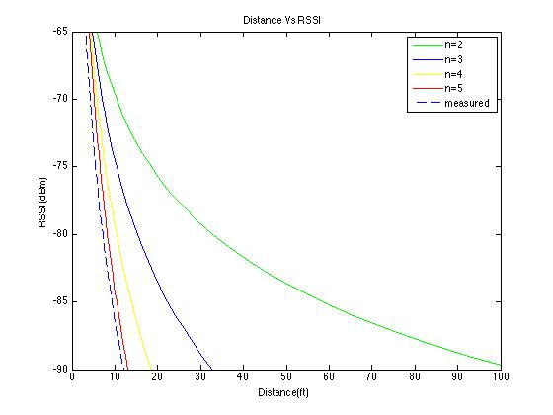
RSSI characterization
19
Notes:
RSSI vs Distance

Slide 20
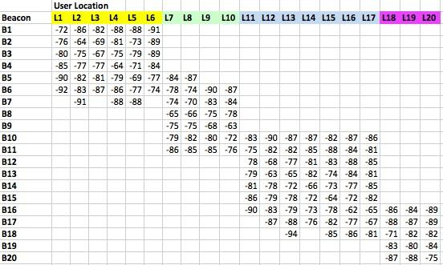
RSSI Data
RSSI characterization
20

Slide 21
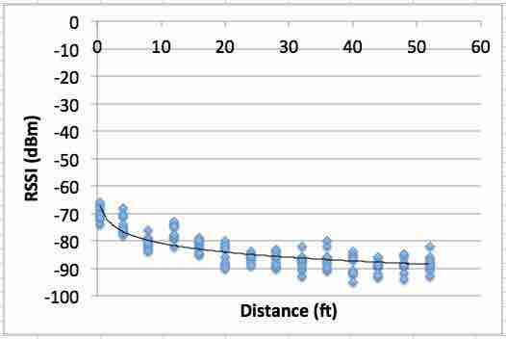
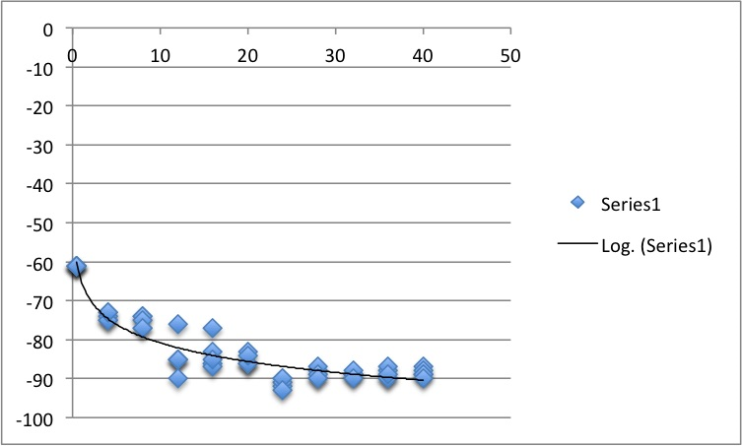
Indoor (Gimbal) Beacons
Outdoor (Estimote) Beacons
n = 2.78
n = 3.28 ?
21

