Slide 1
Digital Fitness Trainer
MDR

Slide 2




Team Members
Ben Sherman
Nate Reynolds
Justin Gardner
Chris Corbo
Advisor: Professor Duarte

Slide 3
Enabling Proper Workout Form through Visual Feedback
Improper workout form has caused many injuries
Without feedback, people may overexert themselves or lose their balance due to improper form
DFT will monitor users’ workouts and warn them about problems with their form and about their muscle exertion
Customer Feedback
  Kinesiology graduate students
Notes:
3
3
3
Lemon costs $1

Slide 4
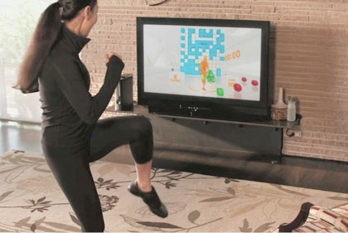
DFT Overview
Kinect to track form
Laptop to display
-rep count
-form feedback
-fatigue estimate
-video of user
Sensors to measure
muscle activity
Microcontroller to
send sensor signals
to laptop application

Slide 5
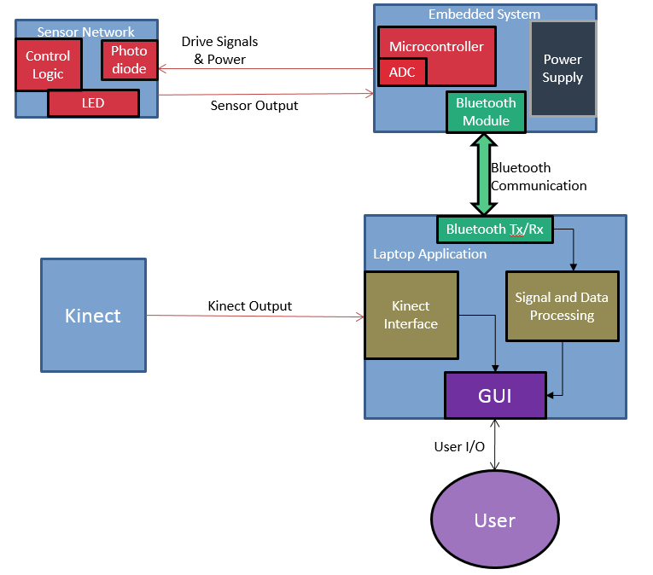
Our Solution: Block Diagram
Notes:
5
5
5

Slide 6
PDR Concerns
Archetypical User
  18 – 30 Years of age
  Low percent body fat (less than about 25%) to minimize difference in light attenuation
Limiting Variability
  Focusing on key indicators of improper form
    eg. Knees over toes, neck straight, hip angle

Slide 7
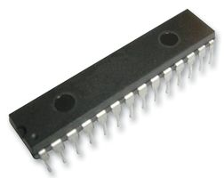
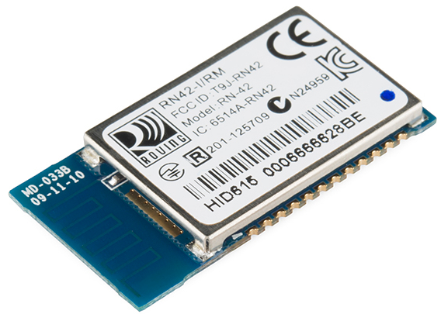
Embedded System
PIC32MX110F016B Microcontroller
10 ADC channels
2 UART channels
40 MHz internal oscillator
RN-42 Bluetooth Module
Adds Bluetooth headers when transmitting
data from MCU to laptop
  Strips headers when receiving data from laptop
Connects to Microcontroller UART RX/TX pins
Baud rate: 9600

Slide 8
Embedded System
Requirements
  Able to receive messages from laptop
  Able to drive sensors and read analog sensor data
  Able to send data accurately to laptop
Accomplishments
  Accurate reception and transmission of multiple bytes via Bluetooth
  Successfully converts analog signals to digital signals

Slide 9
Bluetooth Tx/Rx and Data Processing
Requirements
  Able to send and receive messages from laptop to microcontroller
  Able to successfully process data
Accomplishments
  Accurate reception and transmission of data via Bluetooth from laptop to microcontroller
  Successfully process data to display Hb and HbO2 concentration levels in blood
Notes:
9
9
9
Design a system for monitoring exercise form and intensity in order to prevent injury.
Utilize intensity monitoring to maximize results and minimize injuries.
Accurately detect faults in user’s form.

Slide 10
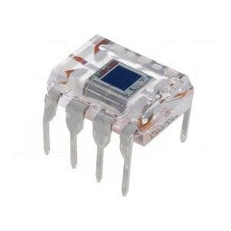

Sensor Network
OPT101 Photodiode
High linear sensitivity to radiant power
  0.45A/W
Low Quiescent Current (120µA)
Diodes
Kingbright 660 nm wavelength red LED
Fairchild T-3/4 I/R EMITTER
  Dominant 940 nm wavelength

Slide 11
Sensor Network
Requirements
  Able to read physiological characteristics from isolated areas of the body and estimate fatigue.
  Low power consumption and negligible interference with workout.
Accomplishments
  Output different voltages based on absorption in the transmission medium
Challenges
  Red Kingbright LED has low output radiant intensity causing difficulty to read through denser media.
  Sensor is sensitive to pressure due to density of tissue increase with compression
Notes:
11
11
11
Design a system for monitoring exercise form and intensity in order to prevent injury.
Utilize intensity monitoring to maximize results and minimize injuries.
Accurately detect faults in user’s form.

Slide 12
Sensor Network
Moving Forward
  Explore options of alternative low wavelength LED to replace the current red LED. Reduce LED count and size
  Consider alternative sensor solution to monitor fatigue
    Experiment with surface electromyography probes as sensors and examine requirements for altering system
Notes:
12
12
12

Slide 13
Power Requirements: Embedded System and Sensors
Sensor Power Consumption
  Based on testing, maximum current using a voltage supply of 3 volts is 45 mA.
  Which would require about 250 mAhr per sensor in order to achieve a 4 hour battery life.
Embedded System Power Consumption
  During Bluetooth transmission (worst case) the system uses 90 mA, from datasheets.
  This would require 525 mAhr for the embedded system in order to achieve 4 hour battery life
Possible Battery Selections
Thin cell phone battery.
Series rechargeable AAA batteries.
Notes:
13
13
13
Design a system for monitoring exercise form and intensity in order to prevent injury.
Utilize intensity monitoring to maximize results and minimize injuries.
Accurately detect faults in user’s form.

Slide 14
Kinect
Requirements
  Be able to accurately identify several markers of incorrect technique
Accomplishments
  Correctly identifies three markers of bad form for squat technique
  Displays a rep counter
  Displays video image of user
  Gives feedback in text form and with red marks overlaid on the user’s joint
Notes:
14
14
14
Design a system for monitoring exercise form and intensity in order to prevent injury.
Utilize intensity monitoring to maximize results and minimize injuries.
Accurately detect faults in user’s form.

Slide 15
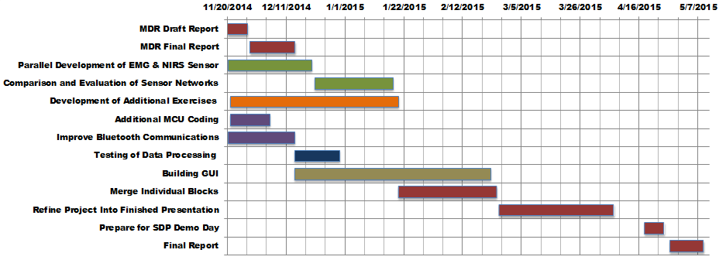
Progress Schedule

Slide 16
Proposed MDR Deliverables
Demonstration of Working Sensor
  Outputting different voltages for different light intensities
Demonstration of Bluetooth Rx/Data Processing
  Using test data
    Receive from microcontroller
    Run algorithm
Notes:
16
16
16

Slide 17
Proposed MDR Deliverables
Demonstration of Kinect Sensor Feedback
  Be able to accurately identify several markers of incorrect technique
Demonstration of Microcontroller Operation
  Send LED pulse signals
  Sample test voltage from function generator
  Transmit test voltage to laptop

Slide 18
Proposed CDR Deliverables
Demonstration of functioning integrated system
  Fully functional and accurate sensor network integrated into wearable and communicating data to microcontroller.
  Consistent Bluetooth communication of data from sensor network to laptop via microcontroller.
  Successful real time data processing displayed to user on GUI
  Accurate fault detection in exercise form displayed to user for multiple workouts.
  Useful feedback on GUI to user about exercise quality.

