Slide 1
Digital Fitness Trainer
PDR

Slide 2
Team Members
Ben Sherman
Nate Reynolds
Justin Gardner
Chris Corbo
Advisor: Professor Duarte

Slide 3
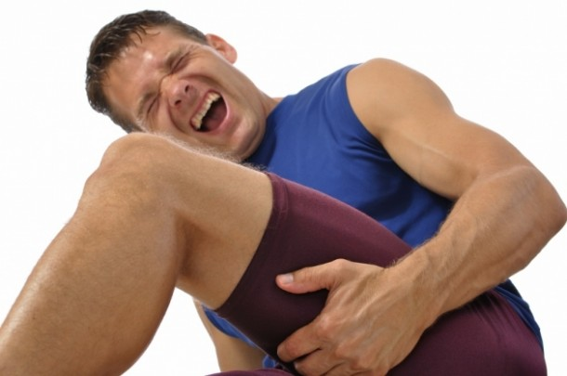
What is the problem?
Notes:
Exercise injuries occur most often from over exertion and improper workout form.
Difficult to know when overexertion is occurring.
Not always convenient to have personal trainer monitor a workout.

Slide 4
How significant is the problem?
More than 970,000 weight training related injuries between 1990 and 2007.
Overexertion, muscle pulls and loss of balance accounted for about 14 percent of emergency room visits.
Based on a study discussed in the NY Times
http://www.nytimes.com/2010/06/15/health/15stat.html?_r=1&
Notes:
4
4
4
Lemon costs $1

Slide 5
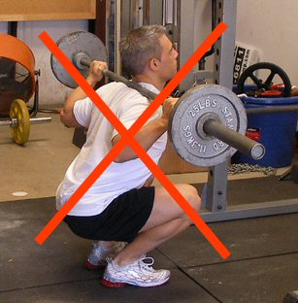
Context: Effect on Individuals
Notes:
5
5
5
Design a system for monitoring exercise form and intensity in order to prevent injury.
Utilize intensity monitoring to maximize results and minimize injuries.
Accurately detect faults in user’s form.

Slide 6
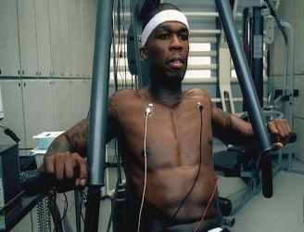
Context: Effect on Groups
Provide alternative to personal trainer that can work with anyone's schedule.
Create a healthier, happier population.
Cannot cause injuries to users.
Notes:
6
6
6

Slide 7
Our Solution: DFT
Array of sensors in compression shorts
Near Infrared Spectroscopy (NIRS) network under fabric
Comfortable for exercise
Detachable microcontroller module
Lightweight and comfortable
Kinect visual tracking
Accurate real-time tracking of form
User Interface
Gives feedback about form and estimated fatigue
Easy to use
Notes:
7
7
7
The Kinect and the sensors work together to give a more complete view of a workout than any current solution.
Combines metabolic and bio mechanic information to give a more complete analysis of your workout.

Slide 8
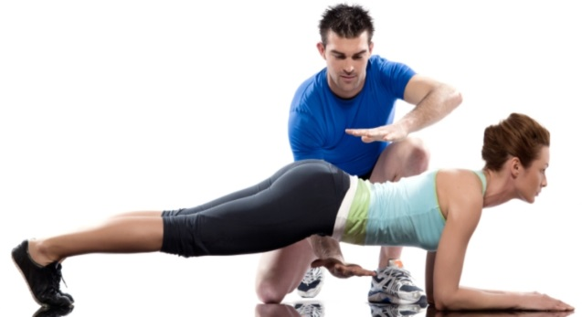
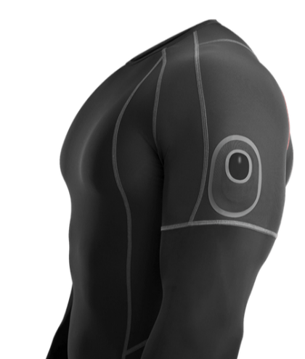
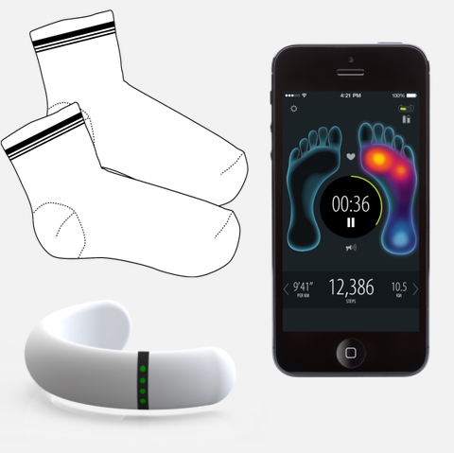
Available Solutions
Personal Trainer
Dependent on trainer’s schedule/location
Qualitative feedback
Athos
Product in development
Electromyography (EMG) sensor network
No visual form tracking
Sensora
Product commercially available
Limited to heart rate and pressure sensors
No visual form tracking
Notes:
8
8
8

Slide 9
Requirements Analysis: Specifications
Real time exercise feedback.
Wearable compression shorts.
Negligible weight increase
Minimum effective range of 10 ft.
Washable
Durable (withstand impacts from workout)
Battery lifetime lasting multiple workouts(~4 hrs)
Notes:
9
9
9

Slide 10
Requirements Analysis: Inputs and Outputs
Input
Sensor oxygenation reading
Video input of user’s technique
User exercise selection
User specific characteristics
Age, weight, height , etc.
Output
Muscle oxygenation level and fatigue estimate
Form tracking & feedback on GUI
Healthy uninjured users
Notes:
10
10
10

Slide 11
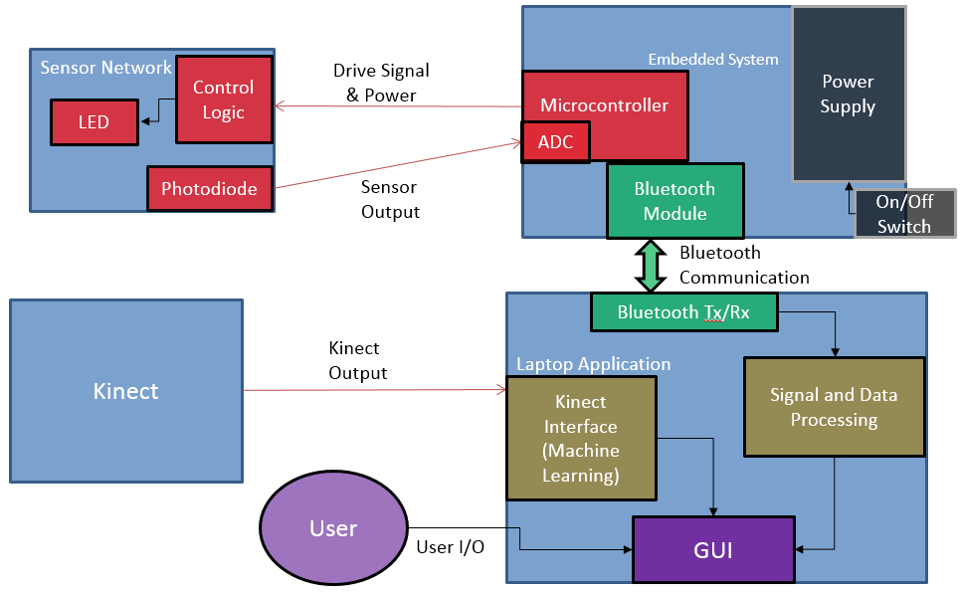
Our Solution: Block Diagram
Notes:
11
11
11

Slide 12
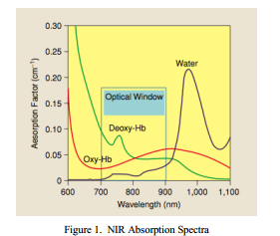
Our Solution: DFT
Sensor Network
Requirements:
Small area and height
Blood oxygenation readings at correct depth
Sensors located correctly on the user’s body
Justin Gardner

Slide 13
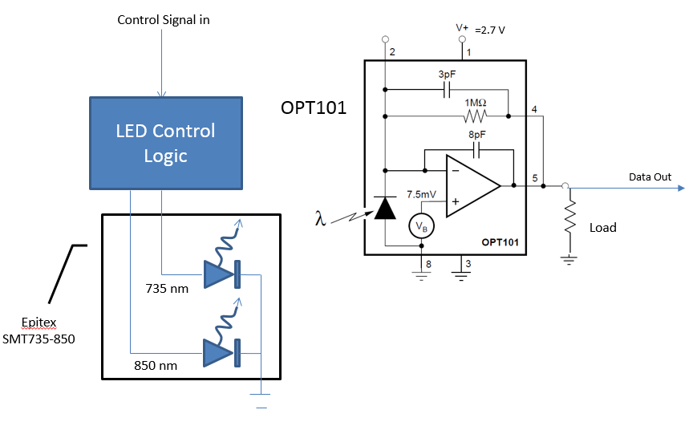
Our Solution: DFT
Sensor
Notes:
Mention state machine in LED logic: 735 on, 850 on, off

Slide 14
Embedded System
Our Solution: DFT
Requirements:
Sends drive signals to LED driver circuitry
Converts analog sensor voltages to digital signals
Transmits digital voltage readings to laptop
On/off switch
Nate Reynolds
Notes:
It will also receive messages from the laptop to decide when to start and stop running the LEDs (saves battery)

Slide 15
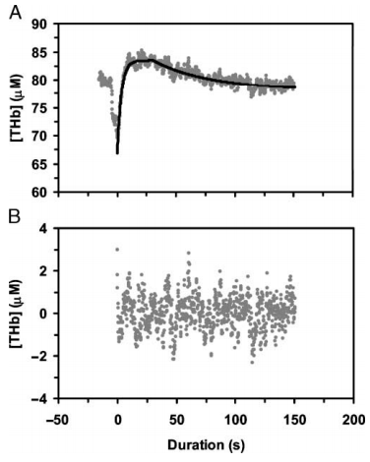
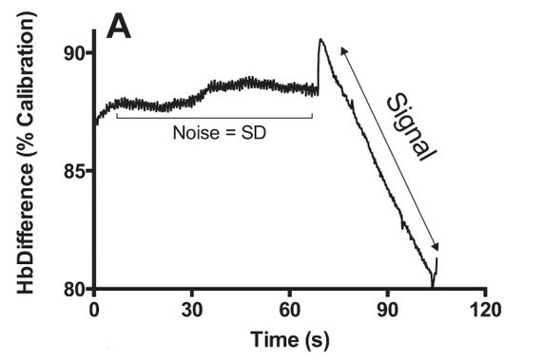
Bluetooth, Signal and Data Processing, GUI
Our Solution: DFT
Requirements:
Data processing and development of algorithms
Transmit Bluetooth data to embedded system
Interpret received signals and display on GUI
Must display results on laptop in real time
Chris Corbo
Notes:
Beer-Lambert Law: Algorithm relating attenuation of light to material properties, which is useful for processing NIRS data

Slide 16
Our Solution: DFT
Building the Application
The PC-based application will receive information from the Kinect and muscle sensors.
It will interpret the data as it pertains to the specifically selected exercise and provide feedback to the user in a GUI.
Ben Sherman
Muscle Sensors
Application w/ GUI
Kinect

Slide 17
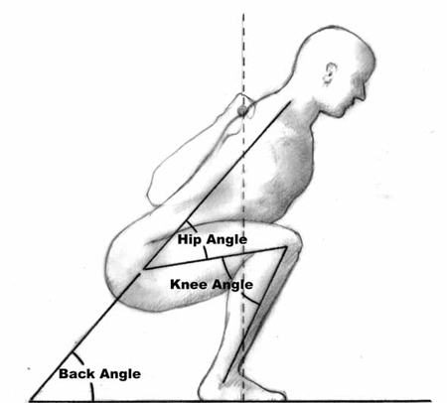
Example Exercise: Squats
✔
“Warning: Keep chest up and butt down.”
“Good!”
Notes:
http://www.machinemuscle.com/wp-content/uploads/Squat-Form.jpg
http://s3.amazonaws.com/cooltools_legacy/startingstrength2.jpg
*There are many form issues that can be detected and used to provide a warning to the user.

Slide 18
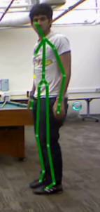
Our Solution: DFT
Utilizing the Kinect Sensor
The Kinect sensor can perform skeletal tracking of the user.
It can use the output to give feedback on form.
It will also show a graphical output of the skeletal tracking.
Ben Sherman
Notes:
It can use this input, in conjunction with known biomechanical information about the specific motion (built in to the app), to provide concrete feedback to the user about their form. It can detect and prevent potential injury through incorrect form.

Slide 19
Design Alternatives
EMG Sensor Design
Generally senses muscle activation
Requires some adhesive or water as conductor to skin
Adjustable Velcro bands
One size fits all
Dependent on user for placement
Wired communications
No wireless communication required
Makes for a less comfortable wearable
Notes:
EMGs will be useful if we cannot get the NIRS sensors to work properly.
Bands will be useful if shorts are too inaccurate.
Wired will be a last resort if for whatever reason we can’t do wireless.

Slide 20
Proposed MDR Deliverables
Demonstration of Working Sensor
Outputting different voltages for different light intensity levels
Demonstration of Microcontroller Operation
Send LED pulse signals
Sample test voltage from function generator
Transmit test voltage to laptop
Notes:
20
20
20

Slide 21
Proposed MDR Deliverables
Demonstration of Bluetooth Rx/Data Processing
Using test data
Receive from microcontroller
Run algorithm
Demonstration of Kinect Sensor Feedback
Be able to accurately identify several markers of incorrect technique

Slide 22
Table of Contents
What is the Problem?
Available Solutions
Our Solution
Specifications
Block Diagram
Design Alternatives
MDR Deliverables

