Slide 1
Digital Fitness Trainer
CDR

Slide 2
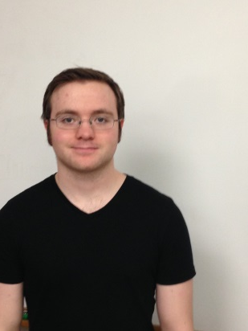
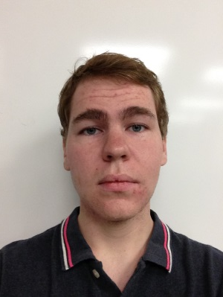
Team Members
Ben Sherman
Nate Reynolds
Justin Gardner
Chris Corbo
Advisor: Professor Duarte

Slide 3
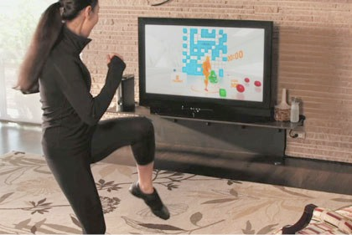
DFT Overview
Kinect to track form
Laptop to display -rep count -form feedback
-fatigue estimate -video of user
Sensors to measure
muscle activity
Microcontroller to
send sensor signals
to laptop application

Slide 4
Differences from Last Time
Sensors are now Electromyography (EMG) probes
They are simply conductors placed on the surface of the skin that measure a voltage differential
In our case, they measure the twitch of muscle fibers
Sampling and data processing changed to cope with the new sensors
Microprocessor now takes 256 samples at 1 kHz and sends them all at once
Laptop is now using a Fast Fourier Transform (FFT) algorithm rather than modified Beer-Lambert Law
The fatigue threshold is where the median power frequency (MPF) of the signal reaches 60-70% of its original value

Slide 5
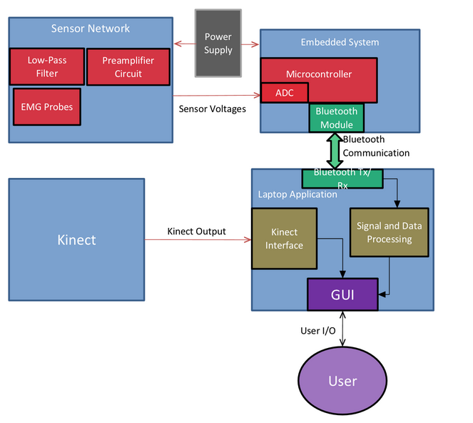
Our Solution: Block Diagram
Notes:
5
5
5

Slide 6
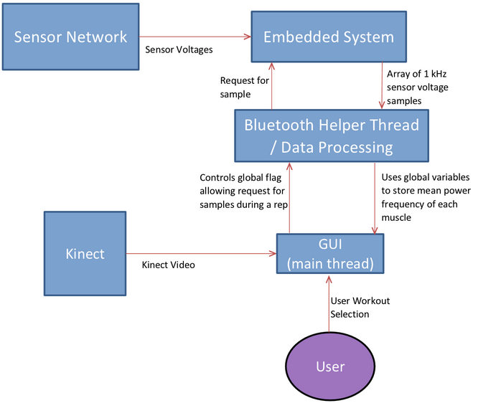
Our Solution: Control Diagram

Slide 7
Power Requirements: Embedded System and Sensors
Sensor Power Consumption
Average current is about 10 mA for six sensors.
Which would require about 250 mAhr per sensor in order to achieve a 4 hour battery life.
Embedded System Power Consumption
The system uses 90 mA when transmitting and 40 mA when not transmitting.
This would require 525 mAhr for the embedded system in order to achieve 4 hour battery life
Currently we are using 4 AA batteries. The final design will use a longer-lasting power source, such as a rechargeable phone battery.
Notes:
7
7
7
Design a system for monitoring exercise form and intensity in order to prevent injury.
Utilize intensity monitoring to maximize results and minimize injuries.
Accurately detect faults in user’s form.

Slide 8
Demonstration Overview
Demonstration of functional sensors
Workout with Ben

Slide 9
FPR Goals
Demonstration of functioning integrated system
Fully functional and accurate sensor network integrated into wearable and communicating data to microcontroller.
Consistent Bluetooth communication of data from sensor network to laptop via microcontroller.
Successful real time data processing displayed to user on GUI in the form of fatigue indicator
Accurate fault detection in exercise form displayed to user for multiple workouts.
Useful feedback on GUI to user about exercise quality.

