Slide 1
Sudo Chef
Dan Abbate
Kyle Despins
Tom Murphy
Eli Siskind
Advisor: Professor Tessier

Slide 2
Introduction to Sudo Chef
Notes:
-Kitchen assistant
-app
-home auto

Slide 3
What is Sudo Chef?
Kitchen Inventory Tracker
Sudo Chef, what groceries do I need?
You are running out of apples!

Slide 4
What is Sudo Chef?
Kitchen Inventory Tracker
Sudo Chef, what groceries do I need?
You are running out of apples!

Slide 5
What is Sudo Chef?
Recipe Selector
Sudo Chef, what can I make for dinner tonight?
Sudo Chef
INVENTORY
RECIPES
SETTINGS
HISTORY
about
You have the right ingredients for Pad Thai!

Slide 6
What is Sudo Chef?
Recipe Selector
Sudo Chef, what can I make for dinner tonight?
Sudo Chef
INVENTORY
RECIPES
SETTINGS
HISTORY
about
You have the right ingredients for Pad Thai!

Slide 7
What is Sudo Chef?
Recipe Assistant
Sudo Chef, what’s next?
Sudo Chef
INVENTORY
RECIPES
SETTINGS
HISTORY
about
Start cooking the shrimp!

Slide 8
What is Sudo Chef?
Recipe Assistant
Sudo Chef, what’s next?
Sudo Chef
INVENTORY
RECIPES
SETTINGS
HISTORY
about
Start cooking the shrimp!

Slide 9
What is Sudo Chef?
Kitchen Automation
350°
Sudo Chef
INVENTORY
RECIPES
SETTINGS
HISTORY
about
Preheating the oven to 350!
Notes:
Transition to Tom; what problems

Slide 10
What Problems Are We Solving?
Cooking is daunting to novices.
???
UMASS

Slide 11
What Problems Are We Solving?
Cooking is daunting to novices.
???
UMASS

Slide 12
What Problems Are We Solving?
It’s confusing to follow multiple recipes at once.
???
Spinach and Mushroom Crepes
1. Chop mushrooms
2. Chop onions and caramelize
Rice Pilaf with Onions
1. Chop mushrooms
2. Chop onions and caramelize
Spinach and Mushroom Crepes
1. Chop mushrooms
2. Chop onions and caramelize

Slide 13
What Problems Are We Solving?
It’s confusing to follow multiple recipes at once.
???
Spinach and Mushroom Crepes
1. Chop mushrooms
2. Chop onions and caramelize
Rice Pilaf with Onions
1. Chop mushrooms
2. Chop onions and caramelize
Spinach and Mushroom Crepes
1. Chop mushrooms
2. Chop onions and caramelize
Notes:
Experienced Cooks

Slide 14
What Problems Are We Solving?
Sometimes you leave things in your fridge for too long.
Notes:
Prevent Sour Milk
Kyle will tell us why we are choosing this implementation

Slide 15
Why Sudo Chef?
Recipe Chooser and Ingredients Tracker
+
Home Automation
Notes:
Recipe selection based on inventory done before
Homeauto research Combination hasn’t been done before

Slide 16
Why Sudo Chef?
Recipe Chooser and Ingredients Tracker
+
Home Automation

Slide 17
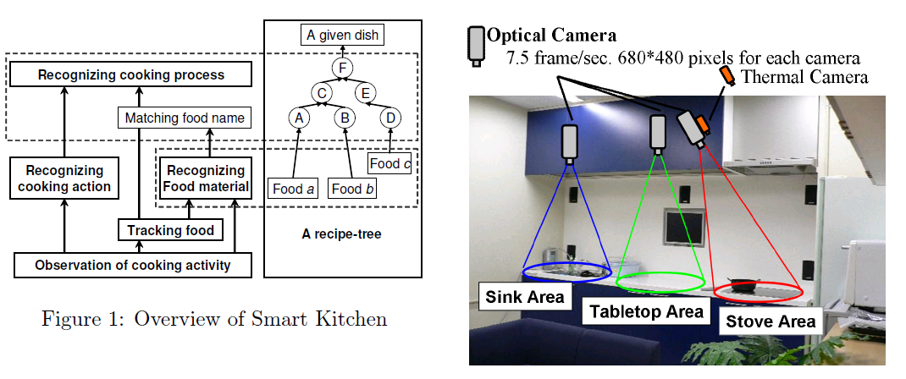
Why Sudo Chef?
Other implementations have issues
84.6% success rate
(Hashimoto et al, 2008)
“If the operation of smart equipment and feedback approaches are inconsistent with behaviors that the users are familiar with … than such a design … causes more inconvenience.”
(Wu and Tsai 2014)
Notes:
Unreliable feedback system/ hardware heavy A smart appliance works 5/6 time, it doesnt

Slide 18
Why Sudo Chef?
Other implementations have issues
84.6% success rate
(Hashimoto et al, 2008)
“If the operation of smart equipment and feedback approaches are inconsistent with behaviors that the users are familiar with … than such a design … causes more inconvenience.”
(Wu and Tsai 2014)

Slide 19
Why Sudo Chef?
We don’t bother trying to guess what is going on.
Sudo Chef, What’s next?
Let the user tell us.
Notes:
Sudo Chef; guessing games

Slide 20
System Overview
Notes:
DAN

Slide 21
Black Box Analysis
Sudo Chef
User Input
-Bar Codes
-Text input
-Voice Commands
Voice Directions
Mobile UI
Yummly Database
Appliance Actions
Notes:
Text Input: Inventory for things without barcodes
VD: Stir the veggies
AA: Preheat oven

Slide 22
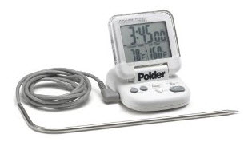
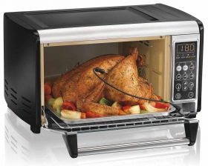
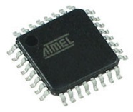
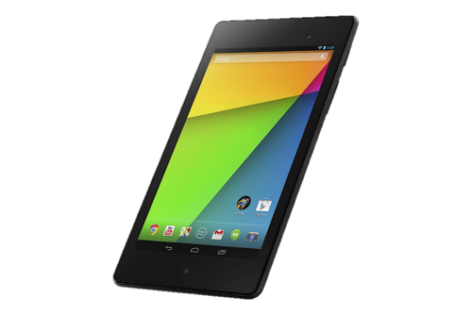
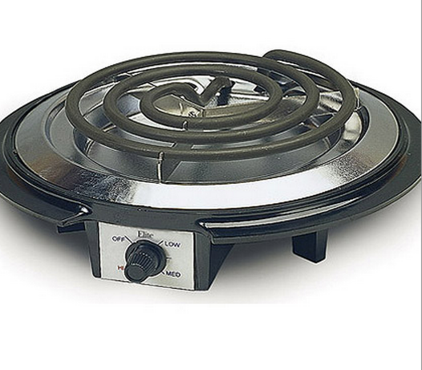
System Components

Slide 23
Block Diagram
Appliance Devices
Kitchen Actions
Microwave Controller
Stove controller
Oven Controller
Bluetooth Hub
Thermometer
Dan
Tom
Recipe Assistance
Mobile Bluetooth Adaptor
Recipe API
Eli
Kyle
Voice Recognition
Audio input
Voice Processing
Recipe helper mobile interface
Interpret Results
Ingredients Tracking
Mobile Camera (Barcode Capture)
Image Processing
Ingredients Database
Notes:
Start IT ->RA -> VR -> AD

Slide 24
Appliance Controllers
Dan Abbate

Slide 25
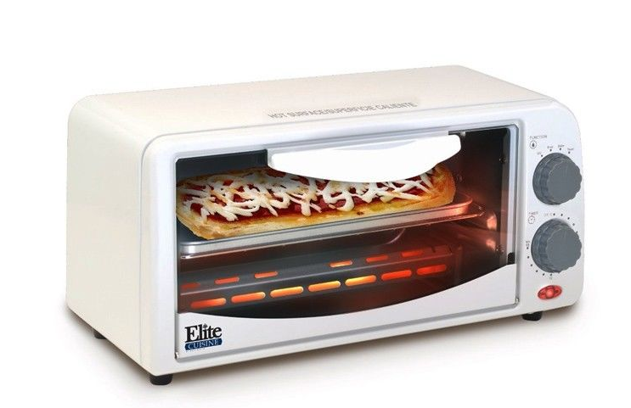
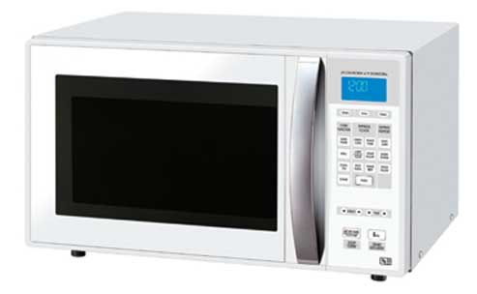
Requirements
Set hot plate to specified heat
Set oven temperature
Interface with microwave
Turn off unused appliances
Send response messages to application
Notes:
- Oven modes
- Response Msgs: Preheat Done, Appliance Shutdown

Slide 26
Appliances
Hamilton Beach Toaster Oven
Elite Cuisine Single Burner Hot Plate
Microwave – MicroFridge

Slide 27
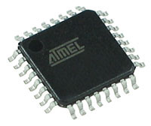
Implementation
Microcontroller
Low Power
16-Bit Processor
Minimal Amount of I/O Pins
Notes:
Most likely use AVR microcontroller

Slide 28
Implementation
Hot Plate
750 watts -> 6.25 amps
3 Heat Settings: Low, Med, High
Notes:
DIAL:
A mechanical potentiometer is substituted with a digital potentiometer
A digital knob is substituted with a microcontroller sending out a modified step-function

Slide 29
Alternatives
Variety of Appliances
Microcontroller Options:
1 Altera
2 Analog Devices
3 Atmel
4 Cypress Semiconductor
5 Dallas Semiconductor
6 ELAN Microelectronics Corp.
7 Energy Micro
8 EPSON Semiconductor
9 Freescale Semiconductor
10 Fujitsu
11 Holtek
12 Infineon
13 Intel
14 Lattice Semiconductor
15 Maxim Integrated
16 Microchip Technology
17 National Semiconductor
18 NEC
19 Panasonic
20 Parallax
21 NXP Semiconductors
22 Rabbit Semiconductor
23 Renesas Electronics
24 Rockwell
25 Silicon Laboratories
26 Silicon Motion
27 Sony
28 Spansion
29 STMicroelectronics
30 Texas Instruments
31 Toshiba
32 Ubicom
33 Xemics
34 Xilinx
35 XMOS
36 ZiLOG
Notes:
Full stove top/oven, crockpot…
Brands - smaller processor [increment by temp by 5] - higher powered

Slide 30
MDR Deliverables & Challenges
MDR Deliverables
Working, digitally controlled hot plate
Begin work on toaster oven
Challenges
Varying Appliance Hardware
Power
“In general, current that is fatal to humans ranges from 0.06 A to 0.07 A, depending on the person and the type of current.”

Slide 31
Communications and Sensor
Tom Murphy

Slide 32
Requirements
Connect appliances with mobile device
Get temperature sensor input

Slide 33
Implementation
Meat Thermometer
Use digital oven thermometer and wire to output
Low powered 16-bit microcontroller

Slide 34
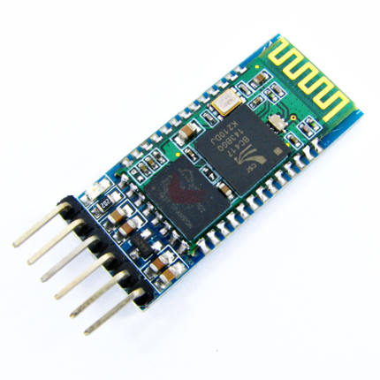
Implementation
Bluetooth
HC-05 Bluetooth serial port module
Bluetooth 2.0 Protocol – 2.4 GHz radio
32 bit AVR for hub

Slide 35
Implementation
Communication Protocol
0 | 1 | 2 | 3 | 4 | 5 | 6 | 7 | 8 | 9 | 10 | 11 | 12 | 13 | 14 | 15 | 16 | 17 | 18 | 19 | 20 | 21 | 22 | 23 | 24 | 25 | 26 | 27 | 28 | 29 | 30 | 31
Dev |  |  | Temperature |  |  |  |  |  |  |  |  |  | Time |  |  |  |  |  |  |  |  |  |  | Checksum
3b
10b
11b
8b
Mobile Device  Appliance Hub

Slide 36
Implementation
Communication Protocol
0 | 1 | 2 | 3 | 4 | 5 | 6 | 7 | 8 | 9 | 10 | 11 | 12 | 13 | 14 | 15 | … | 24 | 25 | 26 | 27 | 28 | 29 | 30 | 31
Type | Operation |  |  |  |  |  |  | Temperature |  |  |  |  |  |  |  |  | Checksum
1b
7b
8b
8b
Appliance Hub  Mobile Device
Notes:
Type – Network Command or Application Operation – Relevant feedback information. Error codes, device status, ACK/NAK Temperature – Meat thermometer & Hot plate
Checksum – Data validation

Slide 37
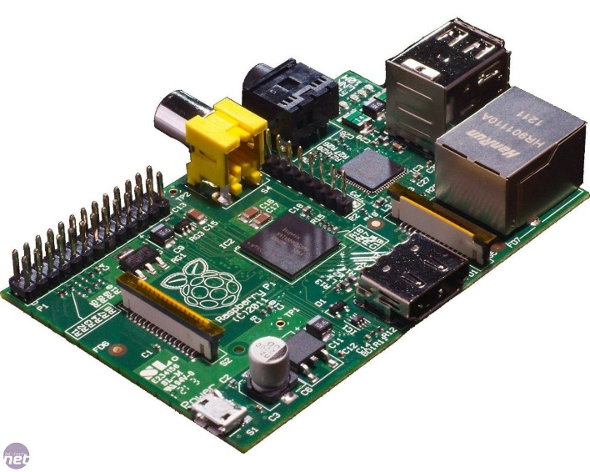
Alternatives
IR Laser Thermometer
DIY thermometer using LM34
Wifi communication with raspberry pi

Slide 38
MDR Deliverables & Challenges
MDR Deliverables
Tablet communication with Bluetooth hub
Standard handshake
Challenges
Tablet Bluetooth interfacing could be difficult
Wiring thermometer

Slide 39
Voice Recognition and Barcode Scanner
Kyle Despins

Slide 40
Requirements
Can process natural voice commands
Read standard bar codes

Slide 41
Implementation
Barcode Scanner

Slide 42
Implementation
Barcode Scanner
Mobile Camera
Image Processing
Barcode
Capture
B/W Image
Grayscale
Location Guidance UI
Localization
Decoding
UPC
1 23456 78999 9
Notes:
Handed off to el’s module

Slide 43
Implementation
Voice Recognition
Sphinx for voice recognition
Database of commands
Notes:
Why Sphinx: -Free –Well supported
“Sudo Chef” + Command

Slide 44
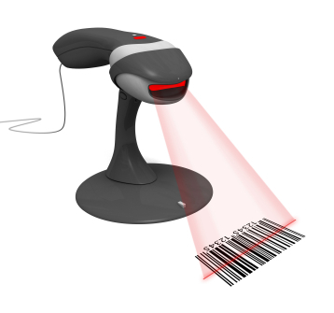
Alternatives
Dragon or Google Speech API
Laser Barcode scanner

Slide 45
MDR Deliverables & Challenges
MDR Deliverables
Complete barcode module without UPC lookup
Working Sphinx interaction
Challenges
Accuracy of voice software & camera
Multiple versions of each voice command

Slide 46
Mobile Application
Eli Siskind

Slide 47
Requirements
Interpret recipes into kitchen actions
Provides visual/touch interface for interacting with system
Can suggest recipes and shopping lists based on inventory

Slide 48
Implementation
Overview
Use Yummly API for recipe database, communicate via HTTP request and JSON objects
Use Java to write an android application

Slide 49
Implementation
Kitchen Actions
Instructions
Push notifications
Voice commands
Appliance Actions
Preheat oven
Set hot plate temperature
Feedback Request
Check if meat is cooked

Slide 50
Implementation
Recipe Guidance System
Recipe Data
Recipe Parser
Mobile Interface
Yummly API
Language Parser
Push Notifications
Text File
HTTP Req.
Kitchen Actions
Text Instructions
Recipe Request
Decision Making
Text to Speech
Voice Commands
Bluetooth Communication

Slide 51
Alternatives
Web application + external database instead of mobile application
Edamam API instead of Yummly

Slide 52
MDR Deliverables & Challenges
MDR Deliverables
Application GUI prototype
Parse a test recipe with examples of each type of kitchen action
Be able to access a recipe based on ingredients using Yummly API
Challenges
Interpreting Yummly output with natural language processing
Finding recipes when few ingredients in inventory
Interfacing with other modules

Slide 53
Conclusion

Slide 54
MDR Deliverables
Digitally controlled hot plate
Standard handshake via Bluetooth between tablet and microcontroller hub
Bar code module up and running
GUI prototype and basic recipe parsing

Slide 55
Questions?

Slide 56
Communication
Bluetooth Protocol

Slide 57
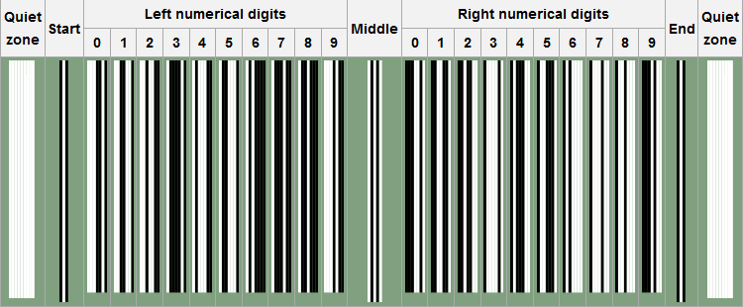
UPC-A format
Notes:
UPC length - 12

Slide 58
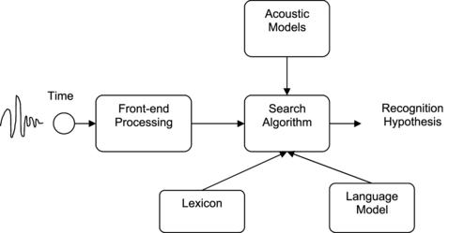
Sphinx
Voice Recognition
Use grammar language model: Java Speech Grammar Format
Statistical Language Model
Notes:
Acoustic Models – Statistical representation of each phonetic part of words (Phoneme) (40 for English language) Lexicon – Mapping of phonetics to actual words Language Model- Probability of that word to appear. (N-gram Models)

Slide 59
Yummly
Two API calls
Search recipes
Get recipe
Supports ANDing or ORing terms
Returns JSON objects with multiple fields
Ingredients
Allergens
Source and attribution information
Prep time
Number of servings

Slide 60
Specifications
Keep track of bought food using bar codes
Suggest recipes containing ingredients in inventory while they are fresh
Parse 100% of recipes, and recognize 95% of recipe terms
Respond to natural voice commands
Guide user through recipes by preheating oven, heating hot plate, microwaving food, and alerting users with push notifications and voice instructions
Always shut off appliances when not in use, including when mobile app fails

Slide 61
Power
“An interesting fact to note is that it takes less alternating current (AC) to do the same damage as direct current (DC). AC will cause muscles to contract, and if the current were high enough, one would not be able to let go of whatever is causing the current coursing through the body. The cut-off value for this is known as the "let-go current". For women, it is typically 5 to 7 milliamperes, and for men, typically 7 to 9 milliamperes. This is dependent on the muscle mass of the individual.
In general, current that is fatal to humans ranges from 0.06 A to 0.07 A, depending on the person and the type of current.”
http://hypertextbook.com/facts/2000/JackHsu.shtml
American Wire Gauge | Recommended Maximum Fuse Size
00 awg | 400 amps
0 awg | 325 amps
1 awg | 250 amps
2 awg | 200 amps
4 awg | 125 amps
6 awg | 80 amps
8 awg | 50 amps
10 awg | 30 amps
12 awg | 20 amps
14 awg | 15 amps
16 awg | 7.5 amps

Slide 62
Power – Pulse Width Modulation
Power/Voltage Regulation
Implement using 555 timer
Manipulate the Duty Cycle

