Slide 1
Sudo Chef
Dan Abbate
Kyle Despins
Tom Murphy
Eli Siskind
Advisor: Professor Tessier

Slide 2
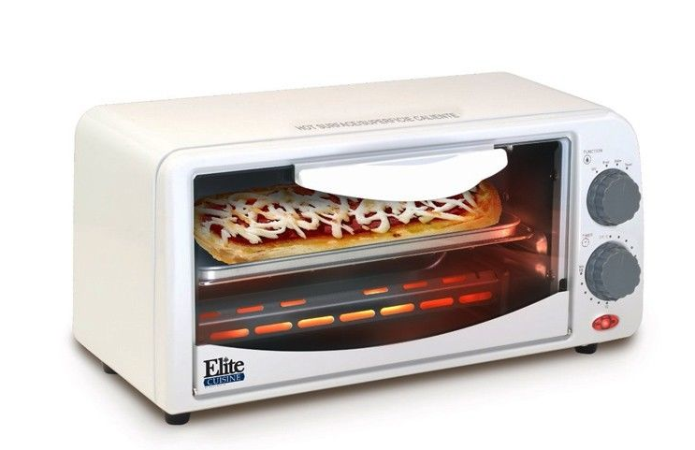
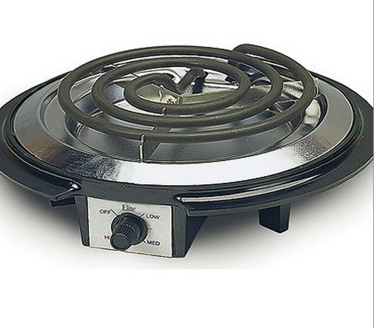
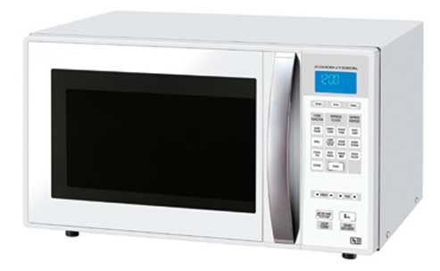
Current State of the Kitchen
Difficulties of following instructions across one or more recipes.
Picking a recipe involves multiple cross references to your inventory of ingredients.
Notes:
-Background

Slide 3
What is Sudo Chef?
Recipe Selection and Ingredients Tracking
+
Home Automation

Slide 4

System Overview
Hot Plate Controller
Sudo Chef
INVENTORY
RECIPES
SETTINGS
HISTORY
about
Oven Controller
350°
Notes:
Start IT ->RA -> VR -> AD

Slide 5
Block Diagram
Appliance Devices
Kitchen Actions
Oven Controller
Thermometer
Stove Controller
Bluetooth Devices
Dan
Tom
Recipe Assistance
Mobile Bluetooth Adaptor
Yummly API
Eli
Kyle
Voice Recognition
Audio input
Voice Processing
Recipe helper mobile interface
Interpret Results
Ingredients Tracking
Camera system controller
UPC lookup
Ingredients Database
Notes:
Start IT ->RA -> VR -> AD FIX

Slide 6
What We Had For MDR
Digitally controlled hot plate
Standard handshake via Bluetooth between tablet and microcontroller hub
Barcode module up and running
GUI prototype, recipe search, and basic recipe guidance

Slide 7
MDR Progress
Appliance Devices
Kitchen Actions
Oven Controller
Thermometer
✓
Stove Controller
Bluetooth Devices
Dan
Tom
✓
Recipe Assistance
✓
Mobile Bluetooth Adaptor
Yummly API
Eli
Kyle
Voice Recognition
✓
Audio input
Voice Processing
Recipe helper mobile interface
Interpret Results
✓
✓
Ingredients Tracking
Camera system controller
UPC lookup
Ingredients Database
Notes:
Start IT ->RA -> VR -> AD FIX

Slide 8
Recipe Fetch, Parsing, and Guidance
Eli Siskind

Slide 9

Context
Barcode
Hot Plate Controller
Sudo Chef
INVENTORY
RECIPES
SETTINGS
HISTORY
about
350°
Oven Controller
Recipe Database
Notes:
Start IT ->RA -> VR -> AD

Slide 10
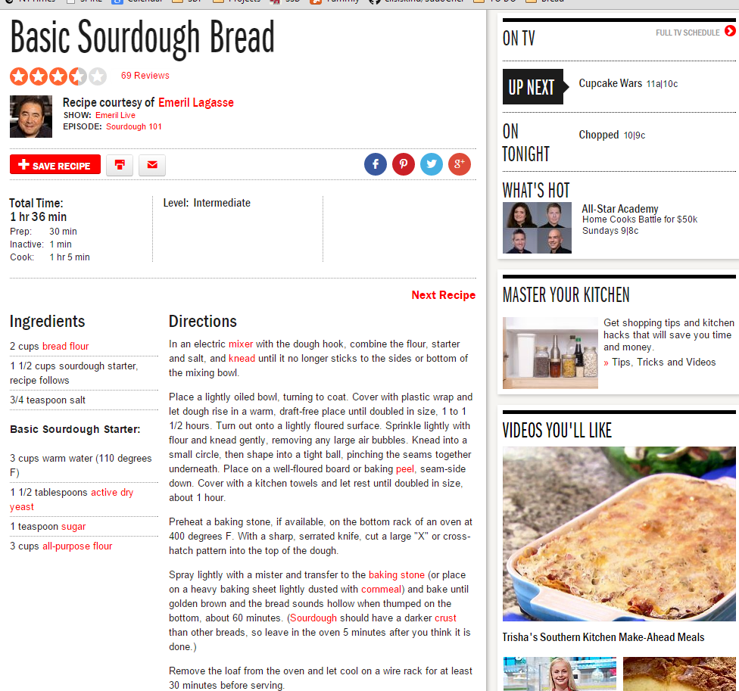
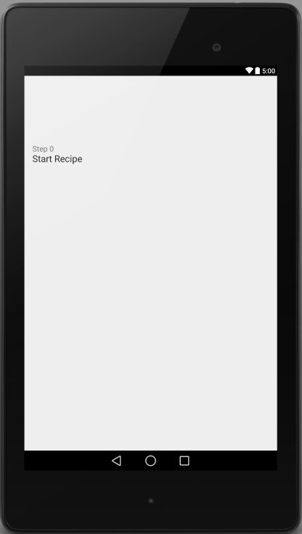
Parsing Recipes
The text of recipe instructions must be extracted from an HTML page
Each instruction must then be parsed into an actionable step by Sudo Chef

Slide 11
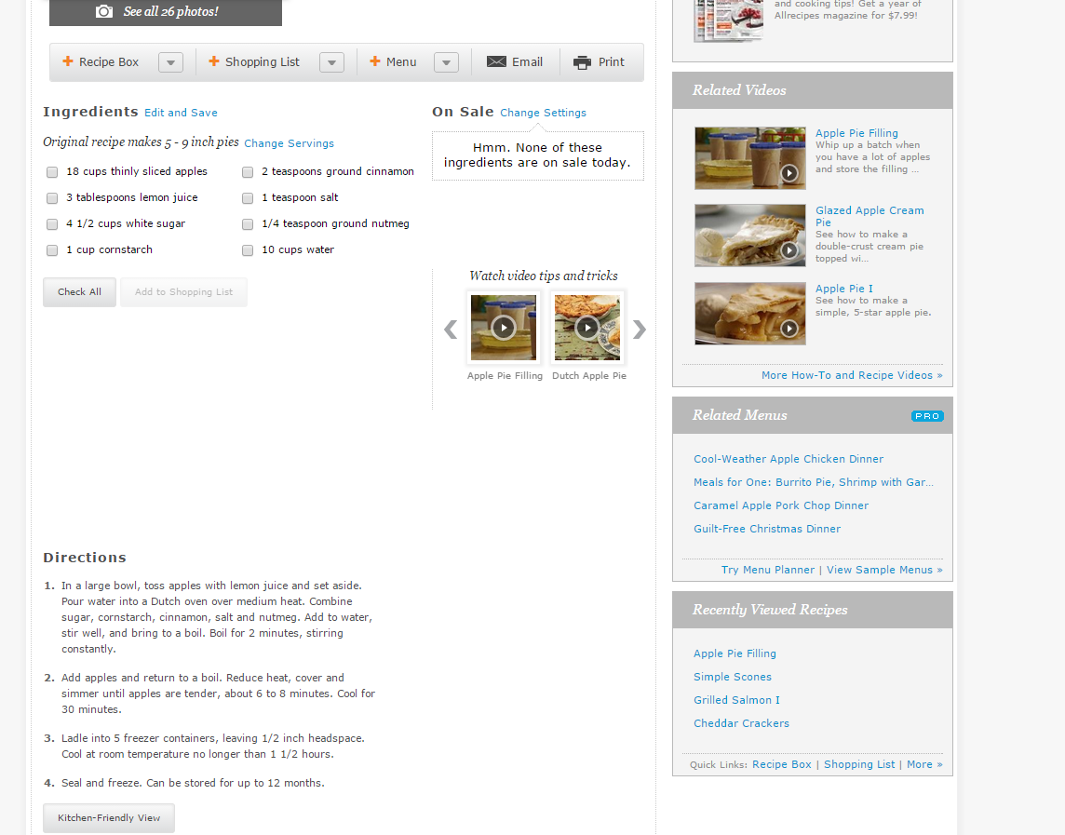

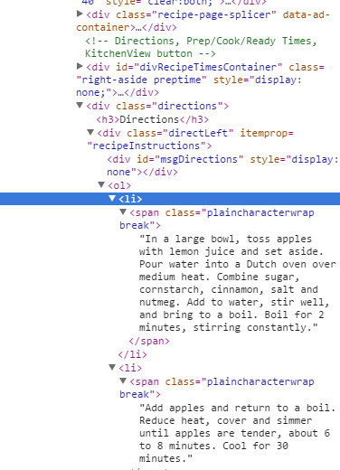
HTML Parser
JSOUP

Slide 12
Keyword Parser
preheat
& oven
& number
bake
& time
(Matches regex)
String contains:
NO
NO
NO
Yes
Yes
Yes
Preheat Oven
Set Timed Reminder
Set Hot Plate
Spoken Instruction

Slide 13
CDR Progress
Appliance Devices
Kitchen Actions
Oven Controller
Thermometer
✓
Stove Controller
Bluetooth Hub
Dan
Tom
✓
Recipe Assistance
✓
Mobile Bluetooth Adaptor
Yummly API
Eli
Kyle
Voice Recognition
✓
✓
Audio input
Voice Processing
Recipe helper mobile interface
Interpret Results
✓
✓
Ingredients Tracking
Camera system controller
UPC lookup
Ingredients Database
Notes:
Start IT ->RA -> VR -> AD FIX

Slide 14
Going Forward
Improve accuracy and scope of parsing
Add recipe suggestions based on ingredients database

Slide 15
Voice Processing & Ingredients
Kyle Despins

Slide 16
Context
Barcode
Hot Plate Controller
Sudo Chef
INVENTORY
RECIPES
SETTINGS
HISTORY
about
350°
Oven Controller
Notes:
Start IT ->RA -> VR -> AD

Slide 17
UPC Integration/Ingredients Database
Ingredients Database
“Hood Milk” “Granny Smith Apple”
“Barilla bowtie pasta”
1
Product Lookup Table (PLT)
Separate into individual words
Eliminate high freq word
>1
User Multiple Choice
0
User Form
Product Lookup Table (PLT)
Ingredients Database
Notes:
Start IT ->RA -> VR -> AD

Slide 18
Voice Input/Output
Voice Recognition Service
Start
Speech Activator
Spawn
Return when successfully heard
Word Matcher
(Soundex)
Notes:
Start IT ->RA -> VR -> AD

Slide 19
Interfacing with Recipe Module
Ingredients Database
Barcode/UPC
Insert
Retrieve
Searching
Voice Processing searching for word “next”
Advance recipe
Notes:
UP NEXT TOM

Slide 20
CDR Progress
Appliance Devices
Kitchen Actions
Oven Controller
Thermometer
✓
Stove Controller
Bluetooth Devices
✓
Dan
Tom
✓
Recipe Assistance
✓
Mobile Bluetooth Adaptor
Yummly API
Eli
Kyle
Voice Recognition
✓
✓
✓
✓
Audio input
Voice Processing
Recipe helper mobile interface
Interpret Results
✓
✓
✓
Ingredients Tracking
Camera system controller
UPC lookup
Ingredients Database
Notes:
Start IT ->RA -> VR -> AD FIX

Slide 21
Going Forward
Improve hit rate of Product Lookup Table
Fix some performance issues
Expand use of Voice processing module
FPR:
“Best Guess” phonetic matching
Using a “Real word” PLT filter
Notes:
UP NEXT TOM

Slide 22
Bluetooth Handshake
Tom Murphy

Slide 23
Context
Hot Plate Controller
Sudo Chef
INVENTORY
RECIPES
SETTINGS
HISTORY
about
350°
Oven Controller
Notes:
Start IT ->RA -> VR -> AD

Slide 24

Android App to create connection from phone to Bluetooth module
Two HC-06 Bluetooth modules connected to both the oven controller and Hot plate controller via Uart

Slide 25
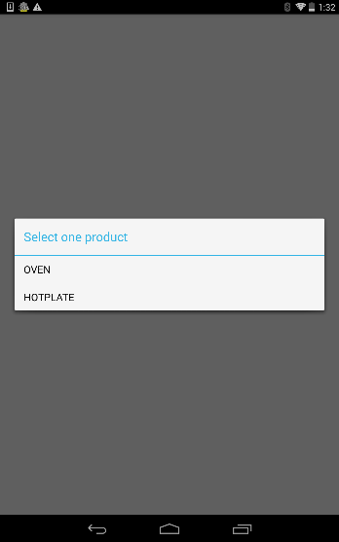
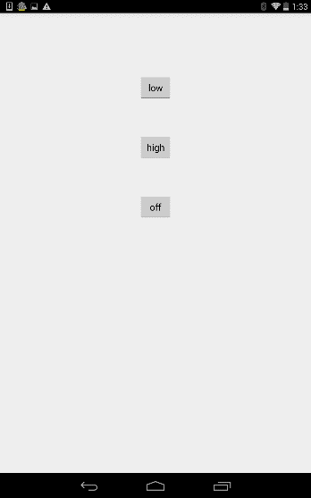
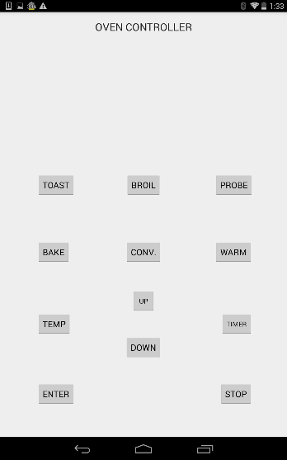
Android App
After starting bluetooth lets user pick between oven and hotplate controllers
SendData used to send data from device to hotplate controller or oven controller based on which device is selected

Slide 26
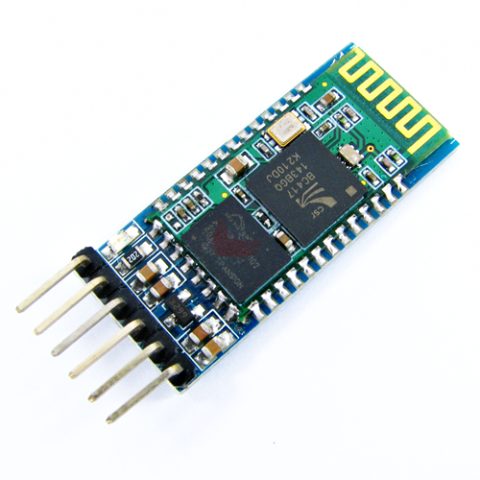
Bluetooth Hardware
HC-06 similar to HC-05 except can act as a slave and not a master
HC-05 chip was causing problems so decided to switch to the HC-06

Slide 27
Interface
As kitchen actions occur we want to send signals to oven/hotplate without having to use oven/hotplate controller
Run Bluetooth in background of app and have option of manual controls in the app

Slide 28
CDR Progress
Appliance Devices
Kitchen Actions
Oven Controller
Thermometer
✓
Stove Controller
Bluetooth Devices
✓
Dan
Tom
✓
Recipe Assistance
✓
Mobile Bluetooth Adaptor
Yummly API
Eli
Kyle
Voice Recognition
✓
✓
✓
✓
Audio input
Voice Processing
Recipe helper mobile interface
Interpret Results
✓
✓
✓
Ingredients Tracking
Camera system controller
UPC lookup
Ingredients Database
Notes:
Start IT ->RA -> VR -> AD FIX

Slide 29
CDR Deliverables
Data being sent from Android application and forwarded to corrected corresponding device (i.e hot plate or convection oven)

Slide 30
Going Forward
Confirm consistent data being sent from android device to each controller
FPR:
Send signals that go along with recipe parsing for seamless control of oven and hotplate
Setting & controlling temperature probe

Slide 31
Toaster Oven Controller
Dan Abbate

Slide 32
Context
Barcode
Hot Plate Controller
Sudo Chef
INVENTORY
RECIPES
SETTINGS
HISTORY
about
350°
Oven Controller

Slide 33
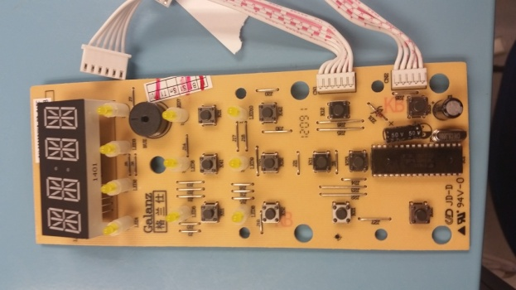
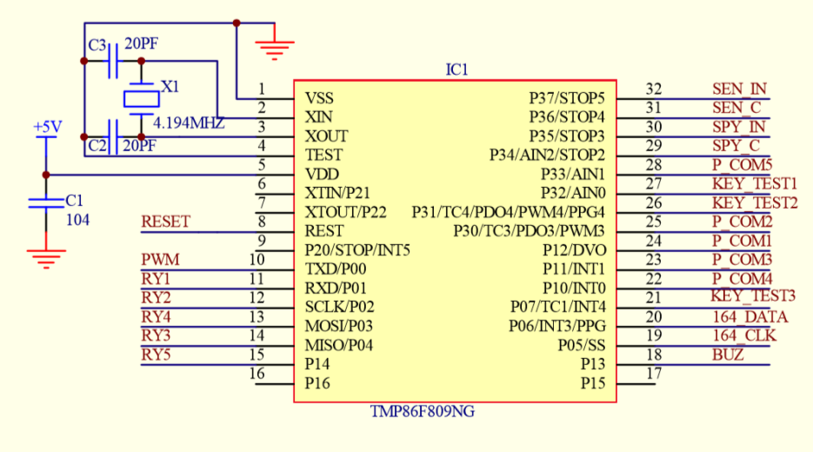
Controller Implementation

Slide 34
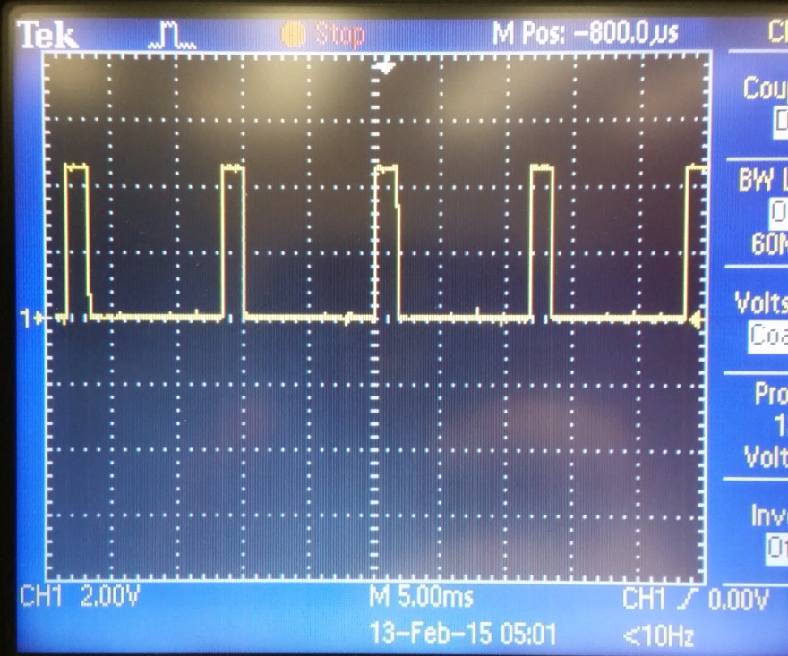
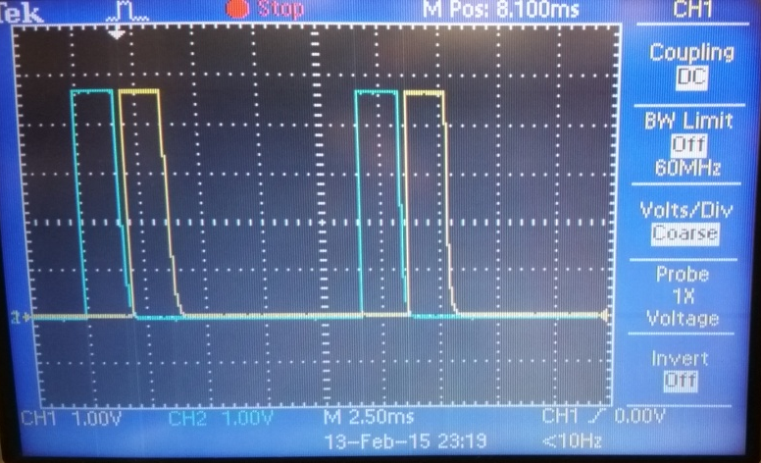
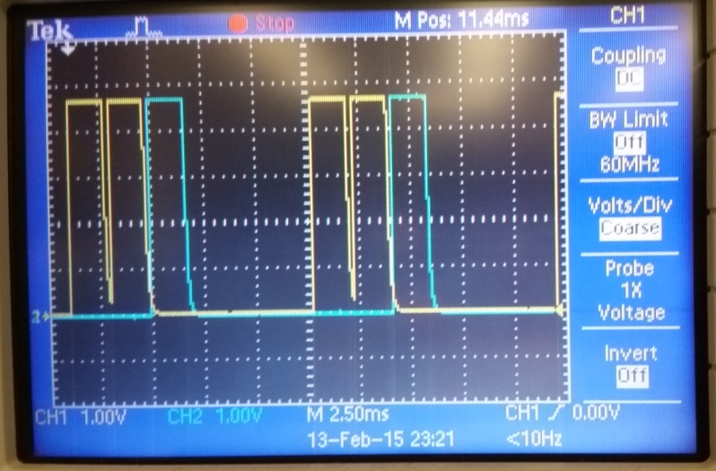
Understanding Toaster Oven Functionality
K11 (blue) - K21(Yellow) Pulses in Phase
1 of the 5 Pulses – Shows Period Length
K11 (blue) - K51 (yellow) Pulses in Phase

Slide 35
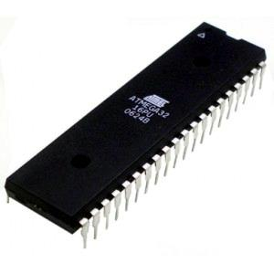
Toaster Oven Automation
USART
Signal
12 General IO Pins
PPM Controller
3 Function
Inputs
(KEY_TEST#)
5 Pulse Positions
(P_COM#)
Notes:
TMP86F809NG – Toaster Oven Microcontroller

Slide 36
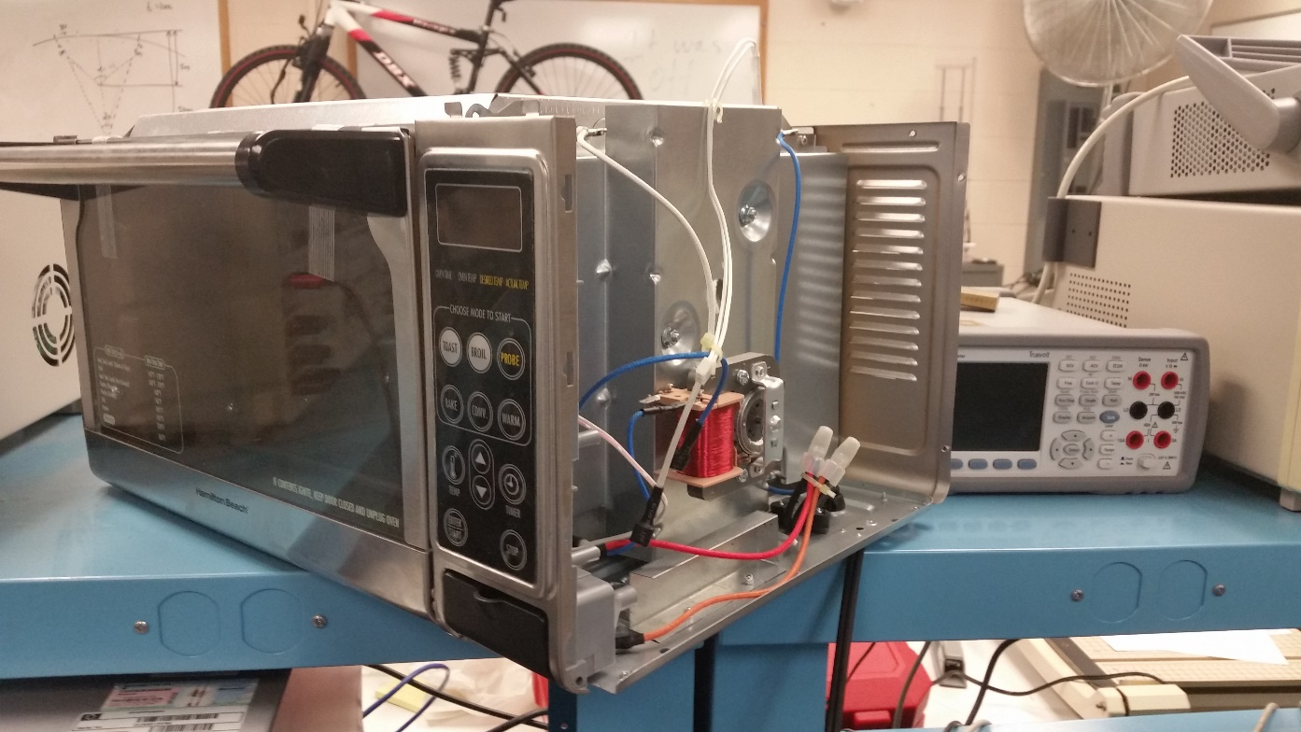
CDR Deliverables
Digitally controlled Toaster Oven

Slide 37
CDR Progress
✓
Appliance Devices
Kitchen Actions
Oven Controller
Thermometer
✓
Stove Controller
✓
Bluetooth Devices
Dan
Tom
✓
Recipe Assistance
✓
Mobile Bluetooth Adaptor
Yummly API
Eli
Kyle
Voice Recognition
✓
✓
✓
✓
Audio input
Voice Processing
Recipe helper mobile interface
Interpret Results
✓
✓
✓
Ingredients Tracking
Camera system controller
UPC lookup
Ingredients Database
Notes:
Start IT ->RA -> VR -> AD FIX

Slide 38
Going Forward
Finalized Comm. Process for Toaster Oven
Install Power Components
PCB Boards for Controller Hardware
Housing for PCB Boards

Slide 39

CDR Deliverables
Digitally controlled convection oven
Data being sent from Android application and forwarded to corrected corresponding device (i.e hot plate or convection oven)
Barcode module full integration and prototype voice processing
Full recipe parsing, communication with hardware via Bluetooth, inventory tracking coupled with barcode module

Slide 40
FPR Deliverables
Recipe suggestion based on inventory
“Best Guess” phonetic matching / Using a “Real word” PLT filter
Send signals that go along with recipe parsing for seamless control of oven and hotplate
Setting of thermometer probe
Install power components
Fabrication and housing of controller hardware

Slide 41
Demonstration

Slide 42
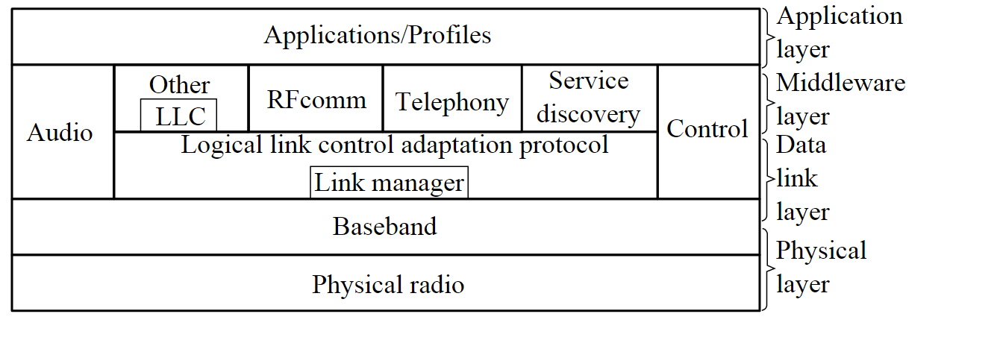
Communication
Bluetooth Protocol

Slide 43
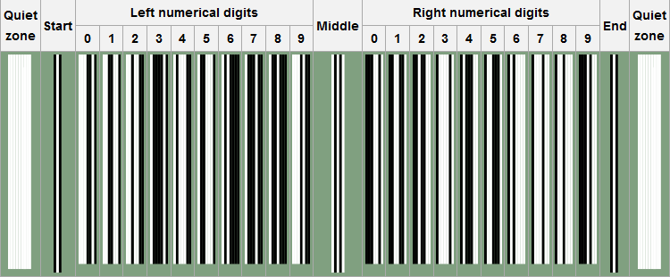
UPC-A format
Notes:
UPC length - 12

Slide 44
Soundex
Soundex Value – Z430
Consonant values:
b, f, p, v = 1
c, g, j, k, q, s, x, z = 2
d, t = 3
l = 4
m, n = 5
r = 6
Following all equal a Soundex value of H400:
Hello
Hallow
Hollow
Halo
Even works for a non word:
Wuerld – W643
Whirled – W643
Worlds – W643
World – W643
Notes:
Retain the first letter of the string and remove all other occurrences of the following letters: a, e, h, i, o, u, w, y.
Assign numbers to the remaining letters (after the first) as follows:
b, f, p, v = 1
c, g, j, k, q, s, x, z = 2
d, t = 3
l = 4
m, n = 5
r = 6
If two or more letters with the same number are adjacent in the original name (before step 1), only retain the first letter; also two letters with the same number separated by 'h' or 'w' are coded as a single number, whereas such letters separated by a vowel are coded twice.
If result is more that 3 digits repeat previous steps, if less than 3 then pad with zeros

Slide 45
Yummly
Two API calls
Search recipes
Get recipe
Supports ANDing or ORing terms
Returns JSON objects with multiple fields
Ingredients
Allergens
Source and attribution information
Prep time
Number of servings

Slide 46
Specifications
Keep track of bought food using bar codes
Suggest recipes containing ingredients in inventory while they are fresh
Parse 100% of recipes, and recognize 95% of recipe terms
Respond to natural voice commands
Guide user through recipes by preheating oven, heating hot plate, microwaving food, and alerting users with push notifications and voice instructions
Always shut off appliances when not in use, including when mobile app fails

Slide 47
Budget

