Slide 1
Functional Verification of Arithmetic Circuits
Maciej Ciesielski
Department of Electrical & Computer Engineering
University of Massachusetts, Amherst
ciesiel@ecs.umass.edu

Slide 2
Outline
Introduction
Hardware verification methods, focus on arithmetic verification
Basics
Boolean techniques: BDD
Word-level canonical: BMD, TED
Equivalence checking, SAT
Bit-vector and word-level techniques
SMT, ILP models
Computer algebra methods
Arithmetic bit level
Data-flow based approach
Other algebraic methods
Extended bibliography

Slide 3
Arithmetic Verification Part I
Basics
Canonical Diagrams, SAT

Slide 4
Hardware Verification
Variety of formal techniques
Model checking, property checking
Equivalence checking
Theorem proving
Solution methods
Canonical diagrams (Boolean, word-level)
SAT (satisfiability)
SMT (satisfiability modulo theories)
Integer Linear Programming (ILP) methods
Computer Algebra approach

Slide 5
Formal Verification Techniques
Theorem proving,
Deductive reasoning with axioms, rules to prove correctness
Term-rewriting, no guarantee it will terminate
Complex, heavy user interaction and domain knowledge
Systems: ACL, PVS, HOL,
Model checking
Automatic technique to prove correctness of concurrent systems
Use temporal logic specification, CTL, etc. to describe properties
Practical tools become available, popular in industry
Equivalence checking
Check if two designs are equivalent
Solved for combinational circuits
Except arithmetic circuits and datapaths
Difficult problem for sequential systems
Functional verification (our focus: arithmetic circuits)
Special case of equivalence checking and property checking
ICCD 2015
Arithmetic Verification - Tutorial
5

Slide 6
Functional Verification
Determined by functional specification
Input-output (I/O) relationship
Our focus: combinational integer arithmetic circuits
How is functional specification given?
By writing a formula that describes I/O relationship
Easy for logic circuits (write a Boolean formula)
What about arithmetic circuits?
Different ways to provide “specification”
By providing reference design with desired function
e.g. standard “text-book” multiplier
Checking equivalence with the reference design

Slide 7
Combinational Equivalence Checking
Functional Approach
Transform output functions of combinational circuits into a unique (canonical) representation
Two circuits are equivalent if their representations are identical
Efficient canonical representations:
BDD, BMD, TED.
Structural
Identify structurally similar internal points
Prove internal points (cut-points) equivalent
ICCD 2015
Arithmetic Verification - Tutorial
7

Slide 8
Canonical Representations
Boolean Representations (f: B → B)
BDDs, ZBDDs, etc.
Moment Diagrams (f: B → Z)
BMDs, K*BMDs, etc.
Canonical DAGs for Polynomials (f: Z → Z)
Taylor Expansion Diagrams (TEDs)
Horner Decision Diagrams (HDDs)
Arithmetic verification needs representation for f: Z₂m → Z₂m
Modular arithmetic
ICCD 2015
Arithmetic Verification - Tutorial
8

Slide 9
Binary Decision Diagrams (BDD)
Based on recursive Shannon expansion [Bryant DAC’85]
f = x f_{x} + x’ f_{x’}
Compact data structure for Boolean logic
can represents sets of objects (states) encoded as Boolean functions
Canonical representation
Reduced, ordered BDDs (ROBDD) are canonical
Essential for verification
Equivalence checking
SAT

Slide 10
Application to Verification - EC
Equivalence Checking (EC) of combinational circuits
Canonicity property of BDDs:
if F and G are equivalent, their BDDs are identical (for the same ordering of variables)
F
G
F = a’bc + abc +ab’c
G = ac +bc
a
a
a
≡
b
b
b
c
c
c
0
1
0
1
0
1
ICCD 2015
Arithmetic Verification - Tutorial
10

Slide 11
Application to Verification - SAT
General SAT
Find a set of satisfying assignments
Functional test generation
SAT, Boolean satisfiability analysis
to test for H = 1 (0), find a path in the BDD to terminal 1 (0)
the path, expressed in function variables, gives a satisfying solution (test vector)
H
a
b
ab
c
Problem: size explosion
ab’c
0
1
ICCD 2015
Arithmetic Verification - Tutorial
11

Slide 12
Large BDDs
Maps: B → B, very low-grain
Can be prohibitively large for arithmetic circuits (multipliers, etc.)

Slide 13
Partitioned BDDs
Circuits for which BDD can be constructed
Represent multiple-output circuits as shared BDDs
BDDs must be identical (with same variable order)
Circuits whose BDDs are too large
Cannot construct BDDs, memory problem
Use partitioned BDD method
decompose circuit into smaller pieces, each as BDD
check equivalence of internal points (cut-point method)
ICCD 2015
Arithmetic Verification - Tutorial
13

Slide 14
Word-level Canonical Diagrams - BMD
BMD for 4-bit Multiplier (bit-level) [Bryant TCAD’95]
Map: B → Z (binary to integers)
*BMD
Devised for word-level operations, arithmetic designs
Based on modified Shannon expansion (positive Davio)
f = x f_{x} + x’ f_{x’} = x f_{x} + (1-x) f_{x’}
= f_{x’} + x (f_{x} - f_{x’} ) = f_{x’} + x f_{Δx}
where f_{x’} = f_{x=0} is zero moment
f _{Δ x} ⁼ (f_{x} - f_{x’} ) is first moment, first derivative
Additive and multiplicative weights on edges (*BMD)
ICCD 2015
Arithmetic Verification - Tutorial
14

Slide 15
*BMD - Construction
Unsigned integer: X = 8x₃ + 4x₂ + 2x₁ + x₀
X _{x3=1} = 8 + 4x₂ + 2x₁ + x₀
X_{x3=0} = 4x₂ + 2x₁ + x₀
X_{Δx3} = 8
x3
x3
*BMD
x2
x2
8
4
x1
x1
BMD
2
x0
1
x0
0
1
0
1
2
4
8
Multiplicative edges
ICCD 2015
Arithmetic Verification - Tutorial
15

Slide 16
*BMD – Word-Level Representation
Efficiently modeling symbolic word-level operators
X Y
y2
X+Y
y2
y1
4
y1
2
4
y0
y0
2
1
x2
1
x2
4
4
x1
x1
2
2
x0
1
x0
1
0
1
0
1
ICCD 2015
Arithmetic Verification - Tutorial
16

Slide 17
Taylor Expansion Diagram (TED)
Canonical representation of multi-variate polynomials of arbitrary degree [Ciesielski-TComp’06]
f: Integer → Integer
More word-level than BMD
When input are Boolean: TED → BMD
TED is not a decision diagram
Cannot solve SAT
Too high-grain
Cannot express output bits as
function of word-level inputs
X + Y
Y
X
0
1
X⋅ Y
Y
X
0
1

Slide 18
TED – a few Examples
AC+BC +1
= A(B+C)+1
A²+AB +2BC
64
A
A
x3
1
16
1
B
16
x2
x2
B
B
1
8
C
C
4
4
1
x1
x1
2
1
4
2
1
0
1
1
x0
x0
0
1
1
1
Useful for finding factored forms
0
1
ICCD 2015
Arithmetic Verification - Tutorial
18

Slide 19
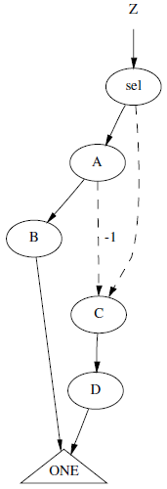
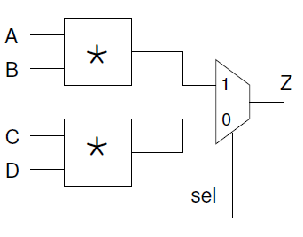
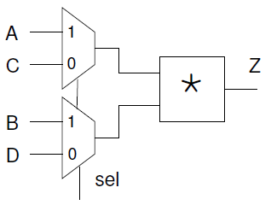
TED – Application to EC
Resource sharing
TED can prove their equivalence
Z = sel(A*B) + (1-sel)(C*D)
= sel(A*B - C*D) + CD

Slide 20
Applications to RTL Verification
Equivalence checking with TEDs
word-level and Boolean variables
A = [a_{n-1}, …,a_{k},…,a₀] = [A_{hi},a_{k},A_{lo}], B = [b_{n-1}, …,b_{k},…,b₀] = [B_{hi},b_{k},B_{lo}]
B
+
A
A
*
F₂
F₁
-
0
1
*
1
0
-
B
*
a_{k}
D
s₁
a_{k}
D
s₂
>
b_{k}
b_{k}
F₁ = s₁(A+B)(A-B) + (1-s₁)D
s₁ = (a_{k} > b_{k}) = a_{k} (1-b_{k})
F₂ = (1-s₂) (A²-B²) + s₂ D
s₂ = a_{k}’ ∨ b_{k} = 1 - a_{k} + a_{k} b_{k}
20

Slide 21
RTL Equivalence Checking
F₁ = F₂
D
B
+
A
F₁
a_{k}
a_{k}
*
1
0
-
1
b_{k}
b_{k}
a_{k}
D
s₁
>
1
-1
-1
b_{k}
2^{2k+2}
A_{hi}
1
B_{hi}
2^{k+2}
^2
-2^{2k+2}
A
A_{lo}
-2^{k+2}
*
F₂
-
0
1
B_{lo}
B
*
2^{k}
2^{k}
a_{k}
D
s₂
0
1
0
b_{k}
^2
= power edge
ICCD 2015
Arithmetic Verification - Tutorial
21

Slide 22
Equivalence Checking with SAT
Equivalence checking using SAT [GRASP, zChaff, MiniSAT]
Create a “miter” at the outputs
Check for unSAT (if always evaluates to 0)
The most popular way to solve equivalence checking (EC)
unSAT
CL2

Slide 23
Property Checking using SAT
Same concept can be applied to property checking
Need to conjunct the system spec (S) with the complement of the property (p)
Invoke a SAT solver
unSAT if system S satisfies property p
S
p

Slide 24
Miter for Cut-point based EC
Use cut-points to partition the Miter
Use SAT to solve the problem: is the output of Miter unSAT ?
Cut-point guessing
Compute signature with random simulation
Sort signatures + select cut-points
Iteratively verify and refine cut-points
Verify outputs
v₁
f₁
f₃
f₂
v₂
= 0?
= 0?
x
= 0?
v₁
f₁
f₃
f₂
v₂

Slide 25

Boolean Satisfiability (SAT)
Well known Constraint Satisfaction Problem.
Given a propositional formula Ψ, determine if there exist a variable assignment such as Ψ evaluates to true.
If it exist, Ψ is called satisfiable
If not, Ψ is called unsatifiable
SAT problems are hard (NP complete)
Most SAT solvers uses Conjunctive Normal Form (CNF) to represent the propositional formula
Conjunction of clauses
Each clause is a disjunction of literals

Slide 26
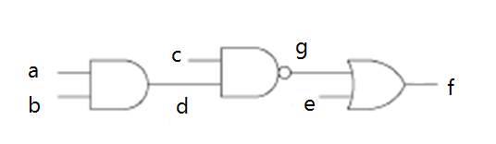
CNF for Gate-level Circuits
Converting gate-level circuit into CNF formula

Slide 27
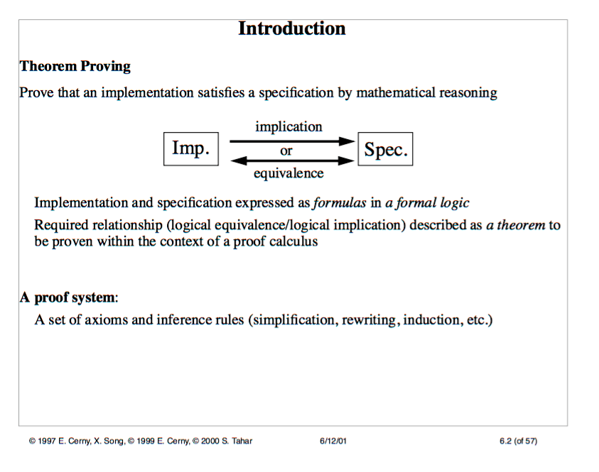
Theorem Provers

Slide 28
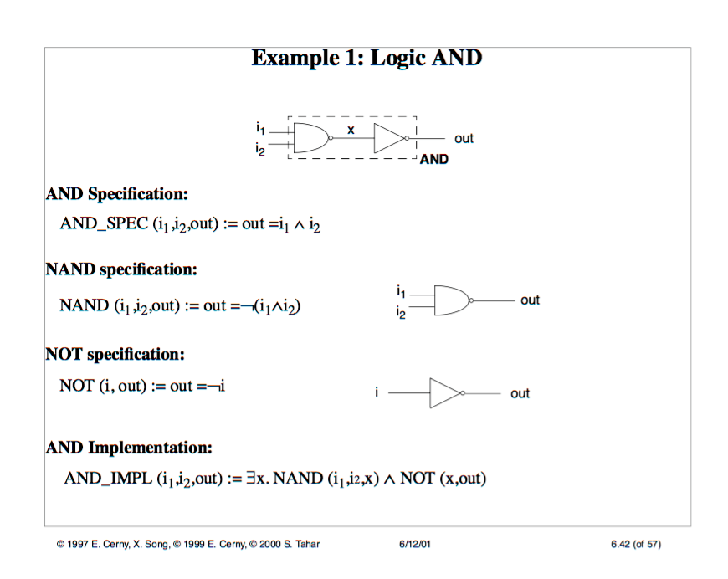
Theorem Prover: Example

Slide 29
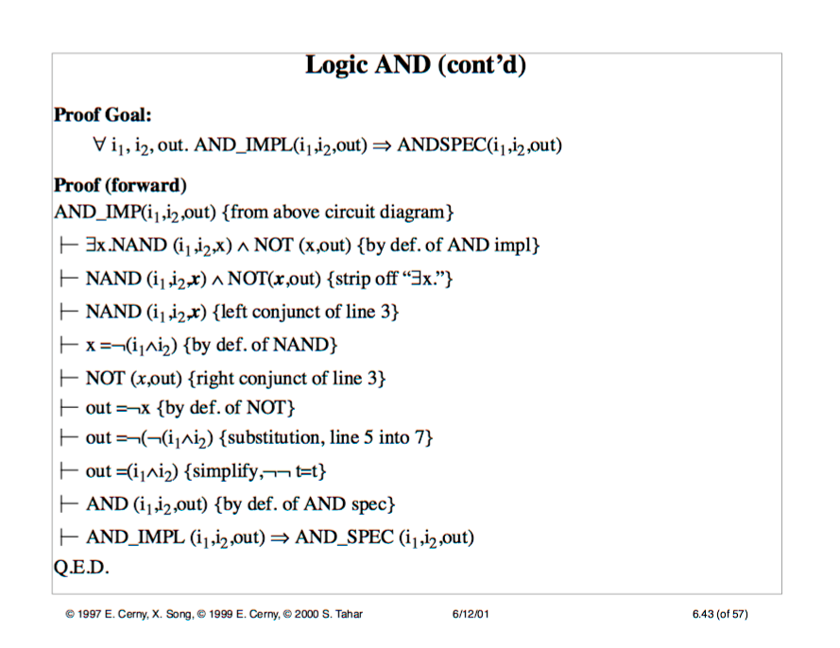
Theorem Prover: Example

Slide 30
Arithmetic Verification Part II
Word-level Models SMT, ILP methods

Slide 31
SMT for bit-vector Operation
Bit-vector operations
variables extended to bit-vectors
SMT-LIB
X₁ = AND (a₀ , b₀)
X₁ – a₀b₀ = 0
gate netlist
A = B
A ≠ B

Slide 32
SMT for bit-vector Operation
Bit-vector operation
variables extended to bit-vectors
SMT-LIB
Z – (A+B)
M – (A*B)
A > B

Slide 33
SMT vs SAT
SMT extends SAT solving by adding extensions (theories)
Core theory (Boolean)
Ints theory
Reals theory
Reals_Ints theory
ArraysEx theory
Fixed_Size_BitVectors theory, etc.
Properties
Decidable: An effective procedure exists to check if a formula is a member of a theory T
Often Quantifier-free
An SMT solver can solve a SAT problem, but not vice-versa
Application:
Software Model Checking, RTL Design, Analog

Slide 34
DPLL(T)
In a nutshell
DPLL(X)
Very similar to a SAT solver, enumerates Boolean model
Not allowed: pure literal, blocked clause elimination, ...
Required: incremental addition of clauses
Desirable: partial model detection
T-Solver
Checks consistency of conjunctions of literals
Computes theory propagations
Produces explanations of inconsistency / T-propagation
Should be incremental and backtractable

Slide 35
SMT modeling without Reference
Full adder using SMT: a+b+c = 2C_{out}+S
{+, -, 2} are bit-vector operations
XOR
XOR
AND
AND
F_{spec}

Slide 36
Functional Test Generation
Deterministic test pattern generation
Formulate a SAT problem for a complex combinational design
Solve SAT: find a set of satisfying assignment
modulo example(
A, B, C, x, a, b, out
);
input [?:0] A,B,C;
input a,b,x;
output out;
assign sel = (A+B)<(B*C);
assign out = (sel)? (a&b) : x;
endmodule
A=?
+
extract
B=?
<
*
out
C=?
x=?
0
1
a=?
b=?

Slide 37
Types of Operators
Arithmetic blocks
(symbolic, word-level operators)
ADD, SUB
MULT, DIV
Mixed-level blocks
MUX
A
0
A
C
+ --
* /
C
B
1
B
s
comparators
shifters, etc
Boolean logic (bit-level)
logic gates
a
A
c
c
b
<
B

Slide 38
Modeling Arithmetic Datapaths
Map entire design to CNF (miniSAT, GRASP, zCHAFF,…)
Any generic CNF-based solver can be used
Representation is large, structural information is lost
Map Boolean logic onto CNF, arithmetic operators onto linear equations (HSAT)
Inconsistent domains, explicit backtracking needed
Represent both domains in a unified format (LPSAT)
Solve Mixed Integer Linear Program (MILP)
Scalable with design size
Constraint propagation implicitly passed to MILP solver
First, assume infinite precision
No overflows, arbitrarily large bit-width
ATPG is also used

Slide 39
Arithmetic and Mixed Operators
n = number of bits
D
A
<
s
+ --
* /
C
E
s = {0,1}
B
D - E - L (1-s) < 0
D - E + L s ≥ 0
C = A + B
A, B ≤ 2^{n}-1
D, E ≤ 2^{n}-1
X
Z – X – L (1-s) ≤ 0
X – Z – L (1-s) ≤ 0
Z – Y – L s ≤ 0
Y – Z – L s ≤ 0
1
Z
Y
0
L = 2^{n}-1
s
X, Y ≤ 2^{n}-1
s = {0,1}

Slide 40
LP: Linearizing the Multiplier
Expand operand A
A = A₀ + 2 A₁ + … + 2 ^{n-1} A_{n-1}
Keep operand B as one variable
Represent result in terms of partial products P_{i}
A_{n-1}
A_{i}
A₀
∗
A
B
*
C = A*B
P₀ = A₀ B
B
………..
P₁ = A₁ B
P_{n-1}=A_{n-1}B
C = P₀ + 2 P₁ + … + 2 ^{n-1} P_{n-1}
for i = 1, …, n-1:
P_{i} – L A_{i} ≤ 0
P_{i} – B + L(1-A_{i}) ≥ 0
0 ≤ P_{i} ≤ B
where L = 2^{n}-1

Slide 41
LP Modeling of Boolean Logic
a, b, c = {0, 1}
a
c
c = 1 - a
a
a
c
c
b
b
c ≤ a
c ≤ b
c ≥ a+b-1
c ≥ 0
c ≥ a
c ≥ b
c ≤ a + b
c ≤ 1

Slide 42
MILP Solvers - Efficiency Issues
Efficiency depends on the number of integer variables
Only IO signals defined as binary variables
All internal signals left as continuous, automatically adjusted to integer
Implicit branch & bound, backtracking
Impose ordering of variables to branch on
Put decision variables first
continuous
…
…
binary
binary

Slide 43
LPSAT - Example
D = A + B
E = B * C (linearized)
0 ≤ A,B,C ≤ 2^{n}-1
A
D
+
+
<
B
<
s
E
D - E - L (1-s) < 0 D - E + L s ≥ 0
*
*
X
1
Z
C
1
Z – X – L (1-s) ≤ 0
X – Z – L (1-s) ≤ 0
Z – Y – L s ≤ 0
Y – Z – L s ≤ 0
0
0
A[..]
Y[..]
C[..]
A[..] , C[..] ,Y[..] = bit vectors
s = decision variable (0,1)
A,B,C,D,E,X,Z = continuous variables
Y[k] ≤ A[k], C[k]
Y[k] ≥ A[k] + C[k] – 1
Y[k] ≥ 0

Slide 44
Improving ILP Modeling
ILP model for RTL design
A
+
C
B
<
s
6
Solve the problem for A=5, B=3 in n=3 bits
ILP solution (incorrect):
C = 8; s = (8 < 6) = 0
Correct solution in 3 bits:
C = 8 mod 2³ = 0; s = (0 < 6) = 1
Note: adding constraint C ≤ 7 will make it infeasible
Need to properly model modulo semantics
Add a slack variable δ to adjust the variable size

Slide 45
Modeling Modulo Semantic
Correctly models modulo semantics [Brinkman VLSI’02]
A
+
C
B
<
s
6
Now the solution is correct:
C = 0; δ = 1; s = (0 < 6) = 1

Slide 46
ILP Model for RTL Design
Complete RTL model

Slide 47
Arithmetic Verification Part III Algebraic Approach

Slide 48
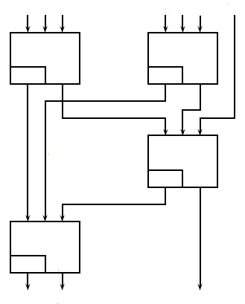
Arithmetic Verification
Functional verification of arithmetic circuits
Verify function implemented by arithmetic circuit
Use algebraic approach
Why is it important
Arithmetic circuits are difficult
to verify on bit-level
Avoid “bit blasting”
(flattening to bit-level)
HA
HA
C
S
C
S
HA
C
S
HA
C
S

Slide 49
Arithmetic Verification
We should be able to answer questions:
Does the circuit meet the specification ?
What function does this circuit implement ?
If it does not meet the specification
Demonstrate error, show bug trace
Find the bug (debugging, difficult)
How to approach it:
with Computer Algebra

Slide 50
Computer Algebra Methods
Arithmetic Bit-level (ABL) representation
[Wienand’08, Pavlenko’11]
Also applied to Galois Fields (GF) [Kalla’14, Tcomp’15]
Circuit specification F_{spec} and implementation B
represented by polynomials
Check if implementation B satisfies specification F_{spec}
Done by reducing F_{spec} modulo B
Methods differ in ways they accomplish the reduction

Slide 51

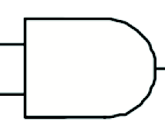
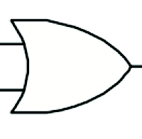
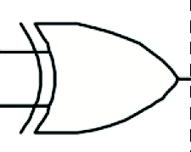
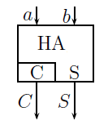
Computer Algebra - Basics
Represent specification and implementation as polynomials, F_{spec} and B in Z₂^{n}.
Example: multiplier Z = X*Y
F_{spec} = Z - X * Y
B = set of polynomials in Z₂^{n} representing circuit elements:
y = INV(x): (y + 1 – x )
q₁ = AND (a, b): (q₁ – a b)
q₂ = OR(a, b): (q₂ – a – b + ab)
q₃ = XOR(a, b): (q₃ – a – b + 2ab)
{C,S} = HA(a, b): (2C + S – a – b)
{C,S} = FA(a, b, c): (2C + S – a – b – c)
Each satisfies the local function if poly = 0

Slide 52

Computer Algebra - reduction
Goal: reduce F_{spec} modulo B:
Systematic methods exist to perform this reduction
If r = 0, the circuit is correct
If r ≠ 0, circuit may still be correct but B needs to be a canonical basis (Groebner basis) to determine if r = 0
Groebner basis
Difficult to compute, computationally complex
In gate-level circuit, B is already Groebner basis
But it must also include polynomials <x²-x> for all Boolean signals x in the circuit (i.e., x = 0, 1)
F_{spec}
r

Slide 53
Reducing F_{spec} modulo B
Reduce F_{spec} modulo B by a series of polynomial divisions
poly (PI)
Implementation
F_{spec} =
Sig_{in}
-
Sig_{out}
0 ?
B
poly (PO)

Slide 54
Example (STABLE)
Example: 2-bit adder
Fspec = a₀ + b₀ + 2a₁ + 2b₁ – 4r₂ – 2r₁ – r₀
B = list of polynomials describing gates

Slide 55
Polynomial Division (1)
Divide polynomial F_{spec} =
a₀ + b₀ + 2a₁ + 2b₁ – 4r₂ – 2r₁ – r₀
= – (a₀ + b₀ – 2a₀b₀) + r₀ + b₀ + 2a₁ + 2b₁ – 4r₂ – 2r₁ – r₀
= 2a₀b₀ + 2a₁ + 2b₁ – 4r₂ – 2r₁
= – 2(a₀b₀) + 2c + 2a₀b₀ + 2a₁ + 2b₁ – 4r₂ – 2r₁
= 2c + 2a₁ + 2b₁ – 4r₂ – 2r₁
= – 2(a1 + b1 – 2a₁b₁) +2d + 2c + 2a₁ + 2b₁ – 4r₂ – 2r₁
= 4a₁b₁ +2d + 2c – 4r₂ – 2r₁
= – 2(c +d – 2cd) + 2r₁ + 4a₁b₁ +2d + 2c – 4r₂ – 2r₁
= 4cd + 4a₁b₁ – 4r₂
= – 4(cd) + 4f + 2cd+ 4a₁b₁ – 4r₂
= 4f + 4a₁b₁ – 4r₂
= – 4(a₁b₁) + 4e + 4f + 4a₁b₁ – 4r₂
= 4e + 4f – 4r₂
= – 4(e + f – ef) + 4r₂ + 4e + 4f – 4r₂
= 4ef

Slide 56
Polynomial Division (2)
Continue dividing polynomial 4ef
4ef
= 4e(cd)
= 4(a₁b₁)(cd)
= 4(a₁b₁) (a₀b₀) (a₁ + b₁ – 2a₁b₁)
= 4(a₁b₁) (a₁ + b₁ – 2a₁b₁) (a₀b₀)
= 4(a₁b₁a₁ + a₁b₁b₁ – 2a₁b₁a₁b₁) (a₀b₀)
= 4(0) (a₀b₀)
= 4ef = 0
This means that F_{spec} mod B = 0 , hence the circuit correctly implements a 2-bit adder.

Slide 57
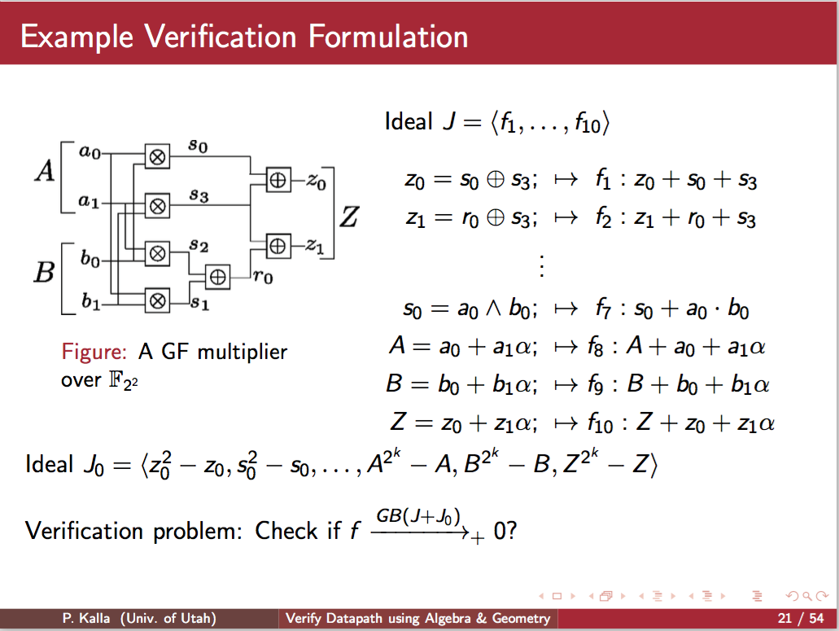

Slide 58
Data Flow Approach
Treat computation as flow of data
[Basith-FMCAD’11, Ciesielski-HVC’13,]
Based on observation that :
In an arithmetic circuit an integer flow across the circuit is the same at any point (cut) in the circuit
Cut: set of signals separating PIs from POs
Write equations to represent the flow for a cut
Functional correctness can be done by proving that the flow at PIs = flow at the POs.
Define input and output signatures of the network
Prove functionality by checking if input signature can be transformed into output signature
(or vice-versa)
ABL networks (HA based, linear)
Gate-level networks (nonlinear)

Slide 59
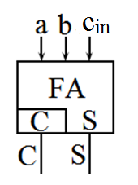
Arithmetic Network Model
Represent design as network of HAs and FAs (if possible)
Half-Adder (HA)
Binary inputs ( a, b)
Binary outputs ( S, C)
Full-Adder (FA)
Binary inputs ( a, b , c_{in})
Binary outputs ( S, C)
a + b = 2C + S
a + b + c_{in} = 2C + S

Slide 60
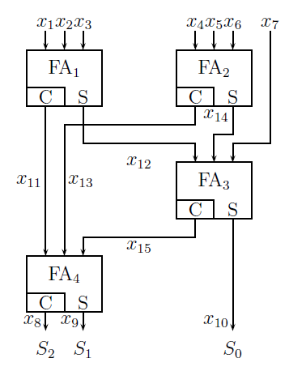
Input & Output Signatures
Input signature: Functionality provided by user (spec)
Sig_{In} = x₁ + x₂ + x₃ + x₄ + x₅ + x₆ + x₇
Transform
Sig_{in} into Sig_{out}
to verify function
Transform
Sig_{out} into Sig_{in}
to extract function
Or
Sig_{out} = 4S₂ + 2S₁ + S₀
Output signature: Binary encoding of outputs

Slide 61
Data Flow Model – Basic Concept
Sig_{in} transformed into Sig_{out} by a series of rewriting steps (~Gaussian elimination)
Replace input part of the FA equation
by the output part
Sig_{in} = x₁ +x₂ +x₃ + x₄ +x₅ +x₆ + x₇ (PI)
→ (2 x₁₁ + x₁₂) + x₄ +x₅ +x₆ + x₇
→ (2 x₁₁ + x₁₂) + (2 x₁₃ +x₁₄) + x₇
Continue:
2 x₁₁ + 2 x₁₃ + x₁₂ + x₁₄ + x₇
→ 2 x₁₁ + 2 x₁₃ + (2 x₁₅ + x₁₀)
→ 2 (2 x₈ + x₉) + x₁₀ = 4S₂ + 2S₂ + S₀ (PO)
This proves that circuit implements a 7-3 compactor
a + b + c = 2 C + S
cut1
cut2

Slide 62
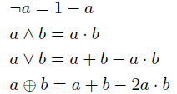
Gate-level Arithmetic Circuits
Functional correctness can be shown by
Forward rewriting (PI → PO) or
Backward rewriting (PO → PI)
Algebraic model:
Forward rewriting
Polynomial division (reduction),
Replacing input expression by outputs
HA: (a + b) / (a + b - 2C - S) = 2C + S
Backward rewriting
Replacing gate output by the expression in its inputs (expansion)
e.g., OR gate: z = a + b - a*b
a
b
z
equation: a + b = 2C + S
polynomial: (a + b - 2C - S)

Slide 63
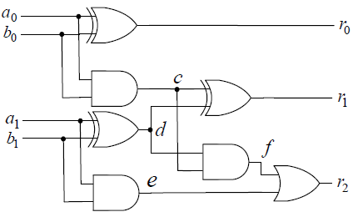
Forward Rewriting
Example: 2-bit adder
Problem: RE ≠ Ø
<x²-x> was not used
Can we reduce it to zero?
4
f₀
f₁
f₂
f₃
1
1
1
2
Problem: RE = 4ef, but … it reduces to 0
2
2
2
4

Slide 64
Backward Rewriting
Replace gate output by its equation
Backward symbolic simulation
No RE ! It will never be generated
But … the expression can explode
f₀
f₁
f₂
f₃
f₀ = 4(a₁b₁) + 2(a₀b₀) + 2(a₁+ b₁ - 2a₁b₁)
+ (a₀ + b₀ - 2a₀b₀)
- 4(a₁b₁)(a₀b₀)(a₁ + b₁ -2a₁b₁)
= 2a₁+ 2b₁ + a₀ + b₀
It matches the specification:
→ circuit is correct

Slide 65
Function Extraction - summary
Important features
Backward rewriting = function extraction !
Different than standard symbolic simulation
Proof of functional correctness is done by propagating cut expressions for all the signals, from POs, rather than from individual outputs
Cancellation happen during the process (example: HA)
Consider cut = 2C+S, with C = ab; S = a + b -2ab
If done separately: first replace C = ab, then replace a, b by other signals, up to certain level, so that cut =
2 f(x) g(y) + f(x) + f(y) – 2ab
It cannot be simplified until a, b are substituted.
But if S is replaced immediately after C, then
cut = 2ab + a + b -2ab = a + b
proving that 2C+S = a + b
a + b = 2C + S

Slide 66
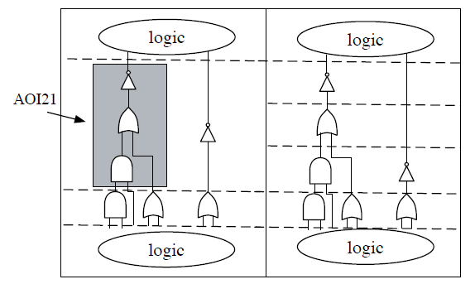
Backward Rewriting - issues
No residual expression !
But the cut expression can explode (fat belly issue)
Choice and ordering of cuts during rewriting affects performance
Issues:
Minimize the “fat belly”, the size of largest expression (memory)
Handling complex gates
Provide cuts in AOI gate

Slide 67
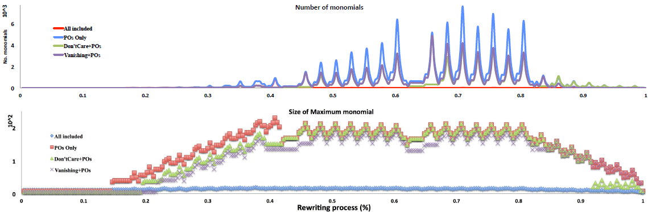
Experimental Results
Effect of ordering of cuts and including some useful redundancy (vanishing polynomials) on the size of cut expressions
4-bit serial squarer

Slide 68
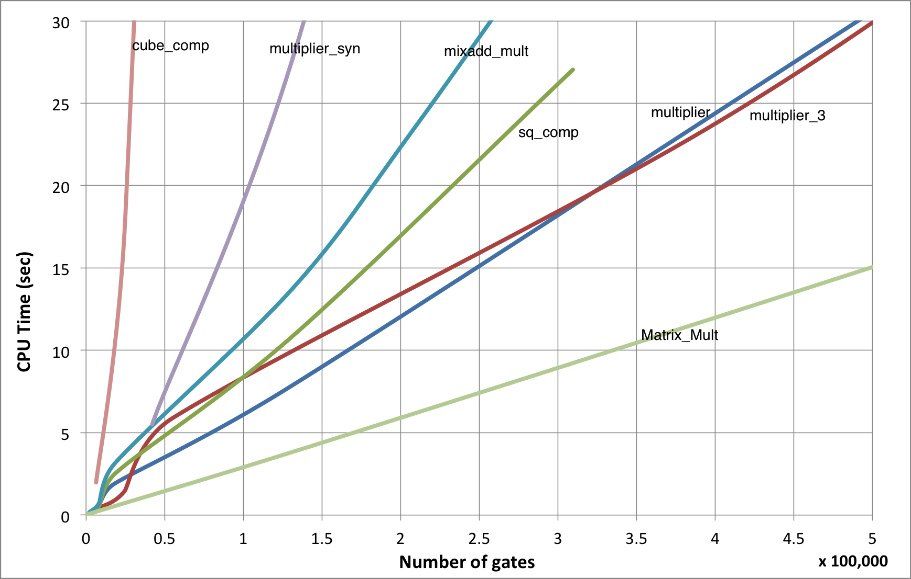
Experimental Results
Performance of the backward rewriting process
Combinational and sequential (bounded model) circuits
4-bit serial squarer

Slide 69
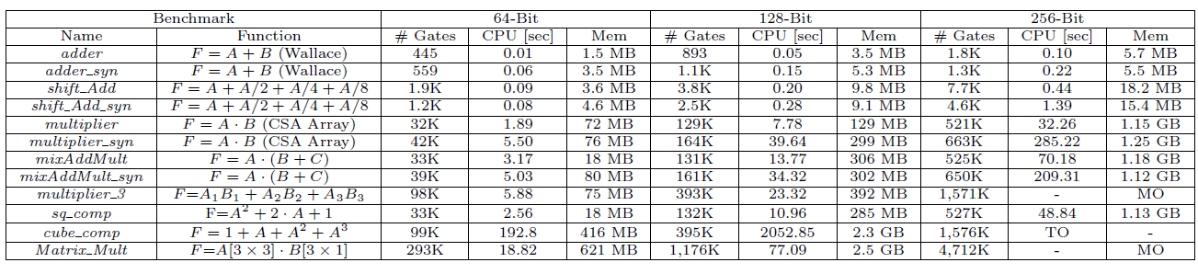
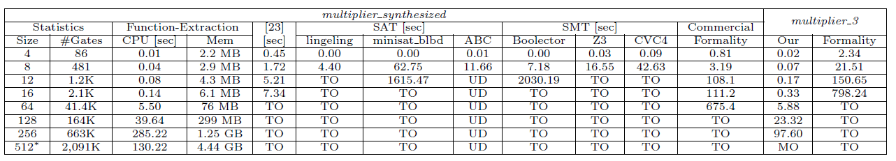
Experimental Results
Performance for original and synthesized designs
Multiplier design - comparisons with other methods

Slide 70
Summary and Conclusions
Forward rewriting is simple to implement
No memory explosion, but ..
Generates RE to be verified (typically using backward rewriting)
Need to compute weights (not easy for non-linear ckts)
Backward rewriting is more reliable (no RE)
But … may explode
Can be used for function extraction:
the computed signature gives the specification
Combining rewriting in both directions
Can be used for debugging
The difference between computed signatures tells which gate should be replaced [isvlsi-2015]
Solving the problem for highly bit-optimized circuits
Remains difficult
Very large fat belly, memory explosion problem

Slide 71
Arithmetic Verification Bibliography

Slide 72
Algebraic
[Basith-FMCAD'11] B., Mohamed Abdul, T. Ahmad, A. Rossi, and M. Ciesielski. "Algebraic approach to arithmetic design verification." FMCAD 2011.
[Ciesielski-HVC'13] M. Ciesielski, W. Brown, and A. Rossi."Arithmetic Bit-level Verification using Network Flow Model." HVC, 2013. 327-343.
[Ciesielski-ISVLSI'14] Ciesielski, M., Brown, W., Liu, D., and Rossi, A. "Function extraction from arithmetic bit-level circuits." ISVLSI, 2014.
[Ciesielski-DAC'15] "Verification of Gate-level Arithmetic Circuits by Function Extraction." DAC,2015
[Wienand-CAV'08] Wienand, Oliver, et al. "An algebraic approach for proving data correctness in arithmetic data paths.” CAV, 2008.
[Pavlenko-DATE'11] Pavlenko, E., Wedler, M., Stoffel, D., Kunz, W., Dreyer, A., Seelisch, F., and Greuel, G. M. "STABLE: A new QF-BV SMT solver for hard verification problems combining Boolean reasoning with computer algebra." DATE, 2011.
[Marx-ICCAD'13] Marx, O., Wedler, M., Stoffel, D., Kunz, W., and Dreyer, A. "Proof logging for computer algebra based SMT solving." ICCAD,2013

Slide 73
Algebraic, cont’d
[Shekhar-ICCAD'05] Shekhar, N., Kalla, P., Enescu, F., and Gopalakrishnan, S. "Equivalence verification of polynomial datapaths with fixed-size bit-vectors using finite ring algebra." ICCAD,2005
[Shekhar-ICCD'05] Shekhar, N., Kalla, P., Enescu, F., and Gopalakrishnan, S. "Exploiting vanishing polynomials for equivalence verification of fixed-size arithmetic datapaths." ICCD, 2005.
[Pruss-DAC'14] Pruss, T., Kalla, P., and Enescu, F. "Equivalence verification of large galois field arithmetic circuits using word-level abstraction via gröbner bases." DAC,2014
[Lv-TCAD'14] Lv, J., Kalla, P., and Enescu, F. "Efficient gröbner basis reductions for formal verification of galois field arithmetic circuits." Trans. on CAD, 2014.
[Lv-DATE'12] Lv, J., Kalla, P., and Enescu, F. "Efficient gröbner basis reductions for formal verification of galois field multipliers." DATE,2012.
[Sun-DATE’15] Sun, X., Kalla, P., Pruss, T., & Enescu, F. (2015, March). Formal verification of sequential Galois field arithmetic circuits using algebraic geometry. DATE, 2015.
[Kroening-2008] Kroening, Daniel, and Ofer Strichman. Decision procedures: an algorithmic point of view. Springer Science & Business Media, 2008.

Slide 74
Algebraic, cont’d
[Cox-1992] Cox, David, John Little, and Donal O'shea. Ideals, varieties, and algorithms. Vol. 3. New York: Springer, 1992.
[Tim-TCAD’15] Tim Pruss, Priyank Kalla and Florian Enescu. Accepted, to appear in IEEE Trans. on CAD, 2015

Slide 75
ILP
[Brinkmann-VLSID'02], Raik, and Rolf Drechsler. "RTL-datapath verification using integer linear programming." VLSID,2002
[Zeng-DATE'01] Zeng, Z., Kalla, P., and Ciesielski, M."LPSAT: a unified approach to RTL satisfiability." DATE, 2001.
[Fallah-DAC'1998] Fallah, F., Devadas, S., and Keutzer, K. "Functional vector generation for HDL models using linear programming and 3-satisfiability." DAC,1998.
[Huan-TCAD’01] Huan, C. Y., & Cheng, K. T. (2001). Using word-level ATPG and modular arithmetic constraint-solving techniques for assertion property checking. Trans. on CAD, 20(3), 381-391.

Slide 76
Abstraction
[Johannsen-CAV'01] Johannsen, P. "BOOSTER: Speeding up RTL property checking of digital designs by word-level abstraction." CAV, 2001.
[Jain-TCAD'08] "Word-level predicate-abstraction and refinement techniques for verifying RTL verilog." Trans. on CAD, 2008.
[Kroening-ICCAD'07] Kroening, D., and Seshia, S. A. "Formal verification at higher levels of abstraction." ICCAD, 2007.
[Andraus-DAC'04] Andraus, Z. S., and Sakallah, K. A. "Automatic abstraction and verification of verilog models." DAC, 2004.
[Brady-MEMOCODE'10] Brady, B., Bryant, R. E., Seshia, S., and O'leary, J. W. "ATLAS: automatic term-level abstraction of RTL designs." MEMOCODE, 2010.
[Andraus-ASPDAC'06] Andraus, Z. S., Liffiton, M. H., and Sakallah, K. A. "Refinement strategies for verification methods based on datapath abstraction." ASP-DAC, 2006.

Slide 77
Theorem Provers
[Sawada-FMCAD'11] Sawada, J., Sandon, P., Paruthi, V., Baumgartner, J., Case, M., and Mony, H. "Hybrid verification of a hardware modular reduction engine." FMCAD, 2011.
[Sawada-FMCAD'06] Sawada, J., and Reeber, E. ”ACL2SIX: A hint used to integrate a theorem prover and an automated verification tool." FMCAD, 2006.
[Russinoff-IMACS'05] Russinoff, D., Kaufmann, M., Smith, E., and Sumners, R. "Formal verification of floating-point RTL at AMD using the ACL2 theorem prover." IMACS, 2005.
[Harrison-2006] Harrison, J. "Floating-point verification using theorem proving." Formal Methods for Hardware Verification, 2006. 211-242.
[Brock-FMCAD'1996] Brock, B., Kaufmann, M., and Moore, J. S. “ACL2 theorems about commercial microprocessors." FMCAD, 1996.
[Hartmanis-2006] Hartmanis, A. C. D. H. J., Henzinger, T., Leighton, J. H. N. J. T., and Nivat, M. "Texts in Theoretical Computer Science An EATCS Series." (2006). Springer.
[Vasudevan-TCAD’07] Vasudevan, S., Viswanath, V., Sumners, R. W., & Abraham, J. Automatic verification of arithmetic circuits in RTL using stepwise refinement of term rewriting systems. Trans on CAD. 56(10), 1401-1414.
[Kapur-FMSD’1998] Kapur, D., & Subramaniam, M. (1998). Mechanical verification of adder circuits using rewrite rule laboratory. Formal Methods in System Design, 13(2), 127-158.

Slide 78
Industry, floating-point
[Aharoni-ARITH'05] Aharoni, M., Asaf, S., Maharik, R., Nehama, I., Nikulshin, I., and Ziv, A. "Solving constraints on the invisible bits of the intermediate result for floating-point verification." Computer Arithmetic, 2005.
[Jacobi-DATE'05] Jacobi, C., Weber, K., Paruthi, V., and Baumgartner, J. “Automatic formal verification of fused-multiply-add FPUs." DATE, 2005.
[Krautz-DAC'14] Krautz, U., Paruthi, V., Arunagiri, A., Kumar, S., Pujar, S., and Babinsky, T. "Automatic Verification of Floating Point Units." DAC, 2014.
[Guralnik-TC'11] Guralnik, E., Aharoni, M., Birnbaum, A. J., and Koyfman, A. "Simulation-based verification of floating-point division." Trans. on Computers, 2011.

Slide 79
ABC, Simulation graph
[Brayton-CAV'10] Brayton, R., and Mishchenko, A. "ABC: An academic industrial-strength verification tool." CAV, 2010.
[Mishchenko-2010]. Mishchenko, A. "ABC: A system for sequential synthesis and verification." URL http://www. eecs. berkeley.edu/alanmi/abc
[Soeken-FMCAD'15] Soeken, M., Sterin, B., Drechsler, R., and Brayton, R. "Simulation Graphs for Reverse Engineering." FMCAD, 2015.

Slide 80
Canonical Diagrams
[Bryant-TC'1986] Bryant, R. E. "Graph-based algorithms for boolean function manipulation." TC, 100.8 (1986): 677-691.
[Bryant-DAC'1995] Bryant, R. E., and Chen, Y. A. "Verification of arithmetic circuits with binary moment diagrams." DAC, 1995.
[Chen-ICCAD'1997] Chen, Y. A., and Bryant, R. E. "PHDD: An efficient graph representation for floating point circuit verification." ICCAD, 1997.
[Drechsler-ISMVL'1997]. Drechsler, R., Keim, M., and Becker, B. "Sympathy-MV: Fast Exact Minimization of Fixed Polarity Multi-Valued Linear Expressions." ISMVL, 1997.
[Ciesielski-TCAD'06] Ciesielski, M., Kalla, P., and Askar, S. "Taylor expansion diagrams: A canonical representation for verification of data flow designs." Trans on Computers, 55.9 (2006): 1188-1201.
[Ciesielski] Ciesielski, M., Gomez-Prado, D., Ren, Q., Guillot, J., & Boutillon, E. “Optimization of data-flow computations using canonical TED representation”. Trans on CAD. 28(9), 1321-1333. 2009

Slide 81
SAT/SMT
[Zhang-ICCAD'01] Zhang, L., Madigan, C. F., Moskewicz, M. H., and Malik, S. "Efficient conflict driven learning in a boolean satisfiability solver." ICCAD, 2001.
[Biere-2009] Biere, A., Heule, M., and van Maaren, H. “Handbook of satisfiability.” Vol. 185, 2009.
[Aloul-IWLS'02] Aloul, F. A., Mneimneh, M. N., and Sakallah, K. A. "ZBDD-Based Backtrack Search SAT Solver." IWLS. 2002.
[Alizadeh-TCAD'10] Alizadeh, B., and Fujita, M. "Modular datapath optimization and verification based on modular-HED." Trans. on CAD, 29.9 (2010): 1422-1435.
[Mishchenko-2010]. Mishchenko, A. "ABC: A system for sequential synthesis and verification." URL http://www. eecs. berkeley.edu/alanmi/abc
[Sörensson-SAT’09] Sörensson, N., & Eén, N. (2009). MiniSat 2.1 and MiniSat++ 1.0—SAT race 2008 editions. SAT, 31.
[Brummayer-2009] Brummayer, R., & Biere, A. (2009). Boolector: An efficient SMT solver for bit-vectors and arrays. In Tools and Algorithms for the Construction and Analysis of Systems (pp. 174-177).

Slide 82
SAT/SMT, cont’d
[Barrett-CAV’11] Barrett, C., Conway, C. L., Deters, M., Hadarean, L., Jovanović, D., King, T., ... & Tinelli, C. “CVC4”. CAV, 2011.
[De Moura-2008]De Moura, L., & Bjørner, N. (2008). Z3: An efficient SMT solver. In Tools and Algorithms for the Construction and Analysis of Systems (pp. 337-340).
[Silva-ICCAD’1997] Silva, J. P. M., & Sakallah, K. A. (1997, January). GRASP—a new search algorithm for satisfiability. ICCAD, 1996.
[Biere-2010] Biere, Armin. "Lingeling, plingeling, picosat and precosat at SAT race 2010." FMV Report Series Technical Report 10.1 (2010).

