Slide 1
Spectral Approach to Verifying
Nonlinear Arithmetic Circuits
  Cunxi Yu, Tiankai Su, Atif Yasin
  Maciej Ciesielski
University of Massachusetts
Amherst, MA / USA

Slide 2
Introduction
Hardware verification
  Checking if the design meets specification
  Equivalence checking
  Property, model checking
  Functional verification (arithmetic)
    Integer, Galois Field – function specified by polynomial
Formal methods (OK for logic and ~arithmetic circuits)
  Canonical diagrams (BDD), SAT, SMT
    Require “bit-blasting”, memory explosion
  Theorem proving
    Requires knowledge of the design, interactive
  Computer Algebra
    Complex math, theory of Groebner basis
    Computationally expensive, order dependent; can be engineered …

Slide 3
Computer Algebra Approach
Represents circuit in algebraic domain
  Circuit specification and its implementation represented by polynomials
  Input signature Sig_{in}: function expressed as polynomial in primary inputs (PI)
  Output signature Sig_{out}: polynomial, encoding of primary outputs (PO)
  Sig_{out} = 4r₂ + 2r₁ + r₀
2- bit adder

Slide 4
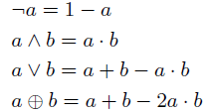
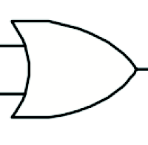
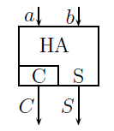
Algebraic Model
Algebraic model of circuit components
  Logic gates
  Example: OR gate
equation: z = a + b - a⋅ b
polynomial : z - a - b + a⋅ b = 0
  Single-bit adders, etc.
a
z
b
equation: a + b = 2C + S
polynomial: (a + b - 2C - S)

Slide 5

Computer Algebra Approach
Algebraic model of circuit components
  Implementation B: set of polynomials representing logic gates
B
  Sig_{out} = 4r₂ + 2r₁ + r₀
2- bit adder
Functional Verification:
F_{spec} = Sig_{out} - Sig_{in}
R

Slide 6
Computer Algebra Approach
Functional Verification
  Does the implementation B satisfy specification F_{spec} ?
  Reduce F_{spec} modulo B
    If R= 0, the circuit is correct
    Otherwise, circuit may still be correct, but …
    need canonical Groebner basis (GB) to check if R = 0
    Polynomials (ideals) < x² – x > are needed for each binary signal x
  In general the problem is complex
F_{spec} = Sig_{out} - Sig_{in}
R

Slide 7
Computer Algebra Approaches
Verification methods differ in how they accomplish reduction
  Arithmetic Bit-Level (ABL) representation [Wienand’08, Pavlenko’11]
    Circuit represented as network of HA, FA, linear
  Computer algebra algorithms
    Column-wise polynomial reduction [Ritirc’17, ’18]
    Combining Groebner basis with logic reduction [S-Ahm’16, Mahzoon’18]
  Galois Field multipliers, debugging [Kalla’14, ’16]
  Algebraic rewriting [Ciesielski, Yu et al, ’16 - ‘18]
    Function extraction, bit-flow model

Slide 8


Algebraic Rewriting
Backward rewriting (PO → PI) (function extraction)
  Start with polynomial expression of output vector, Sig_{out}
  Iteratively replace gate output by expression of its inputs, e.g., r₂ = e + f - e⋅ f
  Check the polynomial at the primary inputs, Sig_{in}
$${Sig}_{f2}=r_{0}+2 r_{1}+4 (e+f−ef)$$
  Sig_{out} = 4 $r$₂ + 2 $r$₁ + r₀
2- bit adder

Slide 9
Algebraic Rewriting Methods
Rewriting a full adder (FA)
  Gate-level, structural rewritng
  Functional rewriting
    On an AIG structure
    Extraction XOR and Majority functions
Structural rewriting
AIG rewriting

Slide 10
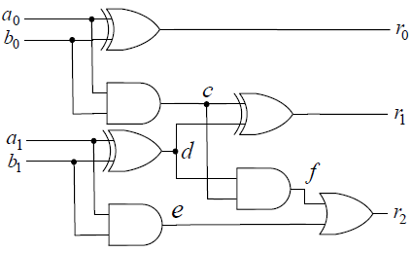
Algebraic (Backward) Rewriting - Demo
Replace variables in reverse topological order
F = Sig_{out} = 4r₂+2r₁+r₀
1
1
F/r₂= 4e+4f-4ef +2r₁+ r₀
1
F/r₁ = 4e+4f-4ef +2c+2d-4cd + r₀
2
2
F/r₀ = 4e+4f-4ef +2c+2d-4cd -2a₀ b₀ +a₀ +b₀
2
2
F/f = 4e+4cd-4ecd +2c+2d-4cd -2a₀ b₀ +a₀ +b₀
2
4
4
F/e = 4a₁b₁+4cd-4a₁b₁cd +2c+2d-4cd -2a₀ b₀ +a₀ +b₀
4
F/c = 4a₁b₁+4a₀b₀d-4a₁b₁a₀b₀d+2a₀b₀+2d -4a₀b₀d -2a₀ b₀ +a₀ +b₀
= 4a₁b₁ - 4a₁b₁a₀b₀d +2d +a₀ +b₀
F/d = 4a₁b₁ - 4a₁b₁a₀b₀(a₁+b₁-2a₁b₁) +2a₁ +2b₁ -4a₁b₁ +a₀ +b₀
4a₀b₀ (a²₁b₁ + a₁b²₁ -2a²₁b²₁) = 0
= 2a₁ + 2b₁ + a₀ + b₀
2-bit adder !
Simplification: a² = a, b² = b (binary)

Slide 11
Algebraic Rewriting - Summary
Two types of simplification during rewriting
  Cancelation of monomials with opposite coefficient signs
  Example: Half Adder, HA (a,b), with outputs C, S
    2C + S = 2ab + (a + b – 2ab) = a + b
  Signals are Boolean, i.e., x² = x
    In polynomial reduction: ideal <x² – x> is needed (Groebner basis)
    In rewriting: simply replace x² by x ( a² = a, b² = b in previous example)
  Polynomials can be large in heavily optimized circuits
  Fat belly effect
A better rewriting: use And-Inverter-Graph (AIG) structure
  Detect adder trees
    HA: XOR and AND pairs with common inputs
    FA: XOR3 and MAJ3 pairs with common inputs

Slide 12
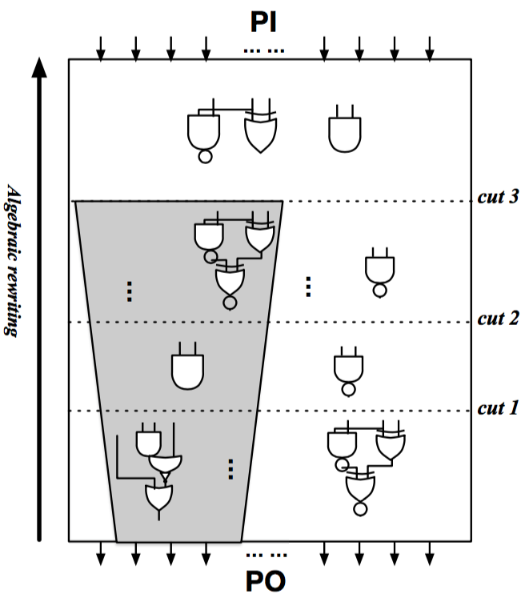
Functional Abstraction – Spectral Method
Extract arithmetic functions from sea of gates
  Assume: PO boundary is known
  No boundary for PIs needed
  Apply backward rewriting
  Where to stop ?
Spectral Method
  Examine distribution of weights (coefficients) of polynomial terms
    Defines the spectrum
  Determine arithmetic function based on its spectrum

Slide 13
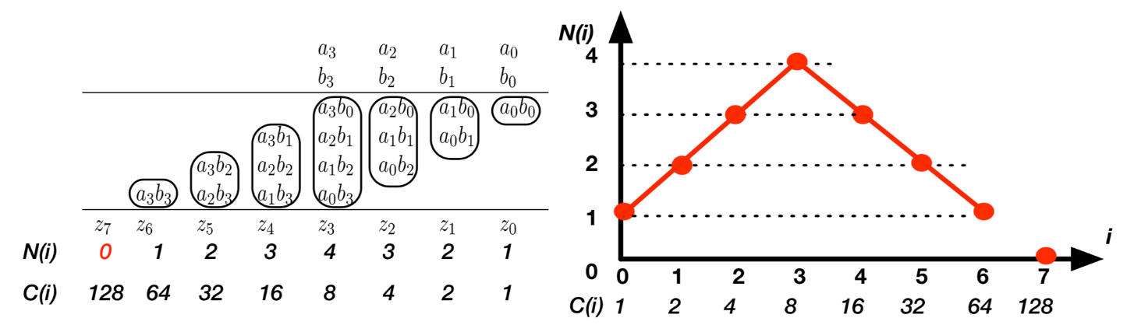

Algebraic Spectrum – Multiplier
Multiplier
$$A=a_{0}+2a_{1}+4a_{2}+8a_{3} \\ B=b_{0}+2b_{1}+4b_{2}+8b_{3} \\ F= A⋅B$$
F = A·B
F = A·B·C

Slide 14
Arithmetic Spectrum – n-bit Adder
n-bit Adder
i = bit position of result
C(i) = 2^{i}, coefficient a bit i
N(i) = # terms with coeff C(i)

Slide 15
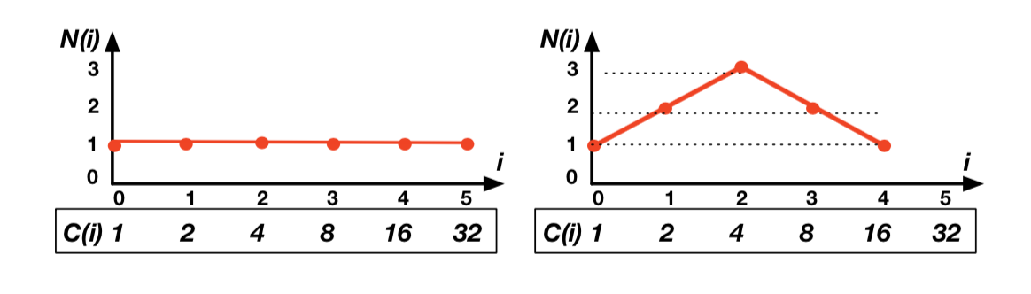
Algebraic Spectrum – MAC
Multiply-Accumulator (MAC)
  F = A*B + C
  A = a₀+2a₁ + 4a₂, B = b₀+2b₁ +4b₂, C = c₀+2c₁+4c₂ +8c₃ +16c₄ +32c₅
  1-variable spectrum + 2-variable spectrum
    1-var: addition
    2-var: multiplication

Slide 16
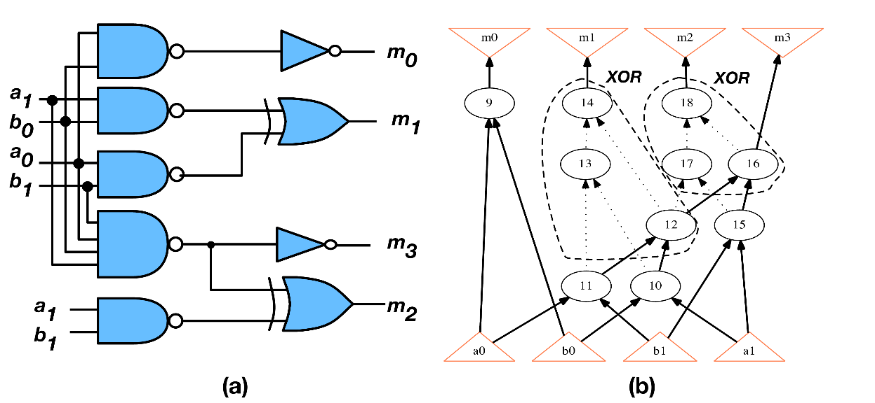
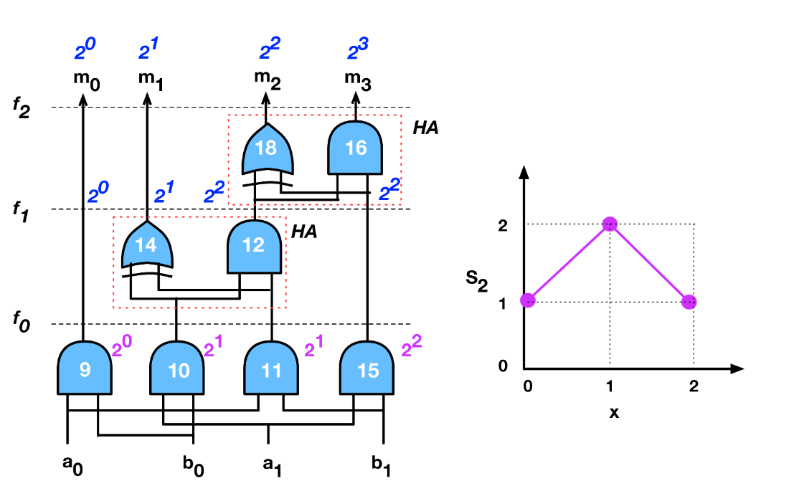
Computing the Spectrum
Step 1: Create AIG; detect XOR & Majority functions
XOR3 = <14,12,13><17,16,18>
MAJ3 = <12,11,10><16,12,15>
Step 2: Detect HA, FA and extract adder tree
Step 3: Propagate constants and create spectrum

Slide 17
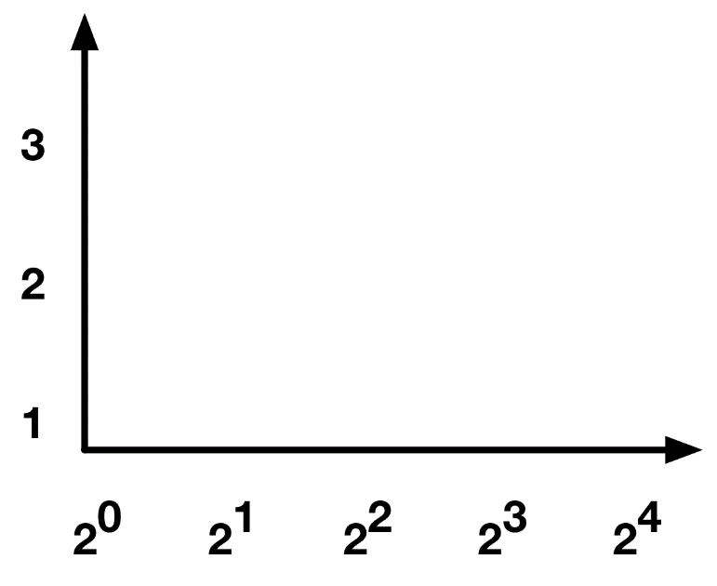
Computing the Spectrum - Demo
Algebraic Spectrum construction on DAG – 3-bit Multiplier
2⁰ 2¹ 2² 2³ 2⁴ 2⁵
Detected 3-bit multiplication !
2⁰ 2¹ 2² 2³ 2⁴ 2⁴ 2⁴
2⁰ 2¹ 2² 2³ 2³ 2³ 2⁴ 2⁴
2⁰ 2¹ 2² 2² 2³ 2³ 2⁴
2⁰ 2¹ 2¹ 2² 2² 2² 2³ 2³ 2⁴

Slide 18
Demo – Booth and CSA Multiplier
Applications of Spectrum
  Equivalence checking of arithmetic functions
  Word-level abstraction
Example: 3-bit Booth-Multiplier vs. CSA-Multiplier
    Single-, two-, three-variable terms
1-var
2-vars
3-vars
Initial step
Expression with: 1-variable terms
2-variable terms and 3-variable terms
  Sig_{out} = 32z₅ + 16z₄ + 8z₃ + 4z₂ + 2$z$₁ + z₀

Slide 19
Demo – Booth and CSA Multiplier
1-var
2-vars
3-vars
3-bit Multiplier
Rewriting progress
20 %
40 %

Slide 20
Demo – Booth and CSA Multiplier
1-var
2-vars
3-vars
Rewriting progress
80 %
Multiplier detected !
100 %

Slide 21
Verification Results – CSA Multipliers
Varication tool built on top of ABC, command: &aspec
CSA Multipliers
  Pre-synthesized and post-synthesized
  TO = time out 3600 sec; MO = memory out of 8 GB, ES = error state (Singular)
# bits | Pre-synthesized |  |  |  |  | Post-synthesized
 | Yu’16 | Ahmed’16 | Ritirc’17 | Ritirc’18 | This work | Yu’16 | Ritirc’17 | Ritirc’18 | This work
64 | 1.9 | TO | 801 | 4.0 | 0.1 | 5.5 | 1073 | 418 | 0.1
128 | 8.1 |  | ES | ES | 0.8 | 50 | ES | ES | 0.9
256 | 33 |  | ES | ES | 7.8 | 285 | ES | ES | 8.4
512 | 130 |  | ES | ES | 30 | MO | ES | ES | 42
1024 | MO |  | ES | ES | 9638 | MO | ES | ES | 9817
Tool available at: https://github.com/ycunxi/abc

Slide 22
Results – Complex Multipliers
Six types of multipliers, including Booth multipliers
  btor : generated by Boolector; abc: generated by abc; AOKI mults:
  sp – standard partial products; bp - booth partial products
  ar - array based adder chain; rc - ripple carry based adder chain
# bits | Designs | Yu’16 | Ahmed’16 | Ritirc’17 | Ritirc’18 | This work (sec)
128 | btor; btor-resyn3; abc; abc-resyn3; CSA; CSA-resyn3; | MO | TO | ES | ES | 1.5
 | abc-booth; abc-booth-resyn3 | MO | TO | ES | ES | 0.5
 | sp-ar-rc [AOKI] | - | TO | ES | ES | 1.5
 | bp-ar-rc-dc2; bp-ar-rc-resyn3; sp-ar-rc-dc2; sp-ar-rc-resyn3; | - | TO | ES | ES | UAT
256 | abc; abc-resyn3; | MO | TO | ES | ES | 14
 | abc-booth; abc-booth-resyn3 |  |  |  |  | 3.5
1024 | abc; abc-resyn3; abc-booth; | - | - | - | - | 9482
 | abc-booth; abc-booth-resyn3 |  |  |  |  | 139
UAT = Unstructured adder trees; TO = time out of 3 hours; MO = memory out of 8 GB; ES = error state

Slide 23
Results – Word-level Abstraction
Experimental results of abstractions
  Multiplier is implemented using CSA-multiplier
  Error = fail to correctly detect the function of F
  TO = 36,000 s
  MO = 8 GB
256-bit | Yu’15 | Seoken’17 | This work
F=AB+C | 23,760 s | error | 45 s
F=A(B+C) | TO | error | 45 s
F=A*B*C | TO | error | 69 s
Tool available at: https://github.com/ycunxi/abc

Slide 24
Summary and Conclusions
Algebraic rewriting
    Conceptually simple, but may explode
    Useful for function extraction
    Computed signature gives functional specification
  Applicable to adders, multipliers
Solving the problem for highly bit-optimized circuits
    Implemented in ABC, AIG rewriting
    AIG is more effective than structural rewriting
    Spectral method most effective, can handle Booth multipliers
Open problems
  Debugging
    Combining backward and forward rewriting
  Verifying dividers, SQRT, etc.

Slide 25
Thank You !

Slide 26
Algebraic (Backward) Rewriting - Demo
Replace gate output by its equation
  Backward symbolic simulation
  Polynomials may explode (fat belly effect)
f₂ = 4(f + e - ef)+2r₁+r₀
= 4f + 4e – 4ef + 2r₁ + r₀
= 4f + 4e – 4ef + 2r₁ + r₀
f₀
f₁
f₂
f₃
f₁ = 4e + 4(cd) – 4e(cd) + 2(c+d-2cd) + r₀
= 4e + 2c + 2d + r₀ – 4ecd
= 4e + 2c + 2d + r₀ – 4ecd
f₀ = 4(a₁b₁) + 2(a₀b₀) + 2(a₁+ b₁ - 2a₁b₁)
+ (a₀ + b₀ - 2a₀b₀)
- 4(a₁b₁)(a₀b₀)(a₁ + b₁ -2a₁b₁)
= 2a₁+ 2b₁ + a₀ + b₀
Matches the specification:
→ circuit is correct
2- bit adder

Slide 27
Rewriting Demo – MAC
Multiply Accumulator (F = A * B + C)
  Can we identify the adder and the multiplier ?
    They may be merged after synthesis
  We can tell that there is an addition and a multiplication
    Identify the upper boundary of function F
  What we cannot do: identify the adder or multiplier
    Structural level
Example : MAC
  2-bit multiplier with a 4-bit adder
1-var
2-vars
3-vars
Initial step

Slide 28
Rewriting Demo – MAC
1-var
2-vars
3-vars
MAC
Addition detected
Addition and
multiplication detected

Slide 29
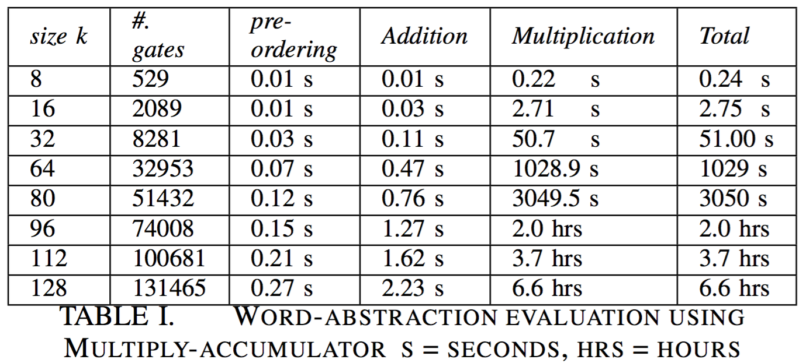
Functional Abstraction - Results
Using Spectral method
8- to 128-bit MAC
Limitations
  Need to know output bits

