Slide 1
Future Directions in Computer Arithmetic
16.10-17.10 June 26, 2018

Slide 2
Panelists
Milos Ercegovac
David Matula
Jean-Michel Muller
Three pillars of our Community!

Slide 3
Meet Our Panelists
Axioms:
If you are not in the Internet, (basically) you do not exist
Wikipedia has a solution for everything
Let’s see what our panelists say about themselves
Run an experiment: google searched
first_name last_name wikipedia

Slide 4
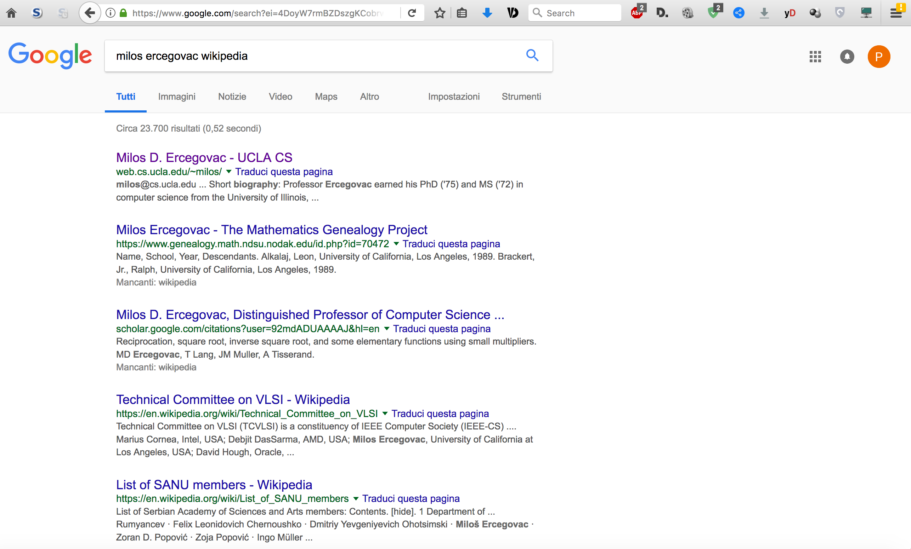

Slide 6
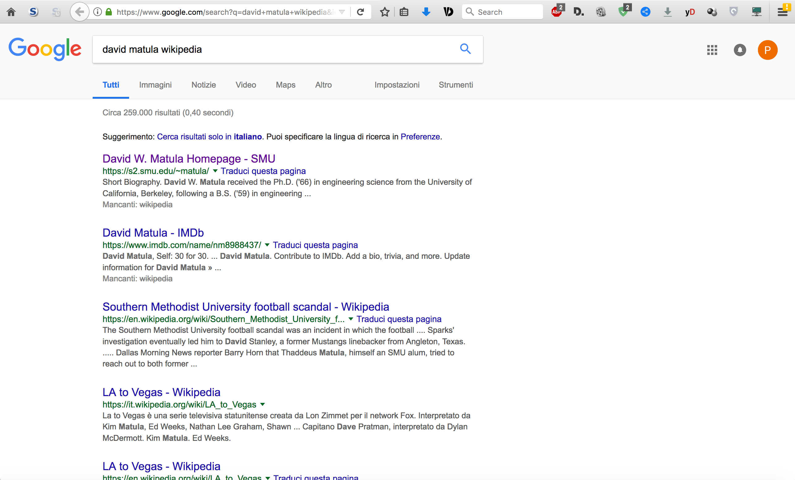

Slide 7
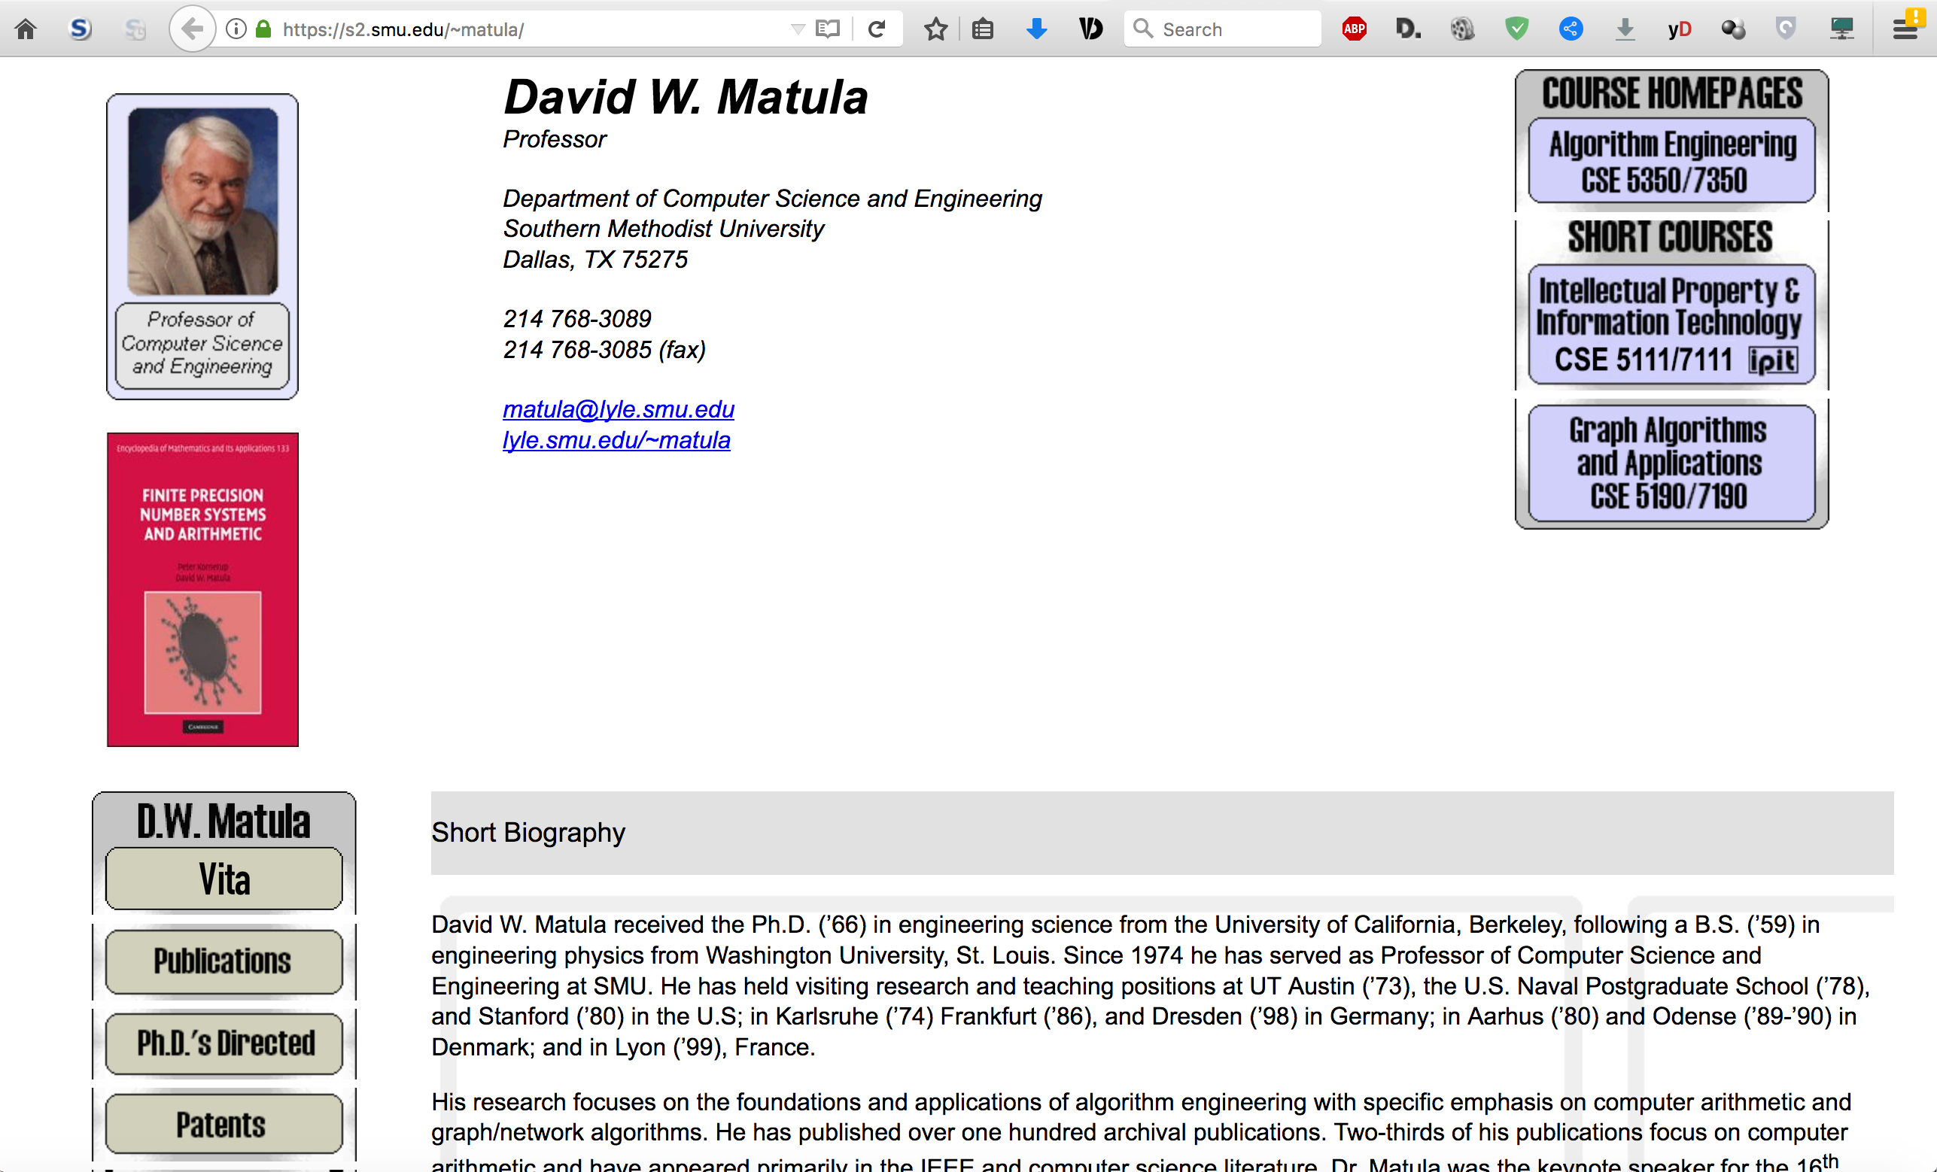

Slide 8
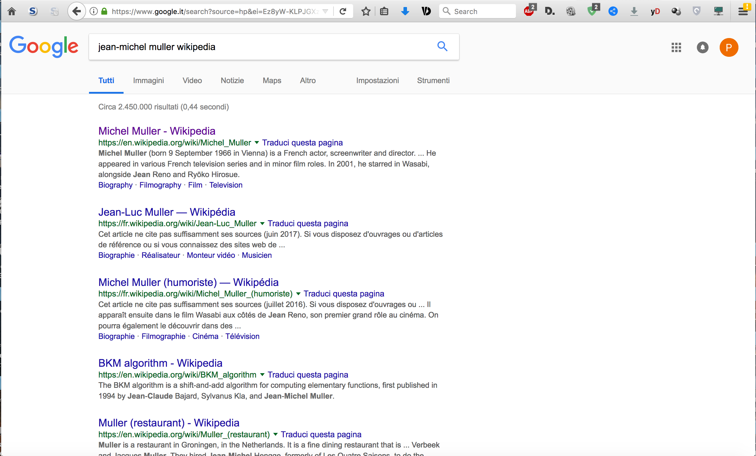

Slide 9
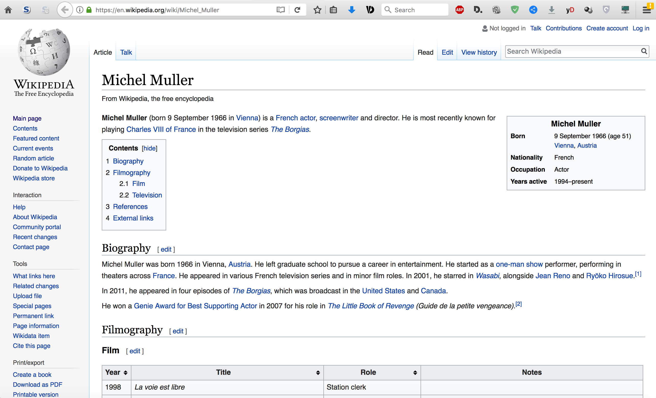

Slide 11
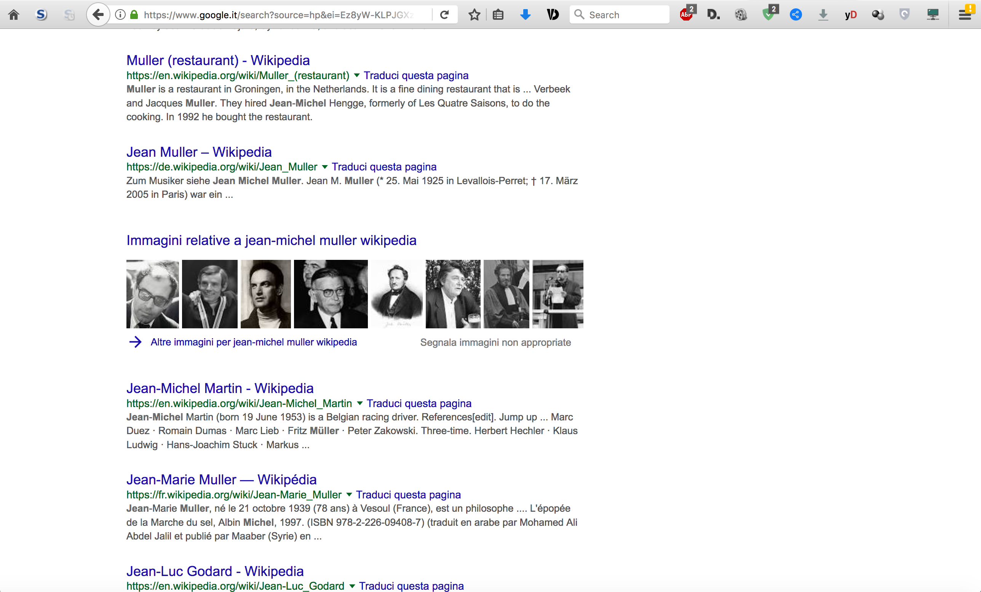

Slide 12
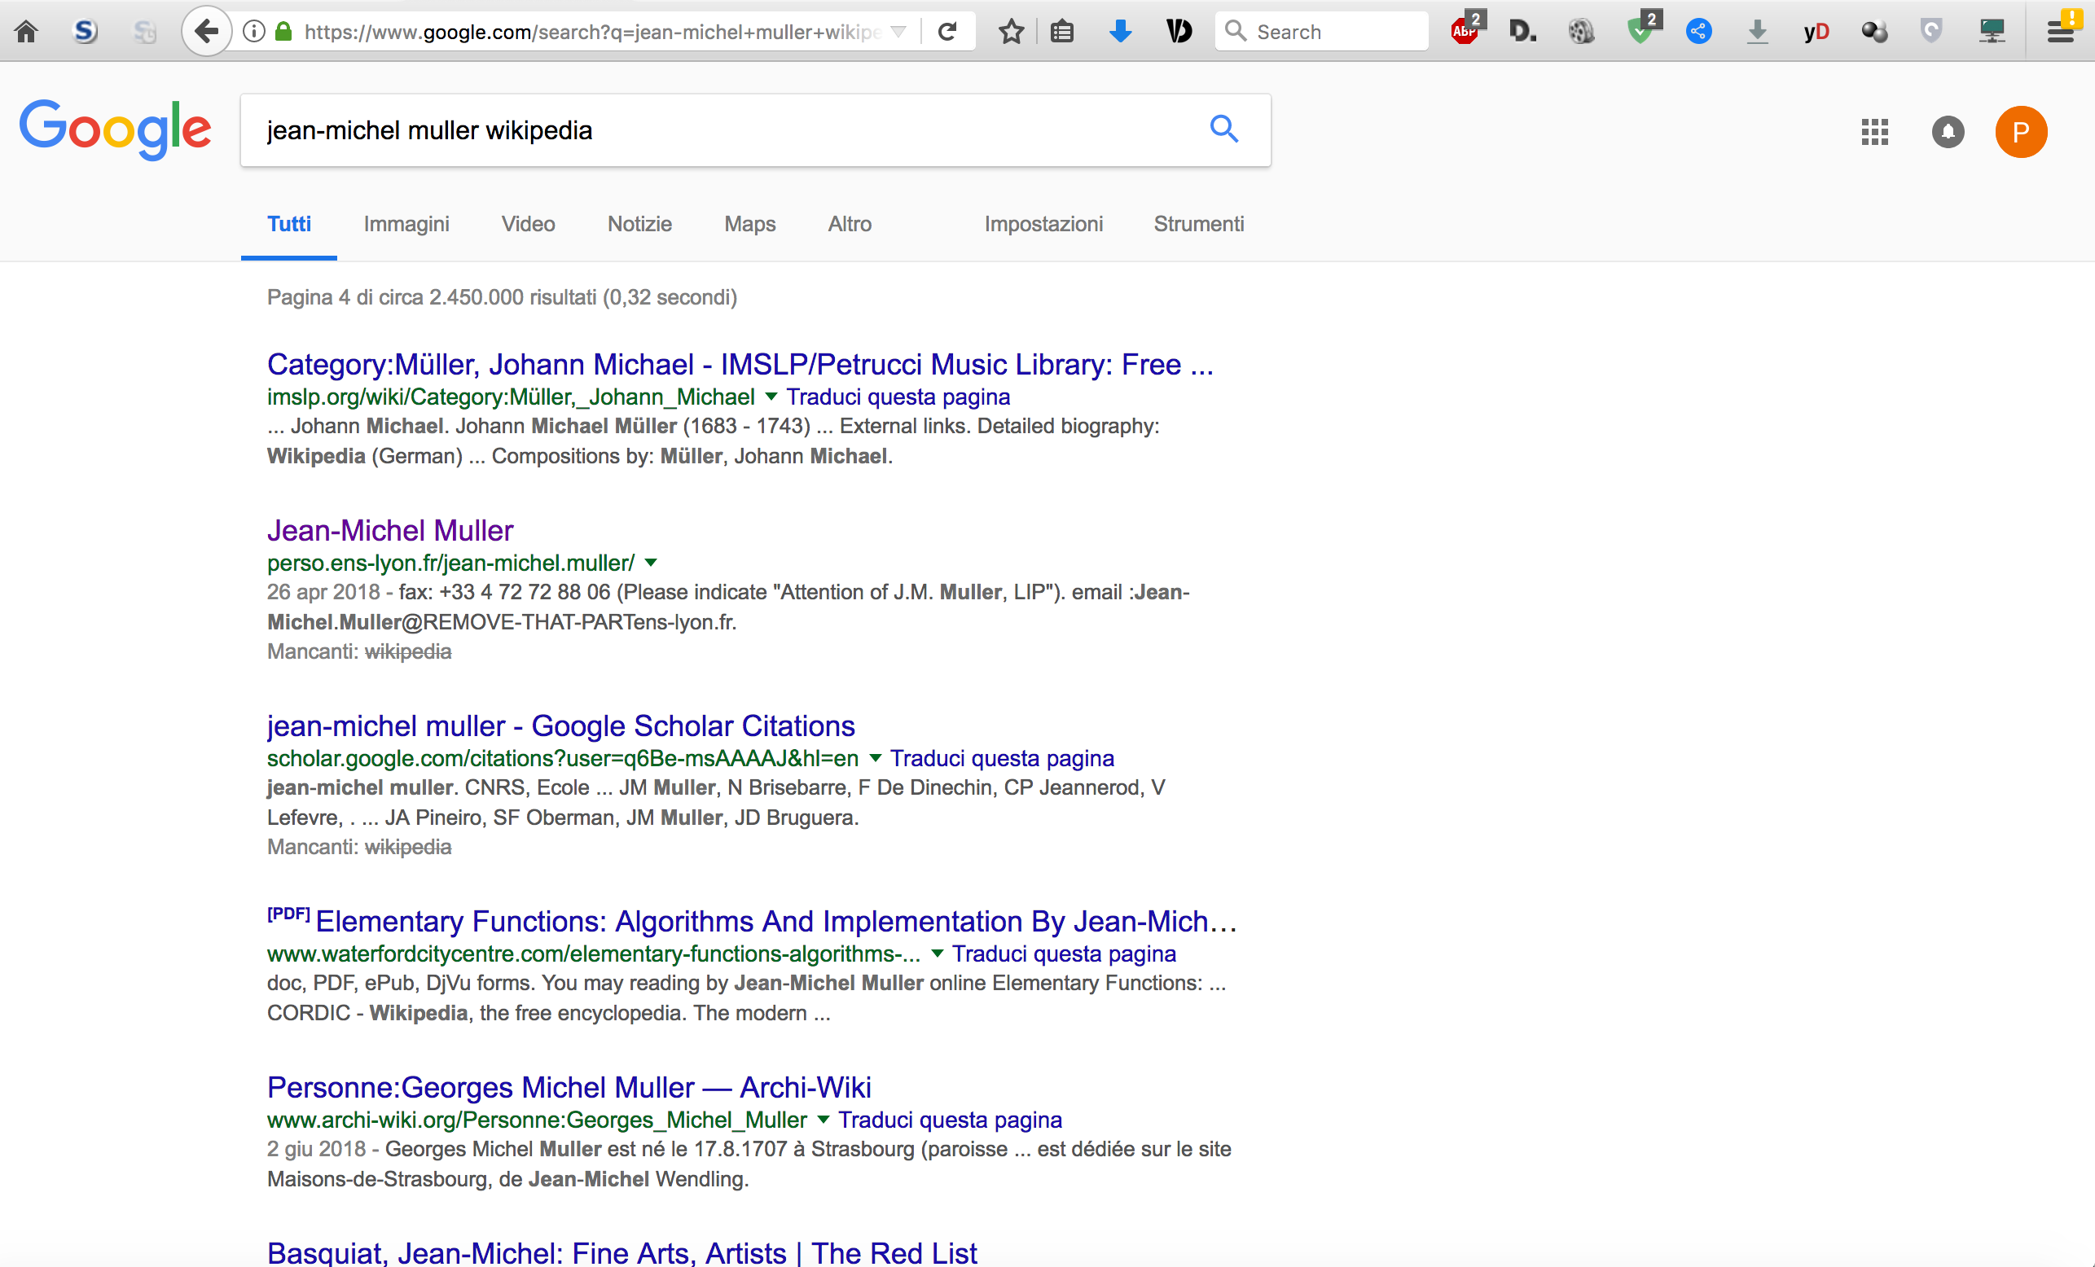

Slide 13
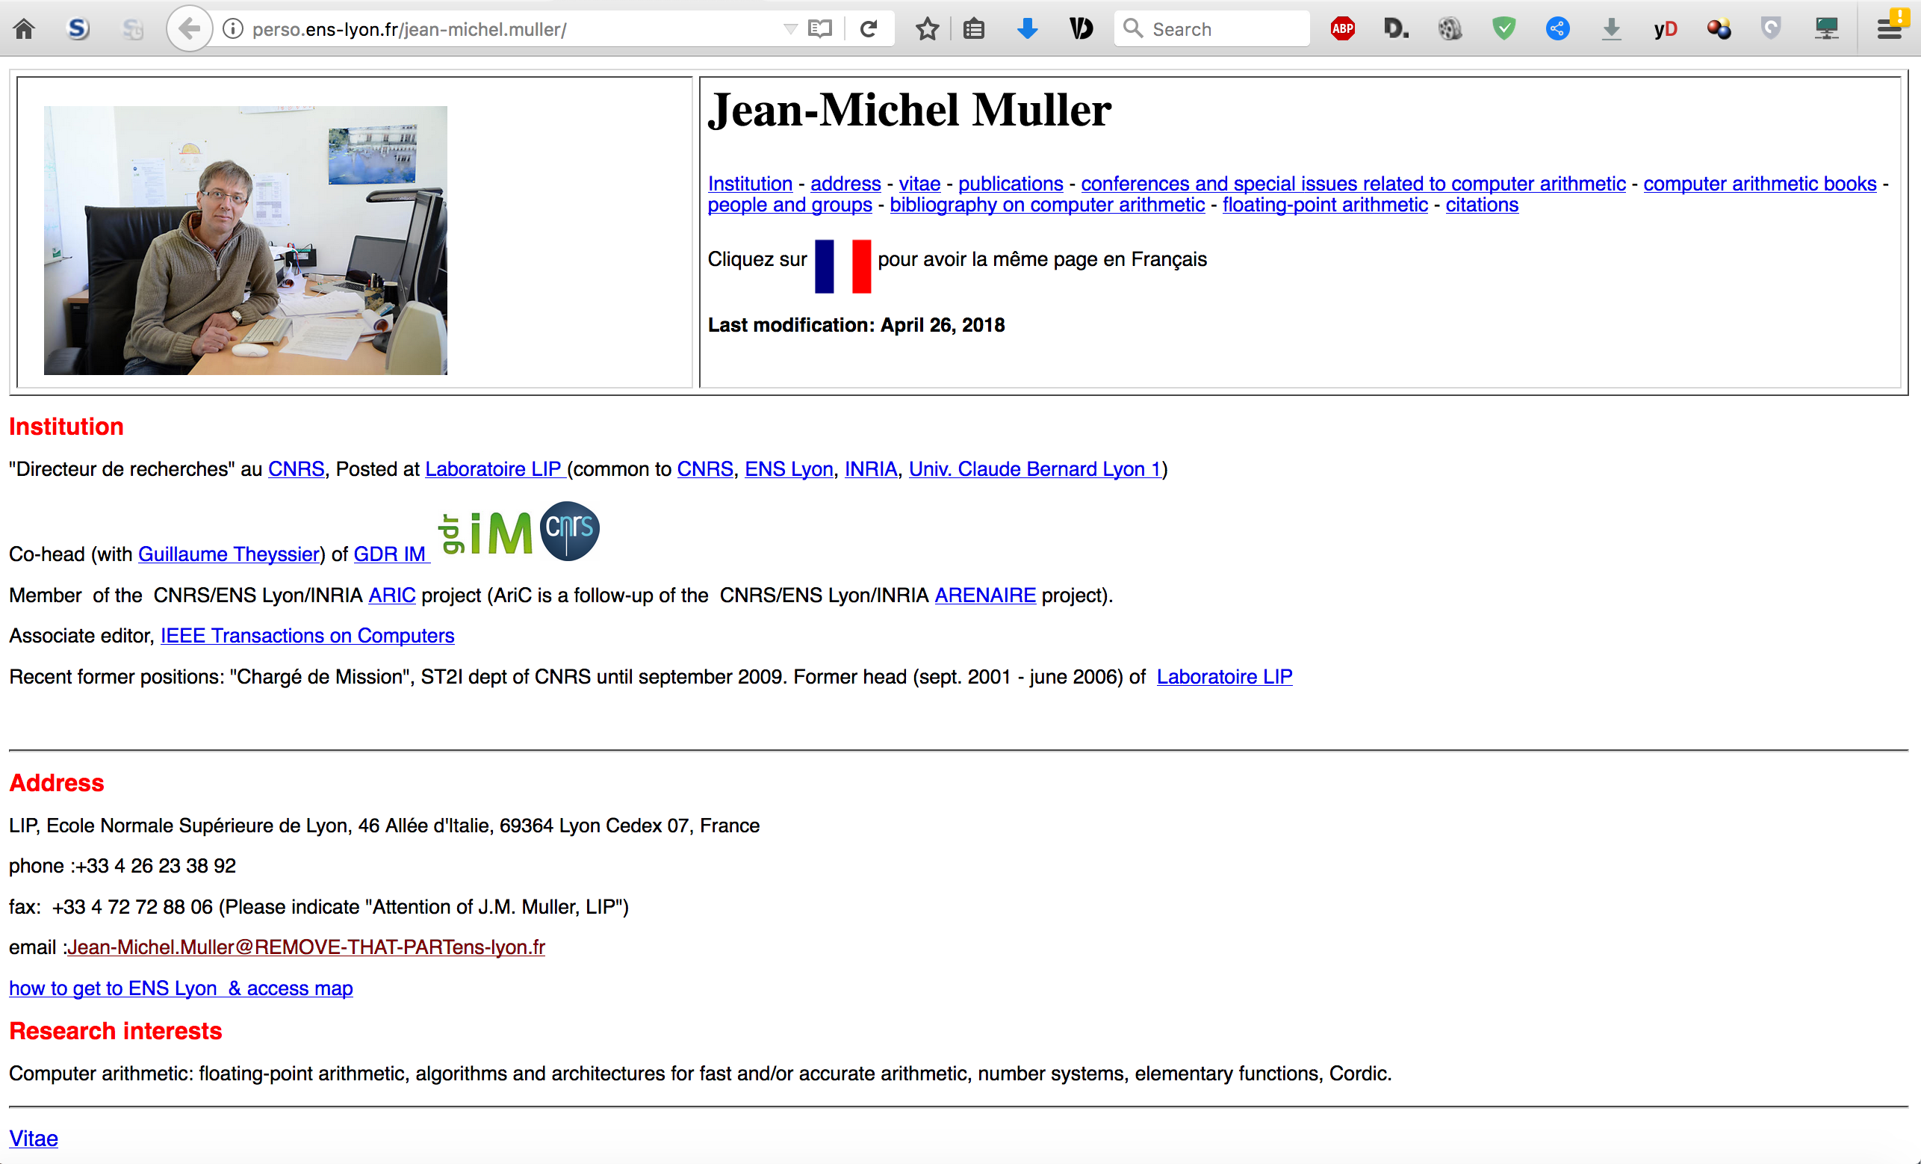

Slide 14
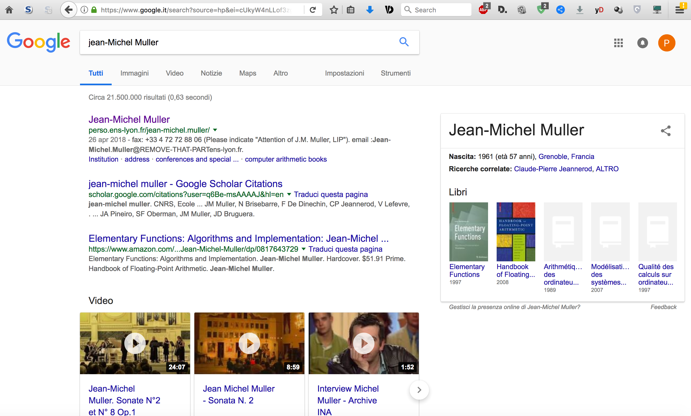
I was a bit unfair (apologies J-M ☺)

Slide 15
Future of Computer Arithmetic
Also requires communication, visibility and creation of awareness about who we are as a Community
We have a new web site
www.arithsymposium.org
(and a wikipedia page too)

Slide 16
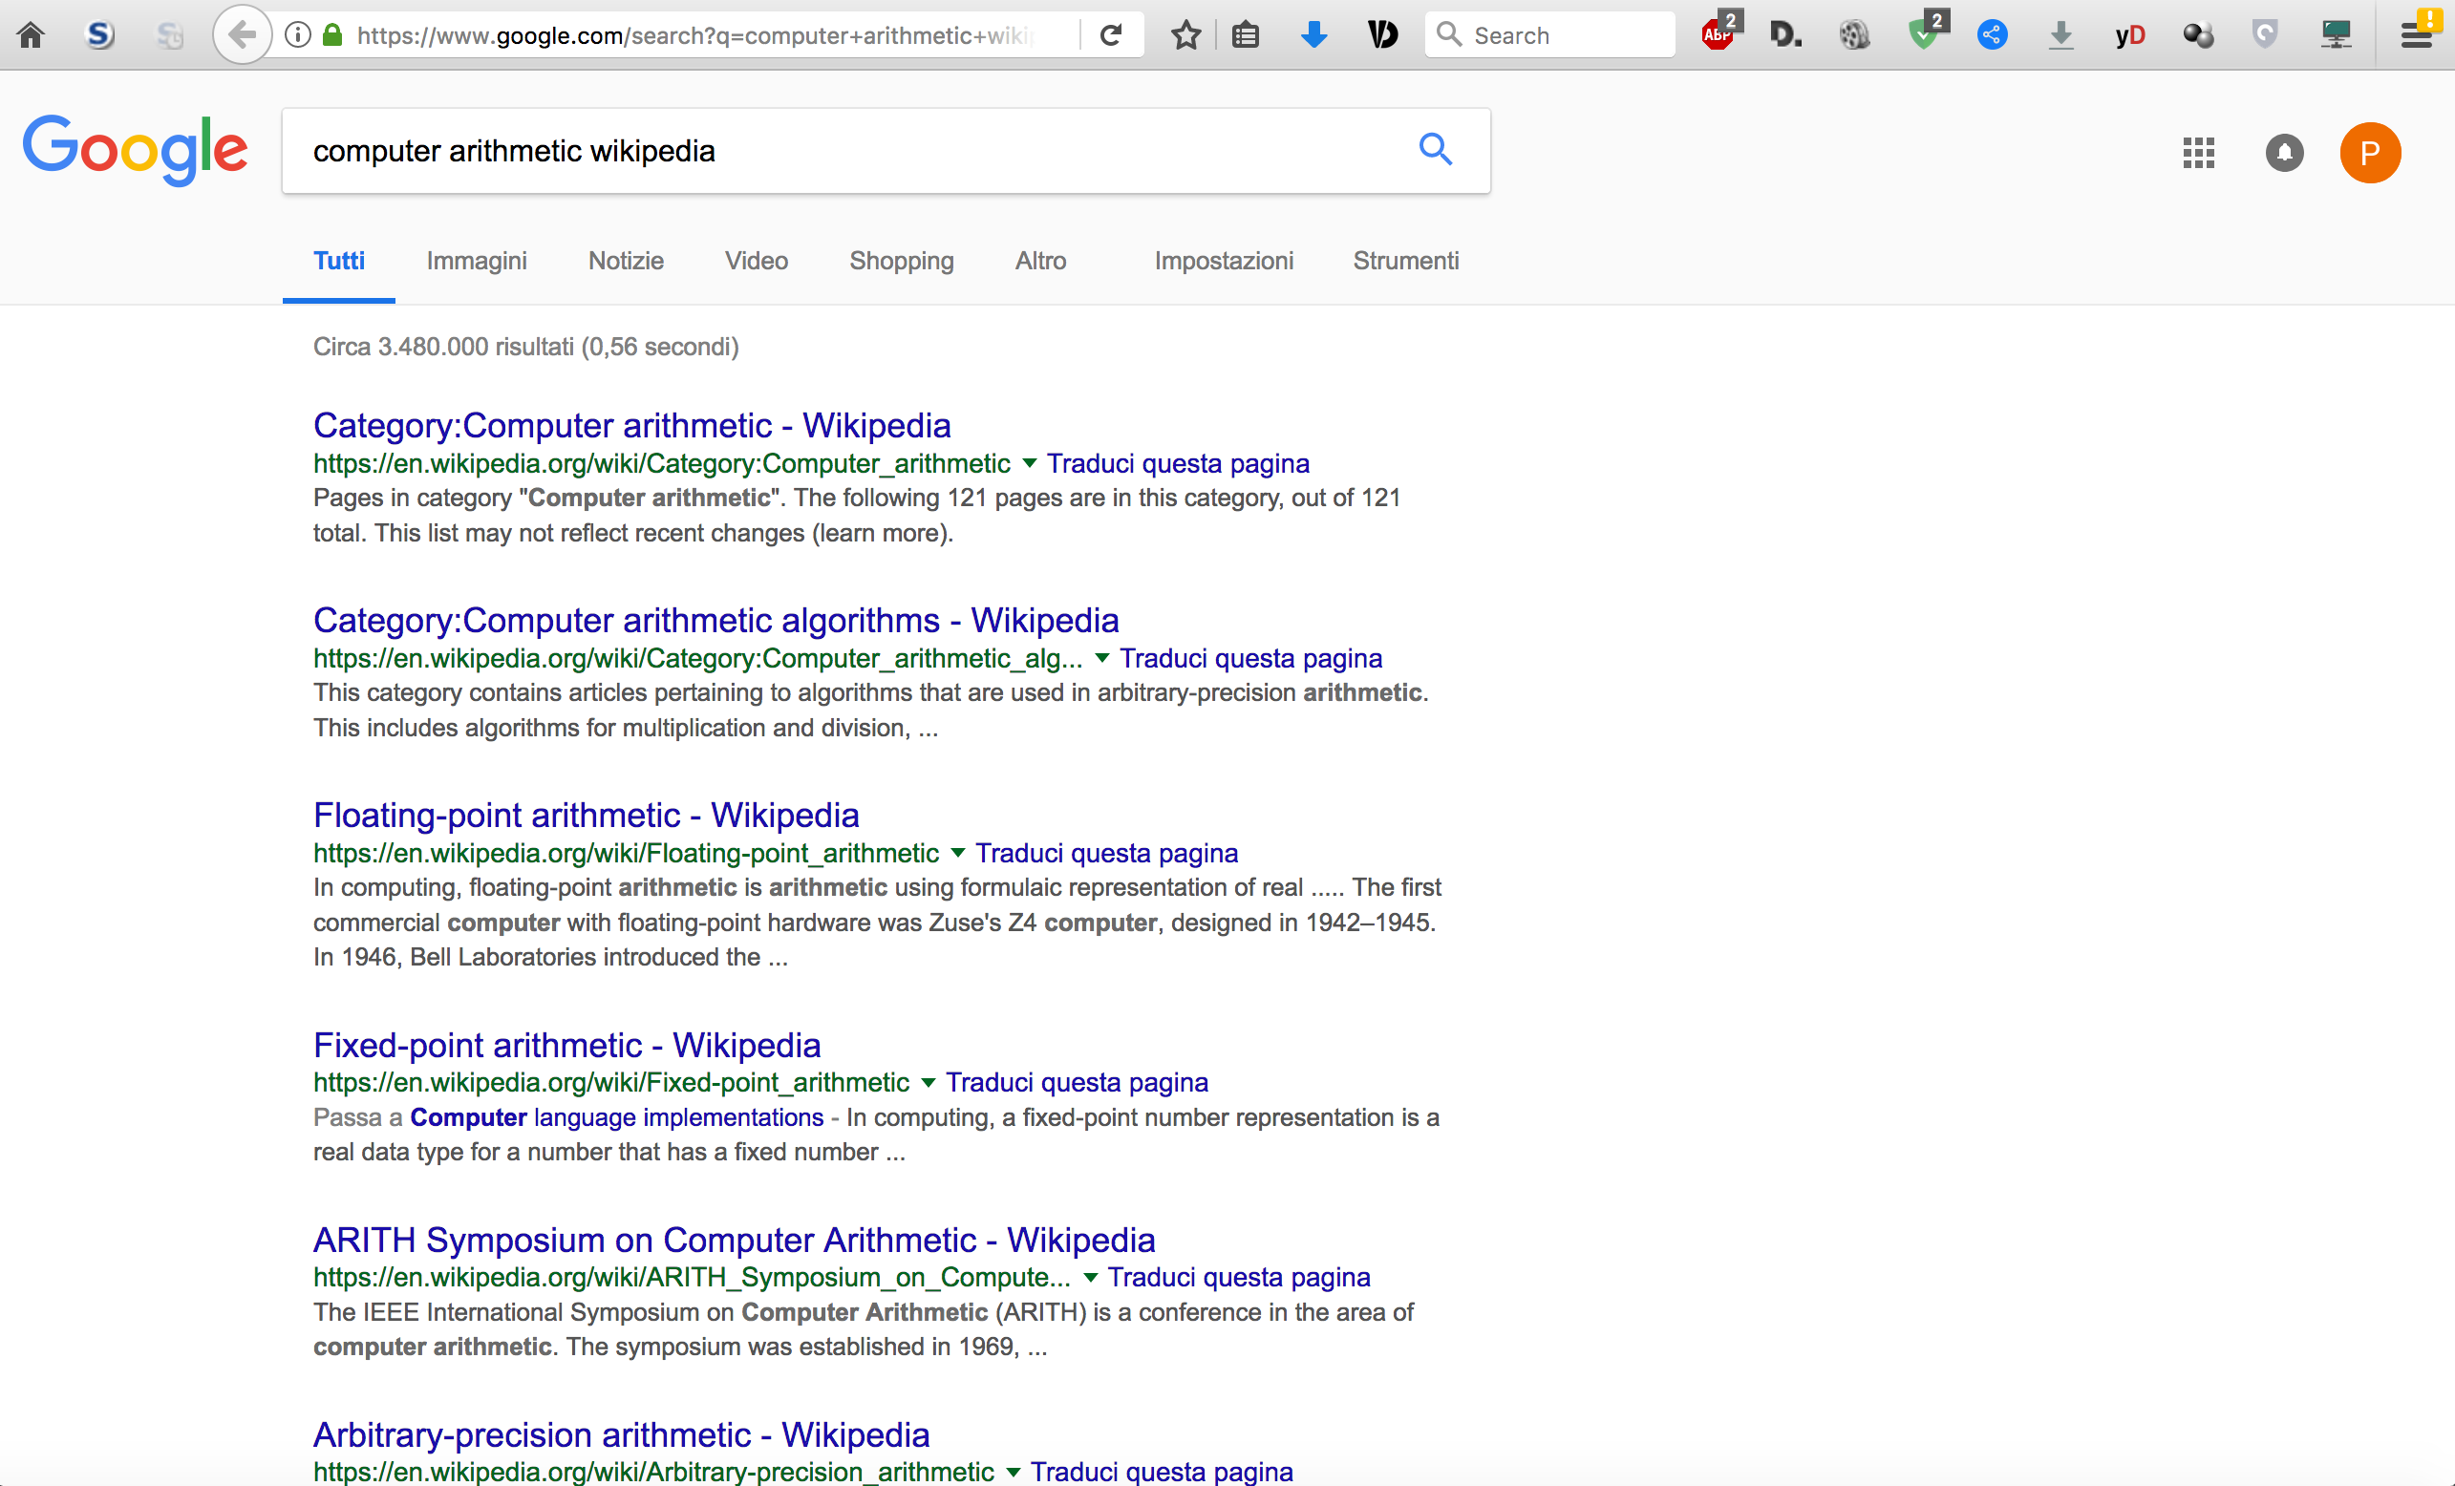

Slide 17
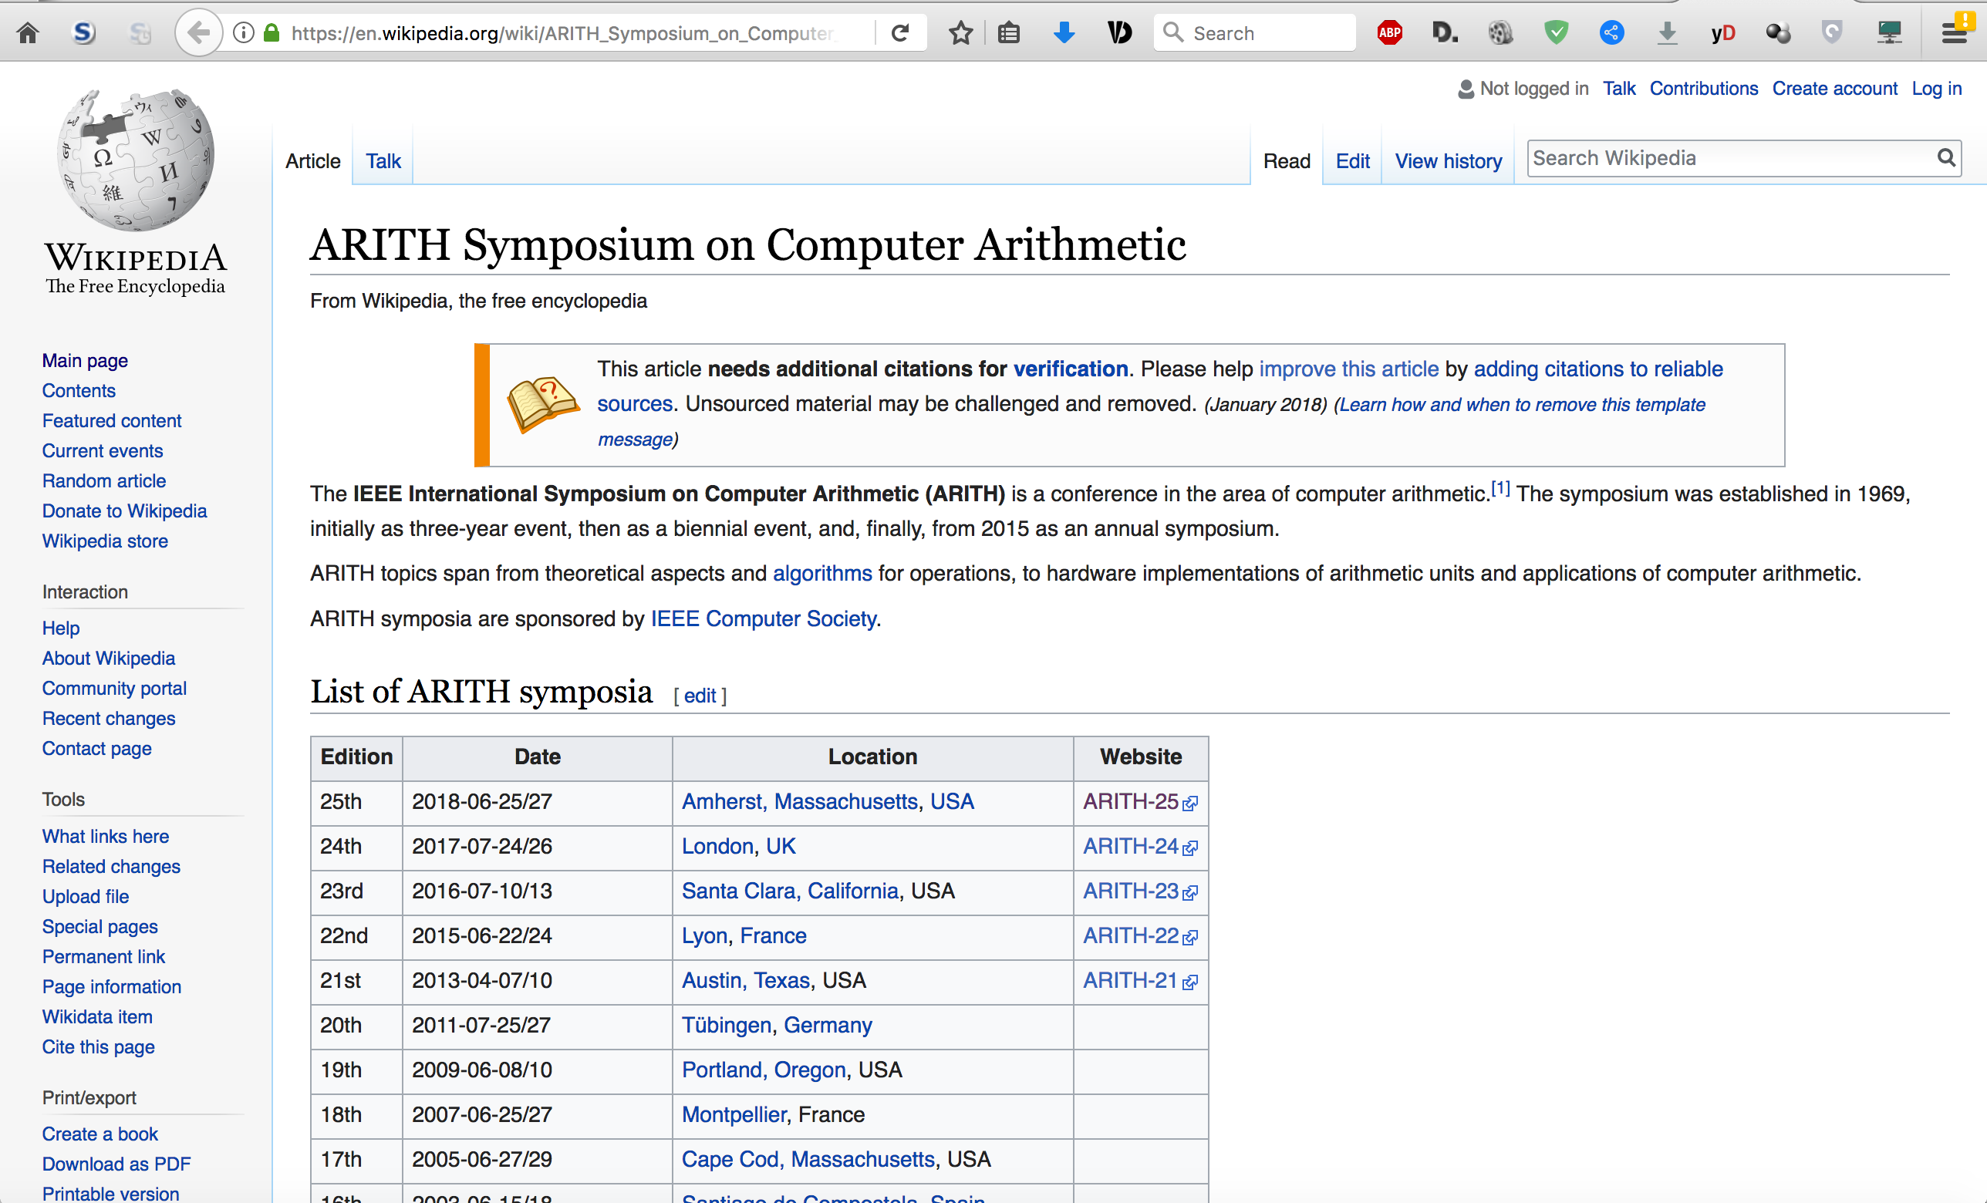

Slide 18
New Arith Web Site
General info about Arith (bylaws, committees, archives, …)
News
Our History
Perspectives
…
JOIN THE WEBSITE EDITORIAL BOARD
(contact Alberto Nannarelli alna@dtu.dk)

Slide 19
Outline of the Panel
Milos
Jean-Michel
David
Question time

