Slide 1
Future Directions in computer arithmetic
To predict the future,
it is important to
learn from the past.
David W. Matula, Professor Emeritus
Formerly: Calahan Centennial Chair in Engineering and
Professor of Computer Science and Engineering, SMU

Slide 2
50 year celebration 1966 - 2016
Completing the Deck

Slide 3
Computer Architecture makes the cover June, 2018 Issue award dinner june 23, 2018

Slide 4
Architecture In the beginning
ARITHMETIC
1950’s,
1960’s
OTHER
Hennessy and Patterson:

Slide 5
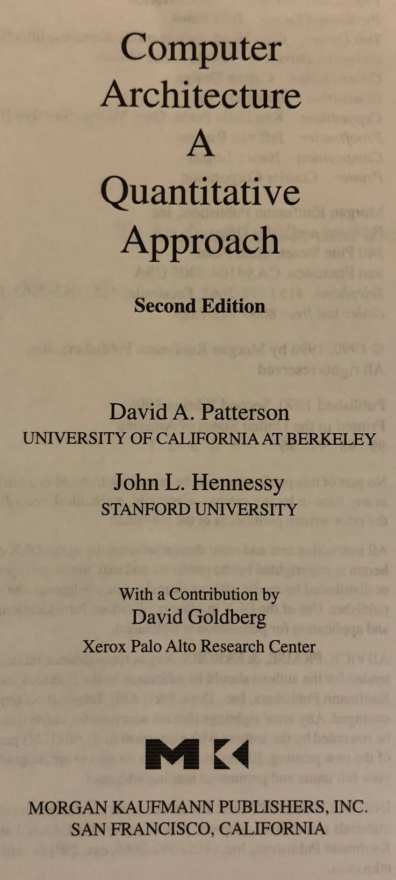
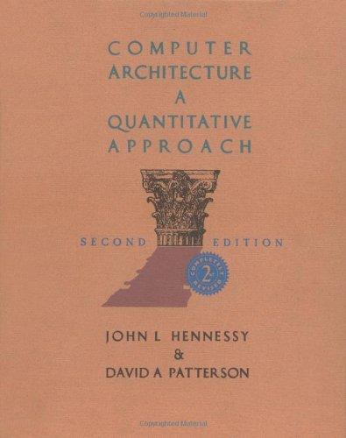
30 years later
2nd Edition
8 Chapters
5 Appendices

Slide 6
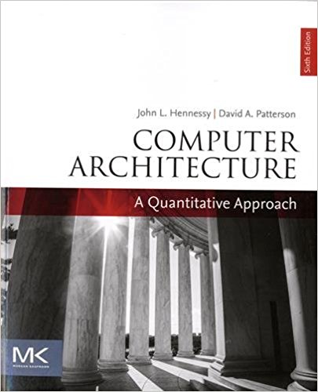
Now – 2018
Computer Arithmetic
6th Edition
7 Chapters
13 Appendices

Slide 7
75th Anniversary ?
ARITH
1950
-
2025

Slide 8
ARITH is not dead
Architecture
Algorithms
Rebrandings:
Graphic Processors
Big Data Arithmetics
Secure Computation Systems
…
ARITH
Number Systems

