Slide 1
New Area Record for the AES Combined S-box/Inverse S-box
Arash Reyhani-Masoleh, Mostafa Taha and Doaa Ashmawy
Presented by: Arash Reyhani-Masoleh
Department of Electrical and Computer Engineering
Western University, London, Ontario, Canada
25th IEEE Symposium on Computer Arithmetic, 2018

Slide 2
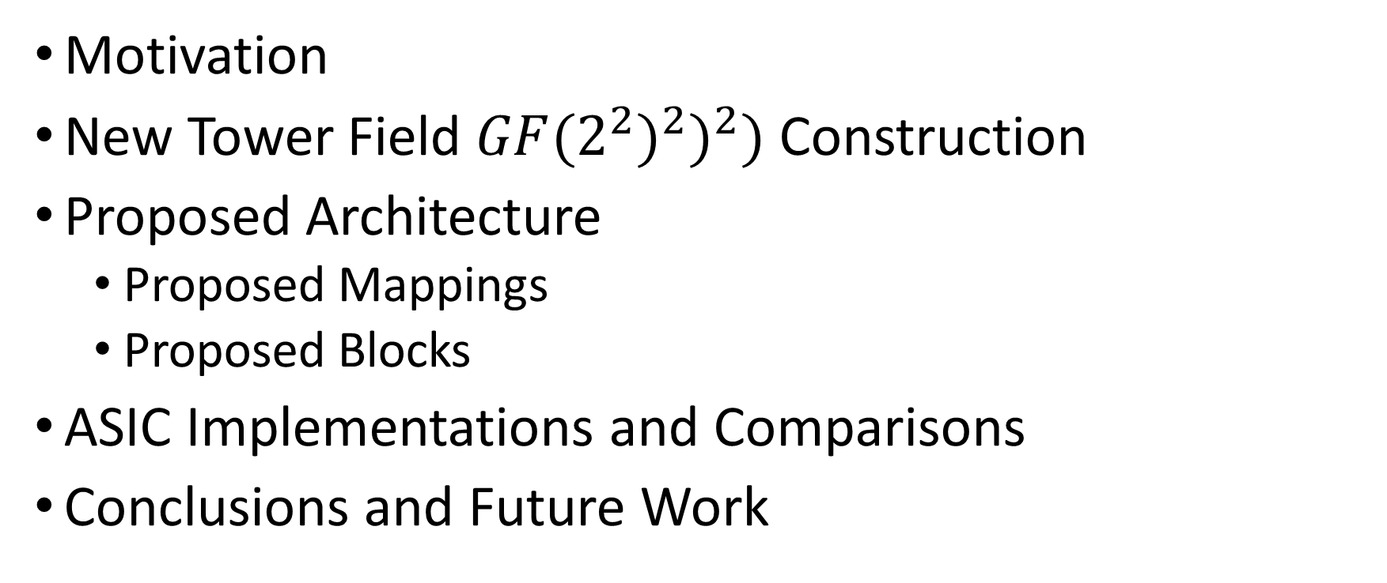
Outline
Motivation
New Tower Field $GF(2^{2})^{2})^{2})$ Construction
Proposed Architecture
  Proposed Mappings
  Proposed Blocks
ASIC Implementations and Comparisons
Conclusions and Future Work

Slide 3
Motivation
The AES combined S-box/inverse S-box is a single construction that is shared between the encryption and decryption data paths of the AES.
Optimization of the AES combined S-box/inverse S-box received little attention from the research community.
Canright’s design [3] is currently the most compact implementation of the AES combined S-box/inverse S-box.
We propose a new AES combined S-box/inverse S-box design that is both smaller and faster than Canright’s design.
New tower ﬁeld is introduced and each and every block inside the combined architecture for this ﬁeld is optimized.
New asymmetric mapping is introduced.
---------------------------------------------------------------------
[3] D. Canright, “A very compact S-box for AES,” in Cryptographic Hardware and Embedded Systems - CHES, Proceedings, 2005, pp. 441–455.

Slide 4
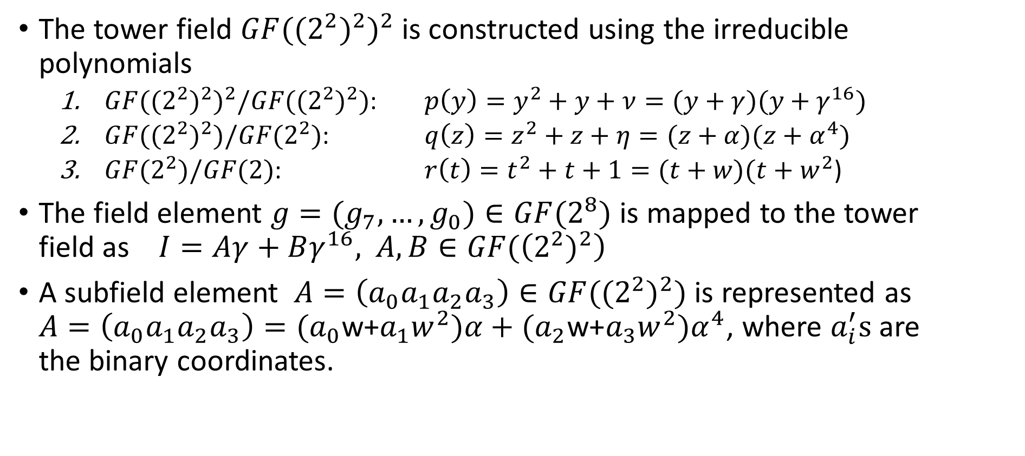

New Tower Field $GF(((2^{2})^{2})^{2})$ Construction
The tower field $GF((2^{2})^{2})^{2}$ is constructed using the irreducible polynomials
  $GF((2^{2})^{2})^{2}/GF((2^{2})^{2})$: $p\left(y\right)=y^{2}+y+ν=(y+γ)(y+γ^{16})$
  $GF((2^{2})^{2})/GF(2^{2})$: $q\left(z\right)=z^{2}+z+η=(z+α)(z+α^{4})$
  $GF(2^{2})/GF(2)$: $r\left(t\right)=t^{2}+t+1=(t+w)(t+w^{2}$)
The field element $g=(g_{7},…,g_{0})∈GF(2^{8})$ is mapped to the tower field as $I=Aγ+Bγ^{16},$ $A,B∈GF(\left(2^{2})^{2}\right)$
A subfield element $A=\left(a_{0}a_{1}a_{2}a_{3}\right)∈GF((2^{2})^{2})$ is represented as $A=\left(a_{0}a_{1}a_{2}a_{3}\right)=(a_{0}$w+$a_{1}w^{2})α+(a_{2}\text{w}\text{+}a_{3}w^{2})α^{4}$, where $a_{i}^{′}s$ are the binary coordinates.

Slide 5


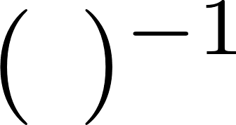








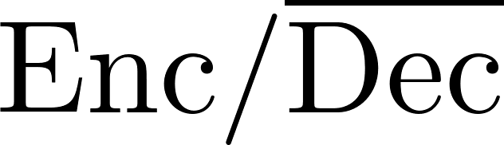
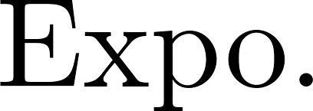

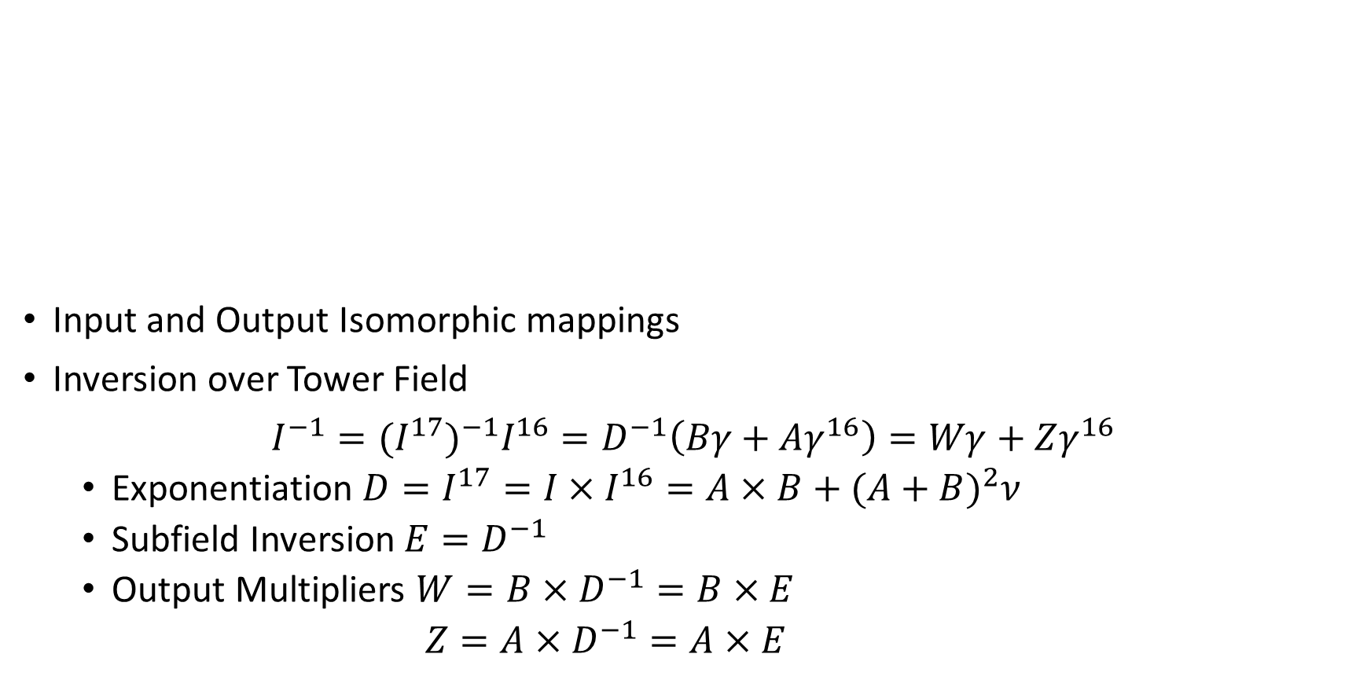

Proposed Architecture
$$4$$
$$4$$
$$4$$
$$1$$
Input and Output Isomorphic mappings
Inversion over Tower Field
$I^{−1}=(I^{17})^{−1}I^{16}=D^{−1}\left(Bγ+Aγ^{16}\right)=Wγ+Zγ^{16}$
  Exponentiation $D=I^{17}=I×I^{16}=A×B+(A+B)^{2}ν$
  Subfield Inversion $E=D^{−1}$
  Output Multipliers $W=B×D^{−1}=B×E$
  $Z=A×D^{−1}=A×E$
$$8$$
$$4$$
$$8$$
$$1$$
$$0$$
$$1$$
$$8$$
$$8$$
$$8$$
$$8$$
$$1$$
$$4$$
$$4$$
$$8$$
$$4$$
$$0$$
$$4$$
$$0$$
$$4$$
$$4$$

Slide 6



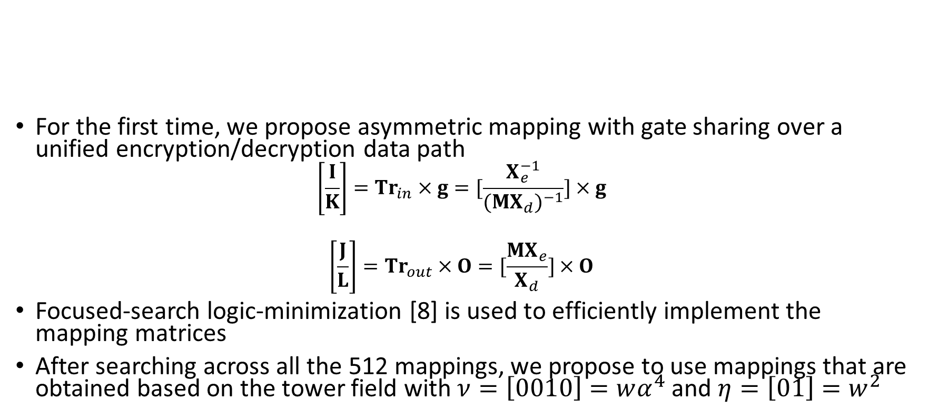










Proposed Mappings
$$4$$
$$1$$
$$4$$
$$4$$
$$8$$
$$4$$
$$8$$
$$1$$
$$0$$
$$1$$
$$8$$
$$8$$
$$8$$
$$8$$
$$1$$
$$4$$
$$4$$
$$8$$
$$0$$
For the first time, we propose asymmetric mapping with gate sharing over a unified encryption/decryption data path
$$\left[\frac{I}{K}\right]={Tr}_{in}×g=[\frac{X_{e}^{−1}}{(MX_{d})^{−1}}]×g$$
$$\left[\frac{J}{L}\right]={Tr}_{out}×O=[\frac{MX_{e}}{X_{d}}]×O$$
Focused-search logic-minimization [8] is used to efficiently implement the mapping matrices
After searching across all the 512 mappings, we propose to use mappings that are obtained based on the tower field with $ν=\left[0010\right]=wα^{4}$ and $η=\left[01\right]=w^{2}$
$$4$$
$$4$$
$$0$$
$$4$$
$$4$$
---------------------------------------------------------------------
[8] A. Reyhani-Masoleh, M. Taha, and D. Ashmawy, “Smashing the implementation records of AES S-box,” IACR Transactions on Cryptographic Hardware and Embedded Systems, vol. 2018 (2), p. 39, 2018.

Slide 7
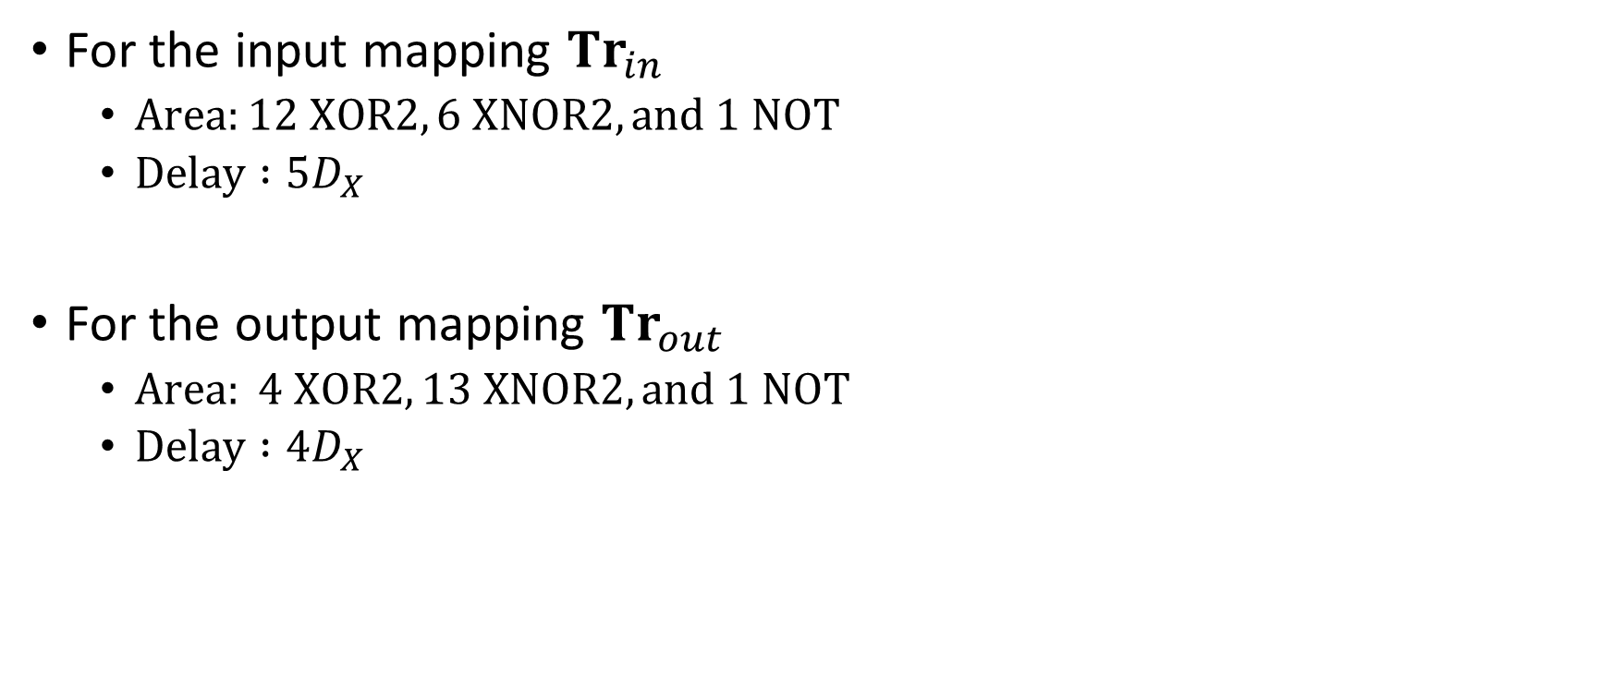
Proposed Mappings (Complexities)
For the input mapping ${Tr}_{in}$
  $Area:12 XOR2, 6 XNOR2, and 1 NOT$
  $Delay :5D_{X}$
For the output mapping ${Tr}_{out}$
  $Area: 4 XOR2, 13 XNOR2, and 1 NOT$
  $Delay :4D_{X}$
$$4$$
$$1$$
$$4$$
$$4$$
$$8$$
$$4$$
$$8$$
$$1$$
$$0$$
$$1$$
$$8$$
$$8$$
$$8$$
$$8$$
$$1$$
$$4$$
$$4$$
$$8$$
$$0$$
$$4$$
$$4$$
$$0$$
$$4$$
$$4$$

Slide 8






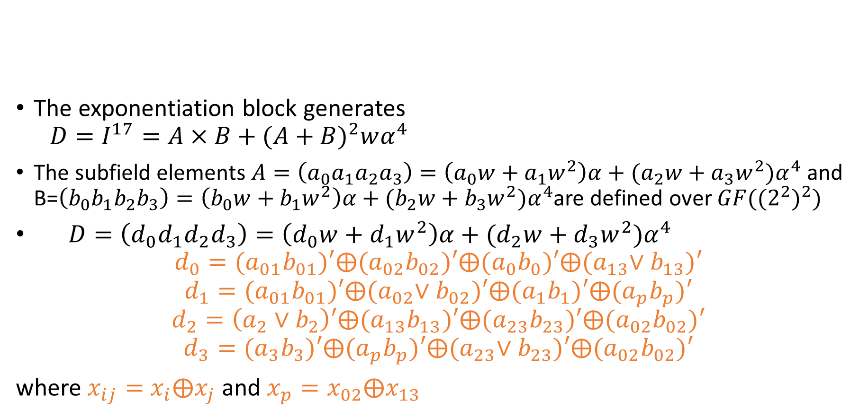





Proposed Exponentiation Block
The exponentiation block generates
$$D=I^{17}=A×B+(A+B)^{2}wα^{4}$$
The subfield elements $A=\left(a_{0}a_{1}a_{2}a_{3}\right)=\left(a_{0}w+a_{1}w^{2}\right)α+(a_{2}w+a_{3}w^{2})α^{4}$ and B=$\left(b_{0}b_{1}b_{2}b_{3}\right)=\left(b_{0}w+b_{1}w^{2}\right)α+(b_{2}w+b_{3}w^{2})α^{4}$are defined over $GF((2^{2})^{2})$
$D=\left(d_{0}d_{1}d_{2}d_{3}\right)=\left(d_{0}w+d_{1}w^{2}\right)α+(d_{2}w+d_{3}w^{2})α^{4}$
$$d_{0}={(a}_{01}b_{01})′⨁{(a}_{02}b_{02})′⨁(a_{0}b_{0})′⨁{(a}_{13}∨b_{13})′$$
$$d_{1}={(a}_{01}b_{01})′⨁{(a}_{02}∨b_{02})′⨁{(a}_{1}b_{1})′⨁{(a}_{p}b_{p})′$$
$$d_{2}=\left(a_{2}{∨b}_{2}\right)′⨁(a_{13}b_{13})′⨁(a_{23}b_{23})′⨁(a_{02}b_{02})′$$
$$d_{3}=(a_{3}b_{3})′⨁(a_{p}b_{p})′⨁{(a}_{23}∨b_{23})′⨁(a_{02}b_{02})′$$
where $x_{ij}=$ $x_{i}⨁x_{j}$ and $x_{p}=x_{02}⨁x_{13}$
$$4$$
$$1$$
$$4$$
$$4$$
$$8$$
$$4$$
$$8$$
$$1$$
$$0$$
$$1$$
$$8$$
$$8$$
$$8$$
$$8$$
$$1$$
$$4$$
$$4$$
$$8$$
$$0$$
$$4$$
$$4$$
$$0$$
$$4$$
$$4$$

Slide 9














Proposed Subfield Inversion Block
$$4$$
$$1$$
$$4$$
$$4$$
$E=\left(e_{0}e_{1}e_{2}e_{3}\right)=D^{−1}={\left(d_{0}d_{1}d_{2}d_{3}\right)}^{−1}$
$$8$$
$$4$$
$$8$$
$$1$$
$$0$$
$$1$$
$$8$$
$$8$$
$$8$$
$$8$$
$$1$$
$$4$$
$$4$$
$$8$$
$$0$$
$$4$$
$$4$$
$$0$$
$$4$$
$$4$$

Slide 10

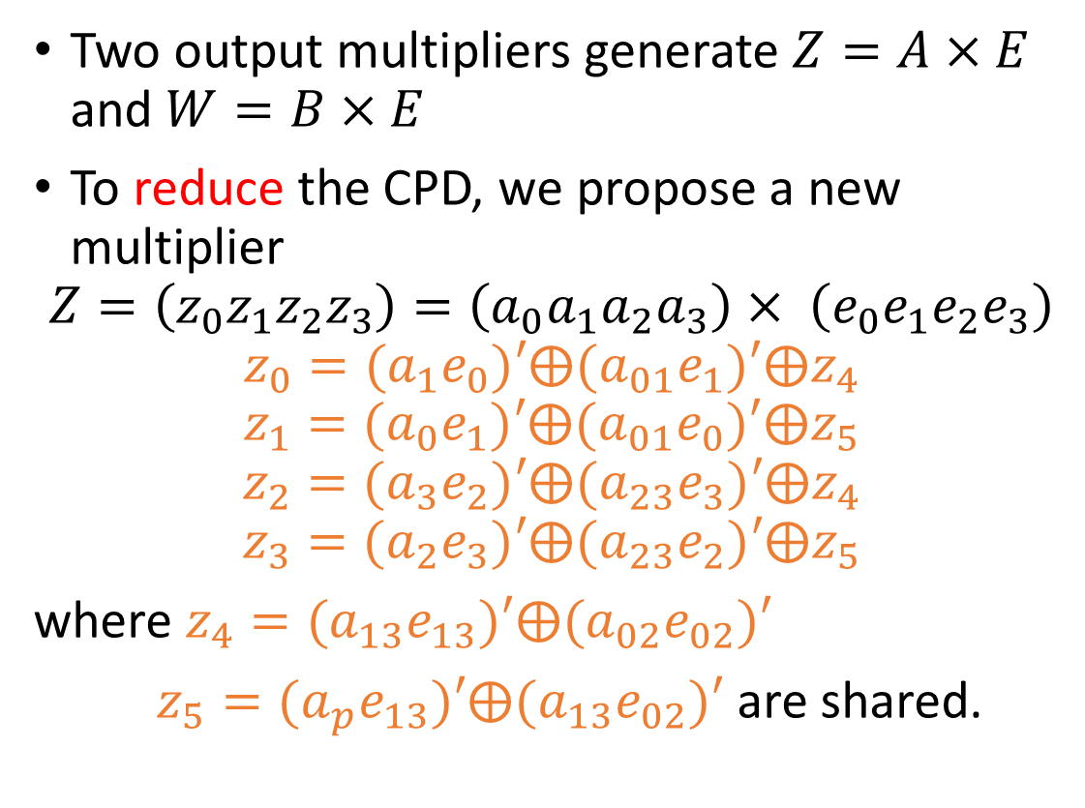
Proposed Output Multipliers
Two output multipliers generate $Z=A×E$ and $W=B×E$
To reduce the CPD, we propose a new multiplier
$$Z=\left(z_{0}z_{1}z_{2}z_{3}\right)=\left(a_{0}a_{1}a_{2}a_{3}\right)× \left(e_{0}e_{1}e_{2}e_{3}\right)$$
$$z_{0}={(a}_{1}e_{0})′⨁{(a}_{01}e_{1})′⨁z_{4}$$
$$z_{1}={(a}_{0}e_{1})′⨁{(a}_{01}e_{0})′⨁z_{5}$$
$$z_{2}={(a}_{3}e_{2})′⨁{(a}_{23}e_{3})′⨁z_{4}$$
$$z_{3}={(a}_{2}e_{3})′⨁{(a}_{23}e_{2})′⨁z_{5}$$
where $z_{4}=(a_{13}e_{13})′⨁{(a}_{02}e_{02})′$
$z_{5}={(a}_{p}e_{13})′⨁{(a}_{13}e_{02})′$ are shared.
$$4$$
$$1$$
$$4$$
$$4$$
$$8$$
$$4$$
$$8$$
$$1$$
$$0$$
$$1$$
$$8$$
$$4$$
$$4$$
$$8$$
$$8$$
$$8$$
$$1$$
$$4$$
$$8$$
$$0$$
$$4$$
$$0$$
$$4$$
$$4$$

Slide 11
Complexity Comparisons
Design | HW Complexity | GEs*
Zhang [27] | 154X+36AD+16M | 385
Jeon [19] | 116X+58AD+2OR+10NT+16M | 347
Ahmad [21] | 123X+35AD+16M | 321.75
Canright [3] | 94X+34ND+6NR+2NT+16MI | 257.5
This Work | 81X+32ND+8NT+8NR+2O2+2O3+16MI | 243.5
The Gate Equivalents (GEs) are based on the STM 65nm technology library
The proposed combined S-box/inverse S-box has the lowest hardware complexity as compared to the schemes proposed in [3],[19],[21],[27].
--------------------------------------------------------------------
[3] D. Canright, “A very compact S-box for AES,” in Cryptographic Hardware and Embedded Systems - CHES, Proceedings, 2005, pp. 441–455.
[19] Y.-S. JEON, Y.-J. KIM, and D.-H. LEE, “A compact memory-free architecture for the AES algorithm using resource sharing methods,” Journal of Circuits, Systems and Computers, vol. 19, no. 05, pp. 1109–1130, 2010.
[21] N. Ahmad and S. R. Hasan, “Low-power compact composite ﬁeld AES S-Box/inv S-Box design in 65nm CMOS using novel XOR gate,” Integration, the VLSI Journal, vol. 46, no. 4, pp. 333 – 344, 2013.
[27] X. Zhang and K. K. Parhi, “High-speed vlsi architectures for the aes algorithm,” IEEE Transactions on Very Large Scale Integration (VLSI) Systems, vol. 12, no. 9, pp. 957–967, 2004.

Slide 12

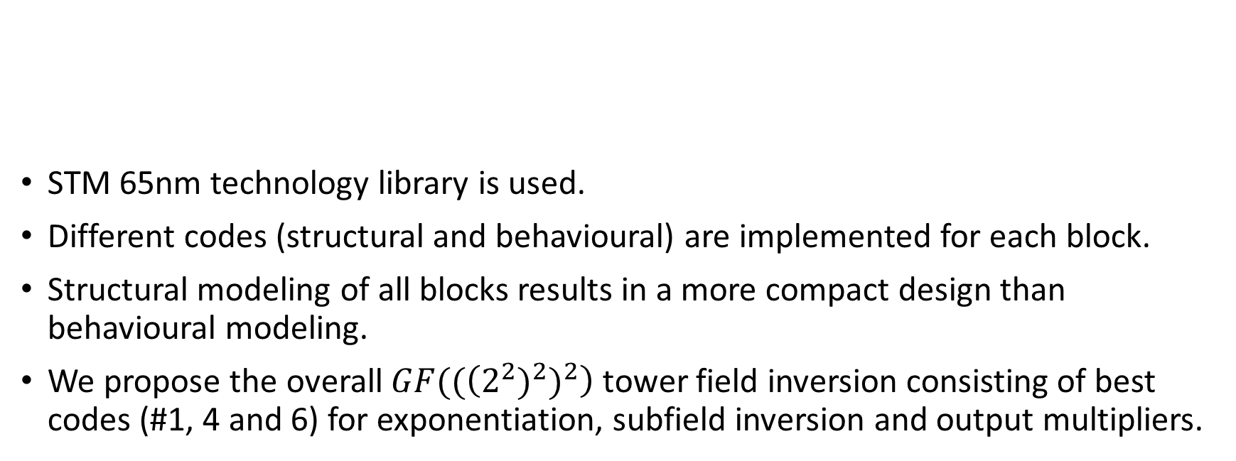




ASIC Implementation Results For the Inversion
 | Code # | Imp. | Ref. | Area |  | CPD | Pow.
 |  |  |  |  | GE | ns
Exp. | 1 | Str. | (18) | 116.48 | 56 | 0.208 | 6.96
 | 2 | Beh. |  | 120.12 | 57.75 | 0.206 | 6.02
Sub. Inv. | 3 | Str. | (22),(24) | 66.56 | 32 | 0.214 | 3.03
 | 4 | Str. | Fig. 2 | 41.6 | 20 | 0.070 | 1.58
 | 5 | Beh. | (27) | 44.72 | 21.5 | 0.083 | 1.26
Out. Mul. | 6 | Str. | (32),(34) | 141.44 | 68 | 0.171 | 6.74
 | 7 | Beh. |  | 143.52 | 69 | 0.192 | 5.67
Tower Inv. | 8 | Str. | #1,4,6 | 299.52 | 144 | 0.607 | 25.02
 | 9 | Beh. | #2,5,7 | 309.4 | 148.75 | 0.762 | 23.22
$$4$$
$$1$$
$$4$$
$$4$$
$$8$$
$$4$$
$$8$$
$$1$$
$$0$$
$$8$$
$$1$$
$$8$$
$$8$$
$$8$$
$$1$$
$$4$$
$$4$$
$$8$$
$$0$$
$$4$$
STM 65nm technology library is used.
Different codes (structural and behavioural) are implemented for each block.
Structural modeling of all blocks results in a more compact design than behavioural modeling.
We propose the overall $GF((\left(2^{2})^{2})^{2}\right)$ tower field inversion consisting of best codes (#1, 4 and 6) for exponentiation, subfield inversion and output multipliers.
$$4$$
$$0$$
$$4$$
$$4$$

Slide 13
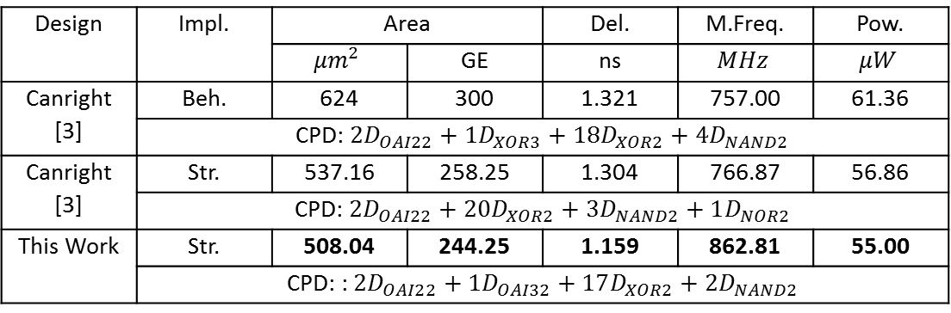
ASIC Implementation Results for the Combined S-box/Inverse S-box
Design | Impl. | Area |  | Del. | M.Freq. | Pow.
 |  | $$μm^{2}$$ | GE | ns | $$MHz$$ | $$μW$$
Canright [3] | Beh. | 624 | 300 | 1.321 | 757.00 | 61.36
 | CPD: $2D_{OAI22}+1D_{XOR3}+18D_{XOR2}+4D_{NAND2}$
Canright [3] | Str. | 537.16 | 258.25 | 1.304 | 766.87 | 56.86
 | CPD: $2D_{OAI22}+20D_{XOR2}+3D_{NAND2}+1D_{NOR2}$
This Work | Str. | 508.04 | 244.25 | 1.159 | 862.81 | 55.00
 | CPD: : $2D_{OAI22}+1D_{OAI32}+17D_{XOR2}+2D_{NAND2}$
STM 65nm technology library is used.
The proposed combined S-box/inverse S-box is more compact and faster than the currently best design [3] in the literature.
---------------------------------------------------------------------
[3] D. Canright, “A very compact S-box for AES,” in Cryptographic Hardware and Embedded Systems - CHES, Proceedings, 2005, pp. 441–455.

Slide 14
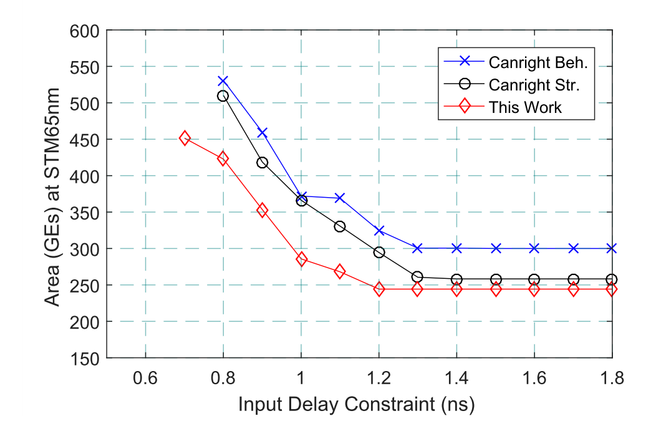
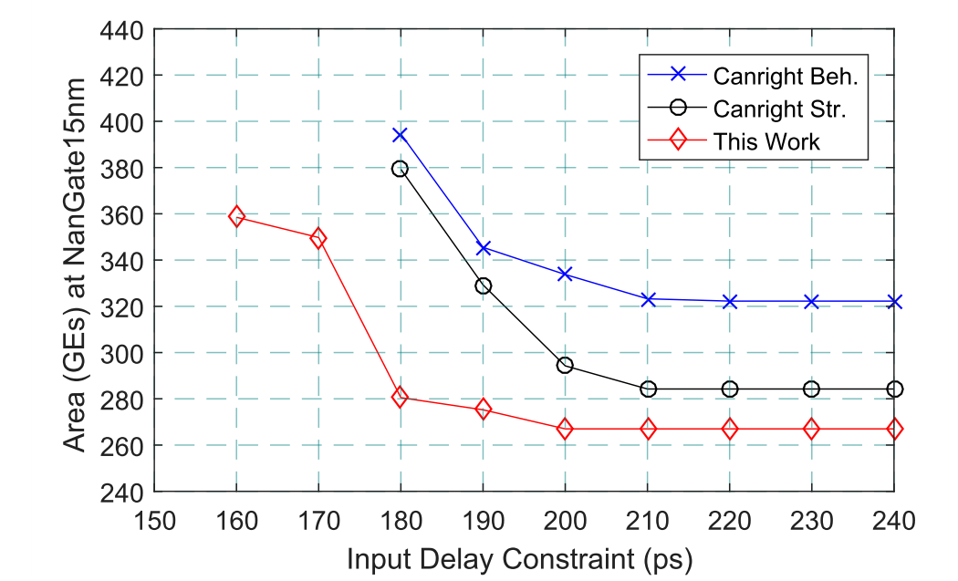
ASIC Implementation Results for the Combined S-box/Inverse S-box (Cont’d)
The proposed scheme is evaluated against previous work in [3] under different delay constraints using two technologies of STM 65 nm and NanGate 15nm
The proposed scheme is more compact circuit than the previous work in [3] across all targeted delay constraints.
The highest speed of our design is 1.43 GHz in the STM technology and 6.25 GHz in the NanGate 15nm technology at the corresponding areas of 451.5GEs and 358.5 GEs, respectively.

Slide 15
Conclusion and Future Work
We have proposed and optimized a new compact and fast design for the AES combined S-box/inverse S-box based on the new tower field.
Matlab has been used to verify the operations in the new field.
VHDL has been used to code the individual blocks as well as the whole design both structurally and behaviourally.
The output of every block as well as the whole design were verified using Modelsim.
We have conducted ASIC implementations of the new circuits and show that they outperform their counterparts.
We will explore side-channel protection in a future work.

Slide 16
Thank You
&
Questions?

