Slide 1
Digit Elision for Arbitrary-accuracy Iterative Computation
He Li, James J. Davis, John Wickerson & George A. Constantinides
{h.li16, james.davis, j.wickerson, g.constantinides}@imperial.ac.uk
26/06/2018
1
Notes:
Good afternoon, everyone!
It’s my great honor to present our paper at ARITH today.
This work targets some optimisations for our previously published paper at 2017 international conference on Field-programmable Technology (FPT), which is one of the premier conferences in the FPGA field.
In that paper, we presented a novel hardware architecture which only uses constant compute-hardware to solve systems of linear equations to arbitrary accuracies, named ARCHITECT.
ARCHITECT computed every digit of every iteration of the computation. While for any continuous function this will give a correct result, it tends to be wasteful in practice, generating more digits than strictly needed.
Therefore in this paper, we try to avoid some superfluous digits during iterative calculations. We call the step of omitting digits as Digit Elision.

Slide 2
Background
One-shot Control Algorithms
Anytime Control Algorithms
Fixed Precision:
specify a target precision in advance and only return one result.
Increasing Precision:
return results of increasing precision over time.
vs
Incremental:
generate results in stages which can be refined in variable precision.
Non-incremental:
start optimisation from scratch every time.
2
Notes:
Before we talk about the details of this paper, I’d like to share some motivations of ARCHITECT and this work.
Many works in the Control field have increasingly been interested in anytime control. Algs that continuously improve result quality instead of returning only one result are generally called anytime algorithms in contrast to one-shot algorithms.
Shortcomings of existing One-shot control algorithms are firstly they require to specify a target precision in advance and return results only once. Secondly, when we want to optimize the control, we need restart calculation from scratch every time.
Compared with one-shot algs, Anytime control algs return results of increasing precisions and the longer the systems computes, the more precise tan answer will be. In addition, anytime algorithms the goes in stages instead of all at once.
The process can be terminated at any time by the processor. The quality of control input is thus improving as time goes.

Slide 3
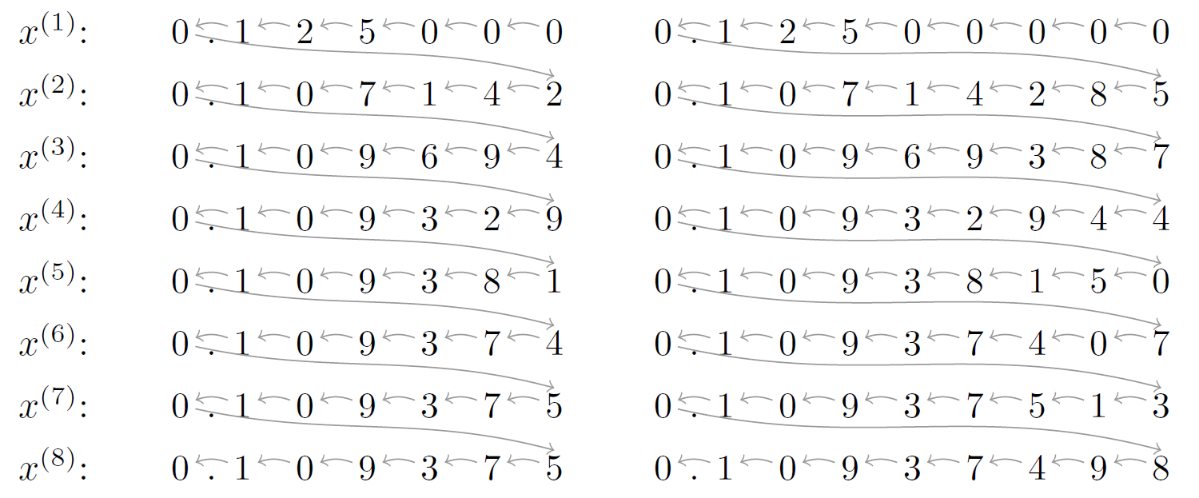
Previous Work: Problem
Question: If the result has not converged…
Run for more iterations K?
b) Restart with higher precision P?
p
k
3
Notes:
In practice, when performing this toy equation using a standard approach, we must choose a fixed precision before starting to iterate.
Here is the implementation with six decimal places and arrows show the computation order: iteration-by-iteration, least-significant digit (LSD) first.
However, this design choice will result in a fundamental problem:
if after several iterations, the result has not converged, we are left with no knowledge as to whether more iteration K needs to be computed or current computation need to be thrown away and restart the alg with a higher P instead.
So choosing the right precision a priori is difficult using conventional arithmetic.
So users often choose an over-budgeted precision so that the answer to the question hopefully needs more iterations.

Slide 4
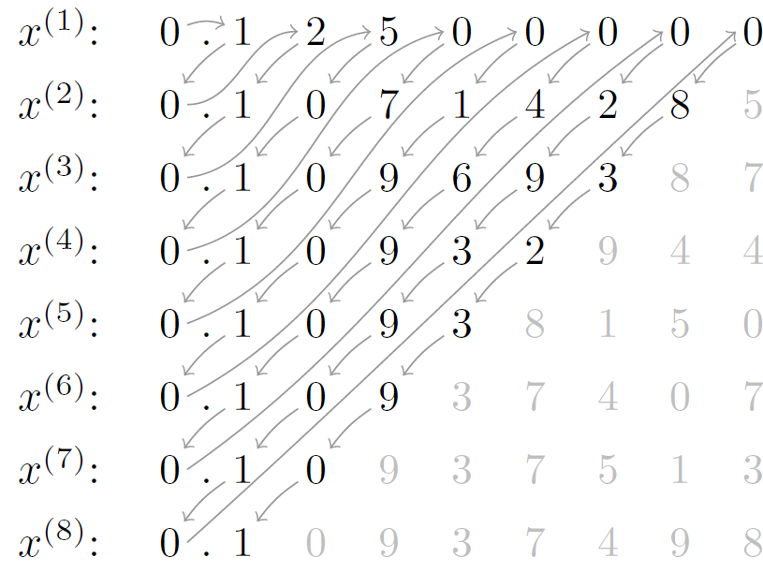
Previous Work: Solution
ARCHITECT:
Arbitrary-precision Constant-hardware Iterative-Compute [FPT17]
p
Zig-zag digit computation pattern
Same hardware for any precision.
No need to fix P and K in advance.
Computation terminates whenever accurate-enough result is obtained.
k
4
Notes:
Motivated by the anytime control application, we presented ARCHITECT.
With only constant-compute resources, we can produce a solution of iterative algorithms to arbitrary accuracies.
In this presentation, we chose a toy equation using Jacobi method as an example.
Arrows here shows the computation order, digit-by-digit and this zigzag pattern sweeps through the iterations and decimal places simultaneously.
The computation can terminate whenever the result is accurate enough.
6. To be able to fa the above requires to calculate from left to right, most-significant digits MSD first.
1st, OA allows computation to infinite precision; 2nd to implement a diagonal pattern, we should have the ability to calculate the partial Top-left results over time which means precision grows only as much as necessary for K.

Slide 5
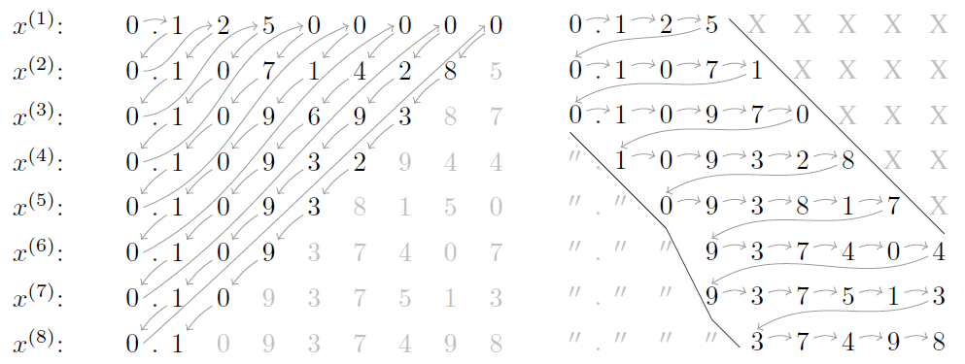
Motivation
ARCHITECT:
Arbitrary-precision Constant-hardware Iterative-Compute [FPT17]
p
Pros & cons:
Can reach arbitrary accuracy (pro).
Generate many more digits than strictly necessary (con).
Need to revisit previous iterations (con).
k
ARCHITECT
This work
5
Notes:
Compared to conventional arithmetic, ARCHITECT is able to calculate an arbitrary number of iteration to arbitrary precision. However, it generates many more digits than strictly necessary
Therefore there is a question coming out: Can we avoid the computation of the unimportant digits in the top right corner and the stable digits in the bottom left corner, meanwhile, need to still guarantee convergence to results at any accuracy?

Slide 6
Proposal
Observation:
Can we avoid superfluous digits in computation?
Don’t-change digits: high-significance digits of later approximants become stable over time.
Don’t-care digits: low-significance digits of early approximants are generally unimportant.
Guarantee the convergence to results of any accuracy.
p
k
ARCHITECT
This work
6
Notes:
There are two reasons. Firstly, because convergence can be seen as agreement in most-significant digits – after a while they don’t change. So why do we recompute them? we end up wasting time and energy computing stable MSDs in each iteration. Secondly, not all iterations may contribute equally to the overall error resulting from early termination. Some digits are effectively ‘don’t care’.
So, in this work, we want to find out can we avoid the computation of the unimportant digits in the top right corner and the stable digits in the bottom left corner, meanwhile, need to still guarantee convergence to results at any accuracy?

Slide 7
Contributions
1. Elision of don’t-change digits
for any online arithmetic-implemented iterative method.
2. Elision of don’t-care digits
for stationary iterative methods only.
3. Reduces memory usage
7
Notes:
Here are some technical details I'd like to talk about:
The first one is don't change digit elision: we present the theoretical analysis of MSD stability within any online arithmetic-implemented iterative method.
The second one is don't care digit elision: we present a theorem for the omission of unimportant LSDs within stationary iterative methods.
With the avoidance of don’t compute digits, it is possible to reduce memory usage.

Slide 8
Online Arithmetic
A different way
The normal way
Left to right
Right to left
Partial inputs
c
$$δ$$
(Online delay)
$$δ$$
Computations
c
cc
8
Notes:
As I mentioned before, the first contribution, don’t-change digits elision is suitable for any OA-impelmented iterative methods. So wha tis OA?
So, let me briefly talk about what is online arithmetic.
The usual way of performing computations are from right to left, least-significant digit first, which is shown as follows.
There is a different way of performing computations if we use left-to-right arithmetic.
The computation order can be one digit by one digit, MSD first.
We can use the partial input digits to generate the output digits, where the number of partial MSDs required for 1st output digit generation is called as Online Delay.
The value of online delay is determined by the operations in the datapath, which indicates the computation dependency between input and output digits. !!!

Slide 9
Don’t-Change Digit Elision
p
$$q$$
$$δ$$
(Online delay)
$$x^{(k−2)}$$
3.1 4 1 5 9 2 6 5
3 5 8 9 7
5 1 9 9 1
… …
Runtime detection
$$x^{(k−1)}$$
3.1 4 1 5 9 2 6 5
3 5 8 9 7
0 5 2 2 1
… …
$$x^{(k)}$$
3.1 4 1 5 9 2 6 5
… …
k
Stablilised digits
9
Notes:
The first, and more general, issue is the wastefulness of computing stabilised digits. But just because they look stable, are they really stable?
Milos’s OA comes to our rescue. If we compute in an appropriate redundant number representation, then we can prove that stability of digits means we don’t need to consider them any more. This is our first contribution.
Because online delay value can be calculated for a particular datapath.
Online delay determines the computation dependency between the input and output, which are two approximants in iterative algs.
We see that if we input q+delta digits at approximant k-2, we can produce first 1 digits in approximant k-1, keep computing using this dependency.
Whenever both two approximants have the same q + δ digits, Online arithmetic can guarantee that three approximants contain the stablised q digits.

Slide 10
Don’t-Change Digit Elision
p
$$q$$
$$δ$$
(Online delay)
$$x^{(k−1)}$$
3.1 4 1 5 9 2 6 5
3 5 8 9 7
0 5 2 2 1
… …
Runtime detection
$$x^{(k)}$$
3.1 4 1 5 9 2 6 5
3 5 8 9 7
0 1 1 1 1
… …
$$x^{(k+1)}$$
3.1 4 1 5 9 2 6 5
Stable digits in later iterations can be omitted.
k
9
Notes:
Let’s keep computing and see what happened in approximant k+1,
Again, after generating approimant k-1 and k. The runtime-detection module will check whether appr.k-1 and k have the same q+ delta digits.
As we can see, if these digits are same, then we still have the same q digits in approximant k+1.
Therefore, we can have the conclusion that these digits don‘t change in later iterations, so that they can be omitted.

Slide 11
Don’t-Change Digit Elision
p
$$q$$
$$δ$$
(Online delay)
$$x^{(k−2)}$$
3.1 4 1 5 9 2 6 5
3 5 8 9 7
5 1 9 9 1
… …
Runtime detection
$$x^{(k−1)}$$
3.1 4 1 5 9 2 6 5
3 5 8 9 7
0 5 2 2 1
… …
Start at digit q
$$x^{(k)}$$
3.1 4 1 5 9 2 6 5
3.1 4 1 5 9 2 6 5
k
Omitted digits
9
Notes:
Now that we have already now such stable digits can be omited. Therefore, instead of waiting time and energy to recompute such MSDs, it is safe to start the computation at digit q here.

Slide 12
Elision of Don’t-Care Digits
ARCHITECT ($δ$ = 1)
p
.
$$1$$
$$0$$
$$9$$
$$6$$
$$9$$
.
$$1$$
$$0$$
$$9$$
$$3$$
But it calculates each approximant exactly.
.
$$1$$
$$0$$
$$9$$
……
.
$$1$$
$$0$$
.
$$1$$
k
ARCHITECT prioritises k.
10
Notes:
The second contribution in this work, and more specific issue is that some digits are effectively ‘don’t care’.
Here is ARCHITECT’s computation order.
ARCHITECT prioritized k (sort of-if delta =1 this is strictly true), but the computation sometimes is not efficient:
Conceptually, ARCHITECT revisits earlier iterations and every digit of every iteration of the computation to infinite precision (as is required for the next approximant).
Since ARCHITECT achieves exact numeric computation by using online arithmetic to allow the refinement of results from earlier iterations over time, eschewing rounding error.

Slide 13
Don’t-Care Digit Elision
This work
p
0. 1 0 9 7 0
0.
1 0 9 3 2 8
Don’t-care digit
omission.
ARCHITECT
p
0. 1
0 9 3 8 1 7
……
k
k
11
Notes:
In this paper, we only analyse the special case of stationery iterative methods for don’t-care digits.
We show that, in these cases, for a fixed digit budget (e.g. “compute at most D digits across all iterations”), you should allocate these digits by computing a constant more digits each iteration, as controlled by this don’t-care line. The slope of this line can be estimated from the inifity norm of a certain matrix involved in the computation.
With the help of this line, the computation order shown here. The dotted boxed mean the stable MSDs.
In this paper, we prove that by using the don’t care digit line, the iterative calculation is able to converge to arbitrary-accuracy.

Slide 14
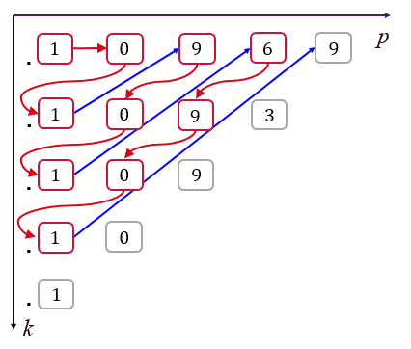
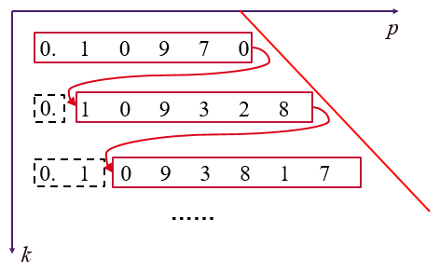
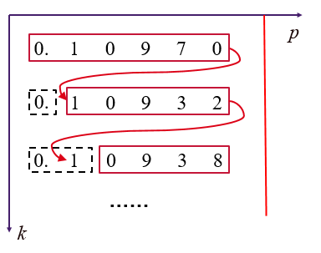
Don’t-Care Digit Elision
Important points:
The gradient is optimal.
steeper or shallower lines require more digits to reach result of same accuracy.
Steeper line may not allow convergence.
No need to refine earlier approximants.
……
12
Notes:
There are some important points to get cross:
The gradient is optimal—a steeper or shallower one will require more digits to be generated to reach a solution of the same accuracy.
A steeper line may not allow convergence. The gradient our method provided is guaranteed to allow it eventually.
The existence of this line allows you to not visit earlier iterations, which ARCHITECT didn’t.
ARCHITECT would require calculating to infinite precision, so this work is more efficient.

Slide 15
Comparisons with Existing Work
Advantages
Don’t-care digit elision.
Versus ARCHITECT
Don’t-change digit elision
Significantly lower memory usage
Versus conventional LSD-first arithmetic
A more efficient digit computation pattern
No need to fix precision prior to computation
13
Notes:
We have talked about the techniques details. As to experimental evaluation, Hardware performance were evaluated to investigate how our method compares to both ARCHITECT and conventional LSD-first equivalents.
Compared to iterative computation architectures constructed using conventional arithmetic (LSD-first) operators, we expect ours to compare favourably due to: 1. 2. 3.
Versus ARCHITECT, we hypothesise that iterative solvers constructed following our proposals will achieve greater performance thanks to: 1. 2. 3.

Slide 16
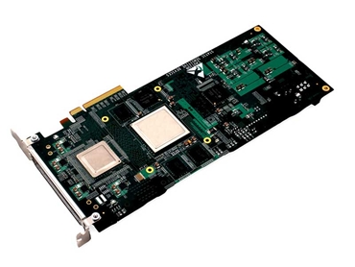
Benchmark: Jacobi Method
2D Jacobi datapath realised on FPGA:
$$Ax=b$$
$$x_{1}^{(k)}$$
$$x_{0}^{(k)}$$
$$x_{0}^{(k+1)}$$
$$x_{1}^{(k+1)}$$
14
Notes:
1. In order to evaluate the approach, we implemented a widely used iterative algorithm, the Jacobi method to solve Ax = b in an iterative way.
2. 2D Jacobi datapath is shown below. This is identical in structure to that used in our previous work [1].
3. The mul and add used here are online arithmetic mul and adder.
4. Digit sequencing and storage were realised using an FSM and memory architecture constructed as outlined in this plot.
5. 2D Jacobi is a case study without loss of generality.
2. Experiments were performed to investigate how ARCHITECT scales and performs versus competing arithmetic implementations, both traditional LSD-first and online arithmetic

Slide 17
Benchmark: Jacobi Method
$$A_{m}x=b$$
$$A_{1}=\left(\begin{matrix}1 & 0.5 \\ 0.5 & 1\end{matrix}\right)$$
$$A_{m}=\left(\begin{matrix}1 & 1−2^{−m} \\ 1−2^{−m} & 1\end{matrix}\right)$$
$$A_{2}=\left(\begin{matrix}1 & 0.75 \\ 0.75 & 1\end{matrix}\right)$$
$$A_{3}=\left(\begin{matrix}1 & 0.875 \\ 0.875 & 1\end{matrix}\right)$$
$$A_{4}=\left(\begin{matrix}1 & 0.9375 \\ 0.9375 & 1\end{matrix}\right)$$
……
15
Notes:
Jacobi benchmark is implemented on FPGAs will solve a set of matrices Am which is expressed here. A1 , A2 ,A3 ,A4…
Am determines the system is easy or difficult to solve.
Basically, with m increasing, the system becomes more and more hard to solve and Higher Prec and Iter are required for harder systems.
A conventional arithmetic-implemented solver can solve any system up to some limit imposed by m, but the method itself is generic.
Have to budget a conventional arithmetic solver for the worst-expected case.
Framework of the set of Am.
Of compute difficulty. Two fixed architecture: one conventional and one ARCHITECT;
A determines the system is easy to hard to solve.
High P and K for hard systems; vice versa;
Postulate ARCHI is better:
You budget for the worst-case: large P for CA and use ARCHI to solve this systems?
Two cases:
1:
2:
ARCHITECT operators to cal results to arb accuracy.

Slide 18
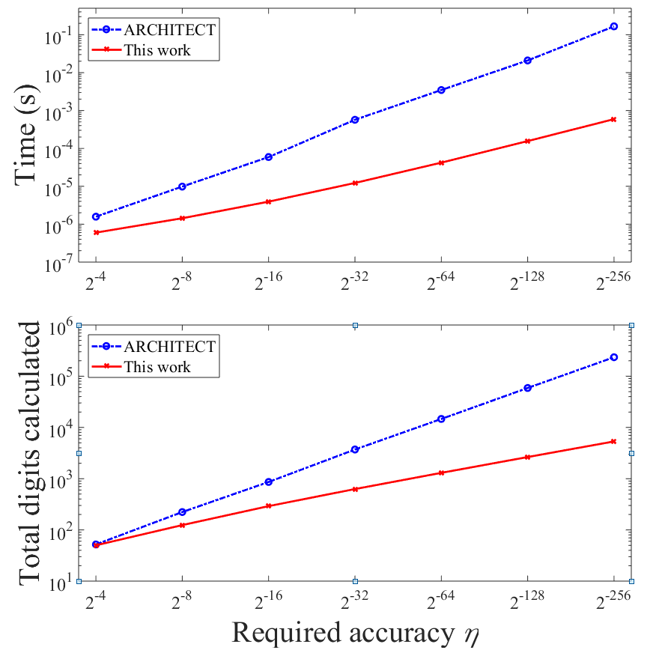
Comparison: This Work vs ARCHITECT
193$×$
Time (s)
_{1.82 times}
44.1$×$
Total digits calculated
Required accuracy η
16
Notes:
Since ARHCITECT is the closest work to us, so that we compare directly.
This slide shows How the requested accuracy bound \eta affects the solve time for ARCHITECT and our proposal.
In this plot, ARCHI requires increasingly more time to reach a solution than our proposal as the requested accuracy increases. With low accuracy requirements, such as η = 2−4 , our method is 1.82× faster than ARCHI. In the case of high accuracy, such as when computing to η = 2−256, our method is 193× faster.
From a more fundamental perspective, plot b shows the relationship between the requested accuracy and the total number of digits calculated. Our proposal calculates almost the same digits as ARCHITECT when η = 2−4 , but increases to 44.1× fewer digits when η = 2−256 .

Slide 19
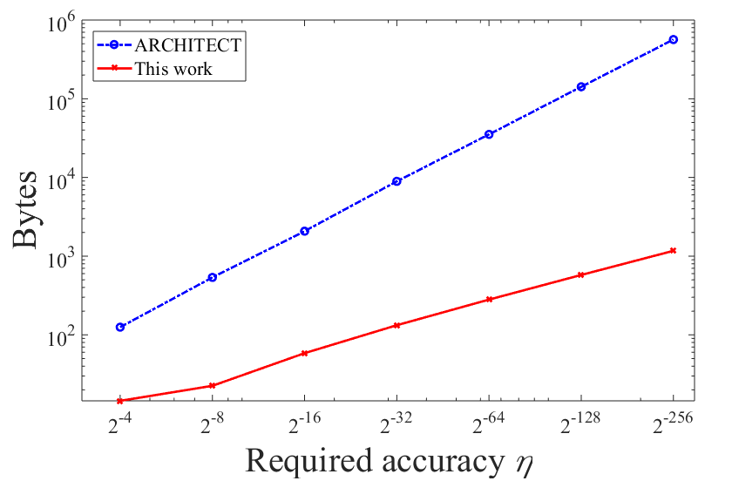
Comparison: This Work vs ARCHITECT
More scalable!
17
Notes:
Say Reasons 1. no revisit. 2. elison.
Finally, we’d like show that our proposal is a far more scalable approach compared to ARCHITECT.
plot c shows the minimum number of onchip memory blocks that need to be instantiated in order for our proposed solver and ARCHI to reach particular accuracies. For lower-accuracy cases, both designs require approximately the same amount of memory, although our proposal is slightly inferior due to don’t-change detection overheads. For the lowest η tested, 2 −256, we observed a 22.4× memory reduction.
This slide shows How the requested accuracy bound \eta affects (a) the solve time, (b) the total num of digits calculated and (c) the min memory requirement for ARCHITECT, our proposal and ours with don’t-care digit omission only, with m = 1.

Slide 20
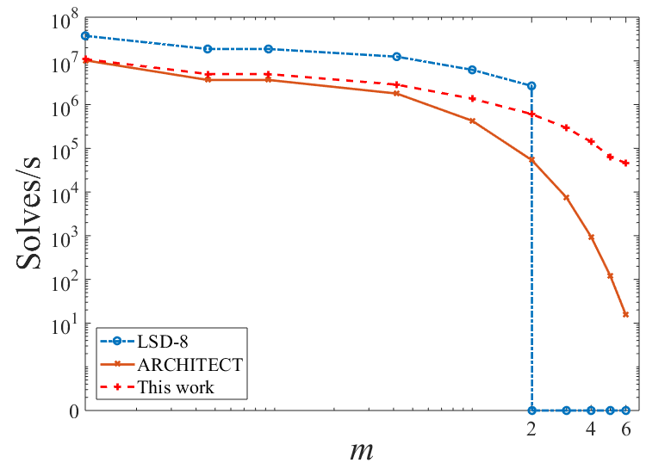
Comparison: This Work VS Conventional Arithmetic (CA)
LSD-8: 8-bit LSD-first arithmetic.
LSD-8 cannot find an accurate-enough solution.
18
Notes:
Let’s start to see the comparisons between our proposal and CA. Precision should be fixed using CA.
This Plot compares our proposal and ARCHITECT against a CA implementation with 8 bits, named LSD-8.
If we use this precision, to solve some ill-conditioned matrices, when m is larger than 2, it is under-budgeted.
Even if LSD-8 could run indefinitely, it would never be able to converge to an accurate-enough result. Then only arbi.-prec. Iter. solvers can solve systems with m > 2.

Slide 21
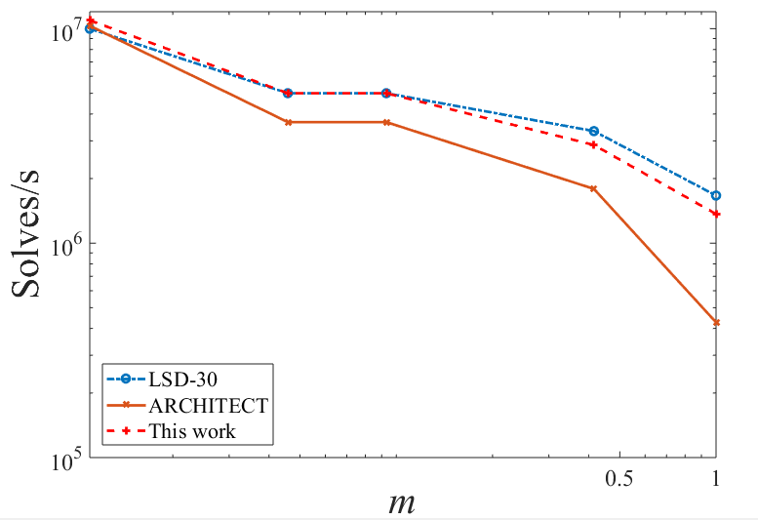
Comparison: This Work vs Conventional Arithmetic (CA)
LSD-30: 30-bit LSD-first arithmetic.
Only this work performs better than LSD-30.
ARCHITECT & this work perform better than LSD-30.
19
Notes:
On the other hand, if we use a fixed-precision of 30 bits (LSD-30) in CA impl, to solve some well-conditioned matrices, when m is small, this precision is over-budgeted. Both ARCHITECT and our proposal can compute more quickly.
Moreover, our proposal has a larger winning region than ARCHITECT

Slide 22
Conclusion
Don’t-change digit detection and subsequent avoidance for any online arithmetic-implemented iterative methods.
A theorem for the avoidance of don’t-care digit computation per iteration within stationary iterative methods.
Performance evaluation:
Versus ARCHITECT: less solve time, less memory usage and lower numbers of digits calculated.
Versus conventional LSD-first arithmetic: runtime-tunable precisions.
20
Notes:
In this paper, we proposed a new methodology for the creation of iterative numeric solvers in hardware which can achieve arbitrary result accuracy.
Our work relies on online arithmetic operators in order to generate results from most-significant digit first.
Our don’t-change analysis holds for any iterative method, and was realised in hardware using simple runtime detection logic.
For the identification of don’t-care digits, we presented a theorem for stationary iterative methods allowing many low-significance digits to be ignored without impacting upon the solver’s ability to reach a result of any accuracy.
Compared to ARHITECT, the new method uses less solve time, less memory, and smaller num of digits in calculation.
We demonstrate that solvers implemented following our proposals can show superiority over conventional arithmetic implementations by virtue of their runtime-tunable precisions.

Slide 23
Future Work
Don’t-care analysis for other iterative algorithms, such as conjugate gradient descent.
Exploring more aggressive don’t-change digit analysis, likely to be algorithm-specific.
Achieving parallel don’t-change and don’t-care lines may allow us to generalise the E-method.
21
Notes:
For don’t care analysis, we will attempt to extend our don’t-care digit analysis to other iterative algorithms, including Krylov subspace methods such as conjugate gradient descent.
We will explore the possibility of more aggressive don’t-change digit analysis, likely to be algorithm-specific, that may allow us to do away with the runtime detection proposed in this work, thereby achieving further performance improvements.
We will explore more analysis of the memory architecture in order to reduce the memory usage in the MSD stability analysis.
We are particularly keen to see if it is possible to obtain the same rates of growth in MSD stability and LSD significance, thus achieving parallel don’t-change and don’t-care lines. Doing so would enable the creation of efficient, fixed compute-resource hardware with no bounds on accuracy, and may allow us to generalise the e-method

Slide 24
Thanks for listening!
Here is the paper:

Slide 25
Motivation
One-shot Control Algorithms:
Fixed Precision: require to specify a target precision in advance and return results only once a full result is generated.
Non-incremental: starting optimization from scratch every time.
Anytime Control Algorithms:
Increasing precision: return several results of increasing precision: the longer the system computes, the more precise an answer will be.
Incremental: generating a rough approximation quickly that is refined in multiple steps.
vs
2
Notes:
Researchers in the Control field has been increasingly in the effect of time-varying processing on control algs.
Many works try to build suitable anytime control algorithms. Algorithms that continuously improve result quality instead of returning only one result at the end of execution are generally called anytime algorithms in contrast to one-shot algorithms.
Shortcomings of existing One-shot control algorithms are 1. 2.
Compared with one-shot algs, anytime algorithms maintain control incrementally, generating a rough approximation quickly that is refined with increasing precisions.
The process can be terminated at any time by the processor. The quality of control input is thus improving as time goes.

Slide 26
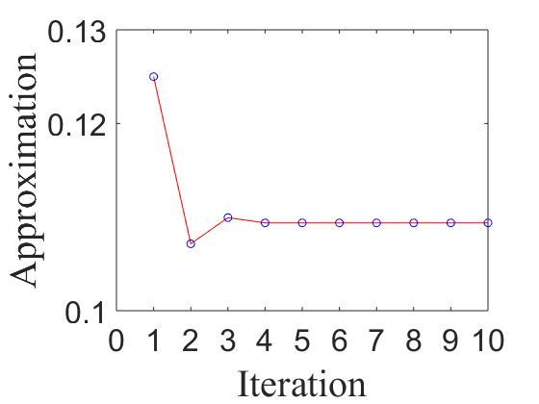
Background
In numerical analysis
$$x^{(k+1)}=f\left(x^{(k)}\right)$$
$$\left\|x^{(k)} −r\right\|<η$$
$$x^{(k+1)}=1/8−1/7x^{(k)}$$
Appr. value
Iteration
In this paper, we focus on stationary iterative methods, such as Jacobi, Gauss-Seidel and successive overrelaxation (SOR).
2
Notes:
First of all, let’s see the background of this paper.
In numerical analysis, many algorithms feature a loop that converges to a result of interest. This is illustrated in this general form. (approximant (k+1) = f(appriximant (k))).
The continuous function f is repeatedly applied to the value we try to find. The iterative process will stop when a calculated result is satisfied by a convergent criterion, eta.
In this paper, we focus on stationary iterative methods.
Here is an example plot of Jacobi method. We can see that the calculated results jump around to convergence.
The computable real function is continuous function http://math.andrej.com/2006/03/27/sometimes-all-functions-are-continuous/.

Slide 27
Don’t Care Digit Elision
ARCHITECT
p
Approximant 1
Approximant 2
p
Approximant 3
No don’t care digits
in ARCHITECT.
……
k
k
10
Notes:
Since ARCHITECT achieves exact numeric computation by using online arithmetic to allow the refinement of results from earlier iterations over time, eschewing rounding error.
There no unimportant digits/don’t care digits considered in ARCHITECT. So its don’t care line is horizontal.

Slide 28
Don’t-Care Digit Elision
ARCHITECT
p
$$δ+1$$
$$δ$$
$$δ$$
……
$$δ+1$$
$$δ$$
$$δ$$
p
$$δ+1$$
$$δ$$
$$δ$$
Can compute to
arbitraryprecision.
……
k
k
11
Notes:
Since ARCHITECT achieves exact numeric computation by using online arithmetic to allow the refinement of results from earlier iterations over time, eschewing rounding error.
There no unimportant digits/don’t care digits considered in ARCHITECT. So its don’t care line is horizontal.

Slide 29
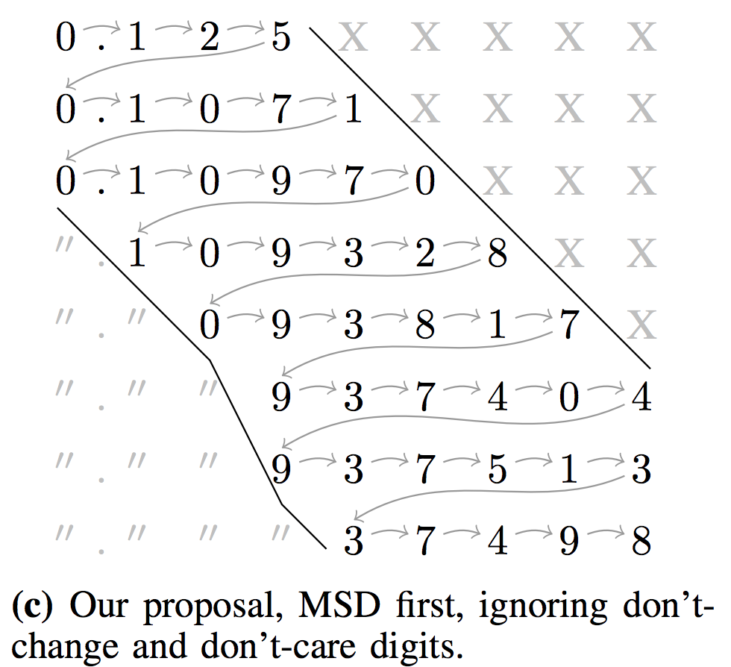
Memory Reduction
Features:
One more approximant is used for don’t-change digit detection.
The computation only goes forward.
It is safe to overwrite every other approximant.
13
Notes:
In our proposal, we don’t need to store don’t-change and don’t-care digits, so that it saves a lot of memory.
But, we need to access to one previously computed approximant to enable don’t-change digit detection.
That is the generation of digits in iteration k can be used to infer the number of stable digits in the yet-to-be-computed iteration k+1.
It is therefore safe for us to overwrite every other approximant . The correct memory location is selected by k mod 2.

Slide 30
Reach Arbitrary Accuracy by Digit Elision
Observation: Superfluous digits can be avoided for computation.
1. Don’t-care digits: low-significance digits of early approximants are generally unimportant.
2. Don’t-change digits: high-significance digits of later approximants generally become stable over time.
6
Notes:
Let's dig into the details:
In the top-right corner lie low-significance digits of early approximants; these are generally unimportant, thus we call them don’t-care digit.
In the bottom-left corner lie high-significance digits of later approximants; these generally become stable over time, so we call them don’t-change digits.

Slide 31
The Proposed Computation Pattern
A toy equation $x^{(k+1)}=1/8−1/7x^{(k)}$using our proposal.
p
This work:
1. doesn’t have to revisit earlier iterations!
2. avoids the computation of
don’t-change digits for any iterative method.
don’t-care digits for stationary iterative methods.
3. can reach solutions of any accuracy for stationary iterative methods.
k
7
Notes:
The proposed computation pattern allows us to generate all the digits digits in full per iteration.
In our work, one of the important thing needs to point out is that it doesn’t have to revisit earlier iteration.
Also, we avoid the computation of don’t care and don’t change digits for iterative calculations.
Lastly, We can reach solutions of any accuracy for stationary iterative methods.
To be able to do the above requires to calculate from left to right, using online arithmetic.
FPGAs represent ideal platforms for the realization of such MSD-first algorithms thanks to their completely flexible fabrics.

Slide 32
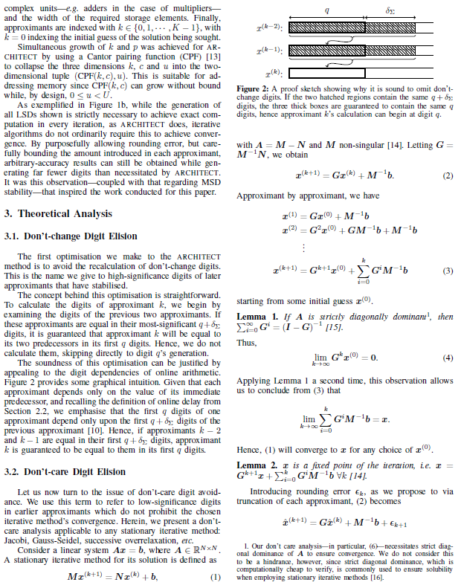
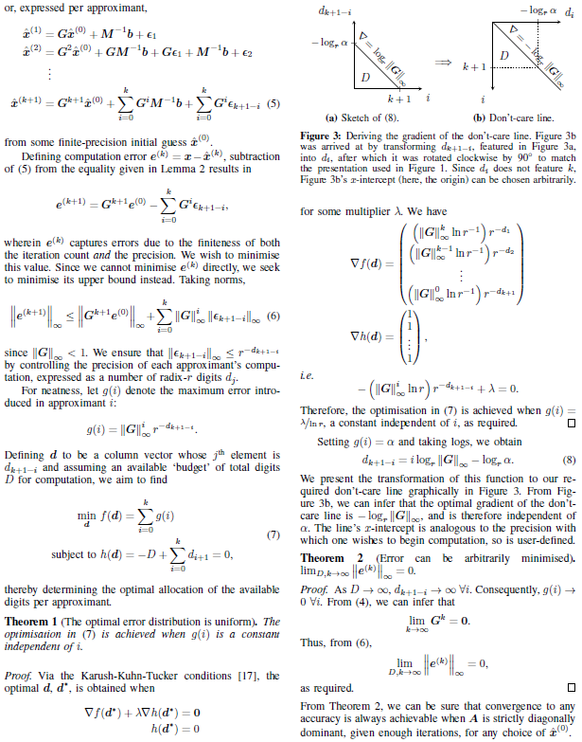
Don’t-Care Digit Elision
Section 3.2 is the proof.
14
Notes:
Because of the time limit, I’d like to show some highlights of our approach and The details of the don’t-care digit elision is shown in the paper.

Slide 33
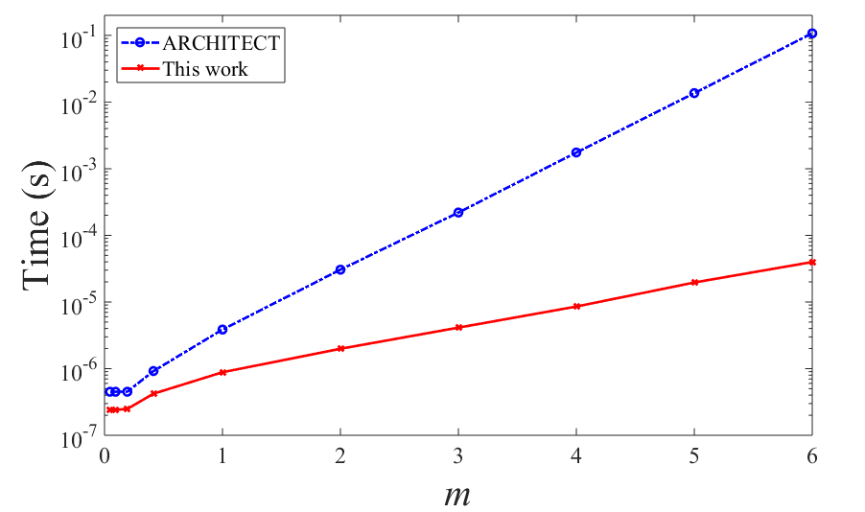
How Does $A_{m}$ Affect The Solve Time?
~2500 times
20
Notes:
In general, we also want to show How the conditioning of Am affects the solve time of ARCHITECT (blue) and our proposal (red).
Our proposal outperformed ARCHITECT in all tested cases, with a geometric mean 20.1× speedup obtained. Specifically, for m = 6 it is some 2500× faster than ARCHITECT.

Slide 34
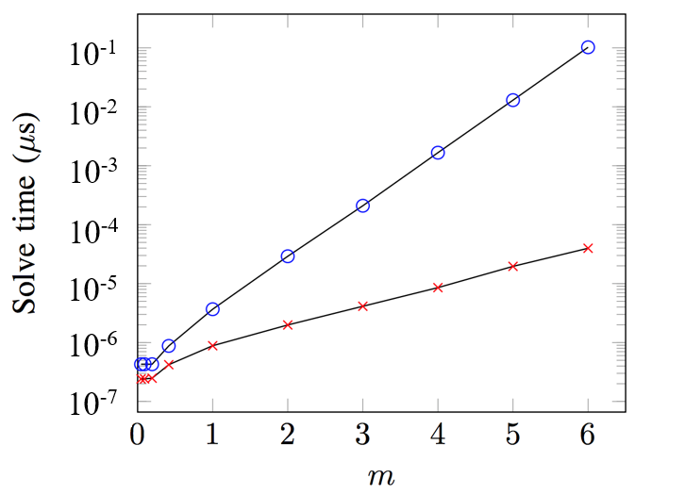
How Does $A_{m}$ Affect The Solve Time?
$${10}^{−1}$$
$${10}^{−2}$$
_{~2500 times}
$${10}^{−3}$$
ARCHITECT
$${10}^{−4}$$
This work
$${10}^{−5}$$
$${10}^{−6}$$
$${10}^{−7}$$
0
1
2
3
4
5
6
20
Notes:
In general, we also want to show How the conditioning of Am affects the solve time of ARCHITECT (blue) and our proposal (red).
Our proposal outperformed ARCHITECT in all tested cases, with a geometric mean 20.1× speedup obtained. Specifically, for m = 6 it is some 2500× faster than ARCHITECT.

Slide 35
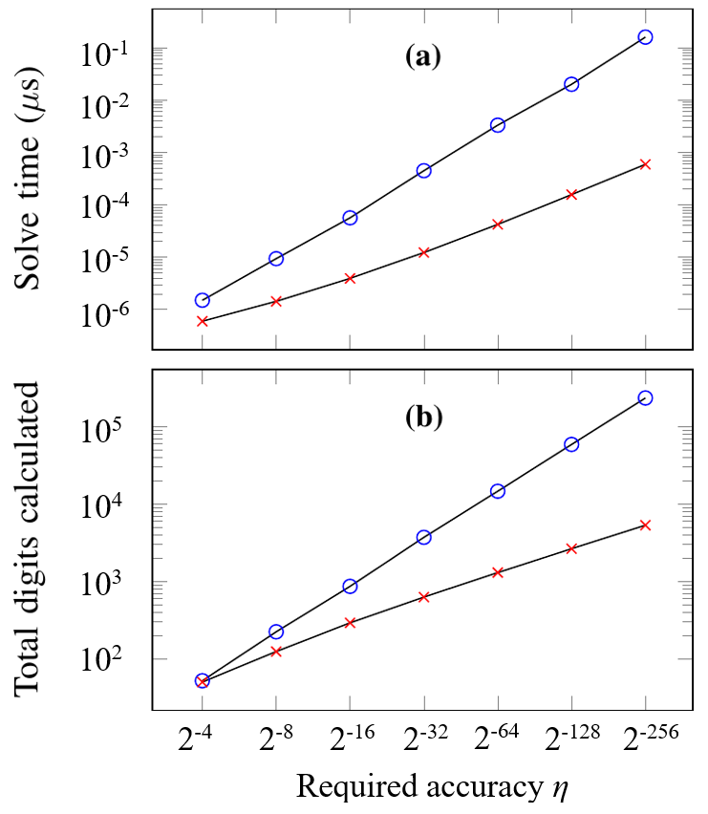
Scalability Comparison
_{193X}
ARCHITECT
This work
_{1.82X}
_{44.1X}
_{1.04X}
21
Notes:
In the following, we’d like to present some scalability analysis.
This slide shows How the requested accuracy bound \eta affects the solve time for ARCHITECT and our proposal.
In this plot, ARCHI requires increasingly more time to reach a solution than our proposal as the requested accuracy increases. With low accuracy requirements, such as η = 2−4 , our method is 1.82× faster than ARCHI. In the case of high accuracy, such as when computing to η = 2−256, our method is 193× faster.
From a more fundamental perspective, plot b shows the relationship between the requested accuracy and the total number of digits calculated. Our proposal calculates almost the same digits as ARCHITECT when η = 2−4 , but increases to 44.1× fewer digits when η = 2−256 .

Slide 36
Don’t-Care Digit Elision (digit choice?)
Features:
The gradient is optimal.
A steeper or shallower line would require more digits to be generated to reach a result of the same accuracy.
A steeper line may not allow convergence.
The existence of this line allows you to not visit earlier iterations, which ARCHITECT didn’t.
P
Approximant 1
Approximant 2
P
Approximant 1
……
Approximant 3
Approximant 2
……
K
Approximant 3
K
……
Not converegnt
13
Notes:
There are some important points to get cross:
The gradient is optimal—a steeper or shallower one will require more digits to be generated to reach a solution of the same accuracy.
A steeper line may not allow convergence. The gradient is guaranteed to allow it eventually.
The existence of this line allows you to not visit earlier iterations, which ARCHITECT didn’t.
ARCHITECT would require calculating to infinite precision, so this work is more efficient.

