Slide 1
Faster Quotient Selection Using Variants of the Barrett Algorithm
Niall Emmart, Fangyu Zheng, Charles Weems

Slide 2
Talk Roadmap
Background and Motivation
Grade-School Long Division & Quotient Selection
Barrett’s Algorithm
Brent and Zimmermann’s Variant
Our Proposed Variant
Möller and Granlund’s Approach
Results

Slide 3
Background & Motivation
Multiple precision (MP) libraries on GPUs
Quotient selection is used in MP division and MP square root
Notation used in the talk
$β$ for the radix, i.e., 2^{w}, where w is the word size
uppercase variables for MP values
lowercase variables for single precision values, i.e., 0 $≤$x $<$ $β$
we assume that the divisor d is normalized, i.e, $β/2≤d< β$

Slide 4
Long Division & Quotient Selection
q₁
4811 334064
Quotient Selection:
Estimate q₁ $≅\left\lfloor \frac{33}{4}\right\rfloor$= 8

Slide 5
Long Division & Quotient Selection
6 q₀
4811 334064
28866
45404
Estimate for q₀ $≅\left\lfloor \frac{45}{4}\right\rfloor$= 11
Final answer: Q=69

Slide 6
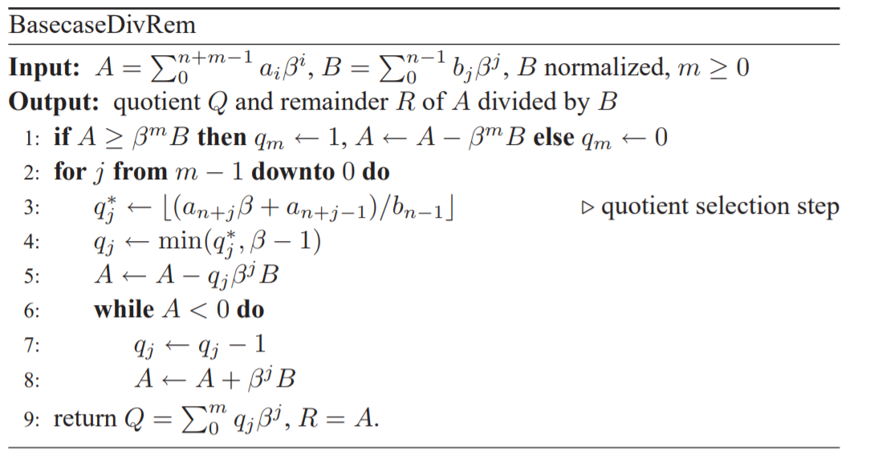
Long Division & Quotient Selection
Source: Modern Computer Arithmetic
by Brent and Zimmermann
Notes:
Steps 3 and 4 are the quotient selection steps
In step 3, the same b(n-1) is used repeatedly
The subquadratic MP division algorithms all require a base case routine

Slide 7
Barrett’s Algorithm
Barrett Algorithm -- Replace divide with multiply:
Precompute: $ν=\left\lfloor \frac{β^{2}}{d}\right\rfloor$
$$qe=\left\lfloor \frac{ν∗\left\lfloor \frac{A}{2^{n−1}}\right\rfloor }{2^{n+1}}\right\rfloor$$
$qe$ is at most 2 correction steps from $q$
Not very suitable for low radix division, e.g, when n=w
Notes:
Barrett’s algorithm was designed for high radix modular multiplication
When you try to write highly optimized assembly for this, the div 2^w-1 and 2^w+1 are not word aligned and are slow
But not to worry, there are many variants

Slide 8
Brent and Zimmermann’s Variant
Brent and Zimmermann’s variant of the Barrett Algorithm
Precompute: $ν=\left\lfloor \frac{β^{2}}{d}\right\rfloor$
$$qe=\left\lfloor \frac{ν∗\left\lfloor \frac{A}{2^{w}}\right\rfloor }{2^{w}}\right\rfloor = \left\lfloor \frac{ν∗a_{1}}{β}\right\rfloor$$
Requires 3 correction steps
Notes:
Shifts are now word aligned

Slide 9
Brent and Zimmermann for QS
uint BZ_QS(uint a0, uint a1, uint divisor, uint nu_prime) {
uint qe, y0, y1, correct;
(y0,y1) = mul_wide(nu_prime, a1);
y0 = add_cc(y0, a1);
qe = addc(y1, a1);
qe = qe + 3;
if(qe <= a1)
qe = beta-1;
(y0,y1) = mul_wide(qe, divisor);
. . . Continues on next slide . . .
}
Where nu_prime = $ν−(β+1)$
Notes:
This is our first result – highly efficient code to implement B & Z for QS

Slide 10
Brent and Zimmermann for QS
uint BZ_QS(uint a0, uint a1, uint divisor, uint nu_prime) {
. . . Continued from previous slide . . .
y0 = sub_cc(a0, y0); // first correction step
y1 = subc_cc(a1, y1);
correct = subc(0, 0);
qe = qe + correct;
y0 = add_cc(y0, divisor); // second correction step
y1 = addc_cc(y1, 0);
correct = addc(correct, 0);
qe = qe + correct;
y0 = add_cc(y0, divisor); // third correction step
y1 = addc_cc(y1, 0);
qe = addc(qe, correct);
return qe;
}

Slide 11
Our Proposed Variant
Our proposed variant:
Precompute: $ν=\left\lceil \frac{β^{2}}{d}\right\rceil$
$$qe=\left\lfloor \frac{ν∗a_{1}}{β}\right\rfloor + \left\lceil \frac{a_{0}}{d}\right\rceil$$
Requires 2 correction steps

Slide 12
Two Correction Steps Proof
Since $ν=\left\lceil \frac{β^{2}}{d}\right\rceil , we have { β}^{2}≤νd <β^{2}+d.$
And, since $\left\lfloor x\right\rfloor +\left\lceil y\right\rceil ≥⌊x+y⌋$we have:
$$q_{e}=\left\lfloor \frac{a_{1}ν}{β}\right\rfloor +\left\lceil \frac{a_{0}}{d}\right\rceil ≥\left\lfloor \frac{{a_{1}νd+ a}_{0}β}{dβ}\right\rfloor ≥\left\lfloor \frac{a_{1}β^{2}+a_{0}β}{dβ}\right\rfloor =\left\lfloor \frac{a_{1}β+a_{0}}{d}\right\rfloor =q$$

Slide 13
Two Correction Steps Proof
Further, $\left\lfloor x\right\rfloor +\left\lceil y\right\rceil ≤\left\lceil x+y\right\rceil$, thus:
$$q_{e}=\left\lfloor \frac{a_{1}ν}{β}\right\rfloor +\left\lceil \frac{a_{0}}{d}\right\rceil ≤\left\lceil \frac{a_{1}νd+a_{0}β}{dβ}\right\rceil ≤\left\lceil \frac{a_{1}β^{2}+a_{1}d+a_{0}β}{dβ}\right\rceil$$ $≤\left\lceil \frac{a_{1}β+a_{0}}{d}+\frac{a_{1}}{β}\right\rceil ≤\left\lceil \frac{a_{1}β+a_{0}}{d}\right\rceil +1≤\left\lfloor \frac{a_{1}β+a_{0}}{d}\right\rfloor +2=q+2$
Conclusion: $q_{e}−2≤q≤q_{e}$
At most two correction steps are required.

Slide 14
Our Proposed – Fast Implementation
uint proposed_QS(uint a0, uint a1, uint divisor, uint nu_prime) {
uint qe, y0, y1, correct;
sub_cc(a0, divisor);
add = subc(a1, beta-2);
y1 = mul_high(nu_prime, a1);
qe = y1 + add;
if(qe < a1)
qe = beta-1;
(y0,y1) = mul_wide(qe, divisor);
y0 = sub_cc(a0, y0); // first correction step
y1 = subc_cc(a1, y1);
correct = subc(0, 0);
qe = qe + correct;
y0 = add_cc(y0, divisor); // second correction step
y1 = addc_cc(y1, 0);
qe = addc(qe, correct);
return qe;
}

Slide 15
Möller and Granlund “Improved Division by Invariant Integers”
uint MG_QS(uint a0, uint a1, uint divisor, uint nu_prime) {
uint q0, q1, r;
(q0, q1) = mul_wide(nu_prime, a1);
q0 = add_cc(q0, a0);
q1 = addc(q1, a1);
q1++;
r = a0 – q1*divisor;
if(r > q0) { // first correction step
q1--;
r = r + divisor;
}
if(r >= divisor) // second correction step
q1++;
if(a1 >= divisor) // step 4: min(q, beta-1)
q1 = beta-1;
return q1;
}

Slide 16
Results
algorithm | Kepler (K80) | Maxwell (M40) | Pascal (GP100) | Volta (GV100)
Compiler Division QS | 2939.325 ms | 1700.210 ms | 1617.181 ms | 285.310 ms
Brent-Zimmermann QS | 432.568 ms | 297.064 ms | 192.920 ms | 68.171 ms
Möller-Granlund QS | 364.828 ms | 249.890 ms | 166.895 ms | 51.170 ms
Proposed QS | 355.197 ms | 240.604 ms | 161.068 ms | 56.495 ms

Slide 17
Conclusions
We have a new variant of the Barrett Algorithm, which we have proven only requires two correction steps
Developed efficient low-level implementations of QS and proven correctness
The performance of our proposed QS algorithm closely matches that of the M-G algorithm, we’re slightly faster on some architectures and slightly slower on others
All of the Barrett based QS approaches are much faster than the compiler built in

Slide 18
Thank you!
Questions?

Slide 19
Plug for XMP 2.0 (alpha release)

