Slide 1
Faster Modular Exponentiation Using Double Precision Floating Point Arithmetic on the GPU
Niall Emmart, Fangyu Zheng, Charles Weems

Slide 2
Talk Overview
Mod Exp is an important cryptographic primitive: RSA, digital signatures, prime generation, content centric networks, etc
Look at a simpler problem: big number multiplication
Computations can be done in the integer domain or floating point domain
Narrow Samples vs Wide Samples
Optimizations
Results
Question / Conjecture

Slide 3
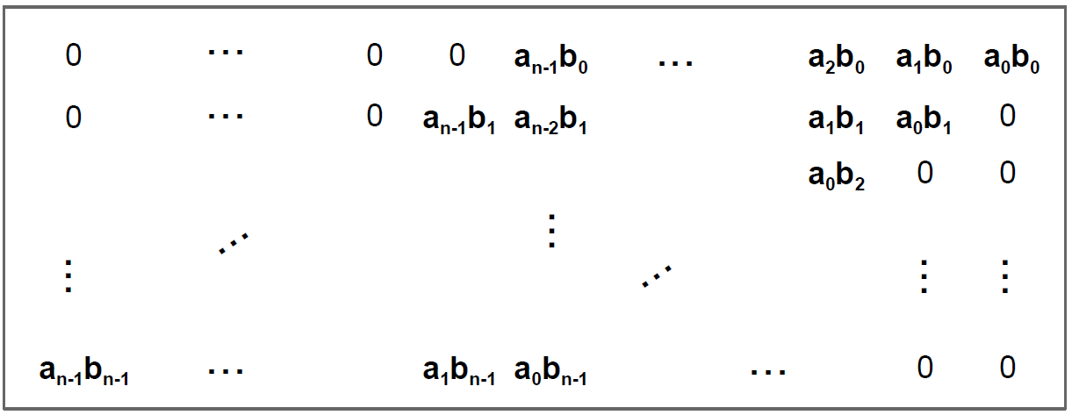
Big Num Multiplication – Narrow Samples
Given MP values A, and B, use floating point arithmetic for samples and column sums:
Ensure the column sums do not overflow the exact integer range.
Implies each samples uses less than half the floating point precision

Slide 4
Big Num Multiplication – Wide Samples

Slide 5
Computing a Dot-Product
Where a₀ = 2⁵⁰, b₀ = 2⁵⁰ and a₁ = 1, b₁ = 1
Desired result: H(sum) = 2¹⁰⁰, L(sum) = 1

Slide 6
Wide Samples
Use the full precision of the floating point value.
Well known fused-multiply-add technique can be used to compute high and low products of a sample as follows:
full_product(double a_sample, double b_sample) {
double hi, lo;
hi = __fma_rz(a_sample, b_sample, 0.0);
lo = __fma_rz(a_sample, b_sample, -hi);
return (hi, lo);
}

Slide 7
Alignment Problem
Does not work well for computing dot products (or column sums):
Consider: a₀ = 2⁵⁰, b₀ = 2⁵⁰ and a₁ = 1, b₁ = 1
We have p₀ = (2¹⁰⁰, 0) and p₁ = (1, 0)
Component-wise addition of p₀ + p₁ gives (2¹⁰⁰, 0) not the desired (2¹⁰⁰, 1)

Slide 8
Alignment Problem -- Solution
Solution -- force the alignment of the high and low products:
Use 52 bit samples instead of 53
Add 2¹⁰⁴ to high products and 2⁵² to low products
full_product(double a_sample, double b_sample) {
double c1=2¹⁰⁴, c2=2¹⁰⁴+2⁵², add;
hi = __fma_rz(a_sample, b_sample, c1); // high(a_samp*b_samp) + 2¹⁰⁴
add = c2 – hi;
lo = __fma_rz(a_sample, b_sample, add); // low(a_samp*b_samp) + 2⁵²
return (hi, lo);
}

Slide 9
Overflow Problem
Returning to our example: a₀ = 2⁵⁰, b₀ = 2⁵⁰ and a₁ = 1, b₁ = 1
We have p₀ = (2¹⁰⁴+2¹⁰⁰, 2⁵²+0) and p₁ = (2¹⁰⁴+0, 2⁵²+1)
These are correctly aligned.
But we can’t use double precision for the sums – it will immediately overflow.

Slide 10
A Slow Approach
full_product(double a_sample, double b_sample) {
double c1=2¹⁰⁴, c2=2¹⁰⁴+2⁵², add;
hi = __fma_rz(a_sample, b_sample, c1);
add = c2 – hi;
lo = __fma_rz(a_sample, b_sample, add);
lo = lo - 2⁵²;
hi = (hi - 2¹⁰⁴) * 2⁻⁵²;
return ((uint64_t)hi, (uint64_t)lo);
}

Slide 11
IEEE 754 – Double Precision Representation
Sign
bit
11 bit Exponent
with bias of 1023
52 bit mantissa, with implicit high bit (i.e., not stored in the bit representation).
If we store 2¹⁰⁴+x, in a double (with rz rounding), where 0 ≤ x < 2¹⁰⁴, then 2¹⁰⁴ becomes the implicit bit and the 52-bit mantissa is exactly filled with $\left\lfloor x/252\right\rfloor$.
Likewise, if we store 2⁵² + y in a double, where 0 ≤ y < 2⁵² then 2⁵² becomes the implicit
bit and the 52-bit mantissa is exactly filled with y.

Slide 12
Overflow Problem -- Solution
full_product(double a_sample, double b_sample) {
double c1 = 2¹⁰⁴, c2 = 2¹⁰⁴+2⁵², sub;
uint64_t uhi, ulo, mask = 0xFFFFFFFFFFFFFull;
hi = __fma_rz(a_sample, b_sample, c1);
sub = c2 – hi;
lo = __fma_rz(a_sample, b_sample, sub);
uhi = to_u64(hi) & mask;
ulo = to_u64(lo) & mask;
return (uhi, ulo);
}

Slide 13
Format Conversion – to_u64 function
uint64_t to_u64(double d) {
union {
double d;
uint64_t u64;
} converter;
converter.d=d;
return converter.u64;
}
Note: this is not equivalent to casting d as an unsigned integer: (uint64)d

Slide 14
Returning to our example
Returning to our example: a₀ = 2⁵⁰, b₀ = 2⁵⁰ and a₁ = 1, b₁ = 1.
p₀ = full_product(a₀, b₀)
p₁ = full_product(a₁, b₁)
We have p₀ = (2⁴⁸, 0) and p₁ = (0, 1).
These can be added using component-wise addition, using unsigned 64-bit integers.

Slide 15
Big Num Multiplication – Wide Samples

Slide 16
MP Product Using Wide Samples
mp_product(double a_samples[], double b_samples[]) {
double c1 = 2¹⁰⁴, c2 = 2¹⁰⁴+2⁵², sub;
uint64_t cols[2N] = {0}, mask = 0xFFFFFFFFFFFFFull;
for(i=0;i<N;i++) {
for(j=0;j<N;j++) {
hi = __fma_rz(a_sample[i], b_sample[j], c1);
sub = c2 – hi;
lo = __fma_rz(a_sample[i], b_sample[j], sub);
cols[i+j] += to_u64(lo) & mask;
cols[i+j+1] += to_u64(hi) & mask;
}
}
return cols;
}

Slide 17
Optimization
Top 12 Bits
Top 12 bits are always constant. For high products, it’s 0x467, which is 104 + 1023 (the bias). For low
products it is always 0x433, which is 52 + 1023.
Since they are constant, we can add them to the column sums and by tracking the number of high and
low products, we can cancel them all out with a single subtractions.
The subtraction can even by avoided by initializing the column sum with the right magic value.

Slide 18
MP Product – Optimized Version
mp_product(double a_samples[], double b_samples[]) {
double c1 = 2¹⁰⁴, c2 = 2¹⁰⁴+2⁵², sub;
uint64_t cols[2*N];
// magic values to cancel high/low constants
for(i=0;i<N;i++) {
cols[i] = make_initial(i, i+1);
cols[2*N-1-i] = make_initial(i + 1, i);
}
for(i=0;i<N;i++)
for(j=0;j<N;j++) {
hi = __fma_rz(a_sample[i], b_sample[j], c1);
sub = c2 – hi;
lo = __fma_rz(a_sample[i], b_sample[j], sub);
cols[i+j] += to_u64(lo);
cols[i+j+1] += to_u64(hi);
}
return cols;
}

Slide 19
Initial Value Routine
uint64_t make_initial(int high_count, int low_count) {
uint64_t value = 0x467*high_count + 0x433*low_count;
return –((value & 0xFFF)<<52);
}

Slide 20
Mod Exp Implementation (lots of hand waving)
Parallel implementation with 4-8 GPU threads assigned to each Mod Exp instance
Uses a CIOS word-by-word Montgomery reduction
Take advantage of “free” bits to avoid Montgomery correction steps (See Orup [15] or Walter [16])
Modular exponentiation implemented with fixed window exponentiation

Slide 21
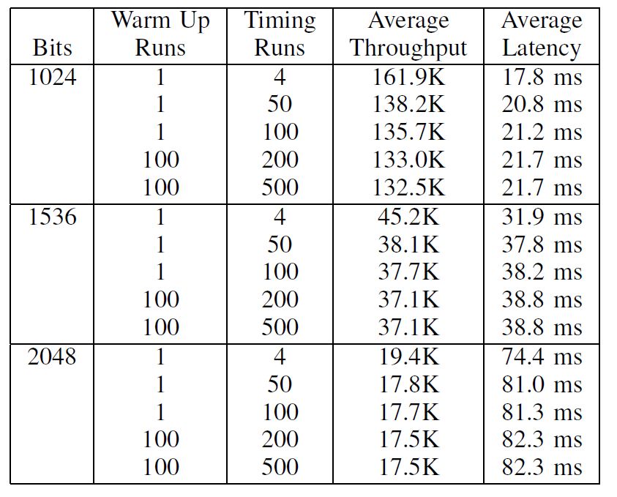
Results
Performance of Modular Exponentiation on a GTX Titan Black GPU:

Slide 22
Comparison to Prior Work

Slide 23
Question / Conjecture / Future Work
Consider the case of A * B, where A and B are chains of doubles:
A = D₀ -> D₁ -> D₂ -> … -> D_{n-1}
B = D₀ -> D₁ -> D₂ -> … -> D_{n-1}
Can we beat the performance of the standard (53 bit) algorithm with normalization by using 52-bits samples, forcing D_{i} -> D_{i+1} to be 52 bits apart and use the approach described in this paper?
Conjecture: Yes! We can do this in O(n²) steps

Slide 24
Thank you!
Questions?

