Slide 1



Combining Restoring Array and Logarithmic Dividers into an Approximate Hybrid Design
Weiqiang Liu, Jing Li, Tao Xu, Chenghua Wang
College of EIE, Nanjing University of Aeronautics and Astronautics, Nanjing, China
Paolo Montuschi
CCE Department, Politecnico di Torino, Torino, Italy
Fabrizio Lombardi
Department of ECE, Northeastern University, Boston, USA

Slide 2
Outline
Introduction to Approximate Computing
Review of Restoring Array and Non-Iterative Logarithmic Dividers
Proposed Approximate Hybrid Divider(AXHD)
Error Analysis and Hardware Evaluation
Applications
Conclusion
2

Slide 3

Introduction
Why Approximate Computing is Needed?
Errors, incompleteness, bugs, variations and approximations are all part of processing/computation
Human senses are very limited (inability to fully discriminate sounds and images)
Growing markets (GPU, tablet, smart/wearable devices) are power hungry
Technology: move further down in scaling
Challenges: complexity and costs
In many cases, approximation may be better than exactness.
3

Slide 4
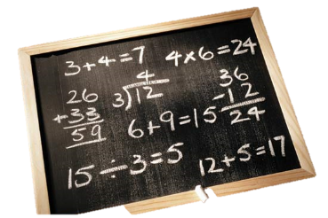

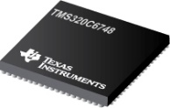

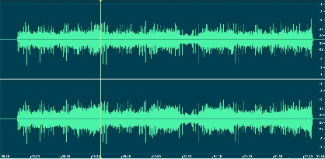
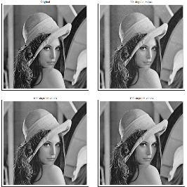
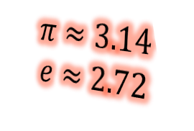
Introduction
APPROXIMATE Computing
Change Exact Design into Approximate Design(s)
Leads to
Lower Accuracy
Acceptable for
Reduced Complexity and Lower Power
Leads to
Improved Performance for Error-Insensitive Applications
Good for
Trade-off
$$π≈3.14$$
$$e≈2.72$$
4

Slide 5

Restoring Array Divider
An exact restoring divider cell
An (exact) unsigned 8-to-4 restoring array divider
$$A=B Q+R$$
dividend A[7:0]
non-zero divisor B[3:0]
quotient Q[3:0]
remainder R[3:0]
Problem: Overflow!
L. Chen, Jie Han, W. Liu, and F. Lombardi, "On the design of approximate restoring dividers for error-tolerant applications." IEEE Trans. Computers, vol. 65, pp. 2522-2533, 2016.
5

Slide 6
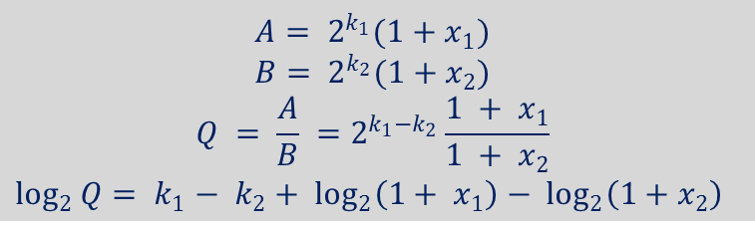
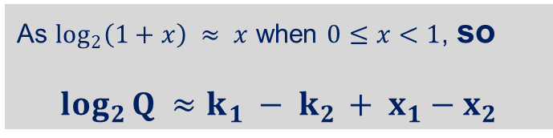
Non-Iterative Logarithmic Divider
A 16-to-8 unsigned non-iterative logarithmic divider
dividend A[15:0] ; non-zero divisor B[7:0] ;quotient Q[15:0]
k : the exponent ; x ∈[0,1): the fractional part of the mantissa
leading one detection
$$A= 2^{k_{1}}(1+x_{1})$$
$${B= 2}^{k_{2}}(1+x_{2})$$
$$Q = \frac{A}{B} =2^{k_{1}−k_{2}}\frac{1 + x_{1}}{1 + x_{2}}$$
$$\log_{2}{Q}= k_{1}− k_{2}+ \log_{2}\left(1+ x_{1}\right)− \log_{2}\left(1+x_{2}\right)$$
binary-to-logarithm conversion
mantissa subtraction
As $\log_{2}\left(1+x\right) ≈ x$ when $0≤x<1$, so
$$\log_{2}{Q ≈k_{1} − k_{2 }+ x_{1}−x_{2}}$$
logarithm-to-binary conversion
No Remainder! (already approximate)
6

Slide 7
Motivation
Restoring Array Divider :
high accuracy but more hardware resources and area required
Non-Iterative Logarithmic Divider :
lower accuracy but less power and chip area required
compare
Hybrid Design
7

Slide 8
Proposed Approximate Hybrid Divider (AXHD)
The truncated p bits are provided to the Restoring
Array Divider to calculate the most significant
quotient digits to improve accuracy.
Additional rows are added to the array to avoid
overflow by computing more trial subtractions.
The remaining 16-p bits are provided to Logarithmic
Divider for remaining quotient digits.
dividend X[15:0]
non-zero divisor Y[8:0]
quotient Q[15:0]
8

Slide 9
Proposed Approximate Hybrid Divider (AXHD)
A 8-to-4 AXHD for p=2
EXAMPLE: dividend is 156 and divisor is 3,
difference in Qs is only 3!
9

Slide 10
Error Analysis and Hardware Evaluation
The proposed AXHD design is compared using HR and TR schemes (i.e. AXDr1, AXDr2 and AXDr3) with exact restoring divider.
Replaced by AXSC1, AXSC2 and AXSC3
HR
TR
L. Chen, Jie Han, W. Liu, and F. Lombardi, "On the design of approximate restoring dividers for error-tolerant applications." IEEE Trans. Computers, vol. 65, pp. 2522-2533, 2016.
10

Slide 11
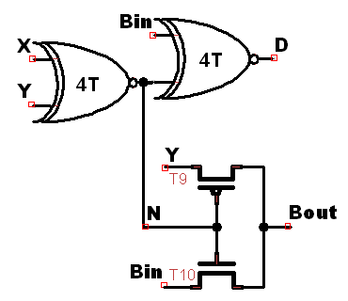
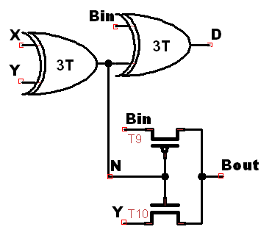
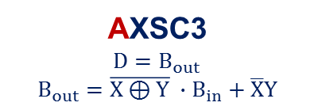

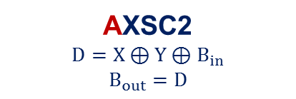
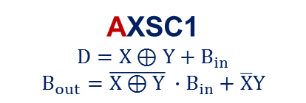
Error Analysis and Hardware Evaluation
EXSC and AXSC1, AXSC2, AXSC3
Exact Subtractor Cell (EXSC)
$$D=X⊕Y⊕B_{in}$$
$$B_{out}=\overline{X⊕Y} ∙B_{in}+\overline{X}Y$$
AXSC2
$$D=X⊕Y⊕B_{in}$$
$$B_{out}=D$$
EXSC XNOR version
EXSC XOR version
AXSC1
$$D=X⊕Y+B_{in}$$
$$B_{out}=\overline{X⊕Y} ∙B_{in}+\overline{X}Y$$
AXSC3
$$D=B_{out}$$
$$B_{out}=\overline{X⊕Y} ∙B_{in}+\overline{X}Y$$
11

Slide 12
Error Analysis and Hardware Evaluation
NMED
NMED : the MED normalized by the maximum output of the accurate design.
Replacement Depth : 16-p (p is the number of truncated bits)
The NMED of the proposed AXHD and AXDrs using HR at replacement depth.
The NMED of the proposed AXHD and AXDrs using TR at replacement depth.
12

Slide 13
Error Analysis and Hardware Evaluation
Power Consumption
Power of the proposed AXHD, EXDr, and AXDrs using HR at replacement depth.
Power of the proposed AXHD, EXDr, and AXDrs using HR at replacement depth
13

Slide 14
Error Analysis and Hardware Evaluation
Delay
Delay of the proposed AXHD, EXDr, and AXDrs using HR at replacement depth
Delay of the proposed AXHD, EXDr, and AXDrs using TR at replacement depth
14

Slide 15
Error Analysis and Hardware Evaluation
Area
Area of the proposed AXHD, EXDr, and AXDrs using HR at replacement depth.
Area of the proposed AXHD, EXDr, and AXDrs using TR at replacement depth.
15

Slide 16
Error Analysis and Hardware Evaluation
PDP (Power Delay Product)
PDP : Trade-off between power consumption and delay to evaluate the overall hardware performance of the designs.
PDP of the proposed AXHD, EXDr, and AXDrs using HR at replacement depth.
PDP of the proposed AXHD, EXDr, and AXDrs using TR at replacement depths.
16

Slide 17
Error Analysis and Hardware Evaluation
NMPP (NMED Power Product )
NMPP : Trade-off between accuracy and power consumption.
NMPP of the proposed AXHD, EXDr, and AXDrs using HR at replacement depth
NMPP of the proposed AXHD, EXDr, and AXDrs using TR at replacement depth
17

Slide 18
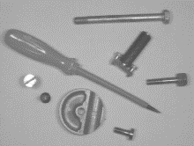
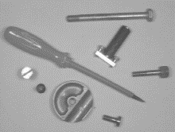
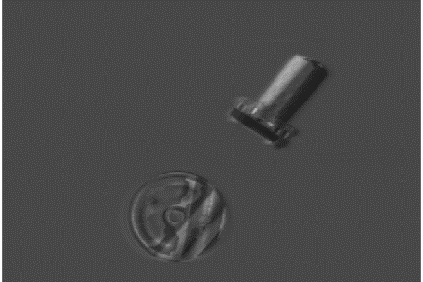
Applications
Change Detection
Difference between two frames (X,Y) of image sequence .
If no movement in scene, then mostly zero valued pixels.
If movement, show difference between frames.
PSNR : The peak signal-noise ratio.
X Y EXDr
Depth=3 Depth=6 Depth=9
Depth | 1 | 2 | 3 | 4 | 5 | 6 | 7 | 8
PSNR /dB | Infinite | Infinite | 84.69 | 64.99 | 61.32 | 54.17 | 39.87 | 39.71
Depth | 9 | 10 | 11 | 12 | 13 | 14 | 15 | 16
PSNR /dB | 39.71 | 39.71 | 39.71 | 39.71 | 39.71 | 39.71 | 39.71 | 39.71
PSNR of AXHD with Different Replacement Depths for Change Detection.
Change detection using EXDr and AXHDs.
18

Slide 19



Applications
Background Removal
Background variations in illumination subtracted from scene (foreground objects better viewed).
Image X with bad illumination during capture (i.e. strong illumination gradient across image).
Blank page Y subtracted from poorly illuminated image X.
Output image with relatively constant illumination.
X Y EXDr
Depth=3 Depth=6 Depth=9
Depth | 1 | 2 | 3 | 4 | 5 | 6 | 7 | 8
PSNR /dB | Infinite | Infinite | 74.17 | 62.95 | 56.07 | 50.32 | 43.04 | 27.12
Depth | 9 | 10 | 11 | 12 | 13 | 14 | 15 | 16
PSNR /dB | 27.12 | 27.12 | 27.12 | 27.12 | 27.12 | 27.12 | 27.12 | 27.12
Background removal using EXDr and AXHDs.
PSNR of AXHD with Different Replacement Depths for Background Removal.
19

Slide 20
Conclusion
Presented detailed analysis, design and evaluation of divider with approximate operations; figures of merit as function of replacement depth.
Accuracy:
  Error in Q increases with replacement depth;
  Compared to AXDrs with HR, AXHD has a smaller NMED at same replacement depth;
  Compared to AXDrs with TR, at a small depth, the NMED of AXHD is slightly larger; as replacement depth increases, the NMED of AXHD increases slowly and is lower than TR.
Power:
  Higher the depth, more pronounced is the power reduction;
  Compared to AXDrs with HR, for replacement depth greater than 8, AXHD is superior;
  Compared to AXDrs with TR, for replacement depth greater than 6, AXHD requires considerably less power.
Trade-off:
  Application specific evaluation;
  AXHD achieves a very good tradeoff between accuracy and hardware performance;
  For image processing, AXHD achieves similar performance as exact version (EXDr).
20

Slide 21
Thanks!

